Slide 1
Motivation and Emotion in Daily Life
Personal Control Beliefs
March 18th, 2019
Erik Chevrier

Slide 2
Check In
How is everything going?
What is going well?
What could be improved on?
Is this class meeting your expectations?
Why?
Why not?
Are you enjoying the material?
Are the readings difficult, easy, or what was expected?
What could help you improve your experience in this class?
Class format/structure?
Learning activities?

Slide 3
Motivation to Exercise Personal Control
How much personal control do you have over your environment?
Are we in control of our own decisions? Dan Ariely

Slide 4
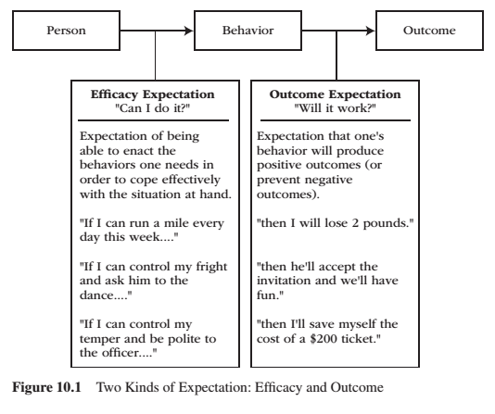
Expectancy
Expectancy is a subjective prediction of how likely is that event will occur.
Two kinds of expectancy
Efficacy expectations – judgement of one’s capacity to execute a particular act or course of action.
Outcome expectations – judgement that a given action, once performed, will cause a particular outcome.
Efficacy and outcome expectations are separate, causal determinants to the initiation and regulation of behaviour.
Both efficacy and outcome expectations must be reasonably high before behaviour becomes energized, goal directed, and sustained over time.

Slide 5
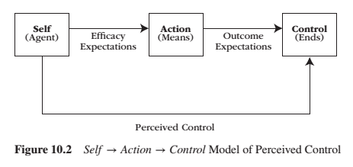
Perceived Self-Control

Slide 6
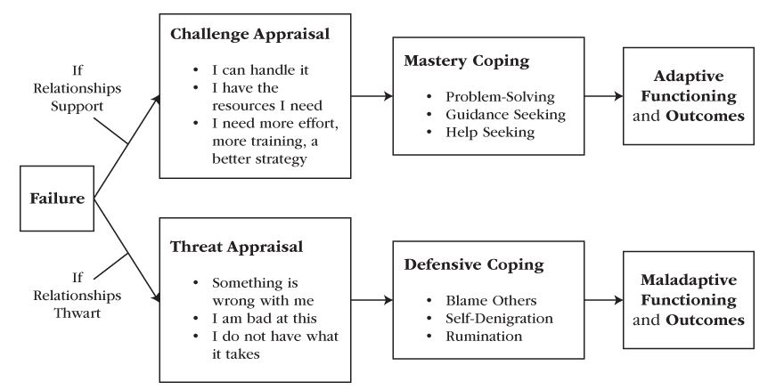
Coping with Failure

Slide 7
Activity
Please think of five different, specific activities you want to/have to perform.
i.e. do Motivation and Emotion homework, play hockey tonight, drive to Ottawa, learn ‘Happy Birthday’ on the xylophone.
Please assess your efficacy and outcome expectations for each activity.

Slide 8
Self-Efficacy
Efficacy expectations and self-efficacy aren’t the same thing.
Self-efficacy is:
a more generative capacity in which the individual organizes and orchestrates their skills to cope with the demands and circumstances they face – even under trying circumstances.
one’s judgment of how well or poorly one will cope with a situation, given the skills one possesses and the circumstances one faces.
not the same as ability because circumstances are taken into consideration.
the general capacity in which the performer improves ways to translate personal ability into effective performance.
Self-efficacy makes a potent contribution to the prediction of performance and outcomes.
The opposite of efficacy is doubt.

Slide 9
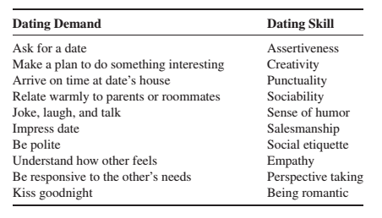
Activity
Think of an important activity you want to/must do in near future.
Write down the demands and skills necessary for this activity…(i.e. see below).
Please assess your self-efficacy and outcome expectations for these tasks.
The amount of self-doubt vs efficacy can be predicted by an analysis of perceived efficacy on the task-related demands.

Slide 10
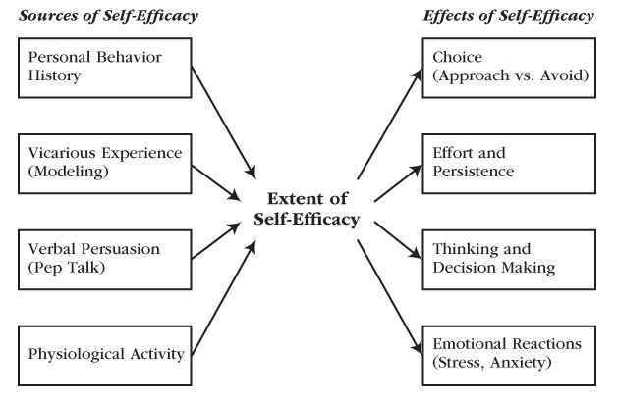
Sources of Self-Efficacy
Self-efficacy beliefs arise from:
One’s personal behavioral history in trying to execute that particular behaviour or way of coping**
Observations of similar others who also try to execute that behaviour, especially for novice learners **
Verbal persuasions from others
Physiological states
Self-efficacy affects
Choice
Effort and persistence
Thinking and decision making
Emotional Reactions
** stronger source of efficacy beliefs

Slide 11
Sources of Self-Efficacy
Personal behavioural history
The extent to which a person believes they can competently enact a particular course of action stems from their personal history of trying to enact that course of action in the past.
People learn their current self-efficacy from their interpretations and memories of past attempts to execute the same behaviour.
Previous competent attempts raise self-efficacy and previous incompetent past attempts lower self-efficacy
Strength of past experience is important.
Strong competent associations in the face of occasional incompetent situations do not lower self-efficacy much. The opposite also applies.
Experience is also important.
If someone is not experienced, competent and incompetent enactments will influence future expectancy of efficacy.

Slide 12
Vicarious Experience
Vicarious experience involves observing a model enact the same course of action the performer is about to enact.
Seeing others perform masterfully raises an observers sense of self-efficacy.
Seeing others perform and fail lowers our sense of self-efficacy
The extent to which a model’s enactment affects our own efficacy depends on:
The greater similarity between the model and observer
The less experienced observer is at the behaviour, the greater the impact of the vicarious experience.

Slide 13
Verbal Persuasion
Verbal persuasions:
shift a performer’s attention from sources of inefficacy to sources of efficacy.
does not work well if it contradicts actual experience – limited by the boundaries of the possible.
depend on the credibility, trustworthiness, and expertise of the persuader.
people can self-persuade to boost efficacy.
works to the extent that it provides the performer with enough of a temporary and provisional efficacy boost to generate the motivation necessary for another try.

Slide 14
Physiological State
An abnormal physiological state is a private, yet attention-getting, message that contributes to one’s sense of inefficacy.
The causal direction between efficacy and physiological activity is bidirectional – inefficacy heightens arousal and heightened arousal fuels perceived inefficacy.
Physiological information communicates efficiently information most when initial efficacy is uncertain.
When efficacy is relatedly assured, people sometimes interpret their physiological cues in a positive fashion.

Slide 15
Activity
Please use the same activity as before – when you assessed your efficacy and outcome expectations.
Please evaluate that activity in regards to:
One’s personal behavioral history in trying to execute that particular behaviour or way of coping**
Observations of similar others who also try to execute that behaviour**
Verbal persuasions from others
Physiological states

Slide 16
Self-Efficacy on Behaviour
Both skill and self-efficacy affect each other; although the effect that skilled performance has on self-efficacy is stronger than is the effect that self-efficacy has on skilled performance.
When people expect that they can perform an action, they are willing to put forth effort and persistence in the face of difficulties. In contrast, when people do not expect that they can perform the required task, they are not willing to engage in activities requiring such behaviour.
Self-efficacy beliefs affect:
Choice
Effort and persistence
Thinking and decision making
Emotionality
Learning and coping

Slide 17
Choice
People seek out and approach activities/situations that they feel capable of adjusting or handling while they shun and avoid activities/situations that they see as likely to overwhelm, their coping capacities.
Doubt-plagued avoidance exert a profound and detrimental effect on a person’s long-term development – it arrests development potentials.
Avoiding activities makes self-doubt more entrenched because doubters never get to prove themselves wrong.

Slide 18
Effort and Persistence
Strong self-efficacy beliefs produce persistent coping efforts aimed at overcoming setbacks and difficulties.
Doubt leads to people to slacken their efforts when they encounter difficulties and perhaps give up or settle for mediocre solutions. Self-efficacy leads to a quick recovery of self-assurances following setbacks.

Slide 19
Thinking and Decision Making
People who believe strongly in their efficacy for solving problems:
remain remarkably efficient in their analytic thinking during stressful episodes
allows a performer to stay focused in the face of stressful situations
buffers the quality of a performers thinking and decision making
allows people to analyze feedback
People who doubt their problem-solving:
think erratically, show confusion and negative thinking
distracts decision makers away from such task-focused thinking
doubt deteriorates the quality of a performers thinking and decision making

Slide 20
Emotionality
Performers with a strong sense of efficacy:
Attend to the demands of the challenge
Visualize competent scenarios for forthcoming behaviour
Exude enthusiasm, optimism, and interest
Keep anxiety at bay
Performers with a weak sense of efficacy:
Dwell on personal deficiencies
Visualize formidable obstacles
Exude pessimism, anxiety, and depression
Quickly threatened by difficulties and react to setbacks with distress

Slide 21
Learning, Coping and Achieving
Self-efficacy beliefs:
Predict people’s learning, coping and performance, and achievement.
Facilitates the type of behaviour that is needed to increase and improve learning, coping, performance and achievement.
Makes people approach situations, exert greater effort, persist in the face of obstacles, think clearly on what needs to be done, experience constructive emotions, like hope.

Slide 22
Self-Efficacy vs Psychological Need for Competence
Self-efficacy and need for competence are similar constructs but not interchangeable.
Psychological need for competence is a developmental constant and self-efficacy beliefs are specific to certain tasks.

Slide 23
Empowerment
Two practical points about self-efficacy are important to highlight:
1 – Self-efficacy beliefs can be acquired and changed.
2 – The level of self-efficacy predicts ways of coping that can be called ‘competent functioning’ or ‘personal empowerment’.
Empowerment involves possessing the knowledge, skills, and beliefs that allow people to exert control over their lives (i.e. people defending one’s self against threats and/or abuse from others)
People need self-efficacy beliefs so that they can:
Translate their knowledge and skills into effective performance when threatened
Exert control over intrusive negative thoughts

Slide 24
Empowering People: Master Modeling Program
A formal program to empower people through self-efficacy training is to employ a mastery modeling program – which involves the following seven steps.
1 – Expert identifies component skills involved in effective coping and measures novices’ efficacy expectation on each component skill.
2 – Expert models each component skill, emphasizing the novices’ most worrisome skill areas.
3 – Novices emulate each modeled skill. Expert provides guidance and corrective feedback, as needed.
4 – Novices integrate the individual skills into an overall simulated performance. Expert introduces only mild obstacles and helps novices integrate the different skill components into a coherent overall performance.
5 – Novices participate in cooperative learning groups. One person gives a simulated performance while peers watch. As they watch, peers provide encouragement and tips. Each person takes a turn until everyone has performed multiple times.
6 – Novices perform individually in a realistic situation that features numerous difficulties, surprises, obstacles, and setbacks while the expert provides modeling and corrective feedback.
7 – Expert models confident demeanor and arousal-regulating techniques.

Slide 25
Learning Check
What are mastery beliefs? How would you develop a master modeling program to empower someone to develop self-efficacy? How do the master modeling steps relate to:
One’s personal behavioral history in trying to execute that particular behaviour or way of coping Observations of similar others who also try to execute that behaviour** Verbal persuasions from others Physiological states
How do the master modeling steps relate to:
Choice Effort and persistence Thinking and decision making Emotional Reactions
What are optimistic and pessimistic explanatory styles? What are alternative explanations? What is hope and how does it contribute to motivation? What is reactance theory and how does it help explain motivation? What is the expectancy-value model? What are value interventions? What is learned helplessness? What are the components of learned helplessness? How does it relate to…
Depression? Mastery orientation?
What is self-efficacy? What predicts (sources) self-efficacy? What are the effects of self-efficacy? What is empowerment? How do we empower people through the master modeling program?
What are the two kinds of expectation? Please describe the Figure 10.1. What is the Self → Action → Control Model of Perceived Control? Please describe figure 10.2. Compare and contrast figure 10.1 and 10.2.
How can people cope with failure? Please describe the Coping With Failure – Adaptively vs Maladaptively Figure 10.3.

Slide 26
Thank you!
Questions? Concerns?

Slide 27
Bibliography
The information obtained to create this PowerPoint slide was obtained from:
Reeve, J. (2018) Understanding Motivation and Emotion, 7th ed. John Wiley and Sons

