Slide 1
Media, Technology and Politics
Media Organizations
Erik Chevrier
March 22, 2019

Slide 2
What is Newsworthy?
What makes a story newsworthy?

Slide 3
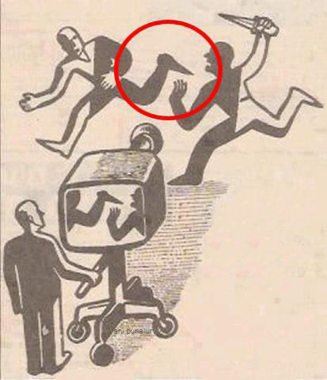
Objectivity vs Bias

Slide 4
Media As a Business
Subject to:
  Discipline of the market
  Laws of the Land
  Cultural and ideological rules of the land
Media organizations have:
  Corporate structures
  By-Laws
  Board of Governors
Erving Goffman
  Official and unofficial bureaucracy
Gaye Tuchman
  Journalists don’t always like to admit that they are not in control
  Media anchors are touchy about objectivity
  Presentation of facts – 5 Ws
  See next slide for a more elaborate explanation
Edward Jay Epstein
These critical demands structure the scope and form of the news
  Budgetary constraints
  Sustain the interest of the audience (flow of programming)
  Government and its actions establish general parameters that condition news
To break away from organizational filters you need to tell a great story and attract an audience
Peter Desbarats
News professionals rely on instinct and gut feeling
  They don’t always like to share trade secrets (competition)
  Guilt for questionable practices

Slide 5
The Credibility of a Journalist
Journalists are touchy about objectivity (Tuchman)
They defend attacks on objectivity via:
1 – Presentation of both sides of a story even if facts cannot be verified
2 – Presentation of supporting evidence to back up weaker evidence
3 – Judicious use of attempts to separate opinions expressed from the reporters own
4 – The use of ‘expert’ opinion
5 – Presentation of the most facts regarding the 5Ws
Tuchman
Objectivity, given the incredible pressures of deadlines, are mere rituals to cover news professionals against attacks on their bias.
- who gets a voice and who does not?

Slide 6
Structure of Media Organizations
Media organizations can be conceptualized as consisting of four principal classes:
1 – The upper class: Large scale owners and senior managers
2 – Media working class: Routine tasks of media work; sound recording, cleaning up, etc.
3 – Middle class professionals: Journalists, managers, production staff
4 – Self employed independent journalists

Slide 7
The ‘Media Factory’ (Nesbitt-Larking)
Suppliers of raw materials – Those whose daily practices produce the requisite news value to be registered as eligible for inclusion. Those more elevated in social status usually get more priority.
Builders of news machinery – Technical operatives who make it possible for experience to be converted into editorial.
Suppliers of liquid capital – Those who invest in and purchase the services of media enterprises.
Principal owners and bosses – Allocative vs operational owners
Workers (and semi-employed workers) – Those doing the groundwork
State inspector – The regulator
Costumers – Those who engage with media
Those affected by externalities – The general public

Slide 8
The Bottom Line - Profit
Since media are businesses, they sell viewers to advertisers
They MUST satisfy their shareholders
They are mindful of how to please audiences and construct stories that ‘sell’
  A great deal of energy is put into attracting and keeping audiences
  Flow is important
Newsrooms must continuously construct products ‘news content’
  The business is fast pace and deadlines are strict
  Stories are relatively simple
  Stories follow a typical story structure – beginning, middle, end, conflict, resolution

Slide 9
Making a Story Newsworthy
More of an art than a science
  Make sure your story is relevant to the current time
  Stage an event – events attract news
  Write a press release – spin your piece into a newsworthy story
  Organize a press conference around your event – invite an array of journalists (you’ll need contacts)
  Construct a compelling ‘story’
  Prepare newsworthy soundbites
  Follow up with journalists – keep their contact information

Slide 10
An Example of a Newswire Posts
Canadian Newswire
Example of a Newswire Story
How was the story covered?
  Montreal Gazette

Slide 11
Selling the System
Media are in the business of selling views to advertisers
Advertisers are in the business of selling products to viewers
Media is the vehicle to transmit commercial messages
Media has become an important player in organizing consumption
  Product placement
  Lifestyle advertising
  Event marketing
  Anxiety advertising
  Keeping up with the Jonses

Slide 12
News Gatekeeping, Agenda Setting, Framing & Priming
Attention and awareness are important
Reporters often repeat key words, phrases and/or sayings
New stories can be found on newswires and recycled or tweaked
Priming effect
The power of words in regards to memory
Context can make us understand things in specific ways
Advertising and priming – page 18

Slide 13
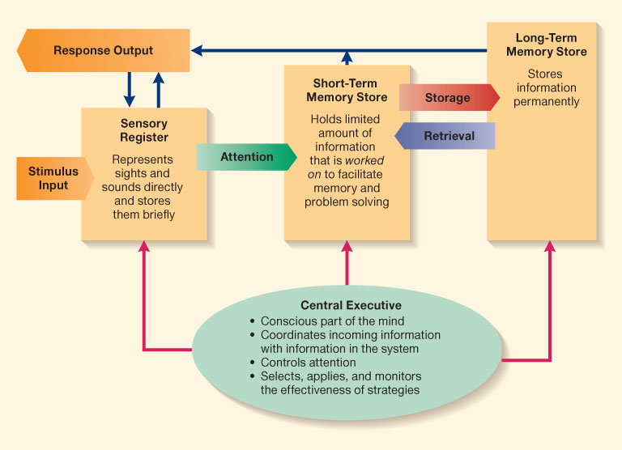
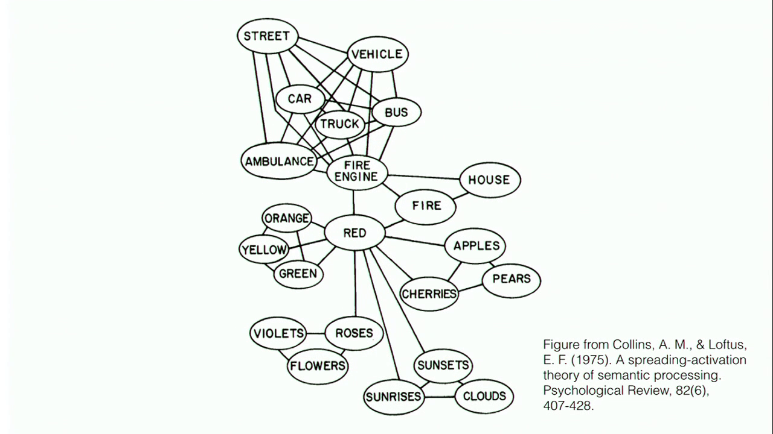
Priming/Framing/Schema
Cognitive Model
Semantic Processing – Spreading Activation

Slide 14
Tactics to Resist the Influence of Agenda Setting (Nesbitt-Larking)
You can tune messages out
Be on the lookout for slogans and clichés
Be alert of infotainment techniques
Remind yourself about the artificial nature of news broadcasts
Talk back to news pieces
Understand what has been ignored or downplayed
Understand what voices are missing
Understand what is said to be impossible
Understand if the news piece favors a conventional idea of the elite
Demand better news content
*Become a producer of news yourself

Slide 15
Learning Check
What dies Nesbitt-Larking mean by suggesting that the media business is like a sausage factory? How does he describe the media business? In your answer please include: what businesses are subject to, what media organizations have and media organizations official and unofficial bureaucracy.
According to Nesbitt-Larking, Edward Jay Epstein suggests that there are three critical demands structure the scope and form of the news. Please name and describe these critical demands.
What does Nesbitt-Larking mean by, media organizations need to tell a great story and attract an audience?
According to Nesbitt-Larking, Peter Desbarats suggests that two factors explain why news professionals are reluctant to elaborate upon their work. What are these factors?
According to Nesbitt-Larking, Tuchman suggests that journalists are touchy about objectivity and defend attacks on objectivity through five primary ways. Please name, describe and provide an example for each.
According to Nesbit-Larking, how are media organizations structured? Who are the actors in ‘the media factory’? Please name and describe their roles?
What does Nesbitt-Larking suggest by stating that profit is the most imperative factor for media organizations. What examples does he provide?
What does Nesbitt-Larking suggest about commercialism, advertising and the media?
What is gatekeeping, agenda setting, priming, semantic-processing, and framing? How are these concepts important in regards to media and politics?
What does Elizabeth Loftus suggest about how words affect memory? How does this apply to the way people understand news media?
Please name and describe the ways Nesbitt-Larking suggests that people can resist the influence of agenda setting.
What does Nesbitt-Larking suggest about the manufacturing of news? What is ‘newsworthy’?
What is Katz’s two-step flow model of communication? What does this model suggest about the relationship between the media and the audience?

Slide 16
Effects of Advertising
Erik Chevrier’s Masters Thesis: An Inquiry into How Individuals are Affected by Profuse Amounts of Publicity

Slide 17
Thanks
Questions?

