Slide 1
Media, Technology and Politics
Encoding and decoding messages & Media effects
Erik Chevrier
March 29, 2019

Slide 2
Encoding vs Decoding
To decode, we must make inferences about the encoding process:
  Most of the time, we do not know:
    The intensions of the encoders
    The reason behind using certain ‘codes’ over others
    The market/demographic research used to make the ‘codes’
    The thought process of those who produced the ‘codes’
  To understand the encoding/decoding process, we should take into account:
    Intended and unintended effects
    Positive and negative effects

Slide 3
Content Analysis
The scientific exploration of texts in order to test inferences about the content of that text (mainly descriptive but can be paired with other inferential methods)
Provides an ‘accurate’ statement of what is in the text
Does not reveal the true intentions of the ‘producer’ nor explain how it will affect every individual
Evaluates denotative meanings or manifest content (as opposed to latent content)
While designing a content analysis experiment, you should:
  Devise a testable hypothesis
  Operationalize and code your variables
  Chose a method of analysis
Topics that may be investigated with content analysis:
  Processes, groups, issues, events
Some things to keep in mind:
  Internal validity
  External validity
  Reliability
  Replicability
  Sampling
  Systematic

Slide 4
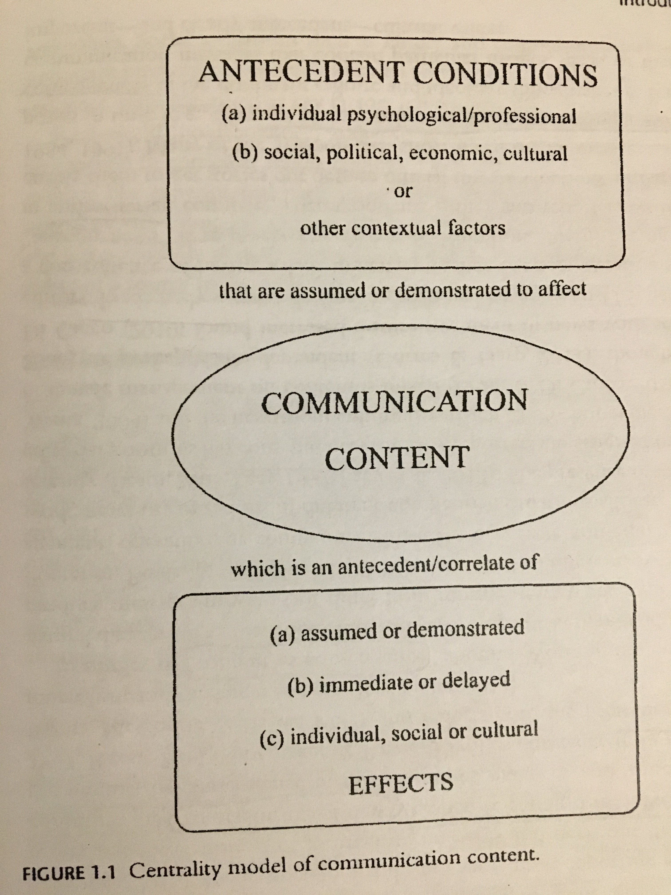
Content Analysis
Advantages of content analysis (Riffe, Lacy, Fico):
  Nonobtrusive, nonreactive measurement technique
  Longitudinal study potential
  Reduction to numbers summarizing large amounts of information
  Unlimited applicability
Useful or necessary when (Riffe, Lacy, Fico):
  Data accessibility is a problem, limited to using documentary evidence
  Communicators language use and structure is critical
  The volume of material exceeds capacity to investigate it

Slide 5
Let’s Perform a Content Analysis
Let’s compare the news coverage from the Toronto Sun and Toronto Star regarding their take on Carbon Tax.
What hypotheses can we derive?
What variables will we be looking at?
How can we measure our variables?
How will we analyze our data?
How do we make sure our results are reliable/valid?
How will we interpret our findings?

Slide 6
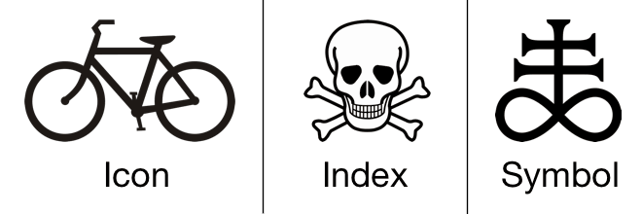
Discourse Analysis
An analysis of a text that goes beyond its overt elements
Semiotic analysis (we will explore this in more detail next lecture)
Nesbitt-Larking
  Semiotic analysis of discourse is centred on the deconstruction of those codes that are invoked in the communication of meaning
  Codes are signs that have been culturally and ideologically organized in order to attach them to certain referents
  Signs come in 3 forms
    Icons – Resemble objects to which they refer
    Indexes – Signs that are immediately implied in their referent
    Symbols – Bear no obvious resemblance to their referents but come to be associated to them

Slide 7
Semiotics
Semiotics:
  Is an analytic method that complements context and medium specificity, by focusing on broad cultural processes by which meaning is produced and communicated across a range of cultural forms.
  Is the study of how meaning is produced and reproduced within a society
  Provides us with powerful tools for analyzing media as well as helping us gain some distance from everyday practices of communication of meaning, so that we can look at them, with new eyes and understand them in new ways.
  Involves ‘unnatural tasks’ (Bignell, 1997) such as abstracting the ad from its environment, and then breaking it down into constituent parts (signs), working out what they mean and how they’re organized, then trying to determine potential ambiguities or alternative readings.

Slide 8
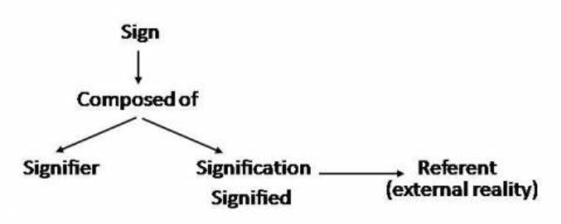
Semiotics
Sign – Most basic discrete unit of meaning
  Word, colour, sound, set of lines, shapes,
  Like atoms, we can dissect individual units
Assemblages – Collections of signs (that carry meaning)
  Texts
Ferdinand de Saussure – Understand power and flexibility of language as a social construction through which meaning is organized.
  Language is a structure that allows for flexibility and consistency.
  Meaning between signifier and signified is arbitrary
    (flexible and consistent)
  Meaning is produced through cultural conventions
  Langue – Giant system of grammar and vocabulary
  Parole – Grammar and vocabulary can be manipulated

Slide 9

Analyzing the Meaning of Signs and Symbols
Bignell (1997)
Break down ads into constituent signs and coherent signs
  Parts vs sum of parts vs complete whole
Denotative meaning of a sign
  Obvious, literal meaning of the sign
Connotative meaning of a sign
  Symbolic, seemingly secondary, more metaphorical meanings
  More socially conditioned
Anchorage
  Barthes – Use of captions or slogans in order to lock down (anchor) one possible meaning out of the many offered by the images
    Words, logos, etc.
  Volkswagen ad – Portaloo Hearse
  Meanings of signs and symbols are not natural – they are constructed, not universal, not eternal and arbitrary.

Slide 10
Mythology and Ideology
Mythology is concerned with the idea that signs are never natural or neutral, but rather always attain their connotations in relation to particular histories and culture.
  Anchorage is part of mythology
  Barthes – Interested in the ways in which meanings reflect the social and cultural arrangements of power, and communicate unspoken understandings about how the social world works.
    How is meaning embodied in a sign?
Ideology
  Is a set of beliefs, values, ideas and feelings that shape how we understand, approach, and engage with the world around us.
  It is always at work, it informs every action and idea in a society
  Media texts imply a particular vision of the world.
  Unpacking problems or obstacles
  Reinforcing representations of social relations (gender, class, etc.)
  Understanding priming, schemas, and controlled vs automatic processing is important

Slide 11
Deciphering Advertisements (Jib Fowles, (1996) Deciphering Advertisements)
Context for the ad
  Product category?
  Which medium does it appear?
  Who is the intended audience?
Implications for the ad
  What is the ad implying about relationships between people?
  What is this ad saying about identity and gender relations?
  What does the ad convey about social status?
  What kind of cultural beliefs are displayed in the ad?
  How does the ad attempt to commodify human experience?
Looking at the ad
  What are the aesthetic properties of the ad?
  Photograph or drawing (retouching?)
  What is in the foreground?
  What is the commodity?
    Subtract the commodity and look at the ad’s symbolic appeal
  List various elements pictured in the symbolic appeal
  What are the meanings of these symbols in relation to the intended audience?
  What are the inferred states of mind of humans in the ads?
  Where is the space in which the ad is situated?
  What is the timeframe in which the ad is situated?
  Consider the ad as a narrative, can we tell the story?
  What is missing?
  Does the symbolic appeal idealize anything?
  Imagine someone looking at the ad, what state of mind would they be in? What does the ad supplement to their state?
  Is there intertextual referents from something earlier?
  What is in frame, what is framed out?

Slide 12
Analyzing Advertisements
Static Advertisements
  Print & digital
  Are easier to analyze than motion pictures
  Digital static ads rely on web-browser technology
  Toyota ‘Elevate’ ad
Video Advertisements
  2014 Toyota Corolla Commercial: 'Style Never Goes Out of Style’
  Television, internet, film, product placement
  More costly
  More complex
    24 frames per second (24 static images)
    Sound
    Story
  Breaks television ‘flow’ to stand out
  2014 Toyota Corolla Commercial: 'Style Never Goes Out of Style’
Digital Advertising
  Interactive
  Static ads and videos are part of integrative campaigns
  Video game ads
    Branded reward tokens

Slide 13
Unpacking Freedom, Gender and Ideology
Kia Sportage

Slide 14

Levi's – Go Forth - Video

Slide 15
Learning Check
What is encoding and decoding of messages entail? What issues exist between media producers and the audience regarding encoding and decoding messages?
What is a content analysis? What does a content analysis evaluate? How do you conduct a content analysis? What kind of topics can you investigate with content analysis? Please define the following terms and disuses why they are important to content analysis: internal validity, external validity, reliability, replicability, sampling, symbols of communication, and systematic method? What are issues with content analysis?
According to Riffe et al., what are advantages of content analysis? When is it useful to perform a content analysis?
According to Riffe et al., what is the Centrality Model of Communication Content? Please name and describe each component of the model.
What is discourse analysis? What are connotative and denotive meanings of signs?
According to Nesbitt-Larking, what is semiotics? What are codes and signs and what is their relationship to culture and ideology? What are icons, indexes, and symbols?
Who is Ferdinand de Saussure and what was he famous for? What is an assemblage? How can we derive meaning from a sign using semiotic analysis?
What is the relationship between mythology and ideology?
What questions can we use to decipher advertising? What are the three major categories that Fowels used to decipher advertising?
According to Danesi, what is semiotics, semiosis, signs, codes and texts? What are their relations to media? What does Danesi suggest about the history of the semiotic approach?

Slide 16
To Be Continued Next Class…
Questions or concerns?

