Slide 1
Motivation and Emotion in Daily Life
Goal Setting and Goal Striving
march 4th, 2019
Erik Chevrier

Slide 2
Discussion
Think of a goal you would like to accomplish.
Why do you want to achieve that goal?
Internal factors? External factors?
Where are you currently in relation to achieving that goal?
Where are you now? Where do you ideally want to be?
How do you plan to achieve that goal?
Is your plan specific or general?
How easy or difficult will it be for you to achieve that goal?
How will you know that you achieved that goal?
What types of feedback do you intend to receive?

Slide 3
Goal Setting and Goal Striving Activity
1 – Identity the objective to be accomplished
2 – Define the goal difficulty
3 – Clarify goal specificity
4 – Ask why you are pursuing this goal
5 – Specifically, how will your performance be measured?
6 – Identify goal-attainment strategies.
7 – Crete if-then implementation intentions
8 – Make performance feedback continuously available

Slide 4
Where do Goals Come From
Goals come from:
Others (other assigned goals)
Self-generated
Our thinking
Valuing
Personality traits
Biological needs
Environmental incentives

Slide 5
Plans of Action
Pioneers of cognitive study of motivation:
George Miller
Eugene Galanter
Karl Pribram
People have mental representations of ideal states of their behaviour, environmental objects, and events.
People are also aware of the present state of their behaviour, environment, and events.
A mismatch perceived between one’s present state and one’s ideal state instigates an experience of ‘incongruity’
Incongruity is the motivational ‘spring to action’ and the plans direct behaviour towards the pursuit of the ideal state.

Slide 6
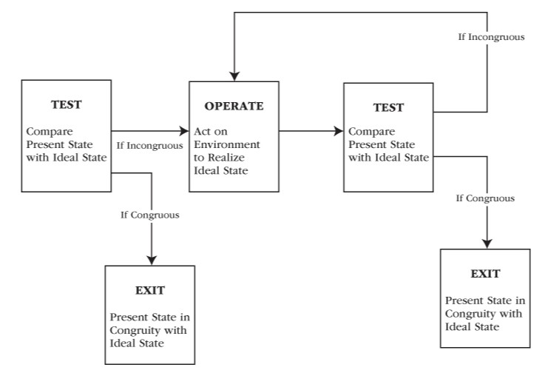
TOTE Model

Slide 7
Corrective Motivation
Plan → action sequence portrays people as:
Detecting present-ideal inconsistencies
Generating a plan of action to eliminate incongruity
Instigating plan-action regulated behaviour
Monitoring feedback as to the extend of any remaining present-ideal incongruity
Most researchers consider plans of action as adaptable and not fixed, static or mechanical.
Corrective motivation activates a decision making-making process in which the individual considers many different possible ways for reducing the present-ideal incongruity:
Change the plan
Change behaviour
Withdraw from the plan altogether

Slide 8
Discrepancy
Discrepancy is the core motivational construct that creates the sense of wanting to change the present state so that it will move closer and closer toward the ideal state.
Small discrepancies can motivate people, larger discrepancies carry more motivational strength.
When people reduce the discrepancy between the present state and ideal state, they feel positive affect.
When people fail to reduce the discrepancy between the present state and ideal state, they feel negative affect.
Affect is a discrepancy-reducing scorecard and a behaviour motivator itself. Negative affect energizes effort and facilitates discrepancy reduction.

Slide 9
Two Types of Discrepancies
Two types of discrepancies exist:
Discrepancy-reduction – which is based on discrepancy-detecting feedback that underlies plans of action and corrective motivation.
Negative feedback
Corresponds to a plan based corrective motivation
Is reactive, deficiency overcoming
Discrepancy-creation – is based on a ‘feed-forward’ system which the person looks forward and sets a future, higher goal.
Positive feedback
Corresponds to goal-setting motivation
Proactive, growth pursuing

Slide 10
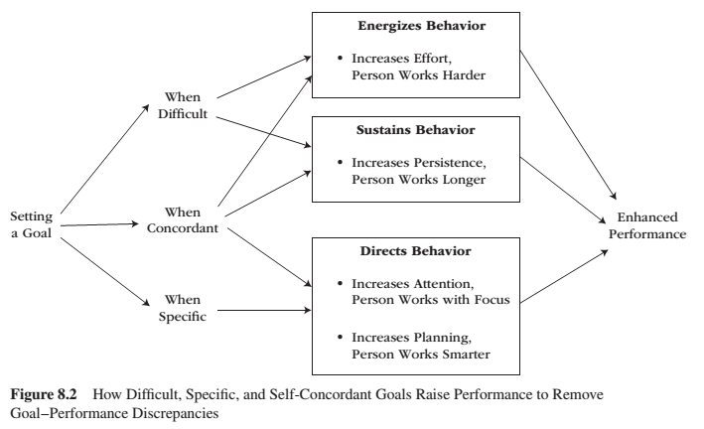
Goal Setting

Slide 11
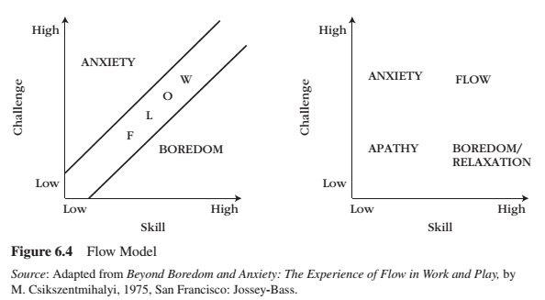
Review – Flow

Slide 13
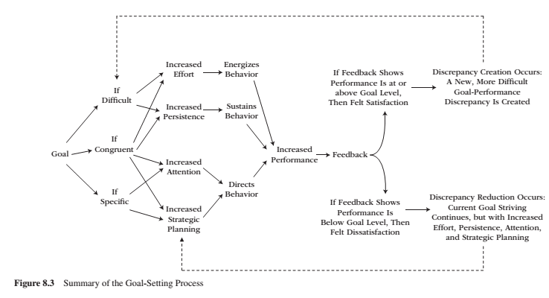
Goal Setting

Slide 14
Criticisms
Goal setting works best when the tasks are relatively uninteresting and require a straightforward procedure. Goal setting provides motivation for a task that cannot be internally generated. For inherently interesting tasks, motivation is derived internally.
People rarely pursue one goal at a time and instead pursue goals that sometimes conflict with one another. The goal-setting process directs attention to specific tasks.
A pitfall for setting goals is that it can generate extrinsic motivating factors if they involve controlling, pressure inducing, and can undermine creativity.

Slide 15
Long-term Goals
Goals can be short-term, long-term or a combination of successive short-term goals that amount to a long-term goal.
Goal proximity affects persistence and intrinsic motivation.
Short-term goals provide more opportunities for feedback and reinforcement.
On uninteresting tasks, short-term goals provide more opportunities for positive feedback.
On interesting tasks, long-term goals facilitate intrinsic motivation.

Slide 16
Mental Simulations & Implementation
To facilitate action, people need to mentally simulate the goal striving PROCESS – the means by which they will accomplish the end task.
To implement a goal, people need to create if-then plans. They need to:
Set a goal (a goal intention) – What you want
Set a plan (implementation intention) – How/when/where one will achieve the goal.
To form an implantation intention, one must:
Identify a response that will promote goal attainment
Anticipate suitable occasions to implement that response
One needs to form a mental link between the critical situation and the goal-directed action. When strong links are formed, the behaviour can occur instantly and automatically.
Proper goal implementation involves:
Getting started
Staying on track
Resuming

Slide 17
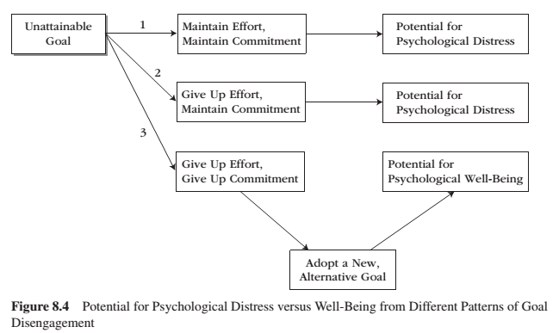
Goal Disengagement

Slide 18
Goal Setting and Goal Striving Activity
1 – Identity the objective to be accomplished
2 – Define the goal difficulty
3 – Clarify goal specificity
4 – Ask why you are pursuing this goal
5 – Specifically, how will your performance be measured?
6 – Identify goal-attainment strategies.
7 – Crete if-then implementation intentions
8 – Make performance feedback continuously available

Slide 19
Thank you!
Questions? Concerns?

Slide 20
Bibliography
The information obtained to create this PowerPoint slide was obtained from:
Reeve, J. (2018) Understanding Motivation and Emotion, 7th ed. John Wiley and Sons

Slide 21
Learning Check
What are cognitive springs to action? How do they motivate behaviour?
What is a plan? Who invented contemporary cognitive study of motivation?
How can motivation be generated by the discrepancy (incongruity) between people’s perceived present state and ideal state of behaviour, environmental objects and events? How does discrepancy relate to emotions and feelings? What are the two types of discrepancies identified by Reeve? What is corrective motivation? How does it function? What is the TOTE model?
What are goals? What are benefits of having goals? Summarize the goal-setting process. (Figure 8.3, p. 191)? What does Reeve suggest about long-term goal setting? Where do goals come from?
What is goal-performance discrepancy? How does goal difficulty, goal specificity, and goal congruence (concordant) affect goal-performance discrepancies? What role does feedback play in making goal setting effective? What are some criticisms of goal setting?
What is goal striving? What are mental simulations? What are implementation intentions? How do they function? What are the three self-regulation problems inherent in goal striving? How do they function?
How can people disengage from a goal without experiencing psychological distress? What are different patterns of goal disengagement and what effects do they have on well-being?

