Slide 1
Motivation and Emotion in Daily Life
Exam Review
April 10th, 2019
Erik Chevrier

Slide 2
Final Exam
Same format as usual (25 multiple choice questions; 1 of 2 short answer questions). You have 3 hours to complete the exam.
Material:
Chapter 9 – Cognitive Dissonance (p. 221 – 225)
Chapter 10, 11 and 12 – The complete chapter
Chapter 13 – Cognitive Aspects of Emotion (p. 324 – 334)
Study tricks:
Form study groups
Read the textbook more than once
Go over the PowerPoint slides and study them in detail
Make sure you can define key concepts
Make sure you understand the charts
If you don’t understand the material, make an appointment to meet with me
Try to explain the material to someone else
Study (again) the night before the exam
Refresh the material for at least an hour before the exam
Get plenty of rest the night before the exam
Eat fruits and/or vegetables (or at least something healthy) before the exam
When you get to the exam, just relax and take your time

Slide 3
Motivation and Emption Gameshow
Get into groups of 3 – 4 people
I will ask a question and you team has 2 minute to answer the question
Every correct answer is awarded 1 point
At the end of the quiz, the team with the most points wins! Yeah!

Slide 4
Question 1
Please name and describe the two types of expectancy and indicate how they influence motivation.

Slide 5
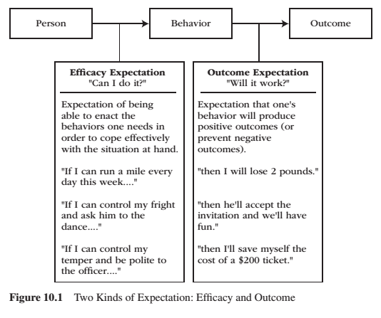
REVIEW – Expectancy
Expectancy is a subjective prediction of how likely is that event will occur.
Two kinds of expectancy
Efficacy expectations – judgement of one’s capacity to execute a particular act or course of action.
Outcome expectations – judgement that a given action, once performed, will cause a particular outcome.
Efficacy and outcome expectations are separate, causal determinants to the initiation and regulation of behaviour.
Both efficacy and outcome expectations must be reasonably high before behaviour becomes energized, goal directed, and sustained over time.

Slide 6
Question 2
Name and explain four factors lead to feelings of cognitive dissonance? What are four dissonance relieving strategies?

Slide 7
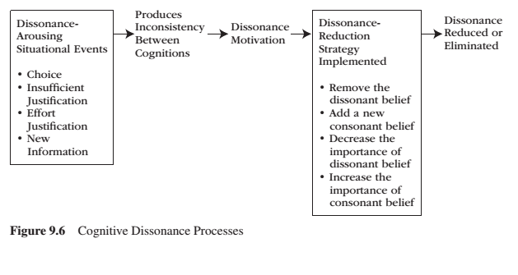
Motivational Processes Underlying Dissonance

Slide 8
Question 3
What are two ways emotions relate to motivation?

Slide 9
Emotions and Motivation
Emotions relate to motivation in two ways:
1 – Emotions are one type of motivation. Like all other motives, they energize, direct, and sustain behaviour.
Researchers generally agree that emotions function as a type of motive
Some researchers suggest emotions constitute the primary motivational system
2 – Emotions serve as an ongoing ‘readout’ system to indicate how well or how poorly personal adaptation is going.
Positive emotions signal that all is well and reflect the involvement and successful satisfaction of our needs and goals
Negative emotions act as a warning signal that all is not well and reflect the neglect and frustrated thwarting of our needs and goals.

Slide 10
Question 4
Compare and contrast Arnold’s and Lazarus’s Appraisal process. What four additional appraisals were mentioned in the text above and beyond Arnold’s and Lazarus’s appraisals?

Slide 11
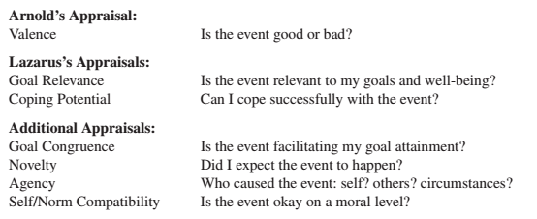
Appraisal as a Process
Each appraisal theorist agreed on this sequence:
life event – appraisal – emotion sequence
They disagree on how many dimensions of appraisal are necessary to explain emotional experience. Arnold explained two emotions, Lazarus explained 15 emotions, others seek to explain all emotions.

Slide 12
Arnold’s Appraisal Theory of Emotion
Come up with five significant life events and apply them to Arnold’s Appraisal Theory

Slide 13
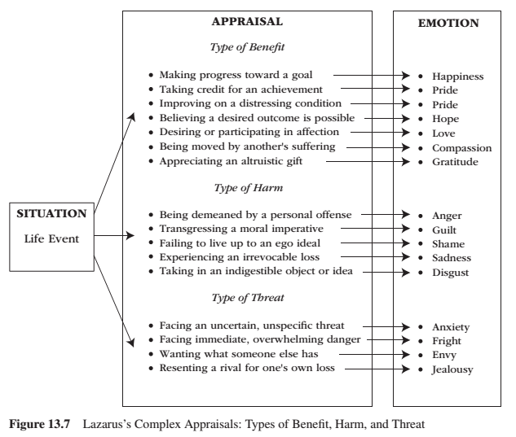
Complex Appraisal
Lazarus – emphasized the cognitive processes that intervene between important life events (environmental conditions) and physiological and behavioural reactivity.
People evaluate whether the situation has personal relevance for their well-being.
Good appraisals – several types of benefit Bad appraisals – several types of harm and threat

Slide 14
Complex Appraisal
Lazarus – appraisals take the form of the following questions:
Is this event relevant to my well-being? Is this event consistent with my goals? How deeply does this event touch my self-esteem?
These are appraisals of:
personal relevance
goal congruence
ego involvement
People appraise situations as particular kinds of harm, as particular kinds of threat, or as particular kinds of benefit
Changed appraisals lead to changed emotions.
People first (primary appraisal) appraise their relationship to the life event then they appraise their coping potential (secondary appraisal) within the life event

Slide 15
Primary Appraisal
Primary appraisal – involves an estimate of whether one has anything at stake in the encounter.
Health
Self-esteem
A goal
Financial state
Respect
The well-being of a loved one
From ordinary life event to a significant life event

Slide 16
Secondary Appraisal
Secondary appraisal – occurs after some reflection, involves the person’s assessment for coping with the possible benefit, harm, or threat.
Coping involves the person’s cognitive, emotional, and behavioural efforts to manage the benefit, harm, or threat.

Slide 17
Complex Appraisal
Lazarus:
portrays emotion as a motivational one. When personal motivations are at stake, emotions follow.
An individual’s personal motives (goals, well-being) lie at the core of the emotional process and the individual continually makes primary and secondary appraisals about the status of those personal motives as events unfold and coping efforts are implemented.
Emotion theory = Cognitive-Motivational-Relational
Cognitive – communicates the importance of appraisals
Motivational – communicates the importance of personal goals and well-being
Relational – communicates that emotions arise from one’s relation to environmental threats, harms benefits.

Slide 18
Question 5
Biological researchers who study emotion postulate that there are between 2 – 8 basic emotions. Despite their disagreements, there are three points of convergence. What are the three points that biological researchers agree on about basic emotions?

Slide 19
How Many Emotions Are There? Biological Perspective
All these 10 biological research traditions agree that:
A small number of basic emotions exist
Basic emotions are universal to all human beings (and animals)
Basic emotions are products of biology and evolution

Slide 20
Question 6
Please describe the limited strength model of self-control.

Slide 21
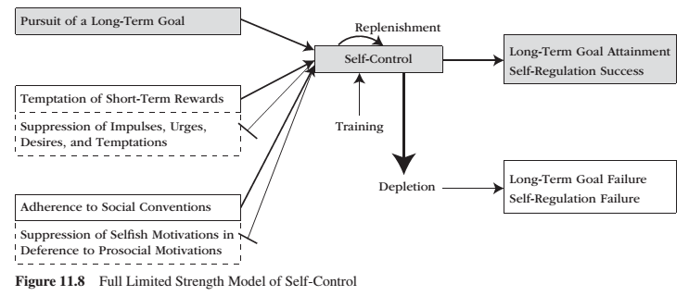
Limited Strength Model

Slide 22
Question 7
What is internalization and what are the two reasons internalization occurs?

Slide 23
Internalization and the Integrating Self
Need for relatedness:
Supports the individual’s proactive motivation to internalize society’s rules, values and concerns – therefore behaviour, emotion and ways of thinking originate within the self and the social context
The process through which individuals take in, and accept as their own, an externally prescribed way of thinking, feeling or behaving is referred to as internalization.
Internalization:
Refers to the process through which an individual transforms a formerly externally prescribed way of behaving or valuing into an internal one.
Internalization occurs for two reasons:
From the individual’s desire to achieve meaningful relationships with family, friends, and others. Internalization is motivated by the need for relatedness.
From the individual’s desire to interact effectively with the social world. Internalization is motivated by the need for competence.
Agency:
The contribution of agency of the self as action and development from within is to recognize that:
Human beings possess a core self, one energized by innate motivation and directed by the inherent development processes of differentiation and integration
Not all self-structures are equally authentic, some reflect the core self and others reflect and reproduce the needs of society
Internal and societal self-structures may produce conflict – conflict is the opposite of integration
True Self:
Reflects the extent to which one is ‘in touch’ with inner experience. With such awareness and mindfulness, a close connection between inner experience and actual behaviour exists. People gain mindful personal knowledge about true self when relationships support strivings, self-expression and intentions.

Slide 24
Question 8
Please name and describe the four sources and four effects of self efficacy. Which are the most influential sources of self-efficacy? Why?

Slide 25
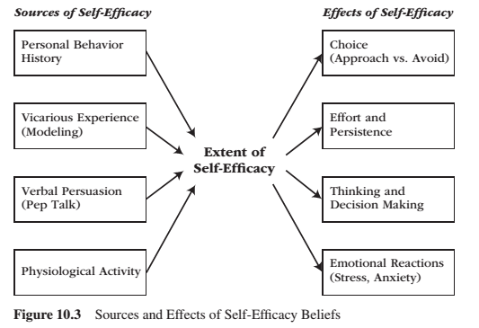
Sources and Effects of Self-Efficacy
Self-efficacy beliefs arise from:
One’s personal behavioral history in trying to execute that particular behaviour or way of coping**
Observations of similar others who also try to execute that behaviour**
Verbal persuasions from others
Physiological states
Self-efficacy affects
Choice
Effort and persistence
Thinking and decision making
Emotional Reactions
** stronger source of efficacy beliefs

Slide 26
Question 9
What are the seven steps in the master modeling program?

Slide 27
Empowering People: Master Modeling Program
A formal program to empower people through self-efficacy training is to employ a mastery modeling program – which involves the following seven steps.
1 – Expert identifies component skills involved in effective coping and measures novices’ efficacy expectation on each component skill.
2 – Expert models each component skill, emphasizing the novices’ most worrisome skill areas.
3 – Novices emulate each modeled skill. Expert provides guidance and corrective feedback, as needed.
4 – Novices integrate the individual skills into an overall simulated performance. Expert introduces only mild obstacles and helps novices integrate the different skill components into a coherent overall performance.
5 – Novices participate in cooperative learning groups. One person gives a simulated performance while peers watch. As they watch, peers provide encouragement and tips. Each person takes a turn until everyone has performed multiple times.
6 – Novices perform individually in a realistic situation that features numerous difficulties, surprises, obstacles, and setbacks while the expert provides modeling and corrective feedback.
7 – Expert models confident demeanor and arousal-regulating techniques.

Slide 28
Question 10
According to the functional view of motivational behaviour, what fundamental life task is likely to produce the following emotions?
Joy Sadness Contempt Anger Pride Interest Shame Guilt Disgust Fear

Slide 29
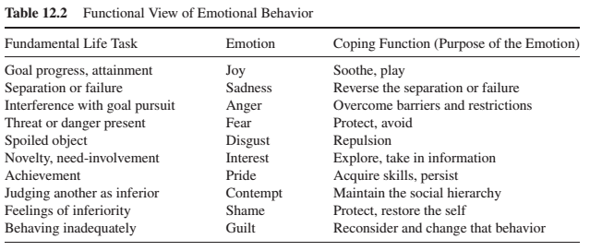
Coping Functions
These are flexible and not rigid categories.
Emotions serve at least 10 distinct purposes.

Slide 30
Question 11
What is the flow of a typical emotion episode and five opportunities to regulate that emotion?

Slide 31
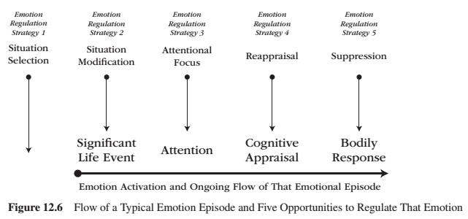
Flow of a Typical Emotion Episode and Five Opportunities to Regulate That Emotion

Slide 32
Question 12
Who is your favourite professor of all time?

Slide 33
Thank you!
Questions? Concerns?

