Slide 1
Media, Technology and Politics
Media, Technology and Privacy
Erik Chevrier
April 12, 2019

Slide 2
Format of the Final Exam
Vote:
10 Multiple choice questions, 2 of 3 essay questions (or)
15 Multiple choice questions, 2 of 3 essay question, (or)
20 Multiple choice questions, 2 of 3 essay questions
March 15 – State and Political Regulating of the Media
March 22 – Media Organizations
March 29 – Encoding and Decoding Media Messages
April 5 – Media Effects
April 12 – Media, Technology and Privacy (this PowerPoint)
Omit:
Taras, D. (2015) Digital Mosaic; Media, Power and Identity in Canada, University of Toronto Press, (Chapter 5)

Slide 3
Discussion
What kind of limits should be put on surveillance – if there should be.
How does surveillance violate individual privacy?
How can we protect privacy – if we should.
What is the difference between public and private spheres.
Do you have a smart phone or other smart devices?
  Do you use apps that track biometrics?
  Do you use apps that track your location?
  Do you have other smart appliances?
How do you use ‘social media’?
  Do you share a lot about yourself or do you keep private?
  Do you frequently engage with social media?
  Which social media platforms do you use?

Slide 4
Privacy Legislation in Canada
Office of the Privacy Commissioner of Canada
Privacy Act – Government
Personal Information Protection and Electronic Documents Act - Business
  Quebec Act Respecting the Protection of Personal Information in the Private Sector
Office of the Privacy Commissioner of Canada

Slide 5
Privacy Act
The purpose of this Act is to extend the present laws of Canada that protect the privacy of individuals with respect to personal information about themselves held by a government institution and that provide individuals with a right of access to that information.
  The Canadian Government shall:
    Inform you that they are collecting information about you (exceptions exist 8.2)
    Inform you about the reason they are collecting information about you – unless it makes the information inaccurate or will defeat the purpose/provide prejudice to the information being collected
    Make sure the information is accurate and up-to-date, and complete
    Dispose of information when the procedure is finished
    They cannot share the information with other sectors of the government or use it for anything other than the purpose it was collected (exceptions exist 8.2)
    Exception (8.2)
  (m) for any purpose where, in the opinion of the head of the institution,
  (i) the public interest in disclosure clearly outweighs any invasion of privacy that could result from the disclosure, or
  (ii) disclosure would clearly benefit the individual to whom the information relates

Slide 6
Anti-Terrorism Act
Security of Information
The concept of "harm to Canadian interests" (also known as a purpose "prejudicial to the safety or interests of the State") was defined to address a wide array of potential harms, including terrorist activity, interference with critical infrastructure, and the development of weapons of mass destruction in contravention of international law.
Surveillance and Identification
Terrorism offences are included in the Criminal Code electronic surveillance scheme. The changes removed the last-resort requirement for the use of electronic surveillance in the investigation of terrorism offences, and extended the duration of a wiretap authorization (from 60 days to a maximum of one year) and permitted delays of up to three years as a requirement to notify a target after a surveillance has been completed in relation to a terrorism offence. The DNA warrant scheme and Data Bank were extended to include terrorism offences to the list of "primary designated offences", thus permitting the use of forensic DNA technology in the investigation and prosecution of these offences. Also, it is possible for courts to issue DNA warrants and to order the inclusion of DNA profiles of persons convicted of these offences in the National DNA Data Bank.

Slide 7
Personal Information Protection and Electronic Documents Act (PIPEDA)
The purpose of this Part is to establish, in an era in which technology increasingly facilitates the circulation and exchange of information, rules to govern the collection, use and disclosure of personal information in a manner that recognizes the right of privacy of individuals with respect to their personal information and the need of organizations to collect, use or disclose personal information for purposes that a reasonable person would consider appropriate in the circumstances..
Limit
This Part does not apply to
(a) any government institution to which the Privacy Act applies;
(b) any individual in respect of personal information that the individual collects, uses or discloses for personal or domestic purposes and does not collect, use or disclose for any other purpose; or
(c) any organization in respect of personal information that the organization collects, uses or discloses for journalistic, artistic or literary purposes and does not collect, use or disclose for any other purpose personal information for purposes that a reasonable person would consider appropriate in the circumstances.

Slide 8
Canadian Spying Agencies
Canadian Security Intelligence Service
Communications Security Establishment
Royal Canadian Mounted Police

Slide 9
Canadian Security Intelligence Service Act
Collection, analysis and retention
12 (1) The Service shall collect, by investigation or otherwise, to the extent that it is strictly necessary, and analyse and retain information and intelligence respecting activities that may on reasonable grounds be suspected of constituting threats to the security of Canada and, in relation thereto, shall report to and advise the Government of Canada.
No territorial limit
(2) For greater certainty, the Service may perform its duties and functions under subsection (1) within or outside Canada.
Measures to reduce threats to the security of Canada
12.1 (1) If there are reasonable grounds to believe that a particular activity constitutes a threat to the security of Canada, the Service may take measures, within or outside Canada, to reduce the threat.
Limits
(2) The measures shall be reasonable and proportional in the circumstances, having regard to the nature of the threat, the nature of the measures and the reasonable availability of other means to reduce the threat.
Warrant
(3) The Service shall not take measures to reduce a threat to the security of Canada if those measures will contravene a right or freedom guaranteed by the Canadian Charter of Rights and Freedoms or will be contrary to other Canadian law, unless the Service is authorized to take them by a warrant issued under section 21.1.
Bill C-59
Bill C-59 Critique

Slide 10
Data Governance
Governments and corporations monitor, track, store, and use personal data for various purposes
  Governments – Spy on citizens to various degrees depending on the government in question
    Stingray technology IMSI catcher
    Canadian police use IMSI catchers
    Vault 7 – WikiLeaks
  Companies – Manage, sell, store data
    Some apps track and store data – apple watch
    Companies sell data to advertisers – especially points cards that track purchases
    Companies are contracted to manage and store data – cloud server companies
    Social media apps display personal information which could be tracked by third parties with ease

Slide 11
Leaks & Hacktivism
WikiLeaks – Collateral Murder
Edward Snowden PRISM
GCHQ in UK collects metadata
Documentaries on Hacktivism and Digital Spying
We are Legion
Citizenfour – Edward Snowden
Hacker Wars
The Internet’s Own Boy: The Story of Aaron Swartz
We Steal Secrets

Slide 12
Metadata Collection
Metadata refers to data that describes data.
  Location
  Date
  Time stamped information
  IP addresses
  Metadata falls into two categories:
    Information that allows communication to occur
    Information about the parties to the communication

Slide 13
Data Farming & Cloud Computing
Clouds are becoming more common for data storage
  Google
  Microsoft (underwater data center)

Slide 14
Consequences of Cloud Technology
Data theft – breach problems
Government monitoring
Corporate monitoring
Protection of youth – time, date location stamps
Leaks of personal information – celebrity nude picture leak
Monitoring dissent
Market research and niche targeting
Customized searches – echo chamber
Stealing intellectual property

Slide 15
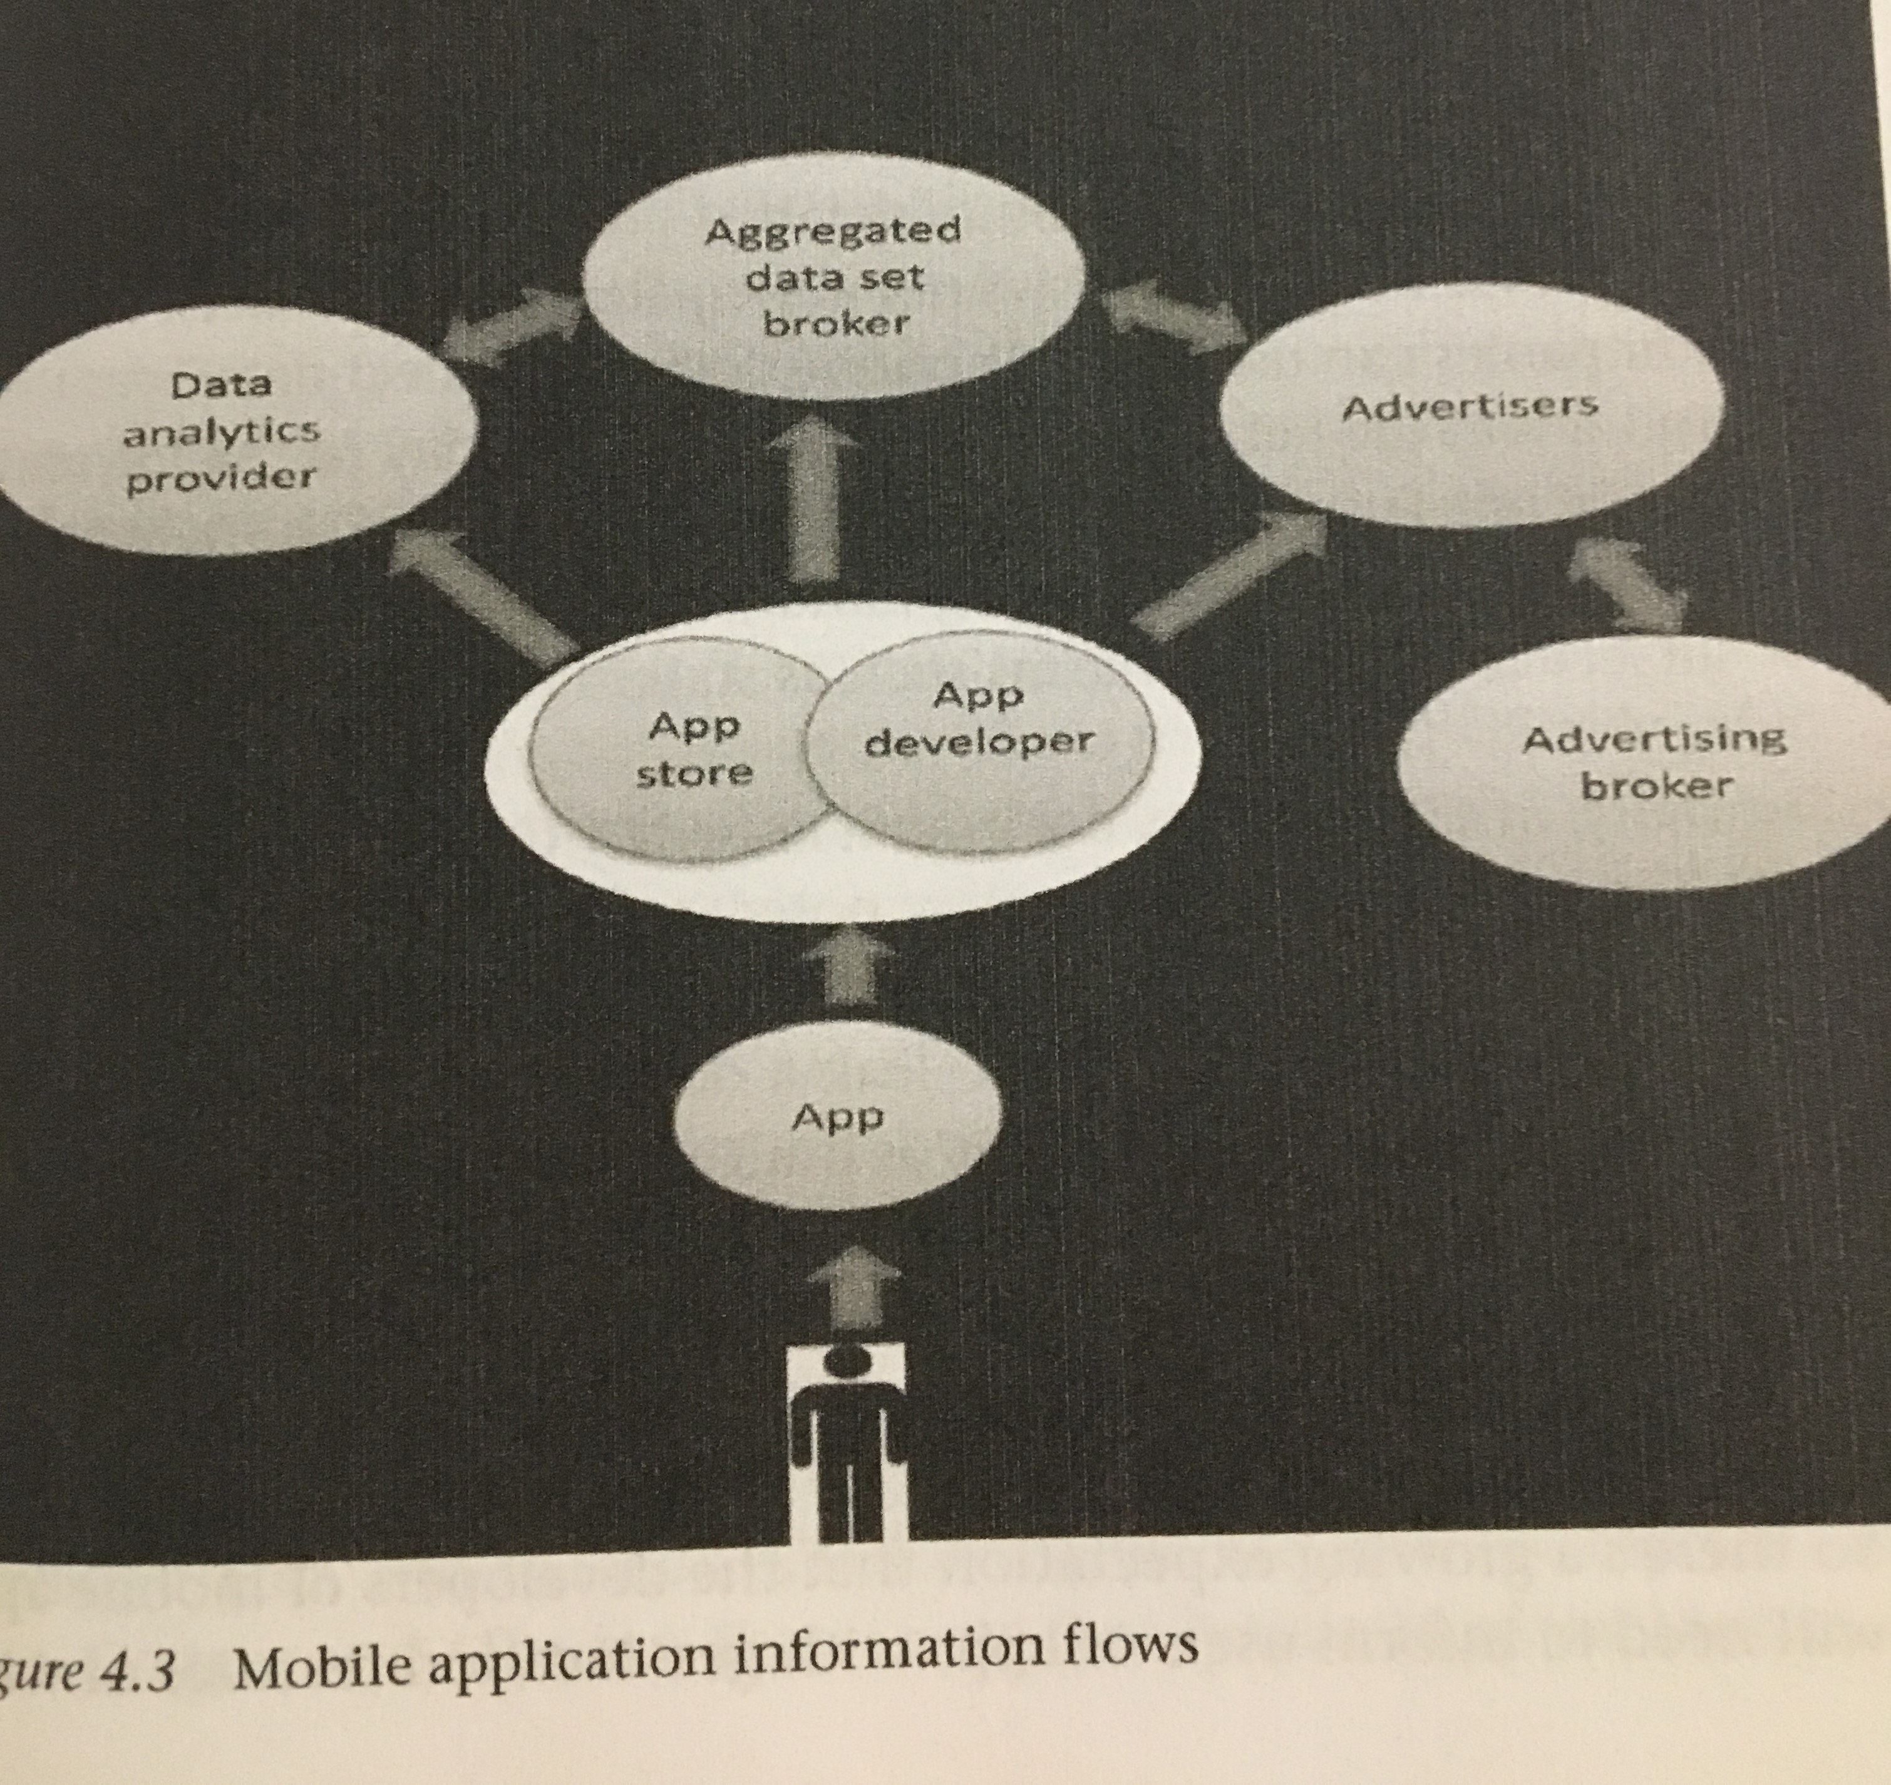
Example of Application Information Flows
Source:
Dwyer, T., (2016), Convergent Media and Privacy, Palgrave MacMillan.

Slide 16
Technology and Media
Definitions of technology (Goggin)
  Greek – Systematic treatment (particularly applied to grammar)
  17th century – German & French (technologie) – Branch of knowledge dealing with the mechanical arts and applied science
  19th century – Technology – The application of such knowledge for practical purposes
  20th century
    The product of such application (of knowledge);
    technological knowledge or knowhow;
    a technological process, method, or technique;
    machinery, equipment, etc. developed from the practical application of scientific and technological knowledge

Slide 17
Technology
Is shaped by social, political, cultural and economic circumstances
New media technology is mainly shaped by users
Digitization vs analogue
Internet and networks of data packets
Science and technology are not ‘neutral’ processes (Law. J, (1996) Laboratories and Tests)
  Actors-networks
  Recourses
  Journals
  Funding
  Statistics

Slide 18
Terms
TCP/IP – Transmission control protocol/Internet protocol
P2P – Peer-to-peer
HTTP – Hypertext Transfer Protocol
E-mail – Electronic mail
MMS – Multimedia messaging
SMS – Short message service
Social Media – A new group of technologies, which rely upon – indeed are constituted by – the productive interactions of media consumers and users.
Pro-am – Distinctive new ways professionals and workers and armature media consumer-come-producers produce media.
Three forms of broadcasting:
  Terrestrial via transmitter
  Satellite
  Cable

Slide 19
Media Technologies, Politics and the Economy
Free market proponents were thrilled about the possibilities of the internet in breaking down government regulations. Their celebration was short lived because they asked government to ‘regulate’ their property.
Breakdown of leisure and work
Sharing economies flourish online – the internet is based on sharing (reciprocity)
  Polanyi – Reciprocity, redistribution and markets.
Marketing segments – long tail, i.e. niche marketing
Gate-keepers are now gate-watchers
Commodities are now virtual but still have value – ‘video game commodities’

Slide 20
Discussion
What is the future of technology?
  What forms of advancements do you expect within the next:
    Year
    5 years
    10 years
    25 years
    50 years

Slide 21
Learning Check
What is the responsibility of the Office of the Privacy Commissioner of Canada?
What is the Privacy Act in Canada?
What kind of information can the Government of Canada collect from Canadian citizens?
What are the exemptions to the Privacy Act in Canada?
What is the Personal Information Protection and Electronic Documents Act?
What are the limits of the Personal Information Protection and Electronic Documents Act?
What is the Quebec Act Respecting the Protection of Personal Information in the Private Sector?
According to the Anti-Terrorism Act in Canada, what does security of information and surveillance and identification refer to?
What are the Canadian Security Intelligence Service, Communications Security Establishment, and Royal Canadian Mounted Police? What do these organizations do regarding spying and security?
What limits do the Canadian Security Intelligence Service have regarding spying on the public?
What is Stingray technology (IMSI catcher)? What is it used for?
How do governments and companies spy on the public according to Dwyer?
What does Dwyer suggest about data farming?
According to Dwyer, what/who are WikiLeaks, Collateral Murder, Tempora, Edward Snowden, NSA, PRISM, GCHQ?
According to Dwyer, what is meta data? What are the two categories of meta data?
According to Dwyer, what is cloud technology? Where does data on the cloud exist?
According to Dwyer, what are consequences of cloud technology?
According to Goggin, what is the history of the definition of technology? How is technology defined today?
What does Goggin mean my saying that science and technology are not neutral processes?
What does Goggin suggest digital forms and formats?
What does Goggin mean my saying that technology is shaped by users?
According to Goggin, what are data packets? How do data packets relate to the internet?
According to Goggin, that do the following terms mean, Network, TCP/IP, P2P, HTTP, E-mail, MMS, SMS, Social Media, Pro-am?
According to Goggin, what are the three forms of broadcasting?
What does Goggin suggest about Media Technologies, Politics and the Economy?
What does Goggin suggest about mobile and wireless networks?

Slide 22
Questions? Concerns?
  Questions or concerns?
  Good luck studying!

