Slide 1
Motivation and Emotion in Daily Life
Nature of emotions
April 1th, 2019
Erik Chevrier

Slide 2
Six Perennial Questions
1 – What is an emotion?
2 – What causes an emotion?
3 – How many emotions are there?
4 – What good are emotions?
5 – Can we control our emotions?
6 – What is the difference between a mood and an emotion?

Slide 3
What is an Emotion?
Emotions are:
Multidimensional
Biological
Subjective
Purposive
Expressive
Arise as a response to significant events in our lives
Distinct patterns of neural activity
Emotions are short-lived, feeling-purposive-expressive bodily responses that help us adapt to the opportunities and challenges we face during important life events.
Thus, a significant life event occurs and produces a distinct pattern of neural activity that, in turn, generates and coordinates the emotional reaction that is a feeling-purposive-expressive-bodily reaction to the life event.

Slide 4
What is an Emotion?
Carroll Izard (2010) asked 34 leading emotion researchers to define the term emotion; he pulled together their replies into the following description.
Emotion consists of neural circuits (that are at least partially dedicated), response systems, and a feeling state/process that motivates and organizes cognition and action. Emotion also provides information to the person experiencing it, and may include antecedent cognitive appraisals and ongoing cognition including an interpretation of its feeling state, expressions, or social-communicative signals, and may motivate approach or avoidant behavior, exercise control/regulation of responses, and be social or relational in nature.

Slide 5
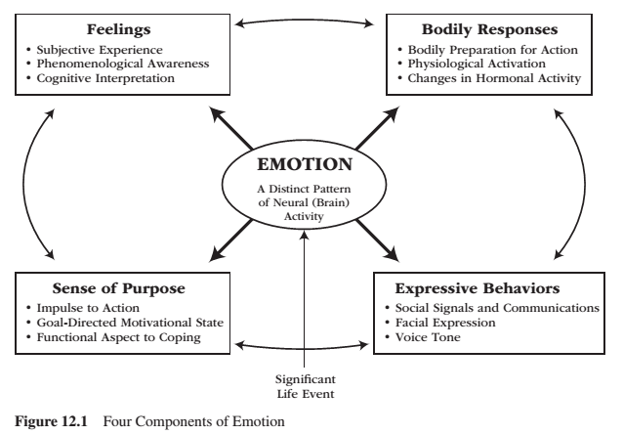
What is an Emotion?

Slide 6
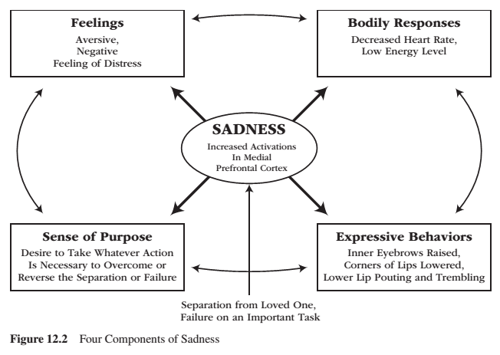
What is an Emotion? – Example Sadness

Slide 7
Learning Check
Please use a different example to reproduce the Four Components of Emotion Model.
Please pick one of the following emotions: fear, anger, disgust, joy.
Go to page 321 for facial expressions.
Fear: page 341
Anger: page 342
Disgust: page 343
Joy: 346

Slide 8
Emotions and Motivation
Emotions relate to motivation in two ways:
1 – Emotions are one type of motivation. Like all other motives, they energize, direct, and sustain behaviour.
Researchers generally agree that emotions function as a type of motive
Some researchers suggest emotions constitute the primary motivational system
2 – Emotions serve as an ongoing ‘readout’ system to indicate how well or how poorly personal adaptation is going.
Positive emotions signal that all is well and reflect the involvement and successful satisfaction of our needs and goals
Negative emotions act as a warning signal that all is not well and reflect the neglect and frustrated thwarting of our needs and goals.

Slide 9
What Causes an Emotion?
When we encounter a significant life event, an emotion arises.
Two systems: Cognitive vs Biological

Slide 10
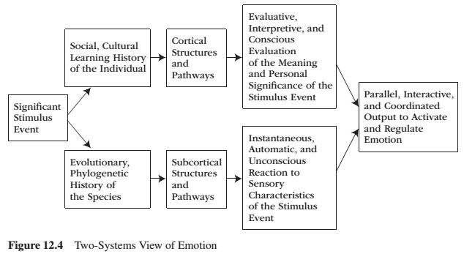
What Causes an Emotion? Two Interactive Systems View

Slide 11
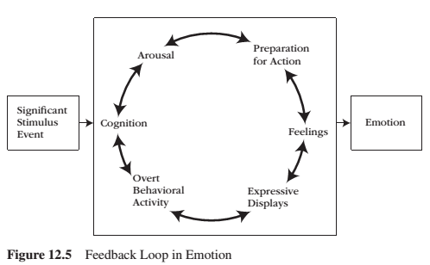
What Causes an Emotion? Feedback Loop
Emotion is a process, a chain of events that aggregate into a complex feedback system. To influence emotion, one can intervene at any point in the feedback loop.

Slide 12
Emotions Begin and End
Emotions arise as reactions to significant life events and to the biological and cognitive processes that these events set in motion.
Emotions end for two reasons:
1 – Emotions end upon the removal of the significant life event.
2 – Emotions generate coping behaviours, and these coping behaviours are often successful in managing and altering the significant life event.

Slide 13
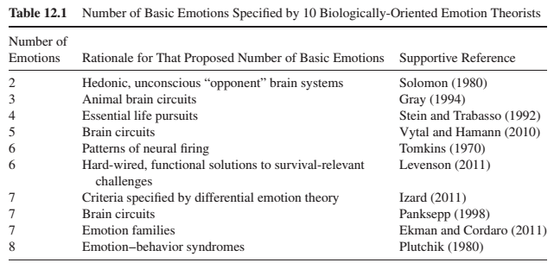
How Many Emotions Are There?
Biological perspective:
Lower limit of two
Upper limit of eight
Each proposal is based on a different emphasis

Slide 14
How Many Emotions Are There? Biological Perspective
Solomon – Two hedonic, unconscious brain systems that exist such that any pleasurable experience is automatically and reflexively opposed by a counter-aversion experience, just as any aversive experience is automatically and reflexively opposed by a counter-pleasurable process.
Gray – proposes three basic emotions based on the number of separate brain circuits he identified on an anatomical basis: behavioural approach system (joy), fight-or-flight (anger/fear), behavioural inhibition system (anxiety).
Stein & Trabasso – Four emotions that reflect reactions to life’s essential pursuits: attainment (happiness), loss (sadness), obstruction (anger), and uncertainty (fear).
Vytal & Hamann – Five emotions that produce distinct patterns of brain activity according to an analysis of 100 different studies: happiness, fear, sadness, anger, and disgust.
Tomkins – Six emotions based on six distinct patterns of neural firing: interest, fear, surprise, anger, distress, and joy.

Slide 15
How Many Emotions Are There? Biological Perspective
Levenson – Six basic emotions that are hard-wired and functional – they provide a general solution to a particular survival-relevant problem: enjoyment, anger, disgust, fear, surprise, and sadness.
Izard – Seven discrete emotions displayed by infants: interest, joy, sadness, anger, disgust, surprise, and fear.
Panksepp – Seven emotions based on findings of seven separate neuroanatomical, emotion generating pathways in the subcortical brain: seeking, fear, anger/rage, lust, care, sadness/grief, and play.
Ekman – Seven basic emotions that correspond with universal facial expressions: fear, anger, sadness, surprise, disgust, happiness, and contempt.
Plutchik – Eight emotions that corresponds to an emotion-behaviour syndrome common to all living organisms: anger, disgust, sadness, surprise, fear, acceptance, joy, and anticipation.
All these 10 biological research traditions agree that:
A small number of basic emotions exist
Basic emotions are universal to all human beings (and animals)
Basic emotions are products of biology and evolution

Slide 16
How Many Emotions Are There? Cognitive Perspective
Cognitive perspective:
There are more that that proposed by biological theories
Several emotions can arise from the same biological reaction
i.e. high blood pressure & appraisal for injustice = anger; high blood pressure & appraisal that one’s relationship is in peril = jealousy
Cognitive activity is a prerequisite to emotion and, because of this, there is an almost limitless number of emotions.
Emotions arise in response to the meaning structures of given situations; different emotions arise in response to different meaning structures

Slide 17
Reconciliation of the Numbers Issue
Two ways to reconcile the debate between cognitive and biology researchers regarding the number of emotions.
1 – Basic emotion is not a single emotion but a family of related emotions
2 – Distinguish first-order emotions and second-order emotions

Slide 18
Emotion Families
Each basic emotion is not a single emotion but a family of emotions.
Anger – ‘destroys obstacle’ family (hostility, rage, fury, annoyance, resentment, envy, outrage…)
Joy – ‘making progress on a goal’ family (satisfaction, relief, enthusiasm, contentment, pride…)
Emotions can be conceived at a general level or situation-specific level
Ekman et al. suggest that all basic emotions feature:
1 – Distinct facial expression 2 – Distinct pattern of physiology 3 – Automatic (unlearned) appraisal 4 – Distinct antecedent cause 5 – Inescapable (inevitable) activation 6 – Presence in other primates 7 – Rapid onset 8 – Brief duration 9 – Distinct subjective experience (feeling state) 10 – Distinct cognition (thoughts, images, memories)
Basic emotions that meet all the criteria above serve as the foundational starting point for the development of an emotion family: anger, fear, surprise, sadness, disgust, happiness, and contempt. Almost basic emotions are guilt, shame, embarrassment, interest, love, and hate.

Slide 19
Emotion Families
Explanation for why other emotions are not considered basic emotions:
1 – Many emotions are experienced-based derivatives of a basic emotion (e.g., anxiety is a derivative of fear). 2 – Many emotion terms actually better describe moods (e.g., irritation). 3 – Many emotion terms actually better describe attitudes (e.g., hatred). 4 – Many emotion terms actually better describe personality traits (e.g., hostile). 5 – Many emotion terms actually better describe disorders (e.g., depression). 6 – Some emotions are blends of basic emotions (e.g., romantic love blends interest, joy, and the sex drive). 7 – Many emotion terms refer to only one specific aspect of a basic emotion (e.g., what elicits the emotion [homesickness] or to how a person who experiences a basic emotion behaves [aggression]).

Slide 20
Basic Emotions and Emotion Schemas
Each basic emotion is identified by meeting the following seven criteria according to Izard’s Differential Emotions Theory:
1 – Is present at birth or emerges during infancy. 2 – Requires only simple or minimal cognitive processing for its activation. 3 – Is derived through evolutionary processes. 4 – Features a unique feeling state: its own unique subjective, phenomenological quality. 5 – Features a unique expression: its own unique facial-expressive signal. 6 – Features a unique function: It serves its own unique purpose. 7 – Features a unique motivational force important to survival and well-being.
Six basic emotions that fulfill each of the seven postulates are from differential emotions theory are: interest, joy, sadness, anger, disgust, and fear.
These basic emotions are developmental building blocks for the development of emotion schemas.

Slide 21
Emotion Schemas
Emotion schemas:
Develop out of a dynamic interplay among basic emotions, cognitive appraisals, and higher-order cognition.
After early development, emotion schemas function as the central source of human motivation.
Are developed from experiences, appraisals, memories, past learning experiences, thoughts, images and information processing.
Emotions are differentiated and complex – as the person develops dozens of emotion schemas, as content becomes more and more central to the emotion while the basic feelings-purpose-bodily preparation-expressive behavioural core becomes less central.
Izard suggests that infants are born with first-order emotions and eventually develop second-order emotion schemas. Adults are suggested to possess no first-order emotions.

Slide 22
Learning Check
What is an emotion? Define an emotion. How does Carroll Izard define an emotion?
What are the four components of emotion – figure 12.1? How do these components interact with each other?
What is the relation between an emotion and motivation?
What causes an emotion?
What is the Two-Systems View of emotions?
What is the Two-Systems View according to Levenson?
Please describe Plutchik’s Feedback Loop in Emotion.
What begins and ends an emotion?
How many emotions are there? Please describe an overview of the biological and cognitive perspectives.
How are biological and cognitive views reconciled regarding how many emotions we have?
Are emotions good and/or bad? Why? What are emotions for? What do emotions do? Why do we have emotions?
Describe coping functions of emotions. Describe social functions of emotions.
How can we control our emotions? What are emotional regulation strategies? What is the difference between an emotion and a mood? What is positive and negative affect?
What are benefits of feeling good?

Slide 23
Thank you!
Questions? Concerns?

Slide 24
Bibliography
The information obtained to create this PowerPoint slide was obtained from:
Reeve, J. (2018) Understanding Motivation and Emotion, 7th ed. John Wiley and Sons

