Slide 1
Motivation and Emotion in Daily Life
Nature of emotions
April 3th, 2019
Erik Chevrier

Slide 2
Discussion
When was the last time you had to regulate your emotions? Please describe the emotion via the Four Components of Emotion Model. What strategies did you use to regulate your emotion?

Slide 3
REVIE What is an Emotion?

Slide 4
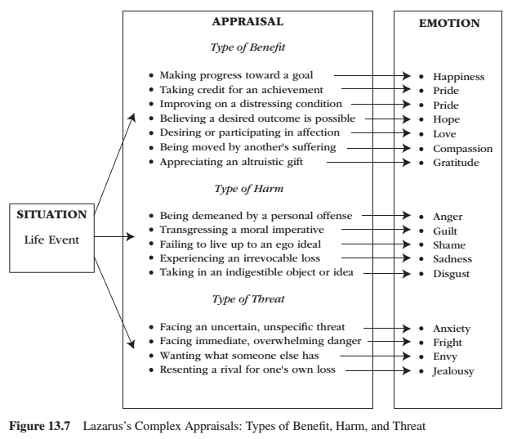
CHAPTER 13 – Complex Appraisal
Lazarus – emphasized the cognitive processes that intervene between important life events (environmental conditions) and physiological and behavioural reactivity.
People evaluate whether the situation has personal relevance for their well-being.
Good appraisals – several types of benefit Bad appraisals – several types of harm and threat

Slide 5
Facial Expressions

Slide 6
Six Perennial Questions
1 – What is an emotion?
2 – What causes an emotion?
3 – How many emotions are there?
4 – What good are emotions?
5 – Can we control our emotions?
6 – What is the difference between a mood and an emotion?

Slide 7
What is an Emotion?
Emotions are:
Multidimensional
Biological
Subjective
Purposive
Expressive
Arise as a response to significant events in our lives
Distinct patterns of neural activity
Emotions are short-lived, feeling-purposive-expressive bodily responses that help us adapt to the opportunities and challenges we face during important life events.
Thus, a significant life event occurs and produces a distinct pattern of neural activity that, in turn, generates and coordinates the emotional reaction that is a feeling-purposive-expressive-bodily reaction to the life event.

Slide 8
What is an Emotion?
Carroll Izard (2010) asked 34 leading emotion researchers to define the term emotion; he pulled together their replies into the following description.
Emotion consists of neural circuits (that are at least partially dedicated), response systems, and a feeling state/process that motivates and organizes cognition and action. Emotion also provides information to the person experiencing it, and may include antecedent cognitive appraisals and ongoing cognition including an interpretation of its feeling state, expressions, or social-communicative signals, and may motivate approach or avoidant behavior, exercise control/regulation of responses, and be social or relational in nature.

Slide 9
REVIE What is an Emotion?

Slide 10
REVIEW – What is an Emotion? – Example Sadness

Slide 11
REVIEW – Learning Check
Please use a different example to reproduce the Four Components of Emotion Model.
Please pick one of the following emotions: fear, anger, disgust, joy.
Go to page 321 for facial expressions.
Fear: page 341
Anger: page 342
Disgust: page 343
Joy: 346

Slide 12
Emotions and Motivation
Emotions relate to motivation in two ways:
1 – Emotions are one type of motivation. Like all other motives, they energize, direct, and sustain behaviour.
Researchers generally agree that emotions function as a type of motive
Some researchers suggest emotions constitute the primary motivational system
2 – Emotions serve as an ongoing ‘readout’ system to indicate how well or how poorly personal adaptation is going.
Positive emotions signal that all is well and reflect the involvement and successful satisfaction of our needs and goals
Negative emotions act as a warning signal that all is not well and reflect the neglect and frustrated thwarting of our needs and goals.

Slide 13
What Causes an Emotion?
When we encounter a significant life event, an emotion arises.
Two systems: Cognitive vs Biological

Slide 14
What Causes an Emotion? Two Interactive Systems View

Slide 15
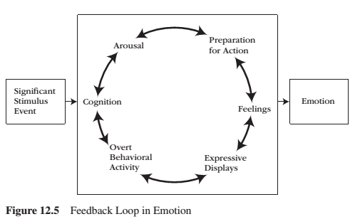
What Causes an Emotion? Feedback Loop
Emotion is a process, a chain of events that aggregate into a complex feedback system. To influence emotion, one can intervene at any point in the feedback loop.

Slide 16
Emotions Begin and End
Emotions arise as reactions to significant life events and to the biological and cognitive processes that these events set in motion.
Emotions end for two reasons:
1 – Emotions end upon the removal of the significant life event.
2 – Emotions generate coping behaviours, and these coping behaviours are often successful in managing and altering the significant life event.

Slide 17
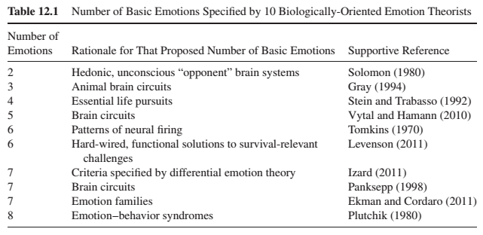
How Many Emotions Are There?
Biological perspective:
Lower limit of two
Upper limit of eight
Each proposal is based on a different emphasis

Slide 18
How Many Emotions Are There? Biological Perspective
Solomon – Two hedonic, unconscious brain systems that exist such that any pleasurable experience is automatically and reflexively opposed by a counter-aversion experience, just as any aversive experience is automatically and reflexively opposed by a counter-pleasurable process.
Gray – proposes three basic emotions based on the number of separate brain circuits he identified on an anatomical basis: behavioural approach system (joy), fight-or-flight (anger/fear), behavioural inhibition system (anxiety).
Stein & Trabasso – Four emotions that reflect reactions to life’s essential pursuits: attainment (happiness), loss (sadness), obstruction (anger), and uncertainty (fear).
Vytal & Hamann – Five emotions that produce distinct patterns of brain activity according to an analysis of 100 different studies: happiness, fear, sadness, anger, and disgust.
Tomkins – Six emotions based on six distinct patterns of neural firing: interest, fear, surprise, anger, distress, and joy.

Slide 19
How Many Emotions Are There? Biological Perspective
Levenson – Six basic emotions that are hard-wired and functional – they provide a general solution to a particular survival-relevant problem: enjoyment, anger, disgust, fear, surprise, and sadness.
Izard – Seven discrete emotions displayed by infants: interest, joy, sadness, anger, disgust, surprise, and fear.
Panksepp – Seven emotions based on findings of seven separate neuroanatomical, emotion generating pathways in the subcortical brain: seeking, fear, anger/rage, lust, care, sadness/grief, and play.
Ekman – Seven basic emotions that correspond with universal facial expressions: fear, anger, sadness, surprise, disgust, happiness, and contempt.
Plutchik – Eight emotions that corresponds to an emotion-behaviour syndrome common to all living organisms: anger, disgust, sadness, surprise, fear, acceptance, joy, and anticipation.
All these 10 biological research traditions agree that:
A small number of basic emotions exist
Basic emotions are universal to all human beings (and animals)
Basic emotions are products of biology and evolution

Slide 20
How Many Emotions Are There? Cognitive Perspective
Cognitive perspective:
There are more that that proposed by biological theories
Several emotions can arise from the same biological reaction
i.e. high blood pressure & appraisal for injustice = anger; high blood pressure & appraisal that one’s relationship is in peril = jealousy
Cognitive activity is a prerequisite to emotion and, because of this, there is an almost limitless number of emotions.
Emotions arise in response to the meaning structures of given situations; different emotions arise in response to different meaning structures

Slide 21
Reconciliation of the Numbers Issue
Two ways to reconcile the debate between cognitive and biology researchers regarding the number of emotions.
1 – Basic emotion is not a single emotion but a family of related emotions
2 – Distinguish first-order emotions and second-order emotions

Slide 22
Emotion Families
Each basic emotion is not a single emotion but a family of emotions.
Anger – ‘destroys obstacle’ family (hostility, rage, fury, annoyance, resentment, envy, outrage…)
Joy – ‘making progress on a goal’ family (satisfaction, relief, enthusiasm, contentment, pride…)
Emotions can be conceived at a general level or situation-specific level
Ekman et al. suggest that all basic emotions feature:
1 – Distinct facial expression 2 – Distinct pattern of physiology 3 – Automatic (unlearned) appraisal 4 – Distinct antecedent cause 5 – Inescapable (inevitable) activation 6 – Presence in other primates 7 – Rapid onset 8 – Brief duration 9 – Distinct subjective experience (feeling state) 10 – Distinct cognition (thoughts, images, memories)
Basic emotions that meet all the criteria above serve as the foundational starting point for the development of an emotion family: anger, fear, surprise, sadness, disgust, happiness, and contempt. Almost basic emotions are guilt, shame, embarrassment, interest, love, and hate.

Slide 23
Emotion Families
Explanation for why other emotions are not considered basic emotions:
1 – Many emotions are experienced-based derivatives of a basic emotion (e.g., anxiety is a derivative of fear). 2 – Many emotion terms actually better describe moods (e.g., irritation). 3 – Many emotion terms actually better describe attitudes (e.g., hatred). 4 – Many emotion terms actually better describe personality traits (e.g., hostile). 5 – Many emotion terms actually better describe disorders (e.g., depression). 6 – Some emotions are blends of basic emotions (e.g., romantic love blends interest, joy, and the sex drive). 7 – Many emotion terms refer to only one specific aspect of a basic emotion (e.g., what elicits the emotion [homesickness] or to how a person who experiences a basic emotion behaves [aggression]).

Slide 24
Basic Emotions and Emotion Schemas
Each basic emotion is identified by meeting the following seven criteria according to Izard’s Differential Emotions Theory:
1 – Is present at birth or emerges during infancy. 2 – Requires only simple or minimal cognitive processing for its activation. 3 – Is derived through evolutionary processes. 4 – Features a unique feeling state: its own unique subjective, phenomenological quality. 5 – Features a unique expression: its own unique facial-expressive signal. 6 – Features a unique function: It serves its own unique purpose. 7 – Features a unique motivational force important to survival and well-being.
Six basic emotions that fulfill each of the seven postulates are from differential emotions theory are: interest, joy, sadness, anger, disgust, and fear.
These basic emotions are developmental building blocks for the development of emotion schemas.

Slide 25
Emotion Schemas
Emotion schemas:
Develop out of a dynamic interplay among basic emotions, cognitive appraisals, and higher-order cognition.
After early development, emotion schemas function as the central source of human motivation.
Are developed from experiences, appraisals, memories, past learning experiences, thoughts, images and information processing.
Emotions are differentiated and complex – as the person develops dozens of emotion schemas, as content becomes more and more central to the emotion while the basic feelings-purpose-bodily preparation-expressive behavioural core becomes less central.
Izard suggests that infants are born with first-order emotions and eventually develop second-order emotion schemas. Adults are suggested to possess no first-order emotions.

Slide 26
What are the Good Emotions?
There is no such thing as a bad emotion, all emotions are beneficial because they direct attention and channel behaviour to where it is needed, given the circumstances one faces.
Darwin – Emotions help animals adapt to their surroundings. Displays of emotion help adaptation much in the same way that displays of physical characteristics do. Such expressiveness is functional, and emotions are therefore candidates for natural selection.
Coping Function:
Emotions evolved because they helped animals deal with fundamental life tasks.
Emotions facilitates adaptation to changing physical and social environments.
Emotions prioritize a way of acting over other ways of acting.
Emotions during a life task energizes and directs behaviour in adaptive ways.
Emotional behaviour provide animals with an ingrained and automated ways for coping with major challenges and threats to their welfare.
Emotions are positive, functional, purposive, and adaptive organizers of behaviour.

Slide 27
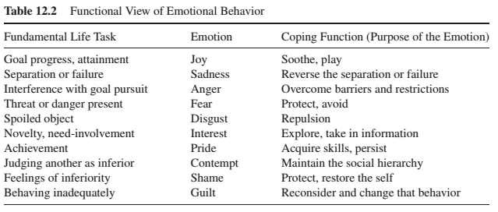
Coping Functions
These are flexible and not rigid categories.
Emotions serve at least 10 distinct purposes.

Slide 28
What event caused you to feel each emotion? How did you cope with the event?
Emotions serve at least 10 distinct purposes.

Slide 29
Social Function
Emotions serve social functions.
1 – Communicate our feelings to others. 2 – Influence how others interact with us. 3 – Invite, smooth, and facilitate social interaction. 4 – Create, maintain, and dissolve relationships.
Emotional expressions are potent, nonverbal messages that communicate our feelings to others. Infants communicate non-verbally:
At birth – joy, interest, and disgust
2 months – sadness and anger
6 months – fear
Infant facial expressions therefore guide caretakers’ emotion-specific care.

Slide 30
Social Function
Emotions serve multiple social functions:
Informative = this is how I feel
Forewarning = this is what I’m about to do
Directive = this is what I want to do
In this way, emotional expressions communicate social incentives (joy, smile), social deterrents (angry face), unspoken messages (embarrassed face), that smooth and coordinate social interactions.
Emotional expressions of interest and joy bring people together and encourage interaction, emotional expressions of anger, disgust, and fear push people apart.
Contempt is a toxic emotion that dissolves relationships.
Anger, disgust, fear and contempt can also prevent relationships from forming in the first place.

Slide 31
Why We have Emotions
Emotions exist as solutions to challenges, stresses and problems experienced in life.
By coordinating and orchestrating feelings, arousal, purpose and expression, emotions:
Equip us with specific, efficient responses that are tailored to problems of physical and social survival.
Establish our position vis-à-vis our environment
Some researchers believe that:
Emotions serve no useful purpose in modern times – emotions disrupt ongoing activity, disorganize behaviour, rob us of rationality and logic.
Others believe that:
Emotions prioritize behaviour in ways that optimize adjustment to the demands we face.
Both views are correct – emotions are both functional and dysfunctional. Emotions can be situationally appropriate and situationally inappropriate.
For emotions to be adaptive across many different situations, they need to be regulated and controlled. We need to regulate our emotions and NOT be regulated by our emotions.

Slide 32
Can we Control Our Emotions?
Emotional regulation:
Refers to how we try to influence which emotions we have, when we have them, and how we experience and express the emotions we have.
Refers to what part of the emotion we try to gain control over – our feelings, our bodily responses, our motivational urge, and our expressive displays.
Involves efforts to change an emotion’s latency, magnitude, and duration.
Emotions hurt us (socially) when they are situationally inappropriate, when they come at the wrong time, or when they occur at the wrong level of intensity.
Emotions are often automatic reactions but we can intervene within the flow of an emotional episode.

Slide 33
Flow of a Typical Emotion Episode and Five Opportunities to Regulate That Emotion

Slide 34
Flow of a Typical Emotion Episode and Five Opportunities to Regulate That Emotion
Situation selection – taking action to make one emotional experience more or less likely.
Situation modification – involves problem-focused coping efforts to establish primary control over a situation and search for social support. Sometimes situations are modified by simply leaving them.
Attentional Focus – does not change the situation but rather, redirects attention within that situation – distraction is a common strategy. Rumination can produce positive benefits when the significant life event is positive but can cause negative consequences when negative events occur.
Reappraisal – refers to changing the way an individual thinks about a potentially emotion-eliciting situation in order to modify its emotional impact. It involves changing the situation’s meaning. Can be used to down-regulate a negative emotion or up-regulate a positive emotion. It is an effective strategy.
Suppression – is used to modify an already occurring emotional experience including any or all of its components, feeling, bodily activation, sense of purpose and expressions. It is used to down-regulate one or more of these four aspects. It often backfires and also produces troubling social side effects. Suppression leads to social costs because we feel less comfortable with people who suppress emotions. Suppression is a blunt strategy, what works best in emotional regulation is a flexible, situation-specific, and situationally sensitive intervention effort.

Slide 35
Flow of a Typical Emotion Episode and Five Opportunities to Regulate That Emotion

Slide 36
Mood vs Emotion
What is the difference between a mood and emotion?
Emotions and moods arise from different antecedent causes. Emotions emerge from significant life situations and from appraisals of their significance to our well-being. Moods emerge from processes that are ill-defined and are oftentimes unknown.
Emotions and moods have different action-specificity. Emotions influence behaviour and direct specific courses of action. Moods influence cognition and direct what the person thinks about.
Emotions and moods have different time courses. Emotions emanate from short-lived events that last for seconds or minutes. Moods emanate from mental events that last for hours or perhaps days.

Slide 37
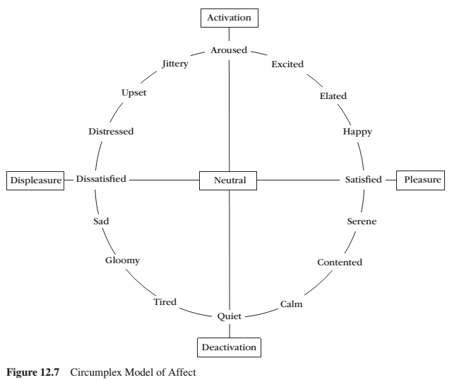
Circumplex Model of Affect
Valence – dimension of pleasure vs displeasure Arousal – activation vs deactivation

Slide 38
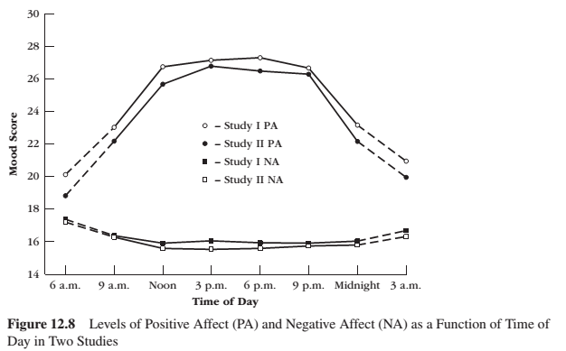
GRAPH FROM 6TH EDITION – Circumplex Model of Affect – Things to Keep in Mind
Positive and negative moods are independent, NOT OPPOSITE. They may occur simultaneously.
Positive affect reflects pleasurable engagement – a ‘go system’
Negative affect reflects unpleasant engagement – a ‘stop system’
Positive and negative affect pertain to cognitive , motivational, biological and behavioural systems – not just mood.

Slide 39
Positive & Negative Affect
Positive affect reflects:
Everyday, low-level, general state of feeling good
Reward-driven, appetitive motivational system
Approach behaviour
Dopaminergic pathways (that can be activated by expectation of positive outcomes)
Negative affect reflects:
Everyday, low-level, general state of feeling bad
Punishment-driven, aversive motivational system
Withdraw behaviour
Serotonergic and noradrenergic pathways (that can be activated by expectation of negative outcomes)

Slide 40
Positive Affect
Positive affect makes someone more likely to:
Help others
Act sociably
Express greater liking for others
Be more generous to others and to themselves
Take risks
Act more cooperatively and less aggressively
Solve problems in creative ways
Persist in the face of failure feedback
Make decisions more efficiently
Show greater intrinsic motivation on interesting activities
Orients people to remember positive events

Slide 41
Video
You aren’t at the mercy of your emotions – your brain creates them

Slide 42
Learning Check
What is an emotion? Define an emotion. How does Carroll Izard define an emotion?
What are the four components of emotion – figure 12.1? How do these components interact with each other?
What is the relation between an emotion and motivation?
What causes an emotion?
What is the Two-Systems View of emotions?
What is the Two-Systems View according to Levenson?
Please describe Plutchik’s Feedback Loop in Emotion.
What begins and ends an emotion?
How many emotions are there? Please describe an overview of the biological and cognitive perspectives.
How are biological and cognitive views reconciled regarding how many emotions we have?
Are emotions good and/or bad? Why? What are emotions for? What do emotions do? Why do we have emotions?
Describe coping functions of emotions. Describe social functions of emotions.
How can we control our emotions? What are emotional regulation strategies? What is the difference between an emotion and a mood? What is positive and negative affect?
What are benefits of feeling good?

Slide 43
Thank you!
Questions? Concerns?

Slide 44
Bibliography
The information obtained to create this PowerPoint slide was obtained from:
Reeve, J. (2018) Understanding Motivation and Emotion, 7th ed. John Wiley and Sons

