Slide 1
Media, Technology and Politics
Media effects
Erik Chevrier
April 5th, 2019

Slide 2
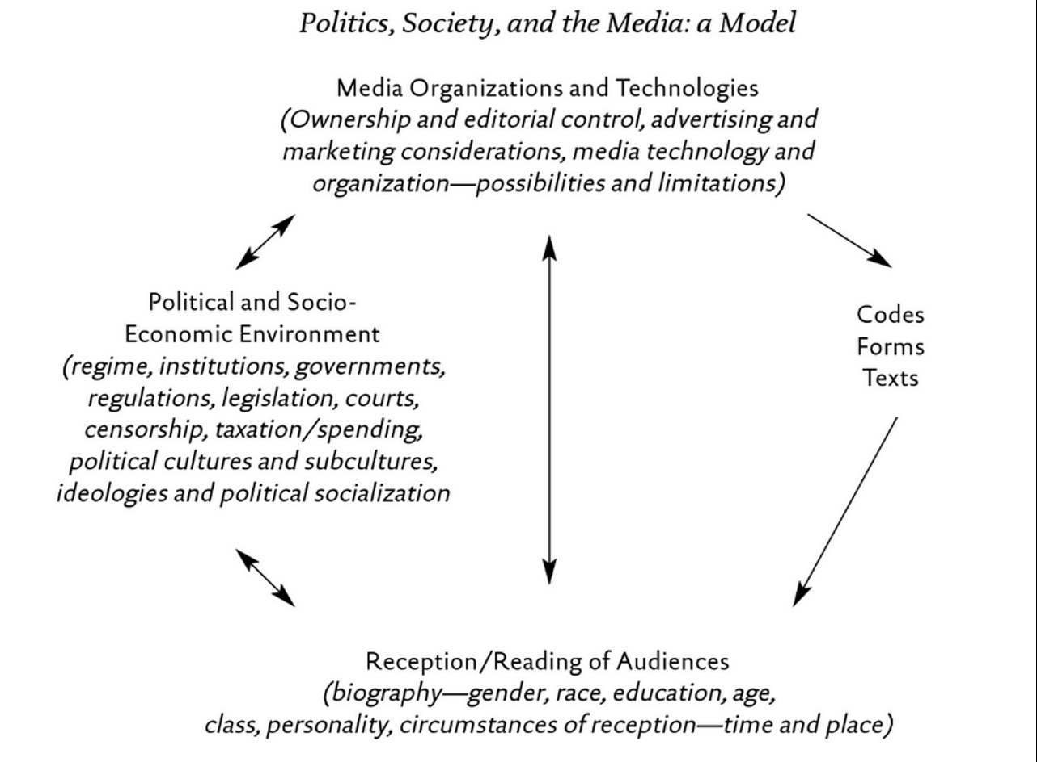
Media Effects
Media effects research usually describes the reception/reading of codes/forms/texts
Receivers are also affected by (and have an effect on)
  Media organizations and technology
  Political and socio-economic environment
Media Organizations and technologies are affected by (and have an effect on)
  Political and socio-economic environment
  Receivers (audiences)
  McLuhan – The Medium is the message
  Machines are an extension of our human experience and bodily sensations

Slide 3
How are you Affected by Media
General Examples
Very basic examples of how I can affect your emotional state via video
  Example 1
  Example 2
  Example 3
Small variations in media texts produce different interpretations
  Example
People are fallible
  Example
What do people learn from media?
  Example

Slide 4
Me-Media
Problems with studying media effects
    Media changes rapidly and suddenly
    Scholars are continuously trying to keep up with the rapidly changing media landscape
      Turns scholars into ‘storm chasers’

Slide 5
Media Effects – Me-Media
Democracy vs illusion of involvement
Democracy
  Todd Gitlin (1999) – “Because of technology, relentless horizontal momentum is irreversible. The vertical cannot hold…Roll over authorities – the culture of the next millennium is not going your way.”
  Francis Fukuyama – “hierarchies of all sorts, political and corporate, have come under pressure and begun to crumble”
  Esther Dyson – “the great virtue of the Internet is that it erodes power. It sucks power out of the center and takes it to the periphery: it erodes the power of institutions over people while giving to the individuals the power to run their own lives”.
  Manuel Castells – “ ‘network’ society had become so expansive, powerful, global, and instant that it had the capacity to overwhelm and sideline the nation state”
  Manuel Castells – Later admits that media conglomerates dominate many areas of these networks and nation states have a stubborn staying power, levers of control over the organization of daily life, and an emotional bond with their citizens that make them difficult to circumvent.

Slide 6
Media Effects - Me-Media
Democracy vs illusion of involvement
Illusion of involvement
Malcolm Gladwell – Social media “are effective at increasing participation – but lessening the level of motivation that participation requires”. “Little can be achieved without strong leaders, hard core political action and specific policy solutions”.
Manuel Castells – It is the looseness and diversity of these movements that allow these movements to create their own cyber-environment, a signature of their success.
Clay Shirky – The very virtues that can make online political engagement so effective – such as the ability to reach millions and stretch across the globe – can also be impediments to action.
  Cognitive surplus
Christopher Waddell on the 2011 Canadian Election – Social media did NOT figure predominantly into the Canadian election campaign or it’s outcome because: Limited number of people on social media, narrow range of issues highlighted, lack of impact on issues, not many uses for social media.
2012 USA presidential elections had 9% less voter turnout than the previous election
VOTE TOGETHER CAMPAIGN

Slide 7
Media Effects - Me-Media
Efficiency vs inefficiency
Efficiency
  Digital natives learn to multi-task, orient to networks and monitor their environments in ways that the pre-digital world is unable to match
Inefficiency
  People are less able to think deeply about a problem
  We are being rewired into shallow thinkers
  We do not fully engage with the communities we get involved with online
  Digital ADD

Slide 8
Media Effects - Me-Media
Identity
  Identity ghettos
  Self-confirming bias (confirmation bias)
  Selective exposure
  Search bias (algorithm based on previous searches)
  Echo chamber
  Greater number of choices leads to political polarization
  Self-performance and management of impressions
  Social capital ‘online friends’
  Feelings of missing out
  Sunstein – narrowing information happens in two ways:
  Loss of by-product learning
  Information ghettos expose people to limited information pool
  Markus Proir – People who are interested in politics tend to migrate from news program to news program regardless whether they are liberal or conservative.

Slide 9
Media Effects - Me-Media
Absence in presence – attention is elsewhere
Presence in absence – you can be there even if you are not physically present (telepresence)
  Erosion of time and space
Inequalities persist – Access problem, subscriptions, etc.
Dangers – Privacy, data, cyber-bullying, extreme content

Slide 10
Media Effects – Cable Explosion
Narrowcasting and fragmentation
Subscriptions (advertising and subscription costs)
Audience niche
Cable revolution weakened structures of Canadian television:
  Syphoning away money from advertisers
  Competition, reluctance to invest in high-quality productions
  Altered boundaries towards more sensational programming
  Offloading of politics to the back alleys of TV
  Canadian content cannot compete

Slide 11
Media Effects – Blogs
Journalism vs blogging
  Blogging not seen as a credible form of journalism
  Bloggers may be able to respond to a story more quickly
  Some journalists get information from blogs to begin a story
  Blogging may provide missing perspectives not covered by mainstream media
  Blogging is like journalism without a salary and organization to back you up with legal troubles
  Four categories of blogs
    Cyber-Celebrities
    Aggregator - centralizes a number of news and blog sites
    Celebrities themselves
    Ordinary people

Slide 12
Media Effects - YouTube
Largest online video archive
Greatest teaching tools
Attracting more and more advertising
National television are a large part of YouTube content
News moments
Amateur production
Mobilizing citizens – contagion effect
  Double edge sword – spying on activists

Slide 13
Media Fantasy Becomes Reality
Jean Baudrillard
  The media – especially when the content is fictional and fantastic – are more real than the world they proport to represent.
  The symbolic structure of the media is so powerful that the meaning is dissolved as mere content is relegated to the demands of form.
  Verisimilitude - They appear to be real.
Mark Poster
  Mediation is becoming so intense and worked over that ‘reality’ is consistently in question
Nesbitt-Larking
  Forms that blend reality:
    Infotainment
    Docudrama
    ‘Faction’ – blending fact from fiction
    Reality television
    News/entertainment spoof

Slide 14
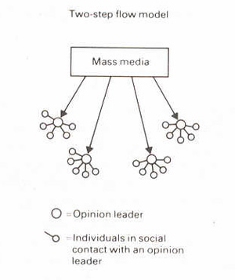
Looking at Nesbitt-Larking
Moral panic
Magic bullet/hypodermic
  War of the Worlds
  War of Worlds follow up
  Manufacturing Consent
  Colin Powell Speech about Weapons of Mass Destruction
  Leni Riefenstahl’s Triumph of Will – Nazi Propaganda Video
Limited effects/uses and gratifications
  Two-step communication flow/discursive elaboration
  Selective attention/cognitive beliefs/selective recall
Critical perspective
  Freedom within determining conditions
  Personality
    Polysemic
    Gendered reading formations
    Ontological
Engagement with Media

Slide 15
How to Propagate Effectively
The next section is an overview of leading theories regarding factors that help influence people.
If you will be involved in political campaigning or devising media strategy, you should utilize some of the following methods.
If you are not planning to be involved in political campaigning, you should be aware of the following social influence tactics used by media companies and politicians.

Slide 16
Discussion
How many of you believe that we need to do our best at protecting the environment so that future generations can inhabit the world?

Slide 17
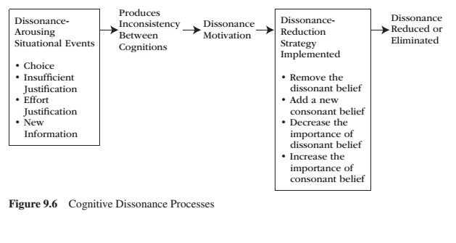
NOT COVERED FROM CHAPTER 9 –
Motivational Processes Underlying Dissonance

Slide 18
The Psychology of Influence
Robert Cialdini
Six weapons of influence
1 – Reciprocation
2 – Commitment and consistency
3 – Social proof
4 – Liking
5 – Authority
6 – Scarcity

Slide 19
The Power of Suggestion
An Inquiry Into How People Are Affected by Profuse Amounts of Publicity: A Multidisciplinary Approach
Advertising as a suggestion – Page 26
Suggestions can bypass critical thought because there is no direct request to refuse

Slide 20
Factors that Help Influence
Groupthink
  In group vs out group
  Conformity to group
  Social Roles – Stanford prison experiment
Physical Factors
  Appearance/attractiveness
  Likability
  Similarities
  Non-verbal communication
Emotional Appeal
  Fear
  Sadness
  Embarrassment
  Confidence
Savvy Media Consumer Appeal:
  Honest about media influence
Contagion:
  When large crowds form, people may behave in ways that is extreme and unlike their normal behaviour

Slide 21
Compliance
A change in behaviour in response to a direct request from another person
Door-in-the-face technique – A technique to get people to comply with a request whereby people are presented first with a large request, which they are expected to refuse, and then with a similar, more reasonable request, to which it is hoped they will accept
  Reciprocity norm – a social norm by which the receipt of something positive from another person requires you to reciprocate, ort behave similarly, in response
Foot-in-the door technique – A technique to get people to comply with a request, whereby people are presented first with a small request, to which they are expected to acquiesce, followed by a larger request, to which it is hoped they will also acquiesce.
  Change in self-perception – People are influenced by their behaviour and adopt values about ‘helping others’
Lowballing – An unscrupulous strategy whereby a salesperson induces a customer to agree to purchase a product at a very low cost, and then subsequently raises the price; frequently, the customer will still make the purchase at the inflated price.
  Illusion of irreversibility
  Anticipation of event
  Convenience of completing the transaction rather than starting over somewhere else
Improving the deal:
When a product is offered at a high price, then after a brief pause, another product is offered to the deal or the price is reduced

Slide 22
Conformity
A change in behaviour as a result of the real or imagined influence of other people
  Can override survival behaviours
  People are more influenceable than they believe
  Produces positive and negative consequences
Informational Social Influence – Conforming because we believe that others’ interpretation of an ambiguous situation is more correct than ours and will help us choose an appropriate course of action.
Normative Social Influence – The influence of other people that leads us to conform in order to be liked and accepted by them; this type of conformity results in public compliance with the group’s beliefs and behaviours but not necessarily in private acceptance. Conformity experiment
  Public Compliance – Conforming to other people’s behaviour publicly, without necessarily believing in what they are doing or saying.
  Private Acceptance – Conforming to other people’s behaviour out of a genuine belief that what they are doing or saying is right.

Slide 23
Automatic Thinking – Low Effort Thinking
Automatic thinking – Is thought that is generally unconscious, unintentional, involuntary, and effortless.
Schemas – Mental structures people use to organize their knowledge about the social world themselves and that influence the information people notice, think about, and remember.
  We tend to fill in the blanks with SCHEMA-CONSISTENT INFORMATION.
How People are Affected By Profuse Amounts of Publicity? – Advertising and Priming

Slide 24
Accessibility and Priming
Accessibility – The extent to which schemas and concepts are at the forefront of people’s minds and are, therefore, likely to be used when making judgments about the social world.
  Schemas can be accessible for three reasons:
    1 – Some schemas are chronically accessible because of past experience – these schemas are constantly active and ready to use to interpret ambiguous situations.
    2 – Schemas can be accessible because they are related to a current goal.
    3 – Schemas can become temporary accessible because of our recent experiences.
    Priming – The process by which recent experiences increase the accessibility of a schema, trait, or concept.
      Words have to be accessible and applicable to act as a prime.
      Schemas may be quite resistant to change
      Schemas are influenced by culture
    Perception Without Awareness (PWA) – Daren Brown – How to Control a Nation – Toy Story
    How to Control a Nation Full Video
    The Art of Misdirection
    Advertising makes consumption schemas continuously accessible. Advertising primes our consumer drives.

Slide 25
Learning Check
According to Taras, what are the new debates about media effects?
What does Taras suggest about scholarly debates regarding deepening democracy or creating an illusion of involvement? Please provide examples.
What does Taras suggest about new media making life more efficient vs more inefficient? Please provide examples.
What does Taras suggest about new media and identity?
According to Taras, Sunstein provides two ways that people are ‘narrowing information arteries’ and creating information bubbles. Please describe these ways. What are other points of view (in Taras) regarding self-restricting of information and creating online echo-chambers?
According to Taras, what is absence in presence and presence in absence? Please give examples of each.
According to Taras, what are some issues with new media? Dangers?
What does Taras suggest about the cable explosion? How has the cable revolution weakened structures of Canadian television?
According to Taras, what is a blog? What are four categories of bloggers? What is the relationship between blogging and journalism?
What does Taras suggest about YouTube and video politics?
What does Nesbitt-Larking suggest about the historical trends of media effects? Please provide examples.
What does Nesbitt-Larking suggest about the internet and media effects?
What does Nesbitt-Larking suggest about the blending of reality and media? Please provide examples – i.e. Beaudrillard, Poster, etc.
Nesbitt-Larking and Reiff defined a variety of media effects trends. Please describe the following effects: moral panic, magic bullet/hypodermic, limited effects/uses gratifications, critical perspective, engagement with media, two-step flow, discursive elaboration, and contingency effects.
What is cognitive dissonance? What factors arouse cognitive dissonance? What are ways to reduce dissonance? Why is this important to media and politics?
What are Cialdini’s six weapons of social influence? How can these weapons be used in media and politics? What other factors used to influence people?
What are compliance techniques? How are they used in politics and media? What are conformity techniques? How are they used in politics and media?
What is priming, schemas, and automatic thinking? How are they used in politics and media?

Slide 26
Questions?
Questions or concerns?
Have a great weekend!

