Slide 1
Motivation and Emotion in Daily Life
Aspects of Emotion
April 8th, 2019
Erik Chevrier

Slide 2
Cognitive Aspects of Emotion
Cognitive theorists of emotion:
Acknowledge the biological contribution to emotions.
Argue that emotion activation are both deeply immersed within cognitive activity.
View emotions as adaptive responses that reflect cognitive appraisals and cognitive mental representations that interpret environmental events as being significant to one’s well-being.
Tend to focus on complex emotions.

Slide 3
Appraisal
Appraisal:
The central construct in a cognitive understanding of emotion is appraisal.
Is a cognitive process that evaluates the significance of environmental events in terms of one’s well-being.
Well-being is driven by the individual’s goals, needs, values, beliefs, and attachments or personal relationships.
Affects each aspect of an emotional episode – feeling, purpose, expressive signals, bodily reactions.
Change over time.
Appraisals change:
As the person’s perception of the environment changes.
As the person’s perception of the person-environment interaction changes.
As appraisals change, so do the person’s feelings, bodily reactions, expressive signals, coping behaviour, and sense of purpose (action).
Changed emotional reactions typically produce changes in the environment and changes in the person-environment interaction.
Appraisal theorists believe that appraisals causes emotions because appraisals cause changes in each aspect of an emotion.

Slide 4
Appraisals
Four beliefs shared by all appraisal theorists:
Without an antecedent cognitive appraisal of the event, emotions do not occur.
The appraisal, not the event itself, causes the emotion.
Emotion is a process.
If the appraisal changes, even if the situation does not, then the emotion will change.

Slide 5
Arnold’s Appraisal Theory of Emotion
Addresses three questions:
How does the perception of an object or event produce a good or bad appraisal?
How does the appraisal generate emotion?
How does felt emotion express itself in action?

Slide 6
Arnold’s Appraisal Theory of Emotion
Come up with five significant life events and apply them to Arnold’s Appraisal Theory

Slide 7
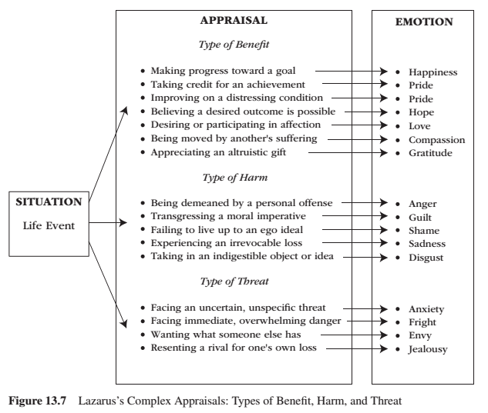
Complex Appraisal
Lazarus – emphasized the cognitive processes that intervene between important life events (environmental conditions) and physiological and behavioural reactivity.
People evaluate whether the situation has personal relevance for their well-being.
Good appraisals – several types of benefit Bad appraisals – several types of harm and threat

Slide 8
Complex Appraisal
Lazarus – appraisals take the form of the following questions:
Is this event relevant to my well-being? Is this event consistent with my goals? How deeply does this event touch my self-esteem?
These are appraisals of:
personal relevance
goal congruence
ego involvement
People appraise situations as particular kinds of harm, as particular kinds of threat, or as particular kinds of benefit
Changed appraisals lead to changed emotions.
People first (primary appraisal) appraise their relationship to the life event then they appraise their coping potential (secondary appraisal) within the life event

Slide 9
Primary Appraisal
Primary appraisal – involves an estimate of whether one has anything at stake in the encounter.
Health
Self-esteem
A goal
Financial state
Respect
The well-being of a loved one
From ordinary life event to a significant life event

Slide 10
Secondary Appraisal
Secondary appraisal – occurs after some reflection, involves the person’s assessment for coping with the possible benefit, harm, or threat.
Coping involves the person’s cognitive, emotional, and behavioural efforts to manage the benefit, harm, or threat.

Slide 11
Complex Appraisal
Lazarus:
portrays emotion as a motivational one. When personal motivations are at stake, emotions follow.
An individual’s personal motives (goals, well-being) lie at the core of the emotional process and the individual continually makes primary and secondary appraisals about the status of those personal motives as events unfold and coping efforts are implemented.
Emotion theory = Cognitive-Motivational-Relational
Cognitive – communicates the importance of appraisals
Motivational – communicates the importance of personal goals and well-being
Relational – communicates that emotions arise from one’s relation to environmental threats, harms benefits.

Slide 12
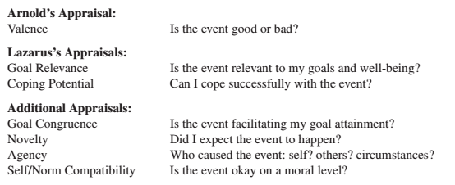
Appraisal as a Process
Each appraisal theorist agreed on this sequence:
life event – appraisal – emotion sequence
They disagree on how many dimensions of appraisal are necessary to explain emotional experience. Arnold explained two emotions, Lazarus explained 15 emotions, others seek to explain all emotions.

Slide 13
Appraisal as a Process
Goal congruence is an evaluation of whether the external event is working to facilitate (versus block, thwart) one’s progress toward goal attainment or motive satisfaction.
Novelty is detection of a change in the environment, and the detection of such a change recruits greater attention and information processing. The environment can change in different ways, including stimulus novelty (i.e., a new object appears in a familiar context) and contextual novelty (i.e., a familiar object appears in a new context).
Agency is an attribution of the cause of the event, because events can be caused by the self, by someone else, or by impersonal circumstances.
Self/Norm compatibility is an evaluation of how compatible versus incompatible (how acceptable versus unacceptable) the event is with one’s self-concept or personal standards.

Slide 14
Emotional Differentiation
Emotion differentiation is:
The phenomenon in which people experience different emotions for the same event.
How the same person experiences different emotions for the same event at different times.
The number one contribution that appraisal theory makes to the study of emotion.
Can explain how different emotions emerge from the same event.
Occurs because different people appraise the same event differently and also because the same person appraises the same event differently at two different times.
Occurs even within a single emotional episode.

Slide 15
Emotional Differentiation
They find that when the person encounters an external event, that stimulus event is very quickly appraised for its novelty and goal relevance, based largely on its sensory information. These two appraisals begin about one-tenth of a second after stimulus exposure and they feed-forward this novelty and goal relevance evaluative information to other brain areas for further processing.
Brain structures such as the amygdala then orchestrate further appraisals and information processing as the stimulus event is appraised for goal congruence and agency. These appraisals occur about one-half of a second after stimulus exposure.
As the appraisal process continues, information processing expands from just sensory stimulus information to learned associations and eventually to the accessing of stored information such as self/norm compatibility and predictive forecasts of the future, as with coping potential. Because these later appraisals feed back to combine with the earlier appraisals, the emotion may change—may undergo emotion differentiation.
After several evaluative iterations and several seconds of time, the appraisal pattern begins to stabilize to the point that the person settles on what the stimulus event means for his or her goals and well-being.

Slide 16
Critiques
Five reasons explain why appraisals are not sufficient for emotion and, hence, why appraisal theory cannot explain emotional reactions with 100 percent accuracy.
1 – Processes other than appraisal contribute to emotion.
2 – Appraisals often function only to intensify (rather than cause) the emotion (e.g., low coping potential intensifies, but does not cause, anger).
3 – The patterns of appraisals for many emotions overlap (e.g., guilt and shame have similar patterns of appraisal).
4 – Developmental differences exist among people such that children experience only general emotions (e.g., joy), whereas socialized adults generally experience a richer variety of appraisal-specific emotions (e.g., pride, relief, gratitude).
5 – Emotion knowledge and causal attributions represent additional cognitive factors beyond appraisal that affect emotion.

Slide 17
Emotional Knowledge
Emotional Knowledge:
The number of emotions any one person can distinguish.
The ability to differentiate emotional experience into discrete categories and to differentiate one particular basic emotion into its various shades.
It refers to the level of complexity individuals rely on to identity, label, and mentally represent their emotional experience.
The depth, complexity, and sophistication of a person’s emotion knowledge is important because greater emotion knowledge leads to:
Greater psychological well-being.
Better emotion regulation strategies.
Decreases negative emotional variability.
People with sophisticated emotion knowledge know clearly what they are feeling, what did and what did not cause them to feel that way, and which behavior and which coping strategies will most effectively deal with the emotion-eliciting event at hand.

Slide 18
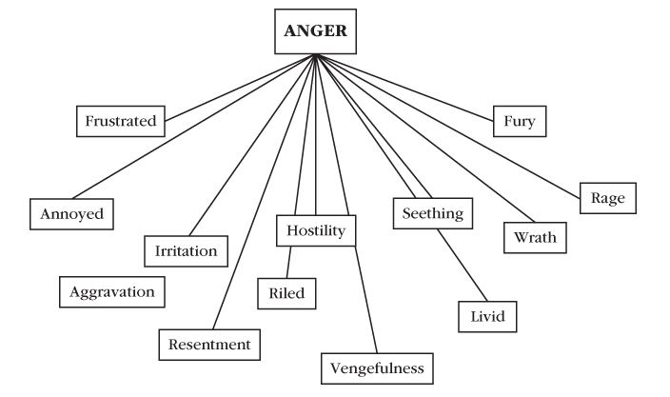
Shades of Anger Emotional Knowledge

Slide 19
Attributions
Attribution:
Is the causal explanation as to why an outcome occurred.
Weiner’s attribution theory of emotion is as follows:
Weiner adds one more appraisal to help explain emotion = post-outcome appraisal of why the outcome occurred.
Primary appraisals of an outcome makes up the outcome-dependent emotional reaction.
In addition, new emotions surface to differentiate the general emotion into secondary, more specific emotions.
For these secondary emotions, a secondary process occurs to further appraise the outcomes of these emotions.
If the attribution changes, the emotion also changes.

Slide 20
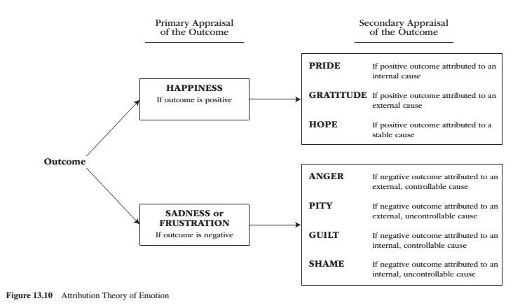
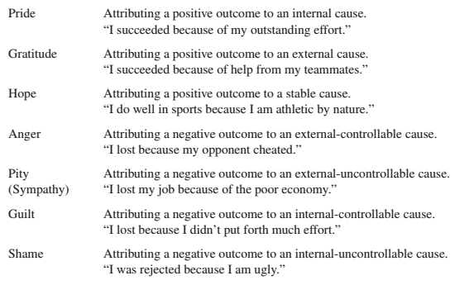
Attribution Theory of Emotion

Slide 21
Learning Check
What is an appraisal? What are 4 central beliefs shared by all appraisal theorists?
What is Arnold's Appraisal Theory of Emotion?
What is Lazarus’s Complex Appraisals: Type of Benefit, Harms and Threats Model (Figure 13.7)
What are primary appraisals? What are secondary appraisals? How do they affect emotion?
Please describe appraisals as processes?
Please compare and contrast Arnold’s, Lazarus’s appraisal theories and describe the four additional appraisals mentioned in the textbook.
What is emotional differentiation?
What is emotion knowledge?
What are attributions?
What is the attribution theory of emotions? (Figure 13.9)

Slide 22
Thank you!
Questions? Concerns?

Slide 23
Bibliography
The information obtained to create this PowerPoint slide was obtained from:
Reeve, J. (2018) Understanding Motivation and Emotion, 7th ed. John Wiley and Sons

