Slide 1
The Political Economy of Inequality
Erik Chevrier May 14, 2019 www.erikchevrier.ca

Slide 2
About Me
Erik Chevrier Website: www.erikchevrier.ca Office hours: By request (Tuesday & Thursday at 4PM by request) Office location: H-1125.12 E-Mail: professor@erikchevrier.ca Post-Capitalist Possibilities Website: Post-Capitalist Possibilities Research Project: Concordia Food Groups Research Project Facebook Group: Concordia Food Groups
Another project I started: Co-op Collective Vision

Slide 3
Readings
Osberg, L. (2018) The Age of Increasing Inequality – The Astonishing Rise of Canada’s 1%, James Lorimer and Company.
Boushey, H., Delong J. B., & Steinbaum M. (2017). After Piketty: The Agenda for Economics and Inequality, Harvard University Press.
Other required readings are listed in the reading schedule.

Slide 4
Assignments, Due Dates & Grades

Slide 5
Recommended Readings
If you do not have a background in Political Economy, you may want to read the following text to help familiarize yourself with the subject matter. Particularly the chapters provided below.
Stanford, J (2015) Economics for Everyone, A Short Guide to the Economics of Capitalism 2nd Edition, Pluto Press. Chapter 1 – The Economy and Economics Chapter 2 – Capitalism Chapter 3 – Economic History Chapter 4 – The Politics of Economics Chapter 14 – Inequality and its Consequences

Slide 6
Tentative Schedule
May 14 – Introduction Reading: Galbraith, J. K. (2004) The Economics of Innocent Fraud: Truth for Our Time, Houghton Mifflin Company.
May 16 – Social, Political and Economic Systems Readings: Please read at least two of the following chapters. Polanyi, K. (2001) The Great Transformation; The Political and Economic Origins of Our Time, Beacon Press. Chapter 4 – Societies and Economic Systems Chapter 5 – Evolution of the Market Pattern Chapter 6 – The Self-Regulating Market and the Fictitious Commodities: Land, Labour and Money.
May 21 –Capital, Value, Production and Reproduction Readings: Please read at least two of the following chapters. De Angelis, M. (2007) The Beginning of History, Value Struggles and Global Capital. Chapter 2 – Value Struggles Chapter 3 – Capital as a Social Force Chapter 4 – With No Limits Chapter 5 – Production and Reproduction
May 23 – Capital in the 21st Century Readings: Please read both chapters. Boushey, H., Delong J. B., & Steinbaum M. (2017). After Piketty: The Agenda for Economics and Inequality, Harvard University Press. Introduction – Capital in the Twenty First Century, Three Years Later. Chapter 22 – Towards a Reconciliation Between Economics and the Social Sciences, Lessons from Capital in the Twenty-First Century.
May 28 – Historical Origins of Global Inequality Readings: Please read both chapters. Boushey, H., Delong J. B., & Steinbaum M. (2017). After Piketty: The Agenda for Economics and Inequality, Harvard University Press. Chapter 11 – Global Inequality Chapter 20 – Historical Origins of Global Inequality Student-Led Seminar 1

Slide 7
Tentative Schedule
May 30 – Inequality in Canada Readings: Please read both chapters. The Age of Increasing Inequality – The Astonishing Rise of Canada’s 1%, Introduction & Chapter 1 Student-Led Seminar 2 Proposal Due
June 4 – Inequality in Canada Readings: Please read both chapters. The Age of Increasing Inequality – The Astonishing Rise of Canada’s 1% Chapter 2 & Chapter 3 Student-Led Seminar 3
June 6 – Inequality in Canada Readings: Please read both chapters. The Age of Increasing Inequality – The Astonishing Rise of Canada’s 1% Chapter 4 & Chapter 5 Student-Led Seminar 4
June 11 – Inequality in Canada Readings: Please read both chapters. The Age of Increasing Inequality – The Astonishing Rise of Canada’s 1% Chapter 6 & Chapter 7 Student-Led Seminar 5
June 13 – Inequality in Canada Reading: The Age of Increasing Inequality – The Astonishing Rise of Canada’s 1% Chapter 8 Student-Led Seminar 6 & 7
June 18 – How to Reduce/Eliminate Inequality Reading: The Age of Increasing Inequality – The Astonishing Rise of Canada’s 1% Chapter 9 Student-Led Seminar 8 & 9 & 10 Final Essay Due

Slide 8
Assignments
Reading Responses: Students will be expected to submit five, one-page (300-400 word) responses to one of the assigned readings (chapters) from May 14th – May 28th. Students will be evaluated based upon their ability to analyze the text critically. The best four readings responses will count for a score on five adding up to a total of twenty points. Students will be evaluated on how well you: a) identify the central claim or thesis of the text and articulate it in our own words; b) identify the supporting evidence for the claim and the key concepts introduced; and c) relate the text to other examples that support or contradict the central claim or thesis – this can come from other texts, documentaries, research or valid examples. Don’t base your claims on conjecture.
Summary of Inequality in Canada: Students will be expected to submit a two-page, (500 - 800 word) summary of the book ‘The Age of Increasing Inequality – The Astonishing Ride of Canada’s 1%. Students will be evaluated based upon their ability to analyze the text critically. Students will be evaluated on how well you: a) identify the central claim or thesis of the text and articulate it in our own words; b) identify the supporting evidence for the claim and the key concepts introduced; and c) relate the text to other examples that support or contradict the central claim or thesis – this can come from other texts, documentaries, research or valid examples. Don’t base your claims on conjecture. The essay is due on June 21st.
Student-led seminar: Beginning on May 30th students will lead a seminar in groups of two. Students will be evaluated on their ability to identify the central claim or thesis of the text and articulate it in our own words, synthesize the readings in a clear, informative manner, lead a discussion about the chapter and provide examples and/or case studies that support or contradict the arguments put forth in the chapter they are presenting. Students should also relate the material to the required and/or recommended readings.
Students will choose a chapter from ‘Boushey, H., Delong J. B., & Steinbaum M. (2017). After Piketty: The Agenda for Economics and Inequality, Harvard University Press’. Students may also choose from a list of books and articles that will be provided in class.
Participation: With regards to the participation grade, you will receive 5 out of 10 points for attending all the classes. The remainder of the grade is based on your involvement in discussion and participation in classroom activities.
Final Essay: Students will write an essay about a subtopic relating to the political economy of inequality. Students are expected to perform a literature review using at least ten sources, then write a report about their findings. Students will be evaluated based on their ability to identify current trends in the literature, the quality of the sources they incorporate, and the clarity and conciseness of the report. A more specific grading rubric will be distributed in class. The essay is due on June 18th.
Indigenous Perspectives about Inequality, LGBTQ Perspectives about Inequality, Degrowth Economics and Inequality, Global Migration and Inequality, Race and Inequality, Performativity, Economies and Inequality, Gendered Perspectives, about Inequality, Geography of Inequality, The Green New Deal, Colonial Perspectives about Inequality, Reformative and Transformative Solutions to Inequality, Micro/Macro Theories about Inequality, Redistribution and Inequality, Democracy and Inequality, Property, Rents, Expropriation and/or Inequality, Black Rights Movements and Inequality, Capitalism and Inequality, Inheritance and Inequality, Theory of Social Balance – J.K Galbraith… I am open to other ideas too. Please approach me if you prefer to write about another topic.

Slide 9
Assignment Submission Policies
Late assignment policy:
Unless you are given permission in advance, late assignments will not be accepted without adequate documentation of medical or personal emergencies.
Handing in Assignments:
All assignments MUST be submitted in hard copy at the beginning of class on the due date. Any assignment submitted electronically will be subject to a reduction of 25% of the value of the assignment.

Slide 10
University Policies
University Rights and Responsibilities
Academic Integrity: “The Academic Code of Conduct sets out for students, instructors and administrators both the process and the expectations involved when a charge of academic misconduct occurs. The regulations are presented within the context of an academic community which seeks to support student learning at Concordia University.” (From Article 1 of the Academic Code of Conduct). Full text:
http://www.concordia.ca/students/academic-integrity/offences.html
Plagiarism: The most common offense under the Academic Code of Conduct is plagiarism, which the Code defines as “the presentation of the work of another person as one’s own or without proper acknowledgement.” This includes material copied word for word from books, journals, Internet sites, professor’s course notes, etc. It refers to material that is paraphrased but closely resembles the original source. It also includes for example the work of a fellow student, an answer on a quiz, data for a lab report, a paper or assignment completed by another student. It might be a paper purchased from any source. Plagiarism does not refer to words alone –it can refer to copying images, graphs, tables and ideas. “Presentation” is not limited to written work. It includes oral presentations, computer assignment and artistic works. Finally, if you translate the work of another person into any other language and do not cite the source, this is also plagiarism. In Simple Words: Do not copy, paraphrase or translate anything from anywhere without saying where you obtained it! Source: Academic Integrity Website: http://concordia.ca/students/academic-integrity
Disabilities: The University’s commitment to providing equal educational opportunities to all students includes students with disabilities. To demonstrate full respect for the academic capacities and potential of students with disabilities, the University seeks to remove attitudinal and physical barriers that may hinder or prevent qualified students with disabilities from participating fully in University life. Please see the instructor during the first class if you feel you require assistance.
For more information please visit http://concordia.ca/offices/acsd

Slide 11
Classroom Conduct
Safe Space Classroom: Concordia classrooms are considered ‘safe space classrooms’. In order to create a climate for open and honest dialogue and to encourage the broadest range of viewpoints, it is important for class participants to treat each other with respect. Name-calling, accusations, verbal attacks, sarcasm, and other negative exchanges are counter-productive to successful teaching and learning. The purpose of class discussions is to generate greater understanding about different topics. The expression of the broadest range of ideas, including dissenting views, helps to accomplish this goal. However, in expressing viewpoints, students should try to raise questions and comments in ways that will promote learning, rather than defensiveness and feelings of conflict in other students. Thus, questions and comments should be asked or stated in such a way that will promote greater insight into the awareness of topics as opposed to anger and conflict. The purpose of dialogue and discussion is not to reach a consensus, nor to convince each other of different viewpoints. Rather, the purpose of dialogue in the classroom is to reach higher levels of learning by examining different viewpoints and opinions with respect and civility.

Slide 12
Introduction
What is your name?
What do you expect to get out of this course?
Why did you take this course?
What excites you about the assignments/readings?
What issues do you foresee with the assignments/readings?
What is your level of experience with topics related to ‘Political Economy of Inequality’?
With political economy? With studies in inequality? In economics? With math and statistics?
What is your interest level in topics related to ‘Political Economy of Inequality’?
What specific topics are you interested you most? What topics interest you least?
What are your outcome expectations?
Grades, learning, engagement, keeping up with the readings?

Slide 13
What Are your Beliefs about Equality/Equity?
Do you believe that people should be treated equally?
Can we completely eliminate inequality?
If so, how?
Are there acceptable degrees of inequality that could exist? If so, what are they?
What forms of inequality exist?
Political, social, economic?
What are forms of inequality in Canada? Globally?

Slide 14
Discussion
Erik Olin Wright ‘Radical Democratic Egalitarian view of Social Justice’
Social Justice: In a socially just society, all people would have broadly equal access to the necessary material and social means to live flourishing lives.
Political Justice: In a politically just society, all people would have broadly equal access to the necessary ,means to participate meaningfully in decisions about things which affect their lives. This includes both the freedom of individuals to make choices that affect their own lives as separate persons, and their capacity to participate in collective decisions which affect their lives as members of a broader community.
Equal access, necessary conditions for human flourishing, eliminate inequalities based on gender, race, physical disabilities, sexual preference, or other identity characteristics.

Slide 15
Discussion Questions
Should we set a maximum wage?
Should we tax people and/or businesses more according to how much they make (progressive taxation)?
Should governments spend money towards business externalities?
Should we limit or restrict inheritance?
Should there be limits to property ownership?
Have you heard of the Green New Deal? Are you in support of such an initiative in Canada?

Slide 16
Labour
Do you presently work?
What do you want to want to do as employment after you graduate from Concordia? Why?
What are the labour conditions that you expect from the job you want to obtain after you graduate?
What are the typical power structures in that labour environment?
What kinds of benefits do you expect?
What kinds of issues do you foresee?
What is important for you in seeking employment?

Slide 17
Discussion – What kind of a consumer are you? How do you acquire that you want and need?
Are you impulsive or plan purchases?
Are you a compulsive consumer?
Do you prioritize ethical products?
Do you self-produce anything?
Do you have an income source?
Do you shop more for necessity or pleasure?
Do you shop to change your moods?
Do you hold material items in high regards (are you materialistic)?
What do you spend your money on? Daily? Weekly? Monthly? Yearly? Future Plans?
Do you prioritize fair trade?
Do you use any alternative currencies?
Do you participate in barter networks?
Do you buy stuff on the illegal market?
Do you get state allocations?
Do you steal things?

Slide 18
What is Your Relationship to Wealth
Are you a business owner?
Do you hold stocks or investments?
RRSP? Pension Plan? Trust Fund?
Do you own your house/apartment?
Do you own equity of any sort?

Slide 19
Aristotle Aristotle. Aristotle in 23 Volumes, Vol. 21, translated by H. Rackham. Cambridge, MA, Harvard University Press; London, William Heinemann Ltd. 1944.
Chrematistics – art of acquisition – limitless accumulation unnatural and problematic
Oikonomia – management of the household – true form of an economy

Slide 20
Karl MarxMarx, K. Capital Volume 1, Penguin Classics.
C – C – Basic barter C – M – C – The way classical economists viewed basic barter with money M – C – M’ – What really happens when barter systems incorporate money – Limitless accumulation M – M’ – Usury capital system – Limitless accumulation

Slide 21
Karl PolanyiPolanyi, K. (2001) The Great Transformation; The Political and Economic Origins of Our Time, Beacon Press
Types of economic practices:
Markets (exchange)
Household economy
Redistribution
Reciprocity

Slide 22
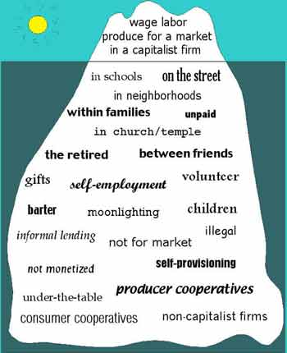
Gibson Graham – Take back the Economy Gibson-Graham, J.K., Cameron, J., Healy, S. (2013) Take Back the Economy: An Ethical Guide for Transforming Communities, University of Minnesota Press
Katherine Gibson Interview Playlist

Slide 23
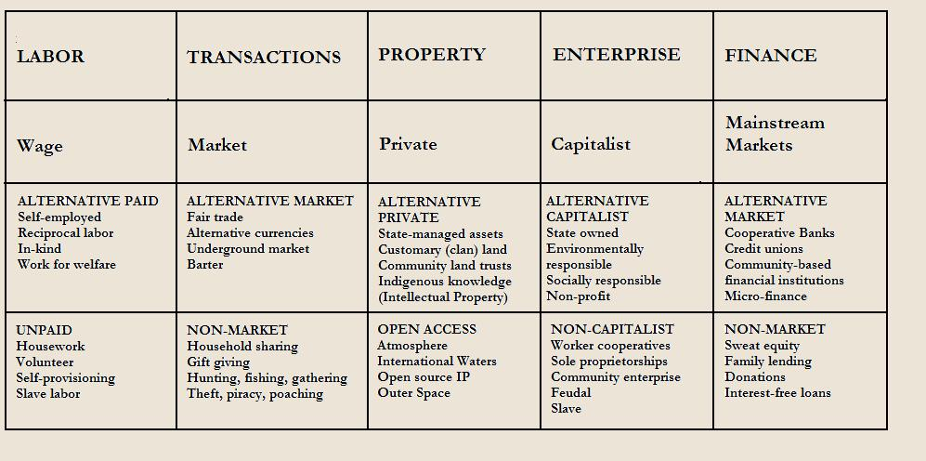
Gibson Graham – Take back the Economy Gibson-Graham, J.K., Cameron, J., Healy, S. (2013) Take Back the Economy: An Ethical Guide for Transforming Communities, University of Minnesota Press

Slide 24
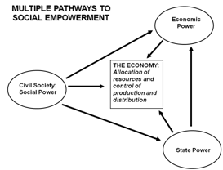
Envisioning Real Utopias – Erik Olin Wright Olin Wright, E. (2010) Envisioning Real Utopias, Verso

Slide 25
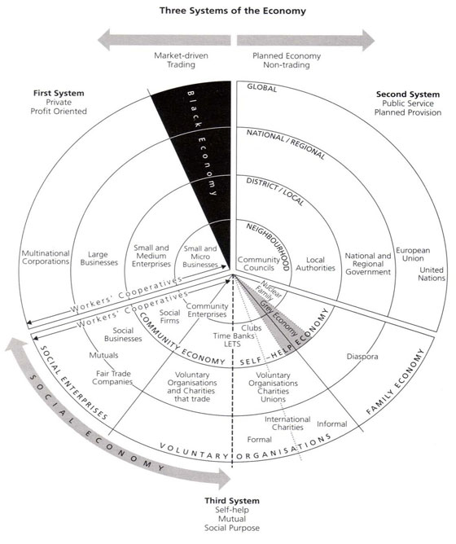
Three Systems of an Economy – John Pierce Pearce, J. (2009) Social Economy: Engaging as a Third System, In Amin, A. The Social Economy; International Perspectives on Economic Solidarity, p. 26.

Slide 26
Questions or Concerns?
Thanks!
Have a great day!

