Slide 1
The Political Economy of Inequality
Erik Chevrier
May 16th, 2019

Slide 2
REVIEW – What Are your Beliefs about Equality/Equity?
Do you believe that people should be treated equally?
Can we completely eliminate inequality?
If so, how?
Are there acceptable degrees of inequality that could exist? If so, what are they?
What forms of inequality exist?
Political, social, economic?
What are forms of inequality in Canada? Globally?

Slide 3
Discussion
Erik Olin Wright ‘Radical Democratic Egalitarian view of Social Justice’
Social Justice: In a socially just society, all people would have broadly equal access to the necessary material and social means to live flourishing lives.
Political Justice: In a politically just society, all people would have broadly equal access to the necessary ,means to participate meaningfully in decisions about things which affect their lives. This includes both the freedom of individuals to make choices that affect their own lives as separate persons, and their capacity to participate in collective decisions which affect their lives as members of a broader community.
Equal access, necessary conditions for human flourishing, eliminate inequalities based on gender, race, physical disabilities, sexual preference, or other identity characteristics.

Slide 4
Discussion Questions
Should we set a maximum wage?
Should we tax people and/or businesses more according to how much they make (progressive taxation)?
Should governments spend money towards business externalities?
Should we limit or restrict inheritance?
Should there be limits to property ownership?
Have you heard of the Green New Deal? Are you in support of such an initiative in Canada?

Slide 5
Labour
Do you presently work?
What do you want to do as employment after you graduate from Concordia? Why?
What are the labour conditions that you expect from the job you want to obtain after you graduate?
What are the typical power structures in that labour environment?
What kinds of benefits do you expect?
What kinds of issues do you foresee?
What is important for you in seeking employment?
What other kind of labour do you participate in (non-capitalist, or alternative)?
What other kinds of labour do you want to participate in?
Would you shift come of your labour to reproduce parts of yourself, family, or community?

Slide 6
Discussion – What kind of a consumer are you? How do you acquire that you want and need?
What do you spend your money on? Daily? Weekly? Monthly? Yearly? Future Plans?
Do you hold material items in high regards (are you materialistic)?
Are you impulsive or plan purchases?
Are you a compulsive consumer?
Do you prioritize ethical products?
Do you self-produce anything?
Do you shop more for necessity or pleasure?
Do you prioritize fair trade?
Do you use any alternative currencies?
Do you participate in barter networks?
Do you buy stuff on the illegal market(s)?
Do you steal (share) things?
Do you dumpster dive for food?
What other kinds of ways to you acquire goods and services?

Slide 7
What is your Ecological Footprint?
Measure your ecological footprint
How often do you eat meat?
What is your main source of transportation (public transit, car, etc.)?
Do you prioritize local production?
Do you live in an energy efficient house or apartment?
Do you travel by plane frequently?
Do you produce a lot of garbage?
Do you strive for a zero waste lifestyle?

Slide 8
What is Your Relationship to Wealth
Are you a business owner?
Do you hold stocks or investments?
RRSP? Pension Plan? Trust Fund?
Do you own your house/apartment?
Do you own equity of any sort?

Slide 9
Karl Polanyi Polanyi, K. (2001) The Great Transformation; The Political and Economic Origins of Our Time, Beacon Press
Types of economic practices:
Markets (exchange)
Household economy
Redistribution
Reciprocity

Slide 10
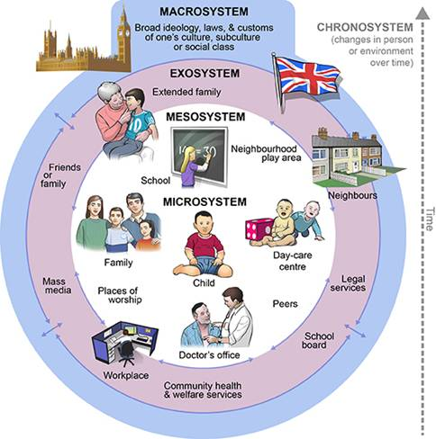
Ecological Systems Theory of Development

Slide 11
RECAP – Aristotle Aristotle. Aristotle in 23 Volumes, Vol. 21, translated by H. Rackham. Cambridge, MA, Harvard University Press; London, William Heinemann Ltd. 1944.
Chrematistics – art of acquisition – limitless accumulation unnatural and problematic
Oikonomia – management of the household – true form of an economy

Slide 12
RECAP – Karl Marx Marx, K. Capital Volume 1, Penguin Classics.
C – C – Basic barter C – M – C – The way classical economists viewed basic barter with money M – C – M’ – What really happens when barter systems incorporate money – Limitless accumulation M – M’ – Usury capital system – Limitless accumulation

Slide 13
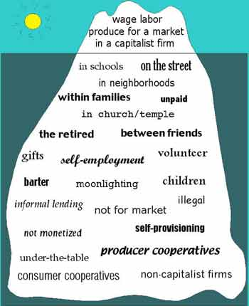
RECAP – Take back the Economy Gibson Graham Gibson-Graham, J.K., Cameron, J., Healy, S. (2013) Take Back the Economy: An Ethical Guide for Transforming Communities, University of Minnesota Press
Katherine Gibson Interview Playlist

Slide 14
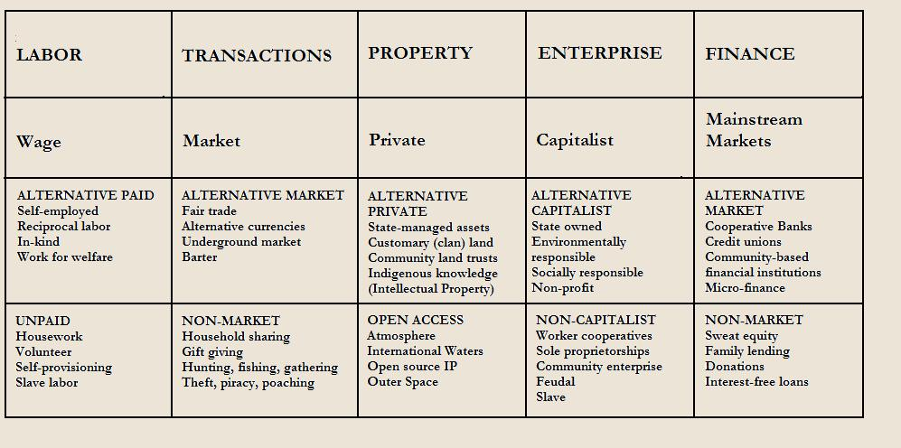
RECAP – Take back the Economy Gibson Graham Gibson-Graham, J.K., Cameron, J., Healy, S. (2013) Take Back the Economy: An Ethical Guide for Transforming Communities, University of Minnesota Press

Slide 15
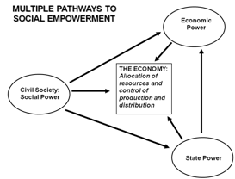
Envisioning Real Utopias Erik Olin Wright Olin Wright, E. (2010) Envisioning Real Utopias, Verso

Slide 16
An Economic Politics for Our Times
The Economy as a site of difference
Performing diverse economies
Genealogy of Diverse Economy Research
Katherine Gibson Interview
A Performative Ontological Politics
Expanding the Scope of Participatory Action Research
How does this apply to geography and urban planning?

Slide 17
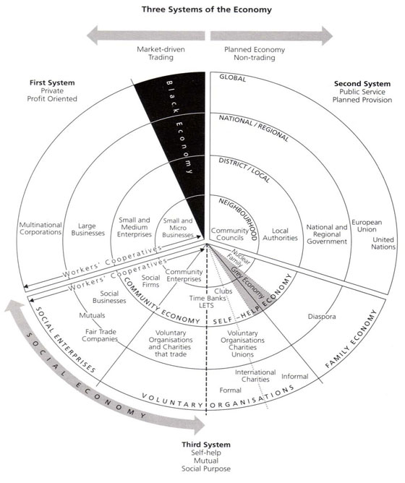
RECAP – Three Systems of an Economy – John Pierce Pearce, J. (2009) Social Economy: Engaging as a Third System, In Amin, A. The Social Economy; International Perspectives on Economic Solidarity, p. 26.

Slide 18
Importance of Action Based Research
Why are action based projects important?
It is important to challenge the problematic dominant epistemological understandings of food.
Instead we should produce ontological formations of the world we want by co-creating and co-recreating social relations that produce positive outcomes on people and the planet.
Action based learning theories incorporate students and facilitators as co-learners and co-collaborators. Together, they learn by doing. They also connect with the community.
Epistemology – A term meaning “theory of knowledge,” which gets at the how we know about the social world that lies behind all theoretical approaches. (Frampton, Kinsman, Thompson, Tileczek, (2006))
Ontology – Assumptions relating to how the social comes into being that inform all theories and ways of writing the social. (Frampton, Kinsman, Thompson, Tileczek, (2006))

Slide 19
Reading Discussion
What are Polanyi’s central arguments in each chapter? What evidence does Polanyi bring to support his claims?
What are types of economic activities and their accompanying institutional patters?
What does Polanyi suggest about the history of economic systems?
What does Polanyi suggest about the evolution of the market pattern?
What does Polanyi mean by suggesting ‘Instead of economy being imbedded in social relations, social relations are embedded in the economic system.’? (P. 60)
What does Polanyi suggest about the formations of the market system?
What does Polanyi suggest about mercantilism, local and distance trading?
What does Polanyi suggest about the formation of towns?
What does Polanyi suggest about fictitious commodities? What are the fictitious commodities? What does Polanyi consider these commodities fictitious? Why is this important?
What does Polanyi suggest about self-regulating markets and ‘state intervention’?

Slide 20
Questions or Concerns?
Thanks!
Have a great day!

