Slide 1
The Political Economy of Inequality
The Age of Increasing Inequality – The astonishing rise of the 1% in canada
Erik Chevrier
www.erikchevrier.ca

Slide 2
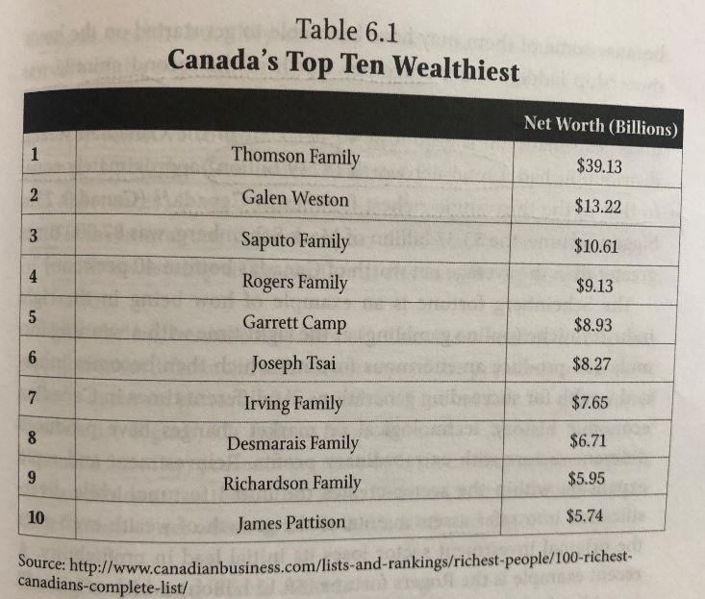
Top Wealth in Canada

Slide 3
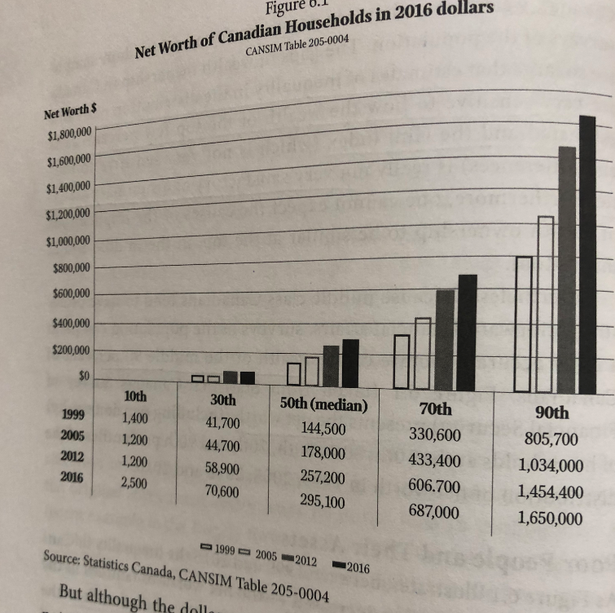
Top Wealth In Canada

Slide 4
Richest People in Canada
Richest 25 People in Canada
Richest Families in Canada
Newest Billionaires

Slide 5
Discussion – What kind of a consumer are you? How do you acquire that you want and need?
Are you impulsive or plan purchases?
Are you a compulsive consumer?
Do you prioritize ethical products?
Do you self-produce anything?
Do you have an income source?
Do you shop more for necessity or pleasure?
Do you shop to change your moods?
Do you hold material items in high regards (are you materialistic)?
What do you spend your money on? Daily? Weekly? Monthly? Yearly? Future Plans?
Do you prioritize fair trade?
Do you use any alternative currencies?
Do you participate in barter networks?
Do you buy stuff on the illegal market?
Do you get state allocations?
Do you steal things?

Slide 6
Discussion
Should we provide provisions to the bottom income earners – or people who are unemployed?
  If so, what form should this take?
  What kind of social services can be provided?
  What about basic income?
  If not, how come?

Slide 7
Discussion – What can we do to eliminate poverty?
Should we attempt any of the following experiments?
  Progressive taxes?
  Taxes on problematic commodities, like carbon?
  Universal basic income?
  Participatory budgeting?
  Prioritizing coops (workplace democracy)?
  Maximum wages?
  Guaranteed necessities?
  Increase social services, especially education?
  What else can you think of to reduce inequality?

Slide 8
Discussion
What kind of economic, political, social system would be ideal?
How can we get from our current situation to a more ideal system?
Discussion points:
  Replace capitalism?
  Reform capitalism?
  Embrace capitalism?
  Social reproduction
  Interstitial change
  Revolution
  Deepen democracy
  Capitalism will fail on its own - something will eventually replace it

Slide 9
Green New Deal
Green New Deal Video
Pact for a Green New Deal Canada

