Slide 1
Food and Sustainability
Erik Chevrier
June 26th, 2019

Slide 2
About Me
Erik Chevrier Website: www.erikchevrier.ca Office hours: By request (Mon & Wed 2:30 – 3:30PM) Office location: H-1125.12 E-Mail: professor@erikchevrier.ca Research Project: Concordia Food Groups Research Project Facebook Group: Concordia Food Groups Facebook Group for the Class: https://www.facebook.com/groups/foodandsustainability/
Other projects I started:
Co-op Collective Vision Post-Capitalist Possibilities

Slide 3
Food and Culture Write-Up
Is your diet sustainable? To redress the question, let’s instead ask, what types of consequences (positive/negative and intended/unintended) does your diet sustain? Digging deeper, we can ask: What were the labour conditions of the farmers that produced your food? What are the ingredients in your food item and how does that contribute to your health? What is the carbon footprint of your food item? What social inequalities are expressed via your food consumption? What do you want your body to look like and how does food contribute to that body type?
Food is more than just a biological need, it is also a way people interact with the biosphere, express culture and communicate about class/gender/race relations. Food is at the center of many serious social, political and economic issues. These issues include: starvation, obesity, eating disorders, malnutrition, climate change, pollution, biodiversity loss, inequality, colonization, and imperialism, among others.
In this course, students will read and discuss recent publications about food and sustainability and meet a variety of people in and around Concordia University that work with local food initiatives.
Students will focus on the political economy of food by examining how food is produced, transformed, distributed, consumed, and how food waste is managed in different areas of the world. They will take a critical perspective to analyze multinational food corporations, like Bayer, by looking at the consequences of large scale industrialized farming, monoculture, and the privatization of genetics. These consequences include, the use of GMOs and the loss of biodiversity; reliance on fossil fuels and its contribution to climate change; use of glyphosate and the accompanying health effects; seed patents and loss of food sovereignty; use of natural resources and the depletion of water and food supplies; among others.
Students will explore what people are doing to prevent these negative consequences. They will examine the food sovereignty movements, like the work done by La Via Campesina. Students will also look at sustainable production, like seed saving, indigenous practices, permaculture, rooftop gardening, and organic farming. Students will learn about alternative food networks that are developing socially responsible, environmentally sustainable, just, and secure food practices.
This course employs the theories and methodologies of sociology and anthropology. Political economy is a paradigm in the tradition of Karl Marx. It draws our attention to the power structure (political, economic, and social) that governs the society and the counter-movements that challenge the existing power structure. The social economy perspective in the tradition of Karl Polanyi will be used to imagine post-capitalist alternatives. The capitalist system has experienced many crises, and the current crisis, both ecological and economic, provides a great opportunity for the transition to global futures that are egalitarian, inclusive, democratic, and sustainable. This course also employs the tradition of critical self-knowledge and auto-ethnography. Students are asked to examine their personal involvement in industrial food systems and alternative food systems as individuals and a collective.
An important focus of this course is community engagement. Students will participate with local food projects in and around Concordia University. Students will perform an action-based research project by creating a new food organization, participating with and enhancing a current food project, and/or conducting research about university food systems. Students can even create content for the Concordia Student-Run Food Group Research project: www.concordiafoodgroups.ca

Slide 4
Class Rules
Course Materials and Text:
Students are expected to complete ALL the designated readings and watch ALL of the assigned videos BEFORE EACH CLASS. Students are also expected to attend ALL classes, and participate in class discussions.
The required readings are available at the Concordia Coop Bookstore (www.co-opbookstore.ca)
Barilla Center for Food and Nutrition, & Nierenberg, D., (2018) Nourished Planet: Sustainability in the Global Food System 3rd ed., Island Press.
Holt-Gimenez, E. (2017) A Foodie’s Guide to Capitalism: Understanding the Political Economy of What We Eat, Monthly Review Press, New York.
The power-point lecture notes will be posted on the course site before each class.
Recommended readings:
Oppenlander, R. (2013) Food Choices and Sustainability: Why Buying Local, Eating Less Meat, and Taking Baby Steps Won’t Work, Langdon Street Press.
Sumner, J. (2016) Learning, Food, and Sustainability: Sites for Resistance and Change, Palgrave MacMillan.
URLs and other electronic sources may be posted on the course website from time to time. Please visit the course website to get this material.

Slide 5
Course Format
This course consists of a variety of pedagogical styles including lectures, discussions, guest speakers, field trips, community service learning and/or experiential learning. Students are expected to read the required text before coming to class. In class, students engage with each other through interactive activities, discussions and by talking with people who work with food – production, transformation, distribution, and waste management. At times, the class participates in fieldtrips on and off campus. Students will be notified in advance by e-mail and in class prior to these events. Students also take turns preparing food items for the class so that we have snacks as we learn. Students work out a schedule in the first weeks of the course.

Slide 6
Course Evaluation
Assignments | Due Date | Grade Weight
Participation | Ongoing | 10
Action Research Project Proposal | Due July 10th | 15
Action Research Project | August 13th | 30
Food Blog 1 | July 24th | 15
Cooking Project | Report Due August 12th | 15
Reading Response | 4 Randomly Chosen Classes | (Best 3/4 = 5 Points Each) 15
 |  | Total 100%

Slide 7
Assignments
Participation: The participation grade is based on attendance, involvement in in discussions, participation in classroom activities and supplemental tasks (i.e. you will grow a plant from seed and will inform classmates about your experience with the plant). As an assignment, students will cook a meal to share with the class. Students can bring food on more than one occasion to improve their participation grade.
Action Research Project: The objective of this assignment is to give students hands on experience with transformative food movements. Students will perform an action-based research project by creating a food project and/or participating with an already existing community food initiative at Concordia University or in the community at large. Students may participate in a group project and submit the report as a group. Students will be evaluated based on the depth of their involvement with the project, clearly reporting the project, and an oral presentation of the project. Students are encouraged to contribute to the Concordia Food Groups Research Project (www.concordiafoodgroups.ca).
Action Research Project Proposal: Students will write a proposal for the action research project they want to partake in. Students may participate in a group project and submit the proposal as a group. Students must (1) identify a food group to participate with or a food project to create, (2) outline a specific timeline for the project, (3) summarize their role in the project, (4) describe how you intend to write their final report, (5) link the topic to class readings and other food issues.

Slide 8
Assignments
Blog Posts: Students will write a blog posts of about 600 words for the www.concordiafoodgroups.ca website. For the first blog post students can (1) attend a food related conference organized by a community group or participate in an ‘action’ related to food and/or sustainability and write about the conference/action, (2) interview a community group and make the findings available via www.concordiafoodgroups.ca (3) produce a brief research report (with five sources) about a food related topic that is approved by me (Erik Chevrier). Blog posts must critically analyze the topic in a clear, concise, informative, and interesting manner and should link the topic/conference/interview to the class readings. The blog must address an appropriate audience and make sure the information is conveyed to this audience based on their level of knowledge of the subject matter. Students with video production skills can produce a video instead of a blog, however this must also be approved by me (Erik Chevrier).
Cooking Project: Students must prepare at least one meal to bring and share with the class. Students will write a short blog of about 600 words about the practices, attitudes, and beliefs as well as the networks and institutions surrounding the production, distribution, and consumption of the food item they prepared. They will also include the recipe.
Reading Responses: Students will be asked four times (randomly), at the beginning of class, to summarize the chapter that was assigned for that class. The objective of this assignment is to make sure students are reading the required material. Students may use (only) hand written notes to help them write their summaries. Material written via computer will NOT be allowed. Students will also NOT be allowed to look at the readings. Three of the four best responses will be counted. The summaries should (1) identify the central claim(s) or thesis(es) of the text articulated in the student’s own words, (2) identify the supporting evidence for the claim(s) and the key concepts introduced, (3) relate the text to other examples that support or contradict the central claim or thesis.

Slide 9
Tentative Schedule and Readings
June 26th – Introduction to Food and Sustainability
July 3rd – Introduction to the Campus/Community Food Organizations in and around Concordia Barilla Center for Food and Nutrition, & Nierenberg, D., (2018) Nourished Planet: Sustainability in the Global Food System 3rd ed., Island Press. Chapter 1 – Food for All (pp. 1 – 35)
July 8th – Food, Sustainability and the Economy Barilla Center for Food and Nutrition, & Nierenberg, D., (2018) Nourished Planet: Sustainability in the Global Food System 3rd ed., Island Press. Chapter 2 – Food for Sustainable Growth (pp. 55 – 95)
July 10th – Food, Sustainability and Health ACTION RESEARCH PROPOSAL DUE Barilla Center for Food and Nutrition, & Nierenberg, D., (2018) Nourished Planet: Sustainability in the Global Food System 3rd ed., Island Press.
Chapter 3 – Food for Health (pp. 115 – 146)

Slide 10
Tentative Schedule and Readings
July 15th – Food, Sustainability and Culture Barilla Center for Food and Nutrition, & Nierenberg, D., (2018) Nourished Planet: Sustainability in the Global Food System 3rd ed., Island Press. Chapter 4 – Food for Culture (pp. 159 – 189)
July 17th –Food, Sustainability and Capitalism Holt-Gimenez, E. (2017) A Foodie’s Guide to Capitalism: Understanding the Political Economy of What We Eat, Monthly Review Press, New York. Introduction – Do Foodies Need to Understand Capitalism? (pp. 13 – 22)
July 22nd – History of Food and Sustainability Holt-Gimenez, E. (2017) A Foodie’s Guide to Capitalism: Understanding the Political Economy of What We Eat, Monthly Review Press, New York. Chapter 1 – How our Capitalist Food System Came to Be (pp. 23 – 56)
July 24th – Food Commodities FOOD BLOG DUE Holt-Gimenez, E. (2017) A Foodie’s Guide to Capitalism: Understanding the Political Economy of What We Eat, Monthly Review Press, New York. Chapter 2 – Food, A Special Commodity (pp. 57 – 82)

Slide 11
Tentative Schedule and Readings
July 29th – Food, Land and Property Holt-Gimenez, E. (2017) A Foodie’s Guide to Capitalism: Understanding the Political Economy of What We Eat, Monthly Review Press, New York. Chapter 3 – Land and Property (pp. 83 – 114)
July 31st – Food and Agriculture Holt-Gimenez, E. (2017) A Foodie’s Guide to Capitalism: Understanding the Political Economy of What We Eat, Monthly Review Press, New York. Chapter 4 – Capitalism, Food and Agriculture (pp. 115 – 142)
August 5th – Food, Race, Gender and Class Holt-Gimenez, E. (2017) A Foodie’s Guide to Capitalism: Understanding the Political Economy of What We Eat, Monthly Review Press, New York. Chapter 5 – Power and Privilege in the Food System: Gender, Race, Class (pp. 143 – 174)
August 7th – Alternative Food Networks Holt-Gimenez, E. (2017) A Foodie’s Guide to Capitalism: Understanding the Political Economy of What We Eat, Monthly Review Press, New York. Chapter 6 – Food, Capitalism, Crises and Solutions (pp. 175 – 212)
August 12th – Transformative Food Systems COOKING REPORT DUE Holt-Gimenez, E. (2017) A Foodie’s Guide to Capitalism: Understanding the Political Economy of What We Eat, Monthly Review Press, New York. Conclusion – Changing Everything: Food, Capitalism, and the Challenges of Our Time (pp. 213 – 240)
August 13th –Conclusion and Potluck ACTION RESEARCH PROJECT DUE

Slide 12
Introduction – Let’s Talk About Food
What is your name?
What’s your favorite food? Why?
What kind of food do you NOT like? Why not?
Do you have any food allergies?
Do you have any dietary needs (vegan, vegetarian etc.)?
Do you have experience producing food (gardening, farming, etc.)?
Do you have experience transforming/processing food (cooking)?
Do you have experience storing food (canning, fermenting, etc.)?
What do you know about food waste management?

Slide 13
Key Points to Consider
Objectivity vs subjectivity
Parts vs whole
Representation vs reality
Process vs structure
Epistemology vs ontology
Discussion
What is true? What is objective?

Slide 14
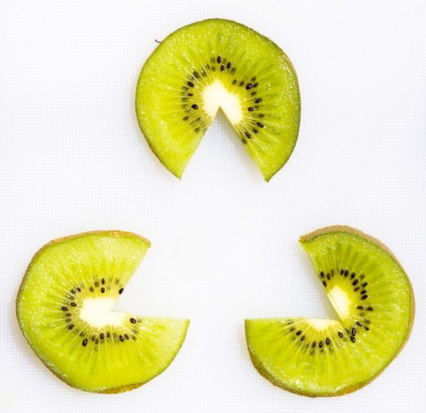
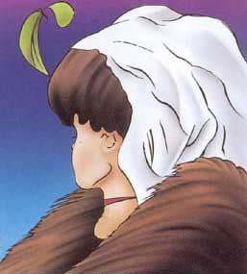
Perception is Subjective

Slide 15
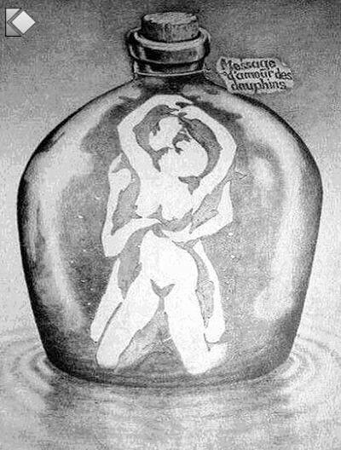
Perception is Deceptive

Slide 16
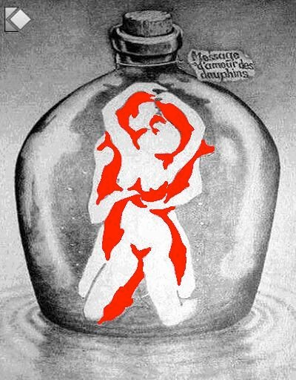
Perception is Deceptive

Slide 17
Sometimes we cannot even notice what’s right in front of us!

Slide 18
Importance of Action Based Research
Why are action based projects important?
It is important to challenge the problematic dominant epistemological understandings of food.
Instead we should produce ontological formations of the world we want by co-creating and co-recreating social relations that produce positive outcomes on people and the planet.
Action based learning theories incorporate students and facilitators as co-learners and co-collaborators. Together, they learn by doing. They also connect with the community.
Epistemology – A term meaning “theory of knowledge,” which gets at the how we know about the social world that lies behind all theoretical approaches. (Frampton, Kinsman, Thompson, Tileczek, (2006))
Ontology – Assumptions relating to how the social comes into being that inform all theories and ways of writing the social. (Frampton, Kinsman, Thompson, Tileczek, (2006))

Slide 19
The Dominant Epistemological View of Food?
The world has or will soon have the agricultural technology available to feed the 8.3 billion people anticipated in the next quarter of a century. The more pertinent question today is whether farmers and ranchers will be permitted to use that technology. Extremists in the environmental movement, largely from rich nations and/or the privileged strata of society in poor nations, seem to be doing everything they can to stop scientific progress in its tracks. It is sad that some scientists, many of whom should or do know better, have also jumped on the extremist environmental bandwagon in search of research funds. When scientists align themselves with antiscience political movements or lend their name to unscientific propositions, what are we to think? Is it any wonder that science is losing its constituency? We must be on guard against politically opportunistic, pseudo-scientists…
Borlaug, N., E. (2000) Ending World Hunger. The Promise of Biotechnology and the Threat of Antiscience Zealotry, Plant Physiology, 124(2) pp. 488.

Slide 20
Critique of Dominant Epistemological View of Food
When poisons are introduced into agriculture to control pests, or when GMOs are introduced under the argument of “feeding the world,” the justification given is always “science”. But “science” does not have a singular entity, and it did not come into existence within a vacuum. Today, what we generally refer to as “science” is in fact Western, mechanistic, reductionist modern science, which became the dominant practice of understanding the world during the Industrial Revolution and has continued as the dominant paradigm….To shape the industrial system in the form of new, violent technologies, and to shape the capitalist system in the form of new, profit-driven economics, a certain type of science was promoted and privileged as the only scientific knowledge system. Two scientific theories came to dominate this new, industrial paradigm, and they continue to shape practices of food, agriculture, health, and nutrition even today. The first is a Newtonian-Cartesian idea of separation: a fragmented world made of fixed, immutable atoms…The second significant theory that has framed the knowledge paradigm for industrial agriculture is Darwin’s theory of competition as the basis for evolution…The Newtonian-Cartesian theory of fragmentation and separation and the Darwinian paradigm of competition, have led to a nonrenewable use of Earth’s resources, a nonsustainable model for food and agriculture, and an unhealthy model of health and nutrition. An emphasis on the legitimacy of these arguments as the sole “scientific” approach has created a knowledge apartheid by discounting the knowledge of Mother Earth.
Shiva, V. (Shiva, V. (2016) Who Really Feeds the World, North Atlantic Books, pp. 4 – 7.

Slide 21
Activity Planting a Seed
Like a seed grows into a plant, we will all grow intellectually together as a class.
Take care of your plant and we’ll take care of each other’s intellectual and social needs during this course.
Your plant will need water, room to grow, light and nutrients (if it grows big).
The goal is to grow a kale plant to eat at the end of the course.
Get into a group and discuss how you will properly care for your plant.

Slide 22
Discussion about the Cooking Project
We will all take turns cooking and bringing food for our fellow classmates.
We will cook once for the project but you can cook more to improve your participation grade
We need to manage waste (no excessive garbage and we need to clean up the room)
We should respect people’s dietary needs (I suggest we do vegetarian or vegan items)
You shouldn’t spend much money
We will discuss who will prepare food for the next class every week
If there are issues why you cannot participate, please come see me (financial, or other)
The report can be submitted on August 12^{th,} 2019.

Slide 23
Corporate Social Responsibility?
Monsanto is recognized as a socially responsible company
Monsanto still uses chemicals that were used to kill people, but in our food
Is Round-Up safe to drink?
Farmer won lawsuit against Monsanto – Glyphosate causes cancer
The World According to Monsanto
Monsanto is now owned by Bayer who used to be part of I.G. Farben, manufacturing poisonous gas for concentration camps during the World War.
What does corporate responsibility really mean?
Environmental Social Governance (ESG) scores

Slide 24
What do you know about industrial food?
What is your current level of knowledge about industrial producing, processing, distribution and waste management?
What are positive and negative consequences of industrial food practices? Please provide sources for evidence of claims if any are made.
What are your current food practices regarding industrial food?
Do you eat at restaurants a lot?
Do you regularly buy already processed food items at the grocery store instead of untransformed ingredients?
Do you buy factory farmed meat (if you consume meat)?
Do you buy GMO and mass produced monoculture farmed vegetables?
Do you buy foods with pesticides or organic produce?
How important are the above questions to you?

Slide 25
Videos
Hero’s Sanctuary
What’s wrong with Industrial Food?
The World According to Monsanto
Monsanto Lobbyist

Slide 26
Questions or Concerns?
Thanks!
Have a great day!
Homework – Go Check Out Le Frigo Vert!
1440 Mackay St
Food for next week:

