Slide 1
The Political Economy of Inequality
The Age of Increasing Inequality – The astonishing rise of the 1% in canada
Erik Chevrier
www.erikchevrier.ca

Slide 2
Value
What do you want/need in life to live a fulfilling life?
What do people (in general) need in life to achieve human flourishing?

Slide 3
Needs
Need – A condition within the person that is essential and necessary for growth, well-being and life.
Deficiency needs – Are responses to a state of deprivation and generate tension-packed, urgency-laden emotions, such as pain, relief, anxiety, frustration, stress, etc.…
Growth needs – Gently guide behaviour toward a developmental trajectory of growth and well-being. They typically generate positive emotions, such as interest, enjoyment, hope and vitality.

Slide 4
Needs

Slide 5
GDP Per Capita

Slide 6
Real Income

Slide 7
Average Disposable Income

Slide 8
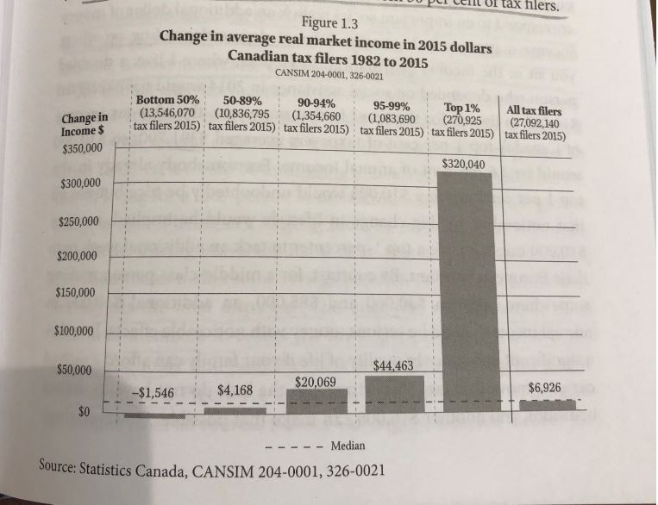
Real vs Market Income

Slide 9
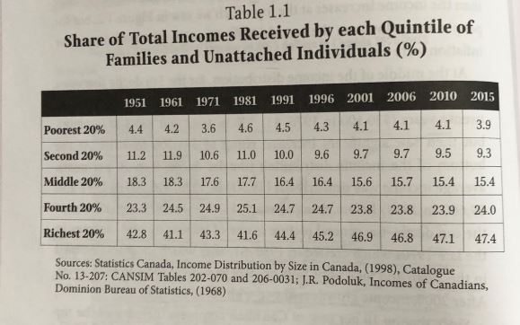
Family Income

Slide 10
Average Wage

Slide 11
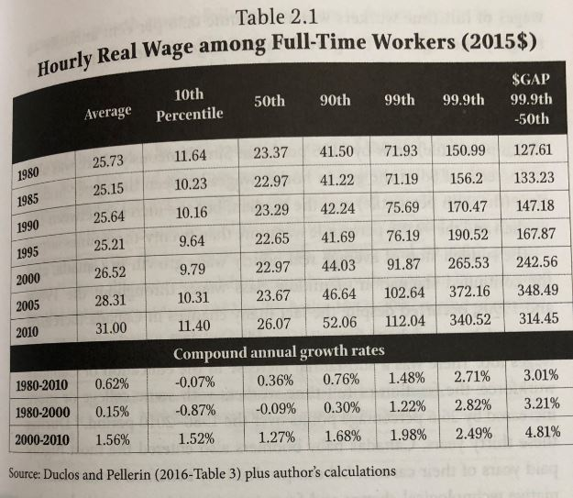
Real Hourly Wages

Slide 12
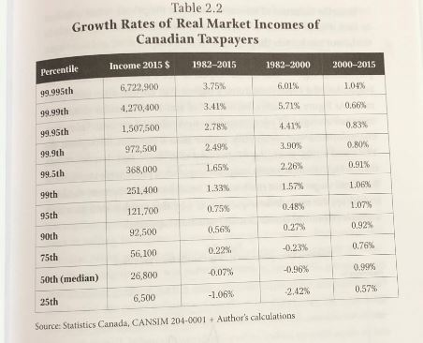
Growth Rates of Real Market Incomes

Slide 13
Unemployment

Slide 14
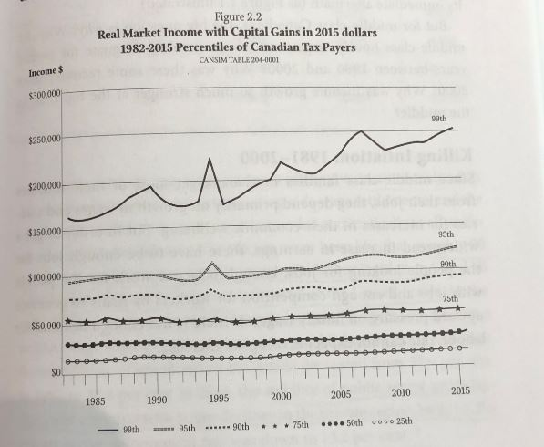
Capital Gains

Slide 15
GINI

Slide 16
Links
Bank’s Big Secret
Debt and Wealth in Canada
Household Debt
House Market in Canada

