Slide 1
The Political Economy of Inequality
The Age of Increasing Inequality – The astonishing rise of the 1% in canada
Erik Chevrier
www.erikchevrier.ca

Slide 2
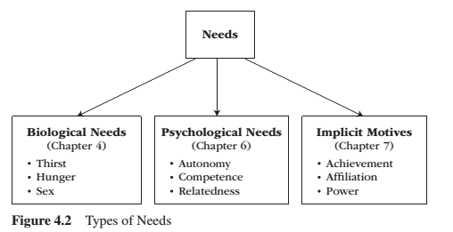
Needs
Need – A condition within the person that is essential and necessary for growth, well-being and life.
Deficiency needs – Are responses to a state of deprivation and generate tension-packed, urgency-laden emotions, such as pain, relief, anxiety, frustration, stress, etc.…
Growth needs – Gently guide behaviour toward a developmental trajectory of growth and well-being. They typically generate positive emotions, such as interest, enjoyment, hope and vitality.

Slide 3
What do you/people want/need?
What do you want/need in life to live a fulfilling life?
What do people (in general) need in life to achieve human flourishing
What are some established rules of decency and what commodities constitute the basic threshold?

Slide 4
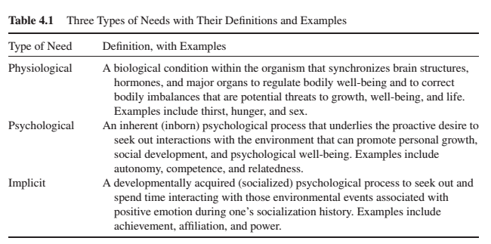
Needs

Slide 5
Measures of Poverty
Absolute vs Relative
Low Income Measure – Absolute
Low Income Cut Off – Absolute + Relative
Market Based Income – International (absolute)

Slide 6
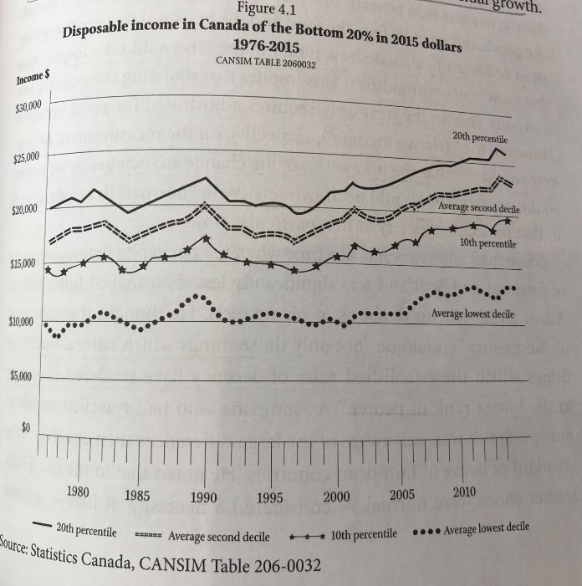
Disposable Income

Slide 7
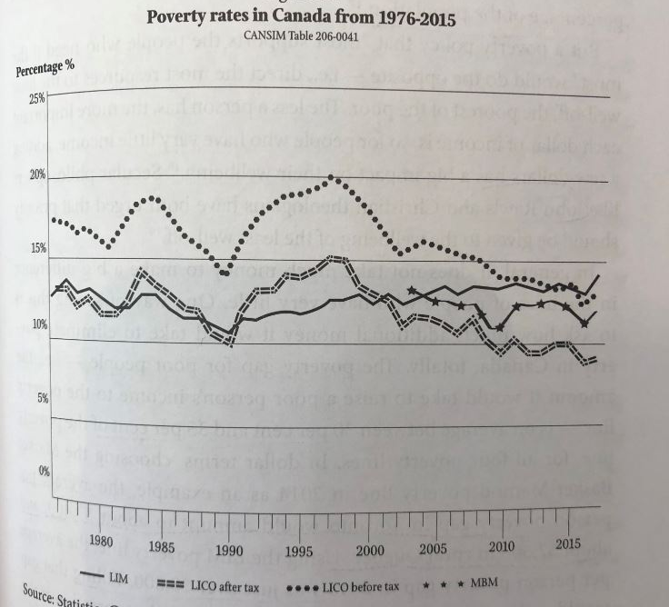
Poverty Rates in Canada

Slide 8
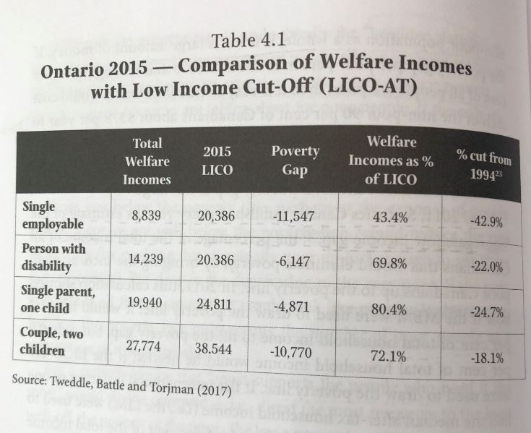
Welfare Incomes Ontario

Slide 9
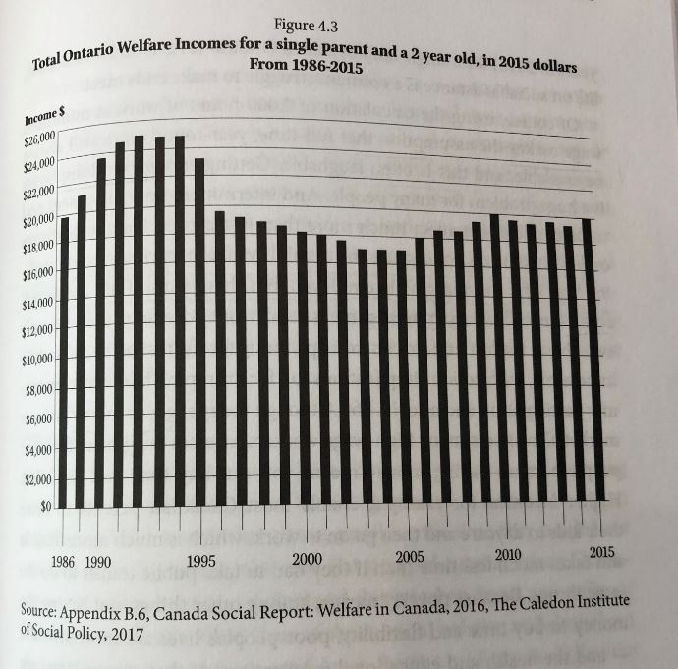
Welfare Ontario

Slide 10
Discussion – What kind of a consumer are you? How do you acquire that you want and need?
Are you impulsive or plan purchases?
Are you a compulsive consumer?
Do you prioritize ethical products?
Do you self-produce anything?
Do you have an income source?
Do you shop more for necessity or pleasure?
Do you shop to change your moods?
Do you hold material items in high regards (are you materialistic)?
What do you spend your money on? Daily? Weekly? Monthly? Yearly? Future Plans?
Do you prioritize fair trade?
Do you use any alternative currencies?
Do you participate in barter networks?
Do you buy stuff on the illegal market?
Do you get state allocations?
Do you steal things?

Slide 11
Discussion
Should we provide provisions to the bottom income earners – or people who are unemployed?
If so, what form should this take?
What kind of social services can be provided?
What about basic income?
If not, how come?

Slide 12
Discussion – What can we do to eliminate poverty?
Should we attempt any of the following experiments?
Progressive taxes?
Taxes on problematic commodities, like carbon?
Universal basic income?
Participatory budgeting?
Prioritizing coops (workplace democracy)?
Maximum wages?
Guaranteed necessities?
What else can you think of to reduce inequality?

