Slide 1
Food and Sustainability
Blog
Erik Chevrier
www.erikchevrier.ca

Slide 2
Assignment Description
Blog Posts: Students will write a blog posts of about 600 words for the www.concordiafoodgroups.ca website. For the first blog post students can
(1) attend a food related conference organized by a community group or participate in an ‘action’ related to food and/or sustainability and write about the conference/action,
(2) interview a community group and make the findings available via www.concordiafoodgroups.ca
(3) produce a brief research report (with at least five sources) about a food related topic that is approved by me (Erik Chevrier).
Blog posts must critically analyze the topic in a clear, concise, informative, and interesting manner and should link the topic/conference/interview to the class readings. The blog must address an appropriate audience and make sure the information is conveyed to this audience based on their level of knowledge of the subject matter. Students with video production skills can produce a video instead of a blog, however this must also be approved by me (Erik Chevrier).

Slide 3
Conference Report
Identify a conference or event related to food that interests you
Ask me (Erik) if this is a suitable conference
Attend the conference
Write a blog post of about 600 words
Include three external sources
Take a picture of the event – ask for permission to take pictures and let then know that this will be for a blog that may circulate on the internet (Facebook and Concordia Food Groups Website)
Report must be submitted no more than a week after the conference you attended or before the last class – whichever comes first

Slide 4
Conference Report: How to Write the Blog
Write a blog summarizing the event
Address the following questions:
What was the conference about?
Why is this topic important?
Logistics – who, what, why, where, when…
Is there a follow up event or other similar events people can attend?
How does this topic relate to other similar topics?
Make sure the blog is (objectives):
Clear and concise
Informative
Interesting
Link to big picture
Critical analysis (properly critical)
Address appropriate audience and make sure information is conveyed to this audience based on their level of knowledge of the subject matter
Link the conference topic to other sources (at least 3)

Slide 5
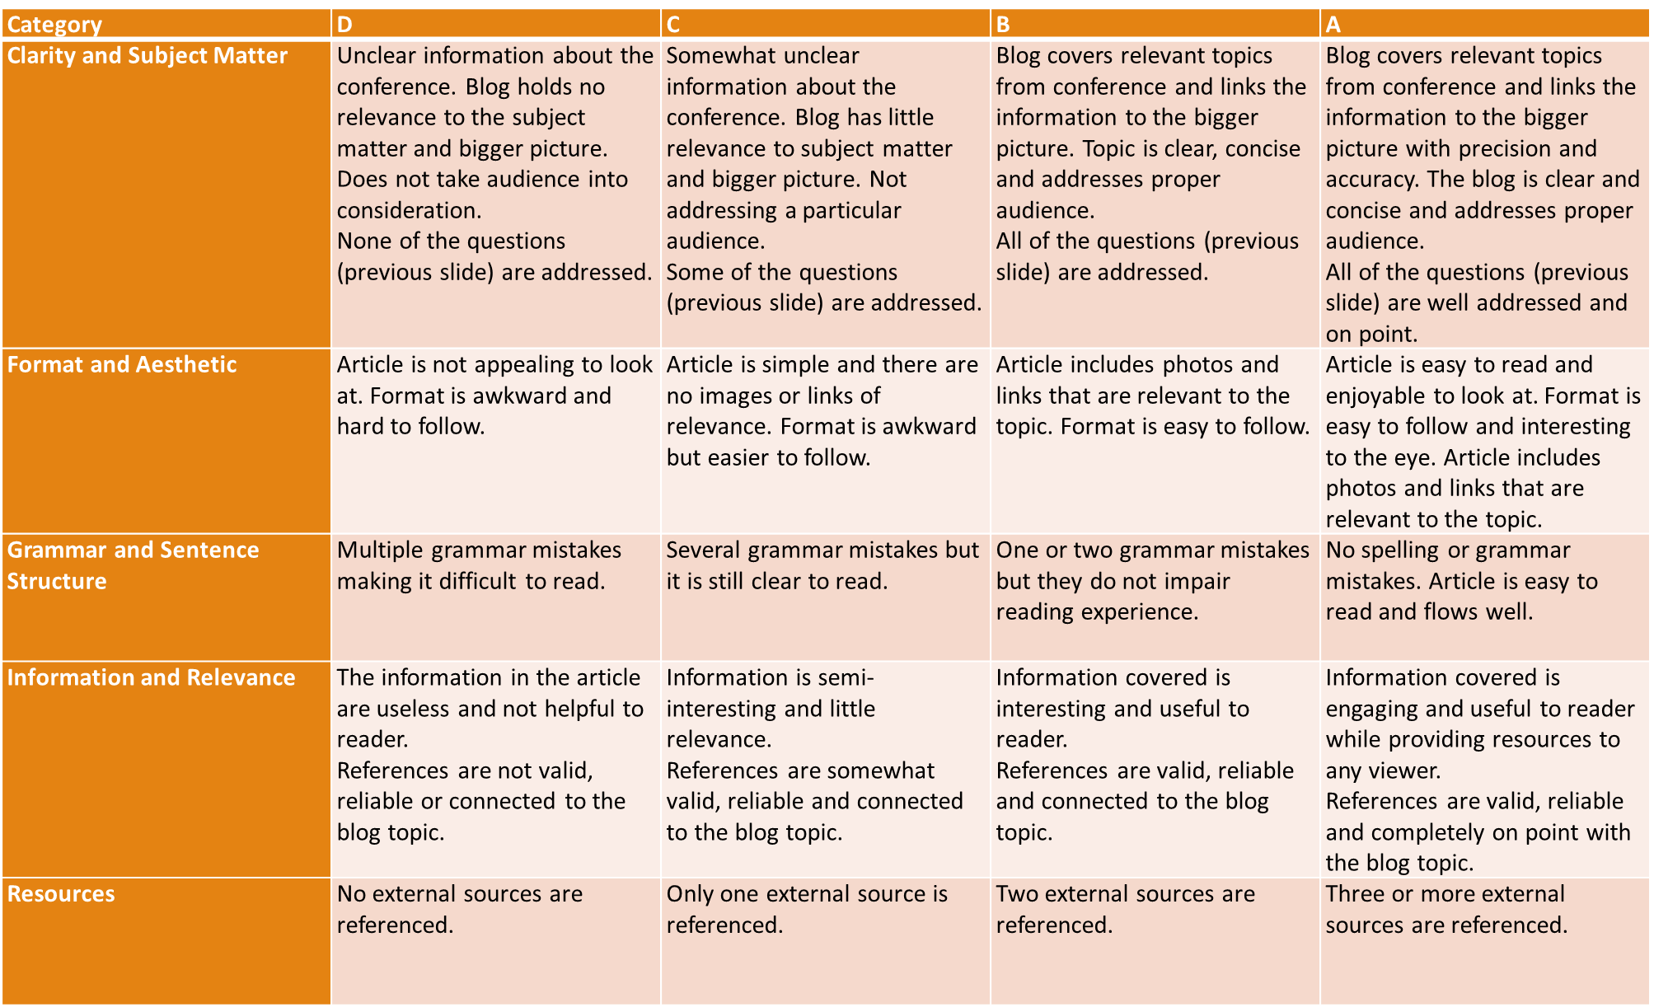

Slide 6
Research Report
Choose a food related topic, conduct a literature review and write a blog of about 600 words about the food topic. You must have at least 5 sources to get in the B range.
Here are some examples of topics.
Organic farming methods
Permaculture
Indigenous food practices
Indicators of ‘healthy’ food systems
Canada’s food policies - New consultations and directions
Food sovereignty
Food justice
Food labeling
GMOs

Slide 7
Research Report Format
To complete the research report blog:
Pick a topic that interests you
Find valid, reliable, and relevant sources to read about the topic
Write a blog that explains the topic (based on the sources you read) in your words (make it interesting)
Include pictures, links to events and/or other useful information for people to follow up with
Your blog should have a central argument and support for the argument based on valid, reliable and relevant sources.

Slide 8
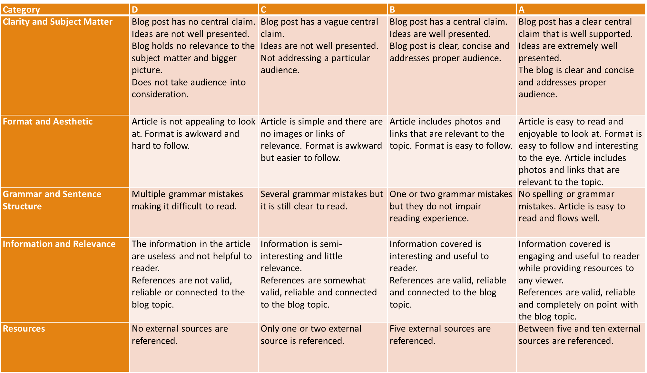

Slide 9
Interview with Community Group
What you need to do.
1 – Ask permission to interview a member (or members) of a community group.
2 – Conduct an interview with the community group – not the same one as the one you are working with for the final project.
3 – Write a blog post about the interview in the style of a mini research report.
Reports must include:
An introduction of why this topic is important. Contextualize the group/topic by performing a literature review. Please incorporate at least 3 external sources.
A brief overview of the methodology used to conduct the interview.
Report the findings of the interview. Summarize the interview.
Provide a discussion linking the topics addresses in the introduction with the findings derived from the interview.
Please do not just write out the questions and provide answers, but write a research paper about your findings.

Slide 10
