Slide 1
Food and Sustainability
Cooking Project
Erik Chevrier
www.erikchevrier.ca

Slide 2
Instructions
Cooking Project: Students must prepare at least one meal to bring and share with the class. Students will write a short blog of about 600 words about the practices, attitudes, and beliefs as well as the networks and institutions surrounding the production, distribution, and consumption of the food item they prepared. They will also include the recipe.

Slide 3
Report Must Address The Following Questions
What is the recipe of your food item?
Please list the ingredients and write about the process of preparing your food item.
What are the positive and negative consequences surrounding the production, transformation, transportation, distribution, consumption and waste management processes of your food item?
First, identify your ingredients – then find out how your food item is produced, transformed, transported, distributed, consumed, and how much waste it produces.
You may include the following topics as discussion points –– labour, gender, class, privilege, colonial imposition, racial issues, health, economy, community, environmental footprint, etc.
You may go in depth about one of these topics if you think it warrants more attention, or you can provide a more general overview of a couple of these topics. You will not have enough space to cover all of these topics; therefore make sure you include what is most important to your food item.
Where should Concordia students acquire the ingredients in the most ethical way?
You can take into consideration: price, labour conditions (i.e. fair trade), environmental footprint, local vs global, coops/non profits vs multinational corporations, health factors (i.e. reduced sugar), shopping convenience, etc.

Slide 4
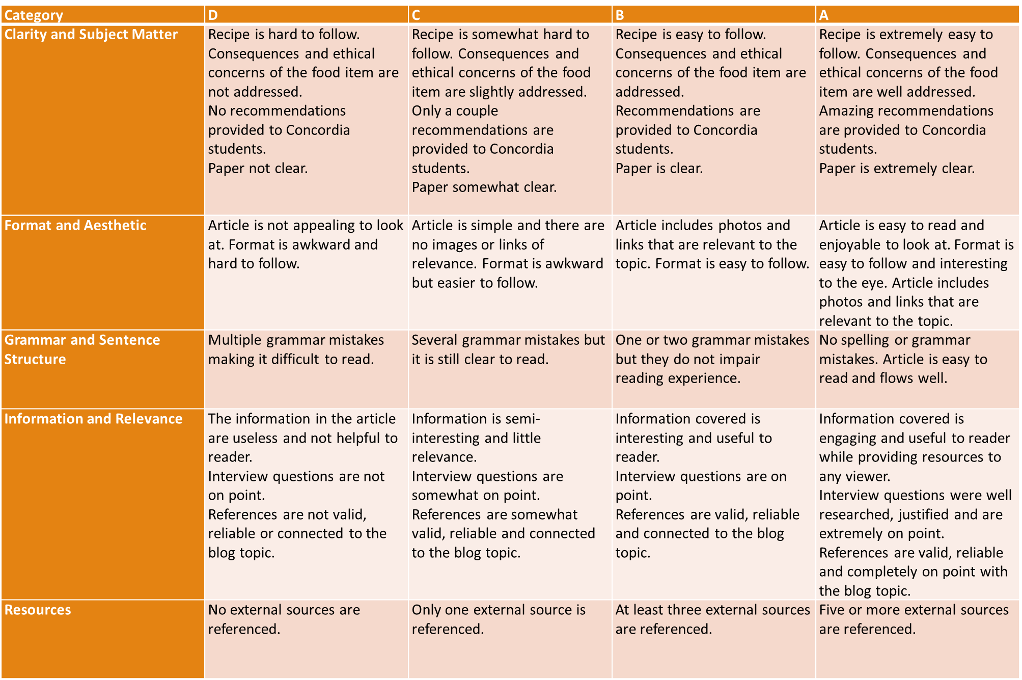

Slide 5
Dates for cooking:
https://docs.google.com/spreadsheets/d/1YYK-4OYKN0_scM0VsAhN-JQejBfy1F6gQ46qOGQ90tM/edit?usp=sharing

