Slide 1
Food and Sustainability
Food Culture and sustainability Erik Chevrier July 15th, 2019 www.erikchevrier.ca

Slide 2
Let’s Identify a Problem With Our Current Food System
1 – Large agrochemical companies are extracting almost all of the profits from Canadian farmers. To compensate, the Canadian government subsidizes farming.
2 – Only a handful of large seed and agrochemical companies own most of the market.
3 – Most of these corporations have directly caused the death of millions of people.
Solution – We need to become food sovereign by taking control of our own food economy locally!

Slide 3
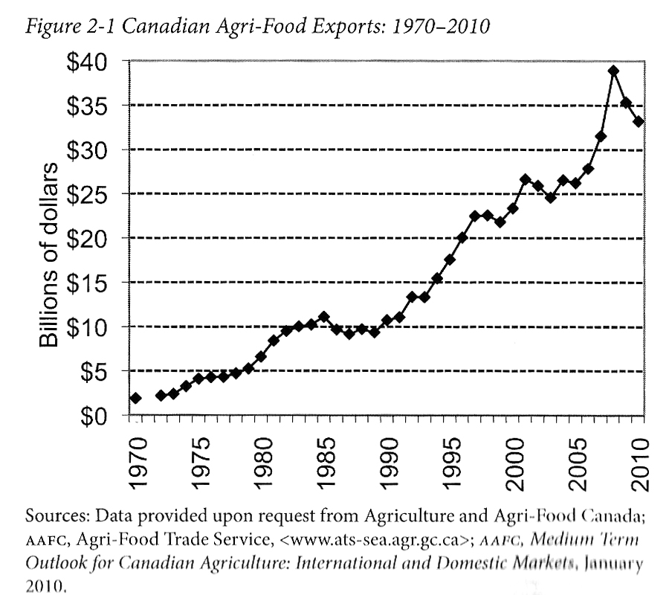
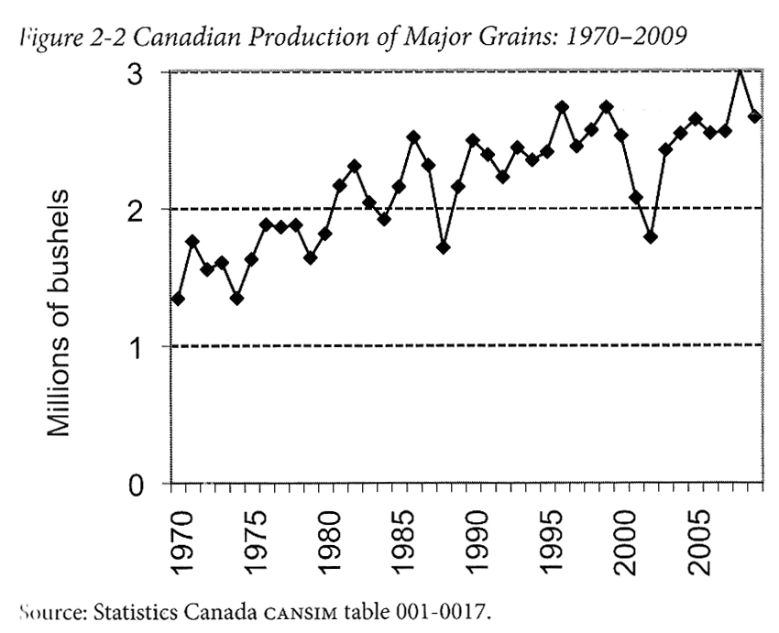
Advancing Agriculture by Destroying Farms? The State of Agriculture in Canada Qualman, D. (2011) Advancing Agriculture by Destroying Farms? The State of Agriculture in Canada, pp. 20 – 42. In, Wittman, H., Desmarais, A. A., & Wiebe, N. (2011) Food Sovereignty in Canada: Creating Just and Sustainable Food Systems, Fernwood Publishing

Slide 4
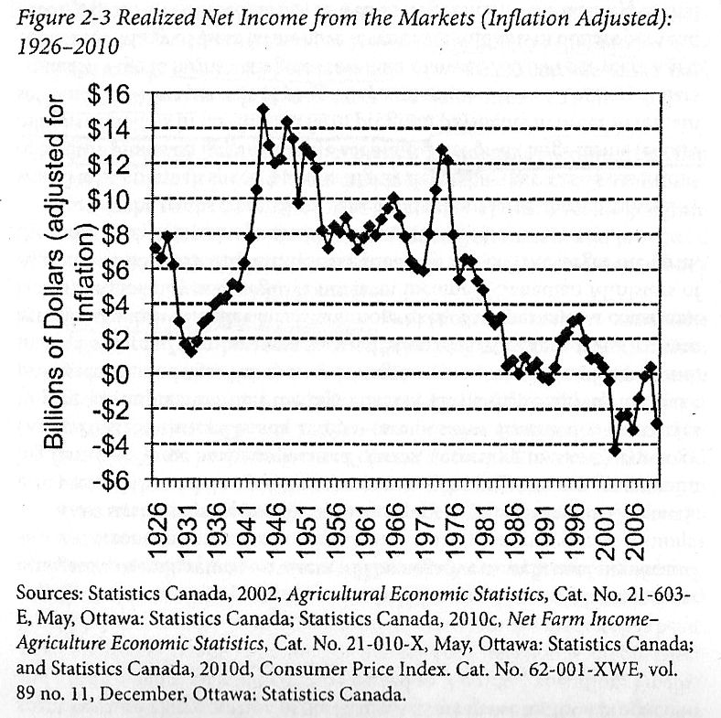
Advancing Agriculture by Destroying Farms? The State of Agriculture in Canada Qualman, D. (2011) Advancing Agriculture by Destroying Farms? The State of Agriculture in Canada, pp. 20 – 42. In, Wittman, H., Desmarais, A. A., & Wiebe, N. (2011) Food Sovereignty in Canada: Creating Just and Sustainable Food Systems, Fernwood Publishing

Slide 5
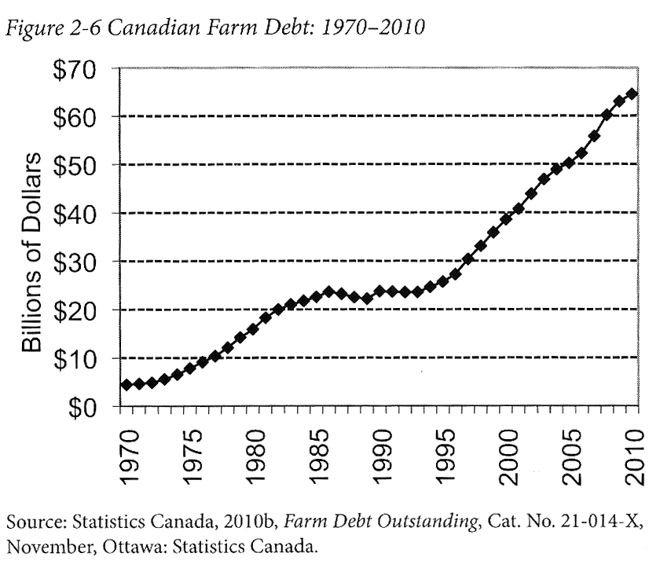
Advancing Agriculture by Destroying Farms? The State of Agriculture in Canada Qualman, D. (2011) Advancing Agriculture by Destroying Farms? The State of Agriculture in Canada, pp. 20 – 42. In, Wittman, H., Desmarais, A. A., & Wiebe, N. (2011) Food Sovereignty in Canada: Creating Just and Sustainable Food Systems, Fernwood Publishing

Slide 6
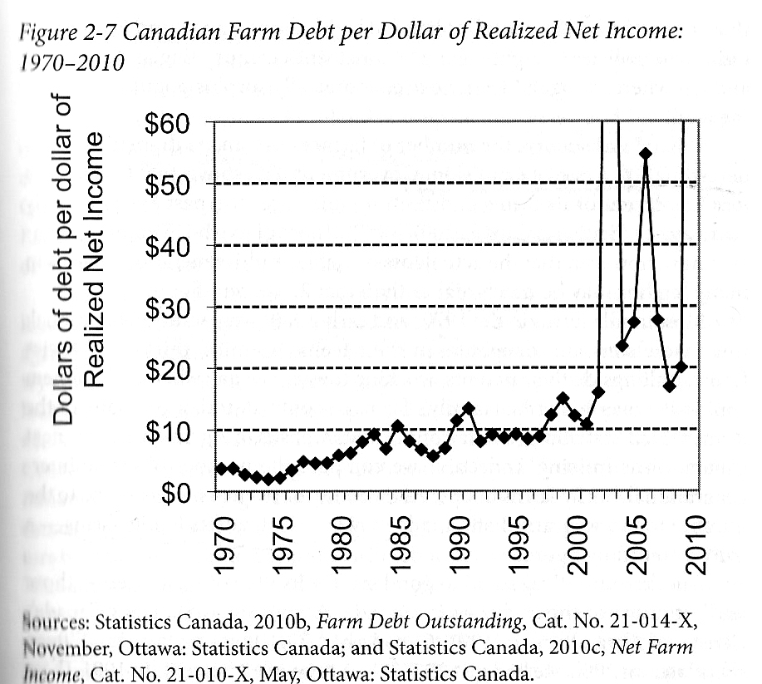
Advancing Agriculture by Destroying Farms? The State of Agriculture in Canada Qualman, D. (2011) Advancing Agriculture by Destroying Farms? The State of Agriculture in Canada, pp. 20 – 42. In, Wittman, H., Desmarais, A. A., & Wiebe, N. (2011) Food Sovereignty in Canada: Creating Just and Sustainable Food Systems, Fernwood Publishing

Slide 7
Advancing Agriculture by Destroying Farms? The State of Agriculture in Canada Qualman, D. (2011) Advancing Agriculture by Destroying Farms? The State of Agriculture in Canada, pp. 20 – 42. In, Wittman, H., Desmarais, A. A., & Wiebe, N. (2011) Food Sovereignty in Canada: Creating Just and Sustainable Food Systems, Fernwood Publishing
Drain on taxpayers:
Canadian taxpayers have provided 3 – 4 billion dollars per year, $67 billion (about 8000$ per household) to agri-business transnationals
Canadian tax payers continue to subsidize agriculture, large portions of these subsidies produce food that is exported.
Example: Dairy farmers get $250 million
Farm subsidies

Slide 8
Only A Few Large Corporations Own Most of the Agrochemical Market https://cban.ca/gmos/issues/corporate-control/

Slide 9
Companies of War, Destruction and Death
These are a few examples:
Monsanto still uses chemicals that were used to kill people, but in our food
Is Round-Up safe to drink?
Farmer won lawsuit against Monsanto – Glyphosate causes cancer
The World According to Monsanto
Monsanto is now owned by Bayer who used to be part of I.G. Farben, manufacturing poisonous gas (Zyklon B) for concentration camps during the World War.
BASF was also part of IG Farben.
Dow Chemical Invented Agent Orange
BASF was also part of IG Farben a company who worked with the Nazis and tested chemicals and drugs on people including Zyklon B
Dow Chemical now owns Union Carbide who was responsible for a large devastating explosion in Bhopal, India:
The Bhopal disaster: Toxic legacy
One Night in Bhopal
The Bhopal Disaster

Slide 10
Reading Review
Regarding the reading:
Barilla Center for Food and Nutrition, & Nierenberg, D., (2018) Nourished Planet: Sustainability in the Global Food System 3rd ed., Island Press. Chapter 1 – Food for All (pp. 1 – 35)
Please summarize the chapter by addressing the following:
(1) identify the central claim(s) or thesis(es) of the text articulated in the student’s own words (2) identify the supporting evidence for the claim(s) and the key concepts introduced (3) relate the text to other examples that support or contradict the central claim or thesis (4) according to the authors, what is a recipe for sustainable food? (5) according to the authors, what are the ingredients for sustainability? (6) according to the authors, what do we know about soil degradation? (7) according to the authors, what do they mean by food for all? (8) according to the authors, what are barriers to food access and affordability? (9) according to the authors, why are food prices precarious?

Slide 11
Reading Review
Regarding the reading:
Barilla Center for Food and Nutrition, & Nierenberg, D., (2018) Nourished Planet: Sustainability in the Global Food System 3rd ed., Island Press. Chapter 2 – Food for Sustainable Growth (pp. 55 – 95)
Please summarize the chapter by addressing the following:
(1) identify the central claim(s) or thesis(es) of the text articulated in the student’s own words (2) identify the supporting evidence for the claim(s) and the key concepts introduced (3) relate the text to other examples that support or contradict the central claim or thesis (4) according to the authors, what is the double food pyramid? (5) according to the authors, how do our diets affect the environment? (6) according to the authors, what is our environmental footprint (water, carbon, GHG, etc.)? (7) according to the authors, what is important about today’s water situation (supply, economy, etc.)? (8) according to the authors, what is important about soil loss and degradation? (9) according to the authors, what is important about food loss and food waste? (10) according to the authors, what is a sustainable agricultural system? (11) according to the authors, how do we revolutionize past practices and envision the future of farming?

Slide 12
Reading Review
Regarding the reading:
Barilla Center for Food and Nutrition, & Nierenberg, D., (2018) Nourished Planet: Sustainability in the Global Food System 3rd ed., Island Press. Chapter 4 – Food for Culture (pp. 159 – 189).
Please summarize the chapter by addressing the following:
(1) identify the central claim(s) or thesis(es) of the text articulated in the student’s own words (2) identify the supporting evidence for the claim(s) and the key concepts introduced (3) relate the text to other examples that support or contradict the central claim or thesis (4) according to the authors, how does food communicate meaning? (5) according to the authors, what is the link between food and culture? (6) according to the authors, what is the Slow Food Movement? (7) according to the authors, what are the endangered foods worldwide and efforts to save them? (8) according to the authors, how does food relate to power? (9) according to the authors, why are indigenous foods important? (10) according to the authors, why is it important to have a diverse food system? (11) according to the authors, should we still eat meat? (12) according to the authors, what role do women play in food production? (13) according to the authors, what is the Mediterranean diet and how does it relate to other diets? (14) according to the authors, what can we take as an action plan to create real food system change?

Slide 13
Aristotle Aristotle. Aristotle in 23 Volumes, Vol. 21, translated by H. Rackham. Cambridge, MA, Harvard University Press; London, William Heinemann Ltd. 1944.
Chrematistics – art of acquisition – limitless accumulation unnatural and problematic
Oikonomia – management of the household – true form of an economy

Slide 14
Karl Polanyi Polanyi, K. (2001) The Great Transformation; The Political and Economic Origins of Our Time, Beacon Press
Types of economic practices:
Markets (exchange)
Household economy
Redistribution
Reciprocity

Slide 15
An Economic Politics for Our Times
The Economy as a site of difference
Performing diverse economies
Genealogy of Diverse Economy Research
Katherine Gibson Interview
A Performative Ontological Politics
Expanding the Scope of Participatory Action Research

Slide 16
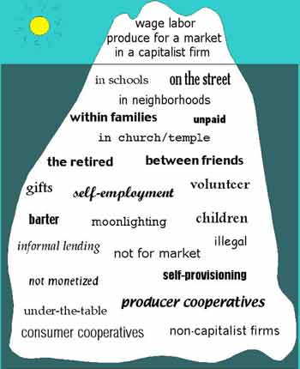
RECAP – Take back the Economy Gibson Graham Gibson-Graham, J.K., Cameron, J., Healy, S. (2013) Take Back the Economy: An Ethical Guide for Transforming Communities, University of Minnesota Press
Katherine Gibson Interview Playlist

Slide 17
RECAP – Take back the Economy Gibson Graham Gibson-Graham, J.K., Cameron, J., Healy, S. (2013) Take Back the Economy: An Ethical Guide for Transforming Communities, University of Minnesota Press

Slide 18
Envisioning Real Utopias Erik Olin Wright Olin Wright, E. (2010) Envisioning Real Utopias, Verso

Slide 19
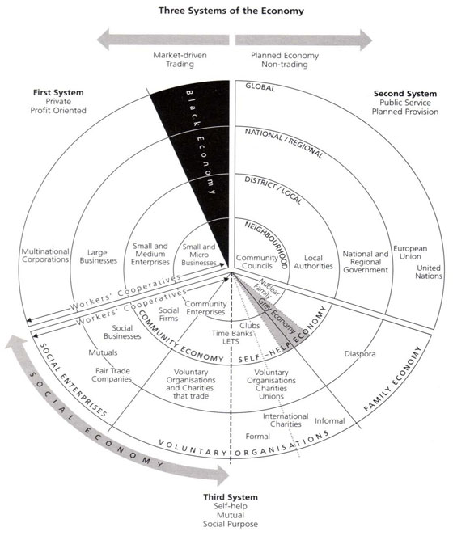
RECAP – Three Systems of an Economy – John Pierce Pearce, J. (2009) Social Economy: Engaging as a Third System, In Amin, A. The Social Economy; International Perspectives on Economic Solidarity, p. 26.

Slide 20
Living Economies – Vandana Shiva

Slide 21
Who is Vandana Shiva?
Hero’s Sanctuary
Vandana Shiva on Food Sovereignty at Concordia

Slide 22
Check in Regarding Project Proposal
How is everything going?

