Slide 1
Food and Sustainability
Erik Chevrier July 8th, 2019 www.erikchevrier.ca

Slide 2
What is an Economy
This course provides an overview of what an economy is in order to understand how food economies function.

Slide 3
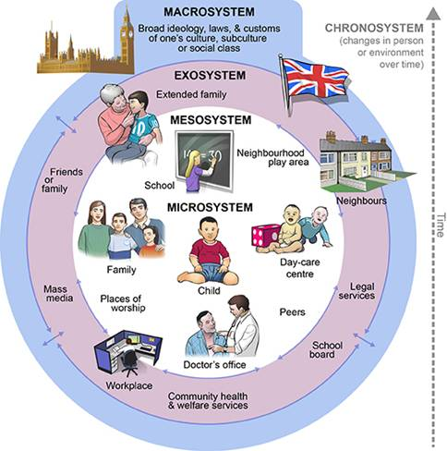
Ecological Systems Theory of Development

Slide 4
Karl Polanyi Polanyi, K. (2001) The Great Transformation; The Political and Economic Origins of Our Time, Beacon Press
Types of economic practices:
Markets (exchange)
Household economy
Redistribution
Reciprocity

Slide 5
RECAP – Aristotle Aristotle. Aristotle in 23 Volumes, Vol. 21, translated by H. Rackham. Cambridge, MA, Harvard University Press; London, William Heinemann Ltd. 1944.
Chrematistics – art of acquisition – limitless accumulation unnatural and problematic
Oikonomia – management of the household – true form of an economy

Slide 6
RECAP – Karl Marx Marx, K. Capital Volume 1, Penguin Classics.
C – C – Basic barter C – M – C – The way classical economists viewed basic barter with money M – C – M’ – What really happens when barter systems incorporate money – Limitless accumulation M – M’ – Usury capital system – Limitless accumulation

Slide 7
An Economic Politics for Our Times
The Economy as a site of difference
Performing diverse economies
Genealogy of Diverse Economy Research
Katherine Gibson Interview
A Performative Ontological Politics
Expanding the Scope of Participatory Action Research
How does this apply to geography and urban planning?

Slide 8
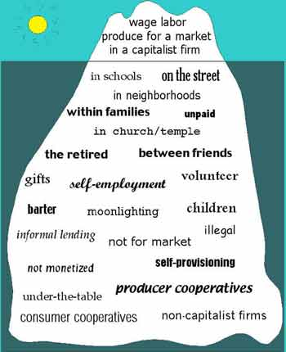
RECAP – Take back the Economy Gibson Graham Gibson-Graham, J.K., Cameron, J., Healy, S. (2013) Take Back the Economy: An Ethical Guide for Transforming Communities, University of Minnesota Press
Katherine Gibson Interview Playlist

Slide 9
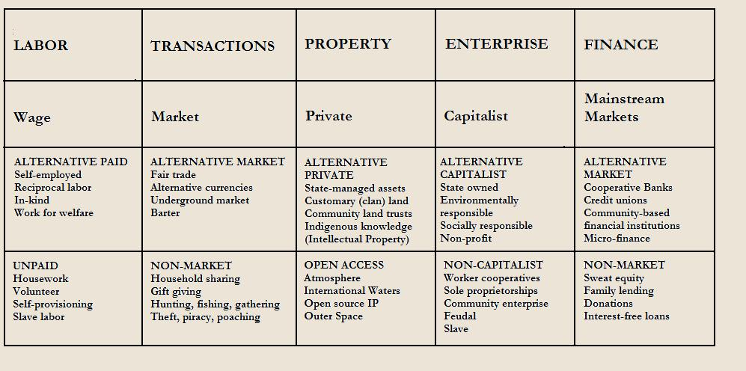
RECAP – Take back the Economy Gibson Graham Gibson-Graham, J.K., Cameron, J., Healy, S. (2013) Take Back the Economy: An Ethical Guide for Transforming Communities, University of Minnesota Press

Slide 10
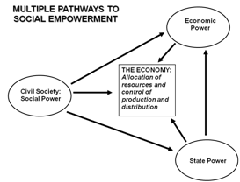
Envisioning Real Utopias Erik Olin Wright Olin Wright, E. (2010) Envisioning Real Utopias, Verso

Slide 11
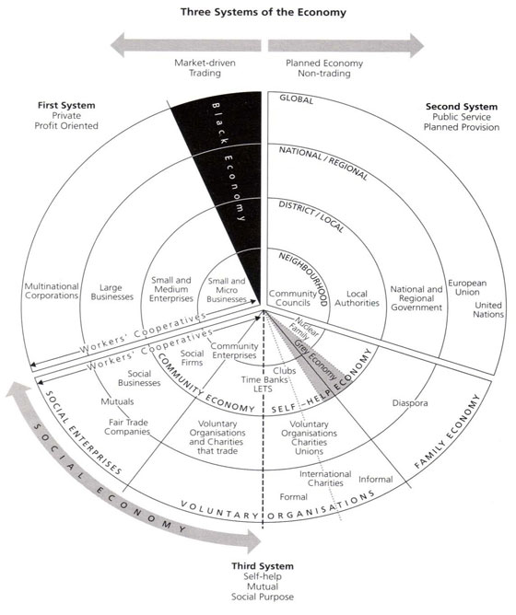
RECAP – Three Systems of an Economy – John Pierce Pearce, J. (2009) Social Economy: Engaging as a Third System, In Amin, A. The Social Economy; International Perspectives on Economic Solidarity, p. 26.

Slide 12
Who is Vandana Shiva?
Hero’s Sanctuary
Vandana Shiva on Food Sovereignty at Concordia

Slide 13
Living Economies – Vandana Shiva
Earth democracy refers to every being having equal access to the earth’s resources that make life possible; this access is assured by recognizing the importance of the other two economies: nature’s economy and the sustenance economy.
Economy and ecology derive from oikos – household Economy derives from the Latin word oeconomia meaning household management
Three types of economies: markets – nature – sustenance

Slide 14
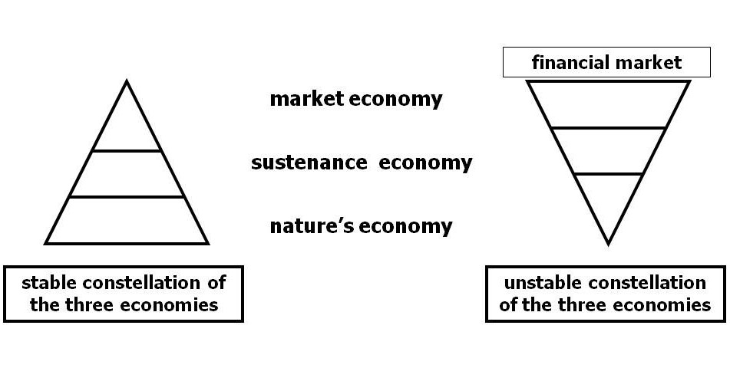
Living Economies – Vandana Shiva

