Slide 1
Food and Sustainability
Check In about Group Projects
Erik Chevrier
August 5th, 2019
www.erikchevrier.ca

Slide 2
Video
What is Agroecology?
Living Soil

Slide 3
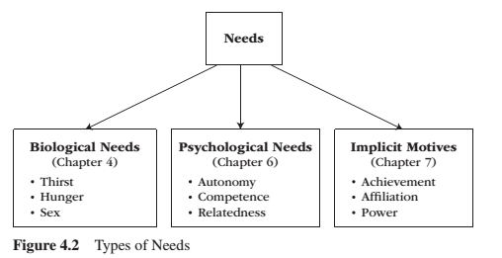
FOLLOW UP – Needs
Need – A condition within the person that is essential and necessary for growth, well-being and life.
Deficiency needs – Are responses to a state of deprivation and generate tension-packed, urgency-laden emotions, such as pain, relief, anxiety, frustration, stress, etc.…
Growth needs – Gently guide behaviour toward a developmental trajectory of growth and well-being. They typically generate positive emotions, such as interest, enjoyment, hope and vitality.

Slide 4
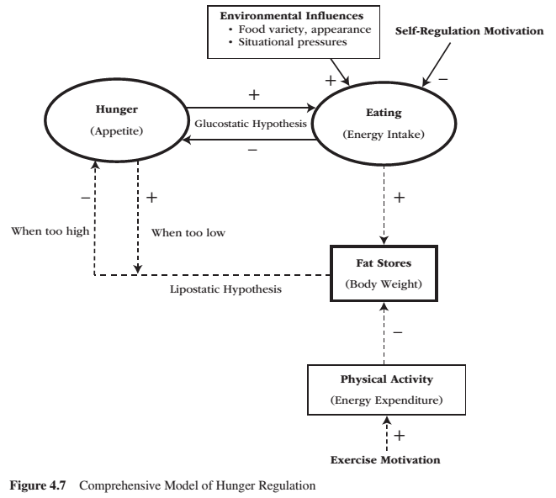
FOLLOW UP – Comprehensive Model of Hunger Regulation

Slide 5
FOLLOW UP – Short-term Appetite
Glucostatic hypothesis is a homeostatic model of short-term appetite
When blood glucose drops, people feel hungry and want to eat
  Cells require glucose to produce energy
When blood glucose is low, the LIVER sends an excitatory signal to the LATERAL HYPOTHALAMUS (LH)
The VENTROMEDIAL HYPOTHALAMUS (VMH) is responsible for negative feedback.
  The liver detects high levels of glucose, the stomach bloats and the gut peptide CHOLECYSTOKININ (CCK) is released
Other factors that influence short-term appetite is the stomach and body temperature
  Stomach distension
    60% empty = hint of hunger
    90% empty = maximum hunger
High protein & high fiber meals produce the greatest satiety

Slide 6
FOLLOW UP – Long-Term Energy Balance
Lipostatic hypothesis – when the mass of fat stored drops below its homeostatic balance, adipose tissue secrets hormones into the bloodstream to promote hunger that increase food intake
Hormones that play a key role in hunger
  Ghrelin – Manufactured in stomach, circulated in the blood, detected and monitored by the lateral hypothalamus (LH) via stomach and intestines
    Ghrelin fluctuates throughout the day and peaks around breakfast, lunch, dinner
    Eating food causes a rapid fall in ghrelin
    Ghrelin was chronically higher when people were on a diet than if they were not on a diet
  Leptin – Manufactured by fat cells throughout the body, circulated in the blood, detected and monitored by the ventromedial hypothalamus (VMH) via stomach and intestines
  Responsible for negative feedback
  Set-Point Theory - Each individual has a biologically determined body weight or “fat thermostat” that is set by genetics either at birth or shortly thereafter.
  Hunger is determined by the size of the fat cells, not the number of cells

Slide 7
FOLLOW UP – Environmental & Self-Regulatory Influences
There are many ENVIRONMENTAL FACTORS that influence hunger
  Time, smell of food, seeing food, social occasion/facilitation/pressure, etc.
SELF-REGULATED INFLUENCES include:
  Cognitively Regulated Eating Style
    Dieters have issues with having willpower over our physiology; getting environmental cues and our own feelings
    Dieters need to deaden internal cues and substitute cognitive controls
  Restraint-Release Situations
    Under conditions of stress, anxiety, alcohol, depression, and/or exposure to high calorie foods, dieters become susceptible to disinhibition (restraint-release) of their cognitively regulated eating style

Slide 8
FOLLOW UP – How Your Belly Controls Your Brain
Video: How Your Belly Controls Your Brain

Slide 9
RECAP – Discussion
What food-values should we be creating?

Slide 10
RECAP – Discussion
How do we create the conditions to make the values identified in the previous discussion come into fruition?

Slide 11
Action Research Project
What project are you working on?
How does this project relate with food and sustainability?
What tasks have you performed so far?
How does your role in the project create conditions for food that has a positive impact on the world?
What have you learned so far?

