Slide 1
Food and Sustainability
Cooking Project
Erik Chevrier
www.erikchevrier.ca

Slide 2
Instructions
Cooking Project: Students must prepare at least two meals to bring and share with the class. Students will write a short blog of about 600 words (1 page) about the practices, attitudes, and beliefs as well as the networks and institutions surrounding the production, distribution, and consumption of the food item they prepared. They will also include the recipe, i.e. list the ingredients and write about the process of preparing your food item.
Students will write about only one of the meals they bring (or plan on bringing).
Due Date: October 7th, 2019

Slide 3
Cultural Significance of Food Assignment
Main Question: What is the cultural significance of your food item?
Food culture refers to the practices, attitudes, and beliefs as well as the networks and institutions surrounding the production, distribution, and consumption of food.
It encompasses the concepts of foodways, cuisine, and food system and includes the fundamental understandings a group has about food, historical and current conditions shaping that group’s relationship to food, and the ways in which the group uses food to express identity, community, values, status, power, artistry and creativity. It also includes a groups’ definitions of what items can be food, what is tasty, healthy, and socially appropriate for specific subgroups or individuals and when, how, why, and with whom those items can or should be consumed.
Source Dr. Long

Slide 4
Cultural Significance of Food – Interview with Family Member/Grandparent
Talk with a family member about the cultural significance of the food item you bring, only if it is relevant to their cultural heritage. You should develop a series of interview/discussion questions to find out:
What the food item means to them
What the food item means to their culture (defining culture and becoming defined by culture)
What historical overview (political, economic and social conditions) of the time and space from which your food item comes from
Any other interesting questions that help define the practices, attitudes, and beliefs as well as the networks and institutions surrounding the production, distribution, and consumption of the food item you chose.
Reports should include: An introduction to the food item you chose, brief overview of methodology, findings, discussion about the cultural significance of food items. Please do not just write out the questions and provide answers, but write a research paper about your findings. You also need to provide external references.

Slide 5
Cultural Significance of Food – Traditional Report
Your paper should identify the the practices, attitudes, and beliefs as well as the networks and institutions surrounding the production, distribution, and consumption of the food item you chose.
Topics can include but are not limited to:
Labour, gender, class, privilege, colonialism, race, health, economy, community, environmental footprint, alternative food systems, survival, social justice, sovereignty, etc.
You need to provide external references.

Slide 6
You can do Artistic Pieces
You can do a video, website, blog, performance, and/or other creative ways to express yourself instead of a traditional paper.
These must be approved by me first.

Slide 7
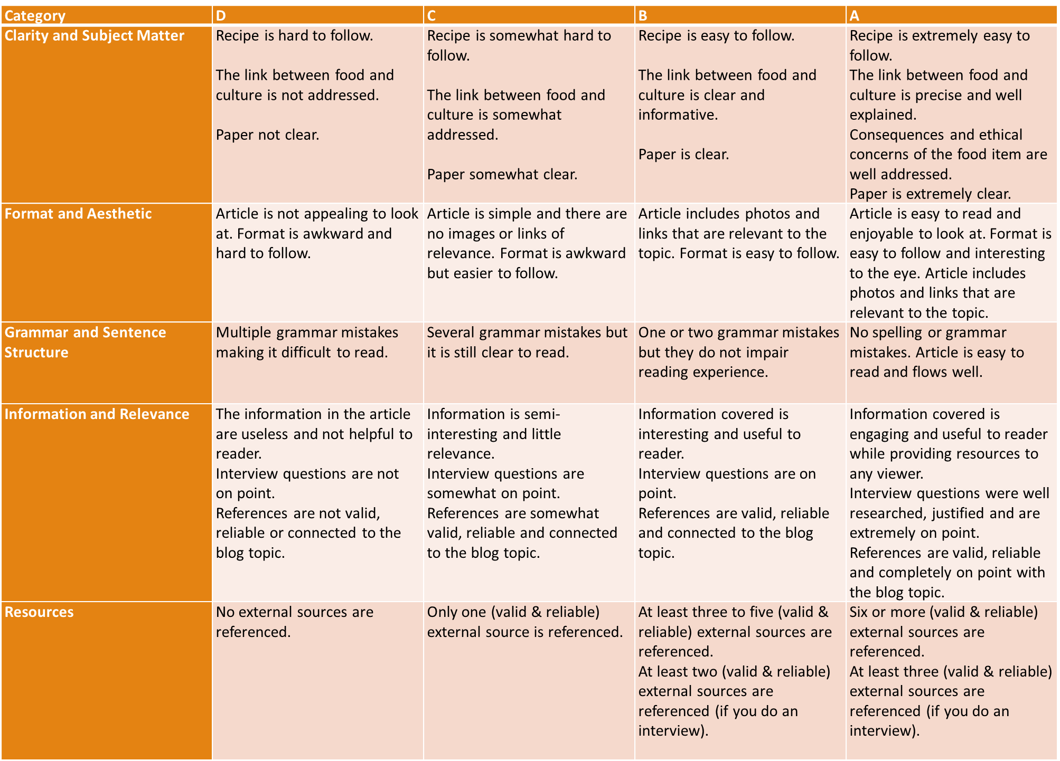

Slide 8
Dates For Cooking
Dates for cooking:
https://docs.google.com/spreadsheets/d/1nrNkYFiCFHbfavw891A9mbTavHq1R_HeGz66hqOR2Hk/edit?fbclid=IwAR2GrHj0YqFdFnKrVRbYittOoo8CjY0zppxbpa2osKNBJPMszoGcdaJyGYs#gid=0

