Slide 1
Fundamentals of Social Psychology
Social Cognition
September 10th, 2019
Erik Chevrier

Slide 2
Automatic Thinking – Low Effort Thinking
Automatic thinking – Is thought that is generally unconscious, unintentional, involuntary, and effortless.
Schemas – Mental structures people use to organize their knowledge about the social world themselves and that influence the information people notice, think about, and remember.
We tend to fill in the blanks with SCHEMA-CONSISTENT INFORMATION.
Kunda, Sinclair, Griffin (1997) – Actor (life of the party) vs Sales person (pushy) – Lawyer (argue) vs Construction Worker (physical fight)
Herold Kelly (1950) – lecturer – cold person vs warm person
How People are Affected By Profuse Amounts of Publicity? – Advertising and Priming
Activity – Automatic Thinking!

Slide 3
SAY THIS WORD OUTLOUD 10 TIMES
ROAST

Slide 4
SAY THIS WORD OUTLOUD 10 TIMES

Slide 5
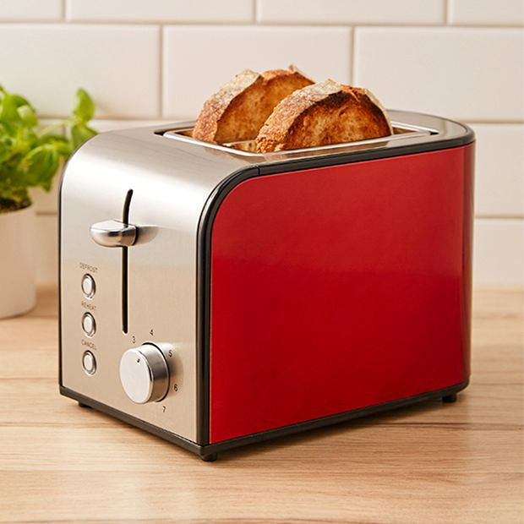
Answer the following question?
What do you put in a toaster?

Slide 6
Information Processing Model

Slide 7
Accessibility and Priming
Accessibility – The extent to which schemas and concepts are at the forefront of people’s minds and are, therefore, likely to be used when making judgments about the social world.
Schemas can be accessible for three reasons:
Some schemas are chronically accessible because of past experience – these schemas are constantly active and ready to use to interpret ambiguous situations.
Schemas can be accessible because they are related to a current goal.
Schemas can become temporary accessible because of our recent experiences.
Priming – The process by which recent experiences increase the accessibility of a schema, trait, or concept.
Words have to be accessible and applicable to act as a prime.
Schemas may be quite resistant to change
Schemas are influenced by culture
Perception Without Awareness (PWA) – Daren Brown – How to Control a Nation – Toy Story
How to Control a Nation Full Video
The Art of Misdirection

Slide 8
Semantic Processing – Spreading Activation

Slide 9
Activity
Write down the first five words that you can think of in under 10 seconds that remind you of the following words.

Slide 10
Feather

Slide 11
Animal

Slide 12
Food

Slide 13
Type of Plant

Slide 14
Priming and Accessibility

Slide 15
Applicability
News Media Utilize Priming Tactics - Sinclair Broadcasting Group
What other positive and negative consequences occur from using automatic thinking?
How is priming used to ‘control’ people other than the example given above?
What are other examples of intentional priming tactics that you come across?

Slide 16
Embodied Cognition: Physical Sensations Can Prime Cognitive Schemas
Scent can prime morality (clean vs dirty)
Clean scented-room = more trusting of stranger & more willing to donate time and money (Lilenquist, Zhong, Galinsky, 2010)
Bodily Sensations can prime mate selection (Kille, Forest, Wood, 2013).
Instability – more inclined to think people’s marriages wouldn’t last
More likely to look for stable qualities in a partner
Music can help activate scripts

Slide 17
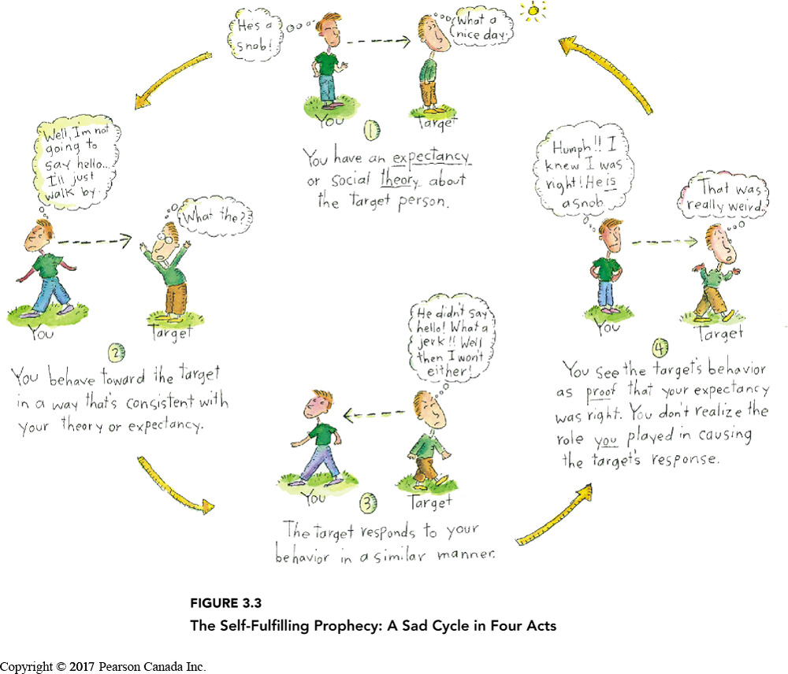
Making Our Schema Come True
Robert Rosenthal

Slide 18
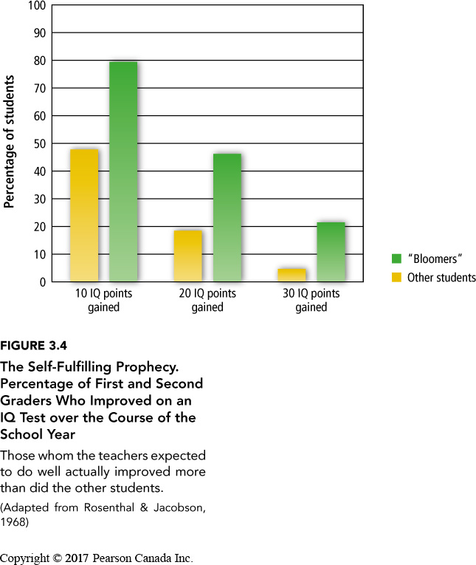
Self-Fulfilling Prophesy
Teachers treated bloomers in four general ways:
1 – They create a warmer environment
2 – Gave bloomers more material & more difficult material
3 – Gave bloomers more & better feedback
4 – Gave bloomers more opportunity & time to respond in class

Slide 19
Mental Strategies and Shortcuts - Heuristics
Judgement Heuristics – Mental shortcuts people use to make judgements quickly and efficiently.
From the Greek word ‘to discover’
Availability Heuristics – A mental shortcut whereby people base a judgment on the ease which they can bring information to mind
Tversky, Kahneman (1973) people remember names of famous people more than non-famous people
People believe that there were more women on a list when the names were of famous women and non-famous men although there were 19 women and 20 men on the list
Can lead to faulty conclusions because we don’t get a typical overall picture
When we do not have a firm schema about our own traits, we often make judgments about ourselves based on how easy it is to recall examples from our own behaviour (Norbert Schwarz, 1991)

Slide 20
Activity
Think of six times you acted assertively
Think of twelve times you acted unassertively

Slide 21
Availability Heuristics & Judgements About Ourselves

Slide 22
Mental Strategies and Shortcuts - Heuristics
Judgement Heuristics – Mental shortcuts people use to make judgements quickly and efficiently.
From the Greek word ‘to discover’
Representativeness Heuristic – A mental shortcut whereby people classify something according to how similar it is to a typical case
Base Rate Information – Information about the frequency of members of different categories
When both base rate and representativeness heuristics produce contradictory information, people pay more attention to representativeness heuristics (Kahneman & Tversky, 1973)

Slide 23
Representativeness Heuristics in Action
The Barnum effect, is a common psychological phenomenon whereby individuals give high accuracy ratings to descriptions of their personality that supposedly are tailored specifically to them but that are, in fact, vague and general enough to apply to a wide range of people.

Slide 24
Horoscopes
Today you might want to try something completely new, Taurus. If you've never done this before, why not try expressing yourself through dance? Even if you're convinced you have two left feet, you might be surprised. Whatever your style, there's a type of dance you can do, whether it's as simple as the twist or as flamboyant as flamenco. You'll feel great, and it's good exercise.
Today's a good day to work toward the goals you've set, Capricorn. The aspect of the day influences your ability to focus on the necessary steps to achieve what you want. No goal is too big! Each step you take toward it will give you focus and improve your life. As time goes by, you'll discover that what previously seemed out of reach is now within your grasp.
Today your creativity might be stimulated by some free time, Libra. You can try and save it for later, but you may not feel the same way then. Try to apply your creativity to a faster or more efficient way to do a particular job or make a dull job more exciting. If you can't give in to that urge now, write down your ideas and plan to return to them soon.
Source

Slide 25
Horoscopes
Taurus – Today you might want to try something completely new, Taurus. If you've never done this before, why not try expressing yourself through dance? Even if you're convinced you have two left feet, you might be surprised. Whatever your style, there's a type of dance you can do, whether it's as simple as the twist or as flamboyant as flamenco. You'll feel great, and it's good exercise.
Capricorn – Today's a good day to work toward the goals you've set, Capricorn. The aspect of the day influences your ability to focus on the necessary steps to achieve what you want. No goal is too big! Each step you take toward it will give you focus and improve your life. As time goes by, you'll discover that what previously seemed out of reach is now within your grasp.
Libra – Today your creativity might be stimulated by some free time, Libra. You can try and save it for later, but you may not feel the same way then. Try to apply your creativity to a faster or more efficient way to do a particular job or make a dull job more exciting. If you can't give in to that urge now, write down your ideas and plan to return to them soon.
Source

Slide 26
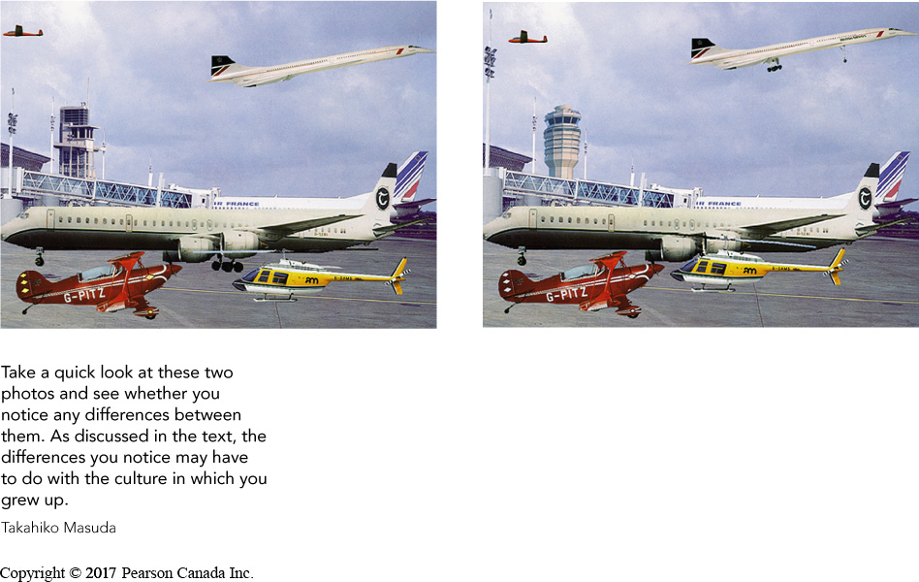
Cultural Differences in Automatic Thinking
Analytic Thinking Style – A type of thinking in which people focus on the properties of objects without considering their surrounding context; this type of thinking is common in Western cultures
Holistic Thinking Style – A type of thinking in which people focus on the overall context, particularly
East-Asians found targets on rich-information websites faster than Canadians
(Nisbett, Masuda, et al.)
fMRI & ERP evidence
Analytic and holistic reasoning can be primed!

Slide 28
Controlled Social Cognition: High Effort Thinking
Controlled Thinking – Thinking that is conscious, intentional, voluntary, and effortful.
Counterfactual Thinking – Mentally changing some aspects of the past as a way of imagining what might have been.
Counterfactual thoughts have a huge impact on people’s emotional reactions to actual events.
The more people engage in counterfactual thinking, the greater their distress.
Counterfactual thinking can lead to paradoxical effects on emotion.
Athletes experience more grief when finishing second than third (Medvec, Madey, Gilovich, 1995).
Counterfactual thinking can be useful if it focuses on ways people can cope in the future – especially to avoid various outcomes.
People who are ‘perfectionists’ may be hindered from counterfactual thinking (Sirous, Monforton, Simpson, 2010).
Overconfidence Barrier – People tend to have too much confidence in the accuracy of their judgements; their judgements are not as correct as they think they are.

Slide 29
Information Processing Model

Slide 30
Critiques of Social Cognition
Gough, McFadden, McDonald (2013)
Social cognition focuses on mental processes outside the social context
Focus on ‘parts’ and not the whole – mental processes are only part of a bigger picture
Focus on the behaviour of individuals rather than on collective behaviour
Biases that have been identified via social cognition experiments are also applicable to the methodology – researchers have the same biases
Experiments may not reflect the ‘real world’ – more experimental control may result in low external validity
Used as a social control mechanism
Subjectivity is not important – moving away from Gestalt approach – removing the subject

Slide 31
Learning Check
What is the difference between controlled and automatic processing?
Please provide examples of judgement heuristics? How do the help or hinder our ability to understand the world?
What is counterfactual thinking? How can it help or hinder our ability to cope with situations?
What are cultural differences in automatic thinking?
What is priming?
What are ways we can make information more ‘accessible’?
Re-create the information processing model.
What is the Barnum effect?

Slide 32
Discussion – The Century of Self
Get into groups of 4 or 5
Answer the following questions.
What is the first part of The Century of Self About?
Who is Edward Bernays? What did he do?
What is PR? What is significant about the PR industry?
What is the relationship between psychology and advertising?
What is the relationship between psychology and politics?
What are the different techniques used to ‘control the masses’?

Slide 33
Questions or Concerns?
Have a great day!

