Slide 1
Fundamentals of Social Psychology
Social Cognition
September 12th, 2019
Erik Chevrier

Slide 2
Activity
Please take out a piece of paper and a pen/pencil.
After three examples, you must write down the first word that comes to your head after I give you a CATEGORY prompt.
The goal of the activity is to write down a word in that CATEGORY the fastest!
Ready, I’m going to catch you off guard.
You will be given three examples to make sure you understand the activity. Don’t let me catch you napping! You’ll need to act FAST!

Slide 3
CATEGORY = THINGS YOU DISLIKE

Slide 4
CATEGORY = THINGS YOU DISLIKE
LITTER

Slide 5
CATEGORY = THINGS YOU DISLIKE
LITTER
CHEATERS

Slide 6
CATEGORY = THINGS YOU DISLIKE
LITTER
CHEATERS
LIARS

Slide 7
CATEGORY = FOOD ITEMS

Slide 8
CATEGORY = FOOD ITEMS
KETCHUP

Slide 9
CATEGORY = TYPES OF SCANS

Slide 10
CATEGORY = TYPES OF SCANS
PET SCAN – Positron emission tomography

Slide 11
CATEGORY = TYPE OF ANIMAL

Slide 12
Automatic Thinking – Low Effort Thinking
Automatic thinking – Is thought that is generally unconscious, unintentional, involuntary, and effortless.
Schemas – Mental structures people use to organize their knowledge about the social world themselves and that influence the information people notice, think about, and remember.
  We tend to fill in the blanks with SCHEMA-CONSISTENT INFORMATION.
  Kunda, Sinclair, Griffin (1997) – Actor (life of the party) vs Sales person (pushy) – Lawyer (argue) vs Construction Worker (physical fight)
  Herold Kelly (1950) – lecturer – cold person vs warm person
How People are Affected By Profuse Amounts of Publicity? – Advertising and Priming
Activity – Automatic Thinking!

Slide 13
REVIEW – SAY THIS WORD OUTLOUD 10 TIMES
ROAST

Slide 14
REVIEW – SAY THIS WORD OUTLOUD 10 TIMES

Slide 15
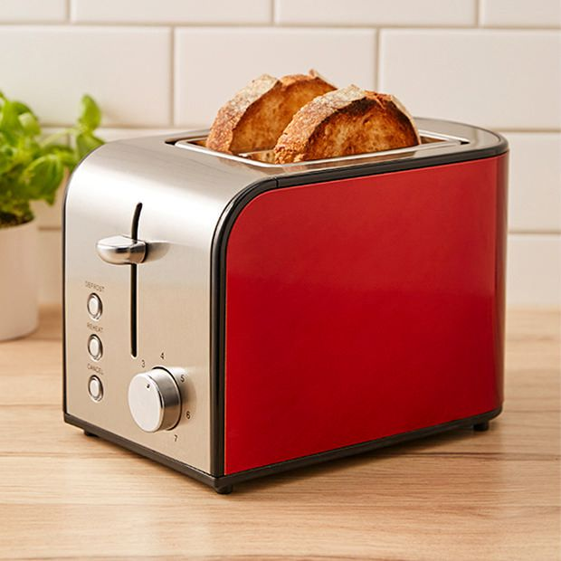
REVIEW – Answer the following question?
What do you put in a toaster?

Slide 16
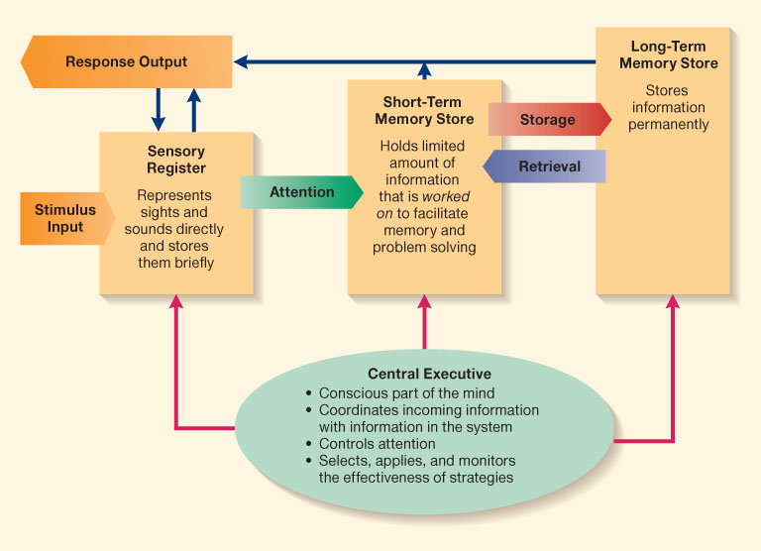
Information Processing Model

Slide 17
Accessibility and Priming
Accessibility – The extent to which schemas and concepts are at the forefront of people’s minds and are, therefore, likely to be used when making judgments about the social world.
  Schemas can be accessible for three reasons:
    Some schemas are chronically accessible because of past experience – these schemas are constantly active and ready to use to interpret ambiguous situations.
    Schemas can be accessible because they are related to a current goal.
    Schemas can become temporary accessible because of our recent experiences.
    Priming – The process by which recent experiences increase the accessibility of a schema, trait, or concept.
      Words have to be accessible and applicable to act as a prime.
      Schemas may be quite resistant to change
      Schemas are influenced by culture
    Perception Without Awareness (PWA) – Daren Brown – How to Control a Nation – Toy Story
    How to Control a Nation Full Video
    The Art of Misdirection

Slide 18
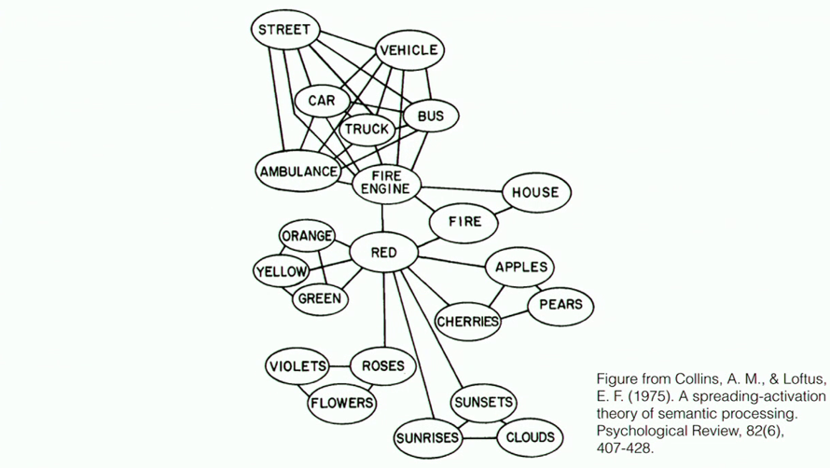
Semantic Processing – Spreading Activation

Slide 19
Activity
Write down the first five words that you can think of in under 10 seconds that remind you of the following words.

Slide 20
Food

Slide 21
Red

Slide 22
Confusion

Slide 23
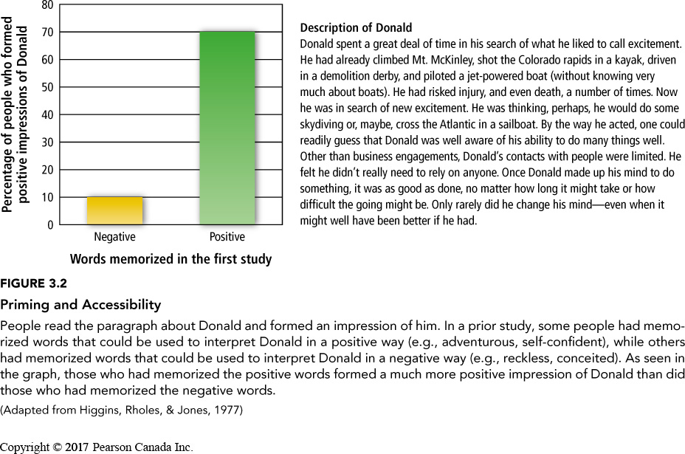
Priming and Accessibility

Slide 24
Applicability
News Media Utilize Priming Tactics - Sinclair Broadcasting Group
What other positive and negative consequences occur from using automatic thinking?
How is priming used to ‘control’ people other than the example given above?
What are other examples of intentional priming tactics that you come across?

Slide 25
Embodied Cognition: Physical Sensations Can Prime Cognitive Schemas
Scent can prime morality (clean vs dirty)
  Clean scented-room = more trusting of stranger & more willing to donate time and money (Lilenquist, Zhong, Galinsky, 2010)
Bodily Sensations can prime mate selection (Kille, Forest, Wood, 2013).
  Instability – more inclined to think people’s marriages wouldn’t last
  More likely to look for stable qualities in a partner
Music can help activate scripts

Slide 26
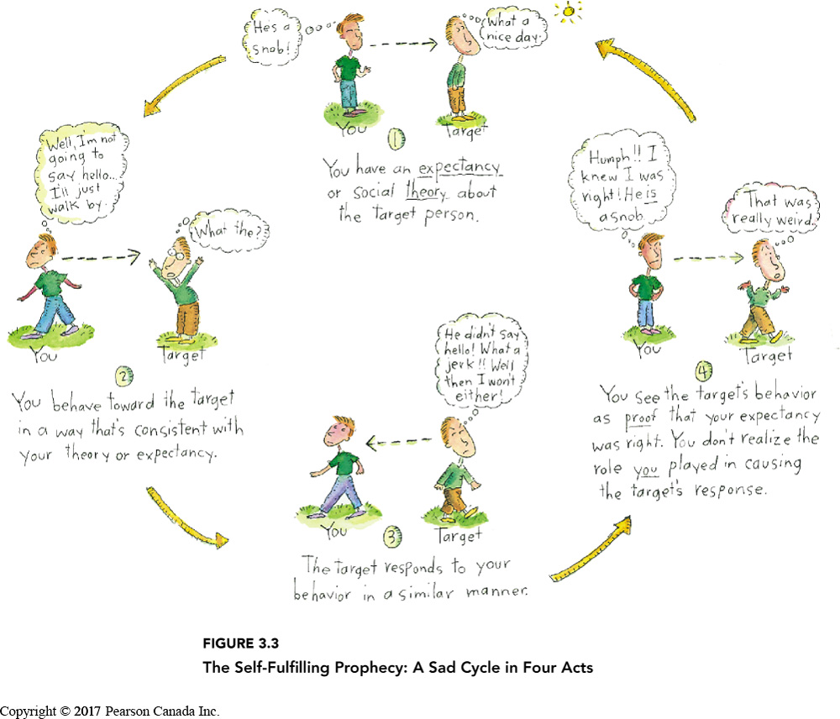
Making Our Schema Come True
Robert Rosenthal

Slide 27
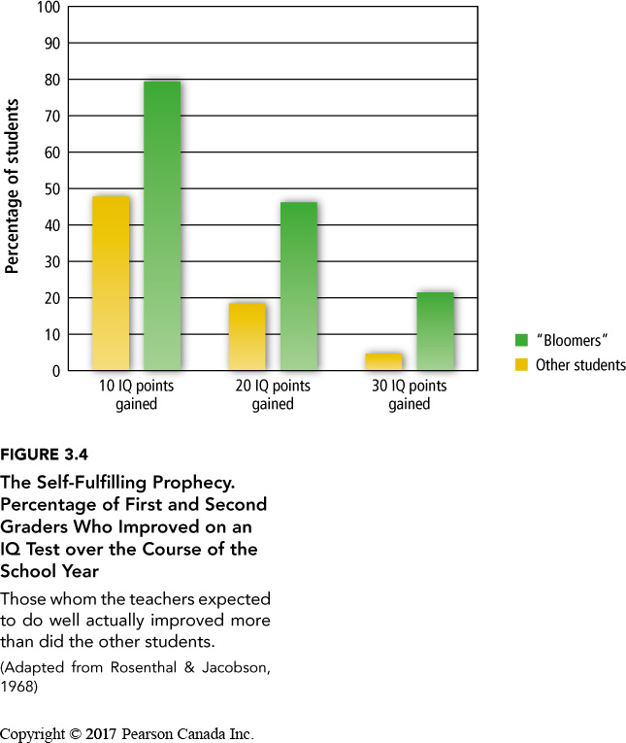
Self-Fulfilling Prophesy
Teachers treated bloomers in four general ways:
1 – They create a warmer environment
2 – Gave bloomers more material & more difficult material
3 – Gave bloomers more & better feedback
4 – Gave bloomers more opportunity & time to respond in class

Slide 28
Mental Strategies and Shortcuts - Heuristics
Judgement Heuristics – Mental shortcuts people use to make judgements quickly and efficiently.
  From the Greek word ‘to discover’
  Availability Heuristics – A mental shortcut whereby people base a judgment on the ease which they can bring information to mind
  Tversky, Kahneman (1973) people remember names of famous people more than non-famous people
  People believe that there were more women on a list when the names were of famous women and non-famous men although there were 19 women and 20 men on the list
  Can lead to faulty conclusions because we don’t get a typical overall picture
  When we do not have a firm schema about our own traits, we often make judgments about ourselves based on how easy it is to recall examples from our own behaviour (Norbert Schwarz, 1991)

Slide 29
Activity
Think of six times you acted assertively
Think of twelve times you acted unassertively

Slide 30
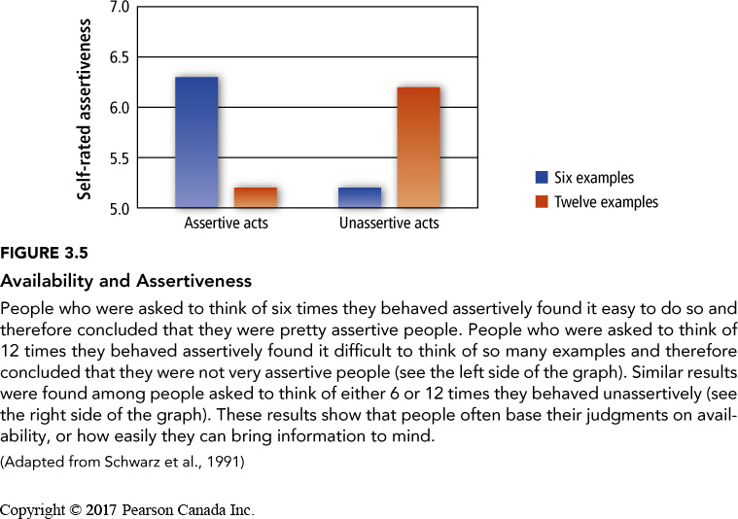
Availability Heuristics & Judgements About Ourselves

Slide 31
Mental Strategies and Shortcuts - Heuristics
Judgement Heuristics – Mental shortcuts people use to make judgements quickly and efficiently.
  From the Greek word ‘to discover’
  Representativeness Heuristic – A mental shortcut whereby people classify something according to how similar it is to a typical case
  Base Rate Information – Information about the frequency of members of different categories
  When both base rate and representativeness heuristics produce contradictory information, people pay more attention to representativeness heuristics (Kahneman & Tversky, 1973)

Slide 32
Representativeness Heuristics in Action
The Barnum effect, is a common psychological phenomenon whereby individuals give high accuracy ratings to descriptions of their personality that supposedly are tailored specifically to them but that are, in fact, vague and general enough to apply to a wide range of people.

Slide 33
Horoscopes
The fast-paced frenzy of the day is just what you need to jump-start your brain and get it moving in the right direction. Take control of the fire within and keep it strong all day. You'll find that there's a more personal aspect to your thoughts, and you can think more rationally about your emotions. Your heart and your head are working well together.
Charge ahead and use your emotions to fuel your fire. You have plenty of mental acumen today that can help break through any puzzle. New beginnings are underway in many areas of your life. There's no reason to delay any longer than you already have. Take this opportunity to live up to your full potential and make things happen for yourself.
Much of your focus is internal, but today it would behoove you to turn some of that energy outward.. Take this opportunity to make a leap of faith in the right direction. You have a great deal of bite behind your words. Don't underestimate your power and bravery. Just be careful that you don't start arguments over petty issues that aren't worth losing friends over.
Source

Slide 34
Horoscopes
Cancer – The fast-paced frenzy of the day is just what you need to jump-start your brain and get it moving in the right direction. Take control of the fire within and keep it strong all day. You'll find that there's a more personal aspect to your thoughts, and you can think more rationally about your emotions. Your heart and your head are working well together.
Virgo – Charge ahead and use your emotions to fuel your fire. You have plenty of mental acumen today that can help break through any puzzle. New beginnings are underway in many areas of your life. There's no reason to delay any longer than you already have. Take this opportunity to live up to your full potential and make things happen for yourself
Pisces – Much of your focus is internal, but today it would behoove you to turn some of that energy outward. Take this opportunity to make a leap of faith in the right direction. You have a great deal of bite behind your words. Don't underestimate your power and bravery. Just be careful that you don't start arguments over petty issues that aren't worth losing friends over.
Source

Slide 35
Horoscopes
Taurus – The fast-paced frenzy of the day is just what you need to jump-start your brain and get it moving in the right direction, Taurus. Take control of the fire within and keep it strong all day. You'll find that there's a more personal aspect to your thoughts, and you can think more rationally about your emotions. Your heart and your head are working well together.
Libra – Charge ahead and use your emotions to fuel your fire, Libra. You have plenty of mental acumen today that can help break through any puzzle. New beginnings are underway in many areas of your life. There's no reason to delay any longer than you already have. Take this opportunity to live up to your full potential and make things happen for yourself
Capricorn – Much of your focus is internal, but today it would behoove you to turn some of that energy outward, Capricorn. Take this opportunity to make a leap of faith in the right direction. You have a great deal of bite behind your words. Don't underestimate your power and bravery. Just be careful that you don't start arguments over petty issues that aren't worth losing friends over.
Source

Slide 36
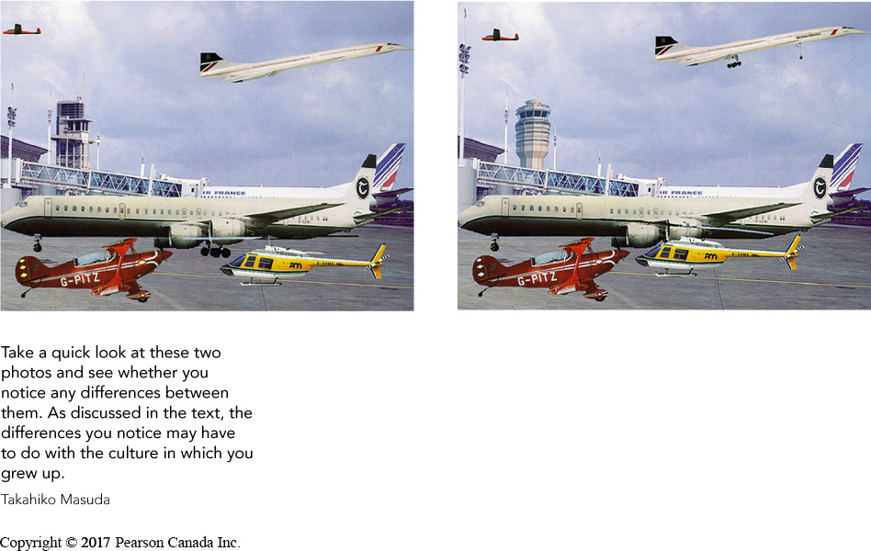
Cultural Differences in Automatic Thinking
Analytic Thinking Style – A type of thinking in which people focus on the properties of objects without considering their surrounding context; this type of thinking is common in Western cultures
Holistic Thinking Style – A type of thinking in which people focus on the overall context, particularly
East-Asians found targets on rich-information websites faster than Canadians
(Nisbett, Masuda, et al.)
fMRI & ERP evidence
Analytic and holistic reasoning can be primed!

Slide 37
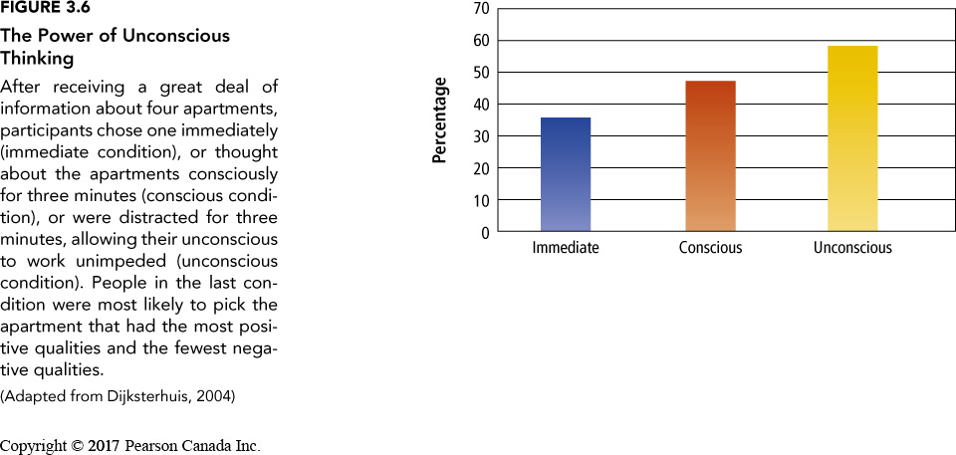

Slide 38
Controlled Social Cognition: High Effort Thinking
Controlled Thinking – Thinking that is conscious, intentional, voluntary, and effortful.
Counterfactual Thinking – Mentally changing some aspects of the past as a way of imagining what might have been.
  Counterfactual thoughts have a huge impact on people’s emotional reactions to actual events.
  The more people engage in counterfactual thinking, the greater their distress.
  Counterfactual thinking can lead to paradoxical effects on emotion.
    Athletes experience more grief when finishing second than third (Medvec, Madey, Gilovich, 1995).
  Counterfactual thinking can be useful if it focuses on ways people can cope in the future – especially to avoid various outcomes.
  People who are ‘perfectionists’ may be hindered from counterfactual thinking (Sirous, Monforton, Simpson, 2010).
Overconfidence Barrier – People tend to have too much confidence in the accuracy of their judgements; their judgements are not as correct as they think they are.

Slide 39
Information Processing Model

Slide 40
Critiques of Social Cognition
Gough, McFadden, McDonald (2013)
Social cognition focuses on mental processes outside the social context
Focus on ‘parts’ and not the whole – mental processes are only part of a bigger picture
Focus on the behaviour of individuals rather than on collective behaviour
Biases that have been identified via social cognition experiments are also applicable to the methodology – researchers have the same biases
Experiments may not reflect the ‘real world’ – more experimental control may result in low external validity
Used as a social control mechanism
Subjectivity is not important – moving away from Gestalt approach – removing the subject

Slide 41
Learning Check
What is the difference between controlled and automatic processing?
Please provide examples of judgement heuristics? How do the help or hinder our ability to understand the world?
What is representativeness heuristics and base rate information? Which do people use more often if both provide contradictory information?
What are cultural differences in automatic thinking?
What is a schema? What is schema consistent information?
What is a self-fulfilling prophecy? How do they work? What did teachers do with ‘bloomers’ in Rosenthal's study?
What is priming? How does it work?
What are ways we can make information more ‘accessible’?
Re-create the information processing model.
What is the Barnum effect?
What is the power of unconscious thinking refer to?
What is controlled social cognition? What is counterfactual thinking – how can it help or hinder our ability to cope with situations?
What is the overconfidence barrier?
What are the critiques about social cognition according to Gough, McFadden, McDonald (2013)?

Slide 42
Discussion – The Century of Self
Get into groups of 4 or 5
Answer the following questions.
What is the first part of The Century of Self About?
Who is Edward Bernays? What did he do?
What is PR? What is significant about the PR industry?
What is the relationship between psychology and advertising?
What is the relationship between psychology and politics?
What are the different techniques used to ‘control the masses’?

Slide 43
Questions or Concerns?
Have a great day!

