Slide 1
Food and Culture
Erik Chevrier
September 16th, 2019

Slide 2
Discussion
What is food?
What is culture?
What is the link between food and culture?

Slide 3
What is Culture?
Raymond Williams
A general process of intellectual, spiritual and aesthetic development.
A particular way of life, whether of a people, period or group.
The works and practices of intellectual and especially artistic activity.
Nesbitt-Larking
The general process of intellectual, spiritual, and artistic development of a people.
The entire way of life of a people, in terms of those practices and facts through which they express their meaning.
High culture – the works and practices of intellectual artistic activity
Culture is the way of life of a people, in particular their evolving ideas, beliefs, and values as they are understood, communicated and represented.
Bennett
Culture consists of all those practices (or activities) that signify; that is, which produce and communicate meaning by the manipulation of signs in socially shared and conventionalized ways.

Slide 4
What is Food Culture?
Food culture refers to the practices, attitudes, and beliefs as well as the networks and institutions surrounding the production, distribution, and consumption of food.
It encompasses the concepts of foodways, cuisine, and food system and includes the fundamental understandings a group has about food, historical and current conditions shaping that group’s relationship to food, and the ways in which the group uses food to express identity, community, values, status, power, artistry and creativity. It also includes a groups’ definitions of what items can be food, what is tasty, healthy, and socially appropriate for specific subgroups or individuals and when, how, why, and with whom those items can or should be consumed.
Source Dr. Long

Slide 5
You Are What You Eat
Spillman
Human process of meaning-making generating artifacts, categories, norms, values, practices, rituals, symbols, worldviews, ideas, ideologies, and discourses.
- institutions - specific or defined group - part of everyday interactions
How social interactions convey meaning and how meaning is interpreted.

Slide 6
You Are What You Eat
Anne Swidler
Culture is toolkit or repertories
A realistic cultural theory should lead us to understand that people are not passive ‘cultural dopes’ but rather active, sometimes skilled users of culture whom we actually observe
Culture should be viewed as a collection of culturally defined elements
From a reparatory, individuals can pick elements that sustain habitual behaviors or select tools to explore new ways of acting in the world
People have agency but are also led by cultural norms

Slide 7
You Are What You Eat
Giddens
Practical consciousness – Tacit understandings and intuitive decisions people make as they go about daily routines but they can’t always directly express.
Discursive consciousness – Formal articulations and rationalizations for actions.
Bourdieu
Habitus – Tastes become internalized and converted into a disposition that generates meaningful practices and meaning-giving perceptions
Habitus typically translates people’s social class into their embodied taste preferences that may give them advantages later on in life.

Slide 8
You Are What You Eat
Cognition is a dual process – Deliberate conscious process that is slow and reflexive & automatic process that is fast and intuitive.
Schemas – Represent deep, largely ‘unconscious’ networks of neural associations that facilitate perception, interpretation and action…Schemas emerge from experience and allow people from becoming cognitively overburdened in daily life. (Vaisey)
Ethical foodscape – A realm where good food is not simply viewed as an individual indulgence, but connects to collective obligations like sustainability, animal welfare, and social justice. (Goodman)
Alternative hedonism – Consuming differently (ethically) can be a source of pleasure. (Soper)

Slide 9
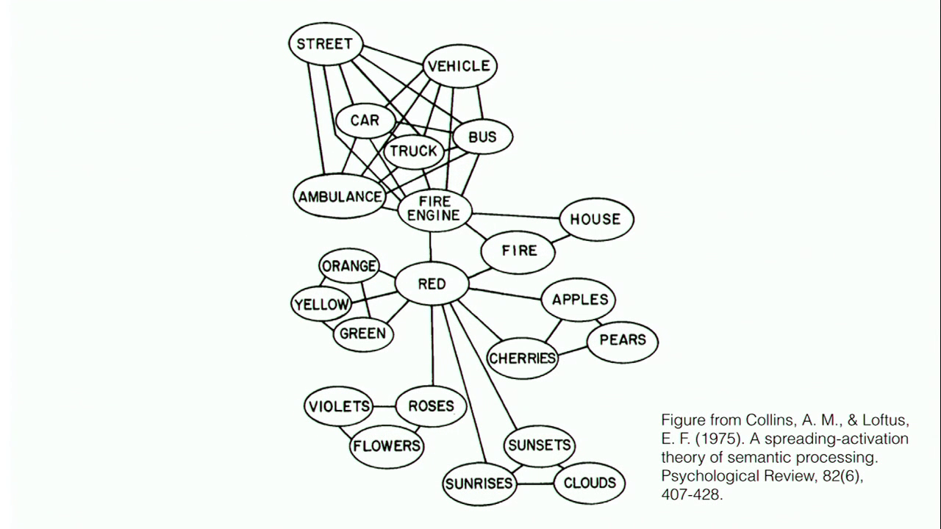
Cognitive Model & Schemas
Cognitive Model
Semantic Processing – Spreading Activation

Slide 10
Ecological Systems Theory of Development

Slide 11
Food and Culture – Meaning Behind Food – You Are What You Eat
Whole Foods Market
Karma Co-op
IGA Tim Horton's I am Canadian I am not Canadian

Slide 12
Your Own Food Shopping Habits
What do eat in a typical day?
Where do you acquire food in your daily routine? i.e. home, restaurant, etc.
How much of your daily food to you cook (including leftovers) in a typical day?
Where do you typically shop for groceries? Why?
How often do you shop for groceries?
Do you grow your own food? If so, what do you grow?
Think about the last time you were shopping for food at a grocery store…
What did you purchase? Why?
Do you typically make a list before grocery shopping? If so, do you follow it?
What can you remember about your subjective experience at the grocery store?
What guides your food purchase decisions most?
Automatic less calculated more impulsive choices? Or Well thought out, planned choices?

Slide 13
General Framework
Richard Johnson What is Cultural Studies Anyways, Social Text, (1986-87)

Slide 14
Critical Multidimensional Model
Paul Nesbitt-Larking. Politics, Society and the Media (2nd Edition). Broadview Press. 2009.

Slide 15
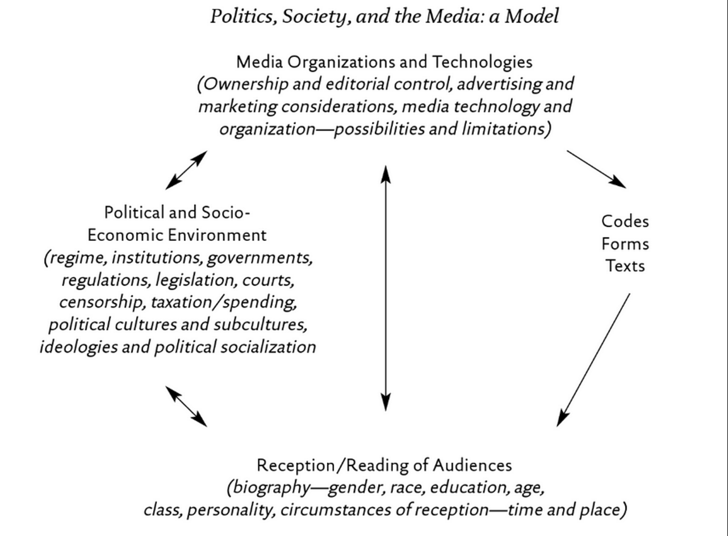
Analyze a brand of Breakfast Cereals Through One of These Models

Slide 16
Please Think About and Answer the Following Questions
How does culture influence eating practices? More concretely, what kinds of food culture promotes healthy, environmentally friendly choices? What kinds of food culture undermine these choices?
When (and how frequently) do food choices involve practical consciousness (i.e. habitus, emotional eating)? When (and how frequently) do people draw on a deliberative level of consciousness to make food choices, and why?
What factors motivate consumers to consume sustainable foods produced with fair labour practices (e.g. fair-trade chocolate)? Do you agree with Kate Soper that pleasurable rewards are necessary to sustain alternative food practices?

Slide 17
Cooking for Next Week
Did everyone fill out the Google Pages Link?
Did you indicate which days you would bring food?
Did you indicate your dietary conditions/allergies?

Slide 18
Le Frigo Vert
Before next class, please check out!
Le Frigo Vert

