Slide 1
Fundamentals of Social Psychology
Social Perception
September 17 & 19th, 2019
Erik Chevrier

Slide 2
Discussion
Please identify ways that people communicate without using words.

Slide 3
Nonverbal Behaviour
Nonverbal communication refers to how people communicate, intentionally or unintentionally, without words.
Facial expressions, tone of voice, gestures, body position/movement, touch, eye gaze, are common nonverbal communication channels.
Nonverbal behaviour is important for forming first impressions, but they are not always accurate
Nonverbal cues serve the following functions in communication:
They express emotions, attitudes and personality
They elicit empathy – mirror neurons
They substitute for verbal messages (emblems)
Many nonverbal cues occur at the same time (although they are mainly studied in isolation)

Slide 4
Facial Expressions of Emotion
Charles Darwin (1872) The expression of the Emotions in Man and Animals – Focus on facial expressions.
Encode – To express or emit nonverbal behaviour, such as smiling or patting someone on the back.
Decode – To interpret the meaning of the nonverbal behaviour other people express, such as deciding that a pat on the back was an expression of condescension not kindness
Primary facial expressions are universal
Nonverbal communication is species specific and not culture specific
They are vestiges of once-useful physiological reactions
Evolutionary significance of conveying emotional states

Slide 5
Facial Expressions of Emotion
Ekman – There are six universal expressions of emotion (anger, happiness, fear, surprise, disgust, sadness)
Not all agree:
There are other emotions besides these six (emotion families and/or first-order – second order emotions) – Embarrassment, contempt, pride, shame, pain, love, wonder, humour/amusement, etc.
Not all six emotions can be interpreted universally
Ekman & Friesen (1975) 82% labelled happiness correctly, 54% identified fear (Argentina & New Guinea), 44% identified disgust (New Guinea)
Less agreement when participants had to name the emotion instead of selecting from list
Contempt was not recognizable across cultures
Context is important – decoding facial expressions is influenced by the presence of other faces
Situation is important – Information about the situation will change our interpretation
Holistic vs analytic thinkers

Slide 6
What is an Emotion? Reeve, J. (2018) Understanding Motivation and Emotion, 7th ed. John Wiley and Sons
Emotions are short-lived, feeling-purposive-expressive bodily responses that help us adapt to the opportunities and challenges we face during important life events.
Thus, a significant life event occurs and produces a distinct pattern of neural activity that, in turn, generates and coordinates the emotional reaction that is a feeling-purposive-expressive-bodily reaction to the life event.

Slide 7
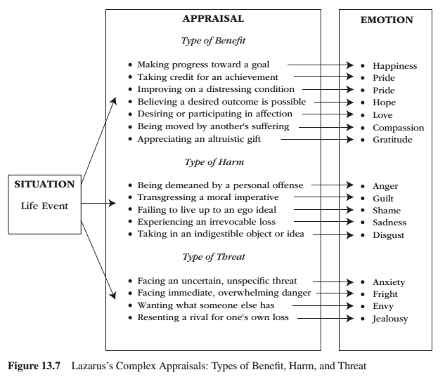
CHAPTER 13 – Complex Appraisal Reeve, J. (2018) Understanding Motivation and Emotion, 7th ed. John Wiley and Sons
Lazarus – emphasized the cognitive processes that intervene between important life events (environmental conditions) and physiological and behavioural reactivity.
People evaluate whether the situation has personal relevance for their well-being.
Good appraisals – several types of benefit Bad appraisals – several types of harm and threat

Slide 8
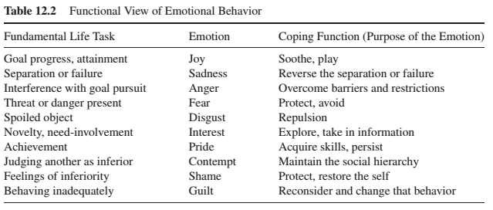
Coping Functions Reeve, J. (2018) Understanding Motivation and Emotion, 7th ed. John Wiley and Sons
These are flexible and not rigid categories.
Emotions serve at least 10 distinct purposes.

Slide 9
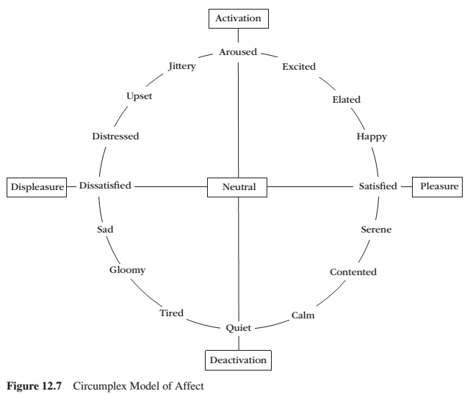
Circumplex Model of Affect Reeve, J. (2018) Understanding Motivation and Emotion, 7th ed. John Wiley and Sons
Valence – dimension of pleasure vs displeasure Arousal – activation vs deactivation

Slide 10
Facial Expressions of Emotion

Slide 11
Facial Expressions of Emotion

Slide 12
Facial Expressions of Emotion
Why is decoding sometimes inaccurate?
Affect blends – A facial expression in which one part of the face registers one emotion while another part of the face registers a different emotion
Display Rules – Culturally determined rules about which emotional expressions are appropriate to show
Gender differences, collectivist vs individualist
What kind of display rules exist in North America & other locations?

Slide 13
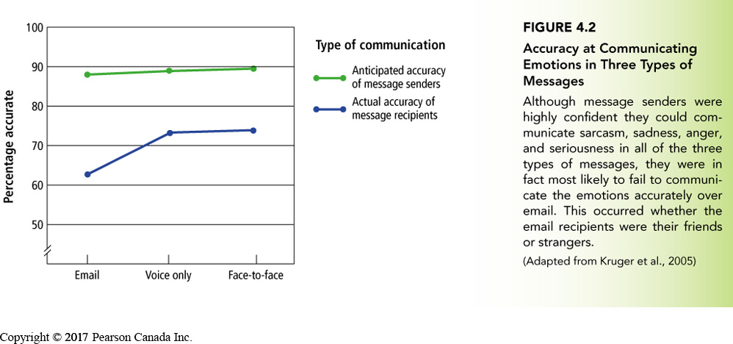
Other Channels of Nonverbal Communication
Eye gaze
Normative use of personal space
Gestures
Emblems – nonverbal gestures that have well-understood definitions within a given culture; they usually have direct verbal translations, such as the ‘okay’ sign

Slide 14
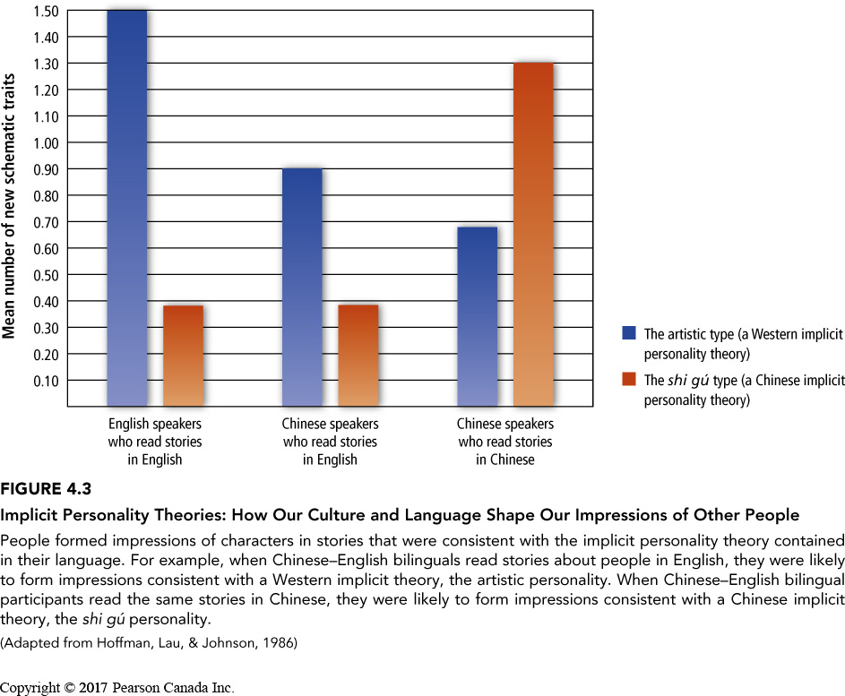
Implicit Personality Theories
Implicit Personality Theory:
A type of schema people use to group various kinds of personality traits together; for example, many people believe that if someone is kind, they will be generous as well.
Happens automatically
Can lead us to misjudge people
Are strongly ties to culture
‘artistic personality’ – creative, intense, temperamental, unconventional lifestyle
‘shi gu’ – Worldly, devoted to family, socially skillful, somewhat reserved

Slide 15
Causal Attributions
Fritz Heider
Attribution theory – The study of how people explain the causes of their own and other people’s behaviour
Internal attribution – The inference that a person is behaving in a certain way because of something about their attitude, character or personality
External attribution – The inference that a person is behaving a certain way because of something about the situation they are in; the assumption is that most people would respond the same way in the same situation

Slide 16
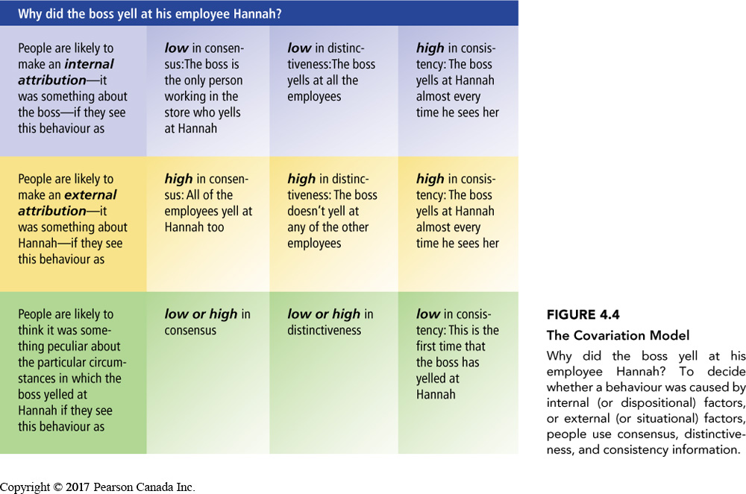
Covariation Model
Covariation model – A theory stating that to form an attribution about what caused a person’s behaviour, we systematically note the pattern between the presence (or absence) of possible causal factors and whether or not the behaviour occurs at different times and in different situations.
Consensus information: Information about the extent to which other people behave the same way as the actor does toward the same stimulus
Distinctiveness Information: Information about the extent to which the actor behaves in the same way to different stimuli
Consistency Information: Information about the extent to which the behaviour between the actor and the stimulus is the same across time and circumstances
Harold Kelly (1967, 1973)

Slide 17
Covariation Model
Covariation model – A theory stating that to form an attribution about what caused a person’s behaviour, we systematically note the pattern between the presence (or absence) of possible causal factors and whether or not the behaviour occurs at different times and in different situations.
Consensus information: Information about the extent to which other people behave the same way as the actor does toward the same stimulus
Distinctiveness Information: Information about the extent to which the actor behaves in the same way to different stimuli
Consistency Information: Information about the extent to which the behaviour between the actor and the stimulus is the same across time and circumstances
Harold Kelly (1967, 1973)
Critique:
People don’t use consensus information as much as what Kelly predicted – they rely more on consistency and distinctiveness.
People don’t always have relevant information needed on all three dimensions

Slide 18
Learning Check
I (teacher) yelled at ‘student X’
The students also yelled at ‘student X’
I (teacher) yell at ‘student X’ almost every class
I (teacher) don’t ever yell at any other student

Slide 19
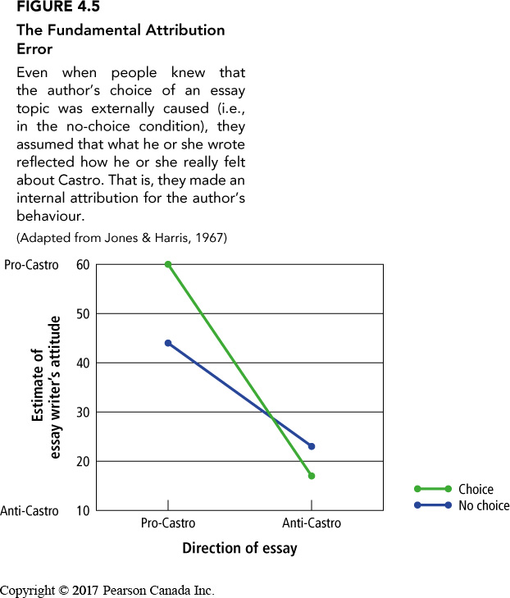
Fundamental Attribution Error
Fundamental attribution error (correspondence bias) – The tendency to overestimate the extend to which people’s behaviour is due to personality traits and to underestimate the role of situational factors.

Slide 20
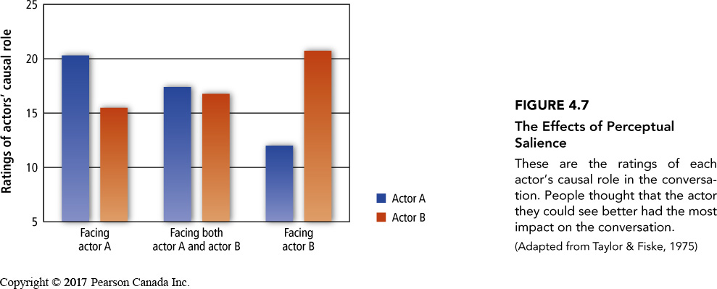
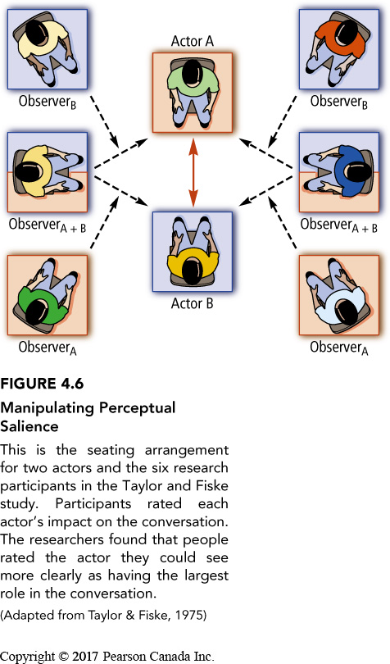
Fundamental Attribution Error
Victim blaming – Even if people are made aware of the situational factors responsible for the plight of disadvantaged members of society they may still see these individuals as responsible for their misfortune
Perceptual salience – Information that is the focus of people’s attention; people tend to overestimate the causal role of the perceptually salient information

Slide 21
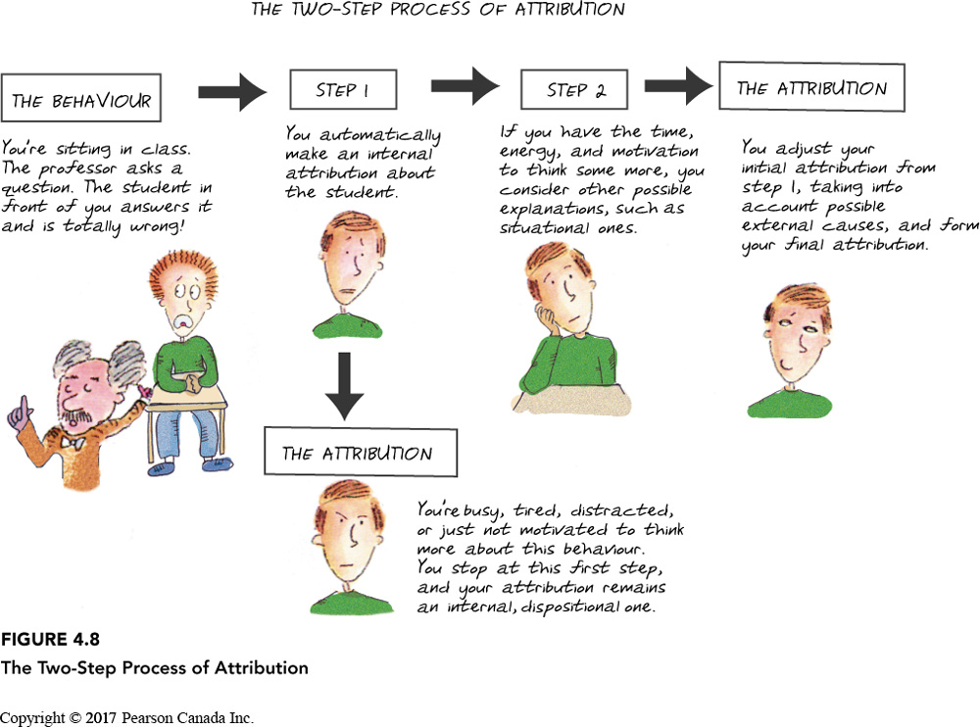
Two-Step Process of Making Attributions
Two-Step Process of Attribution: Analyzing another person’s behaviour first by making an automatic internal attribution and only then thinking of possible situational reasons for the behaviour, after which one may adjust the original internal attribution
Varies across cultures
Changes depending if we are describing ourselves or others
Actor/observer differences

Slide 22
Self-Serving Attributions
Self-Serving Attributions: Explanations for one’s success that credit internal, dispositional factors and explanations for one’s failures blame external, situational factors.
Remember what we worked on with others more than what they did
Can be seen in athlete speeches – some experienced athletes don’t fall into the trap
Cultural influence – More present in individualist (Western) cultures

Slide 23
Defensive Attributions
Defensive attribution: Explanations for behaviour that avoid feelings of vulnerability and mortality
Belief in a Just World: A form of defensive attribution wherein people assume that bad things happen to bad people and good things happen to good people

Slide 24
Learning Check
What are examples of nonverbal communication?
What did Darwin suggest about facial expressions?
According to Ekman, what are the six universal emotions determined by unique facial expressions?
Give evidence for and against the argument that facial expressions of emotion universal.
Why is decoding sometimes inaccurate?
What are other channels for nonverbal communication?
What is implicit personality theory?
How to people draw causal attributions about people’s behaviour?
How do people draw causal attributions about their own behaviour?
What is the covariation model of attribution?
What is the fundamental attribution error and how does it manifest cross culturally?
What are consequences of the fundamental attribution error?
What is the two-step process of making attributions? How does it apply cross culturally?
What are defensive attributions? Give some examples of defensive attributions.
What is an emotion?

Slide 25
Questions or Concerns?
Have a great day!

