Slide 1
Food and Culture
Erik Chevrier
Foundations of Food and Culture
September 23rd, 2019

Slide 2
RECAP – General Framework
Richard Johnson What is Cultural Studies Anyways, Social Text, (1986-87)

Slide 3
Foundations of Food and Culture
Margaret Mead – Why do we overeat? *Published in 1971
What is the main message in Mead’s article?
What evidence/examples does Mead refer to support her claims?
According to Mead, why do people overeat?
What does Mead suggest about the way society views body type?
According to Mead, how can we help our children eat in a ‘new style’?

Slide 4
Foundations of Food and Culture
Margaret Mead – Why do we overeat? *Published in 1971
Daily abundance of food is one of the main characteristic of affluence in society.
Those who have just enough to survive on, feast at festivals and eat meagerly in the long intervals between great events.
Most people in affluent societies aren’t struggling to obtain food but have to resist eating too much.
In affluent societies, cooking is seen as an art.
Obesity is looked at negatively in America (as well as other industrialized nations)
We can help our children eat in a new style
1 – We can give up using food as a punishment and reward – as a symbol of duty performed (or neglect) a consolation or an accolade. Where food is so plentiful, food can be food and the focus of our feelings can be directed toward the pleasure of sharing a meal with others.
2 – We an recognize the fact that the rule of “there square meals a day” has become a kind of straightjacket. We would do better to take into account the variations in individual rhythms in the need for food as well as the different rhythms in the working day for different people.
3 – The whole world today is linked through food, the food that some have in superabundance and others urgently need. By freeing our children of the strictures of conscience about their personal consumption of food, the would be freer to think of shared food as a source of well-being for everyone everywhere.

Slide 5
Foundations of Food and Culture
Roland Barthes – Towards a Psychosociology of Contemporary Food Consumption *(published in 1961)
What is the main message in Barthes article?
What evidence/examples does Barthes refer to support his claims?
How does food convey meaning?
How do food practices convey meaning?
How does food transform into a situation?
What is meant that food will lose substance but gain function?
What does food advertising convey (three themes)?
How does Barthes article link to Johnson’s model (introduced in class on September th)?

Slide 6
Foundations of Food and Culture
Roland Barthes – Towards a Psychosociology of Contemporary Food Consumption *(published in 1961)
Foodstuff (sugar) is more than an item to be consumed, it is bound to certain usages, certain protocols that have to do with more than food.
M. Perrot (Le Mode de Vie des Familles Bourgeoys de 1873 - 1953) economic factors played a less important role in the changes that have taken place in the middle-class food habits in the last hundred years than changing tastes, this really means ideas, especially about nutrition.
The development of advertising has led to the development of the ‘ideal nature’ of foodstuff – which by no means represents the actual product.
Food is a system of communication, a body of images, a protocol for usages, situations and behaviours.
Food sums up and transmits a situation, it constitutes information, it signifies.
Food substances, techniques of preparation, habits, all become part of a system of differences in signification.
Looking at food advertising, three themes are identified.
1 – Food functions as something commemorative.
2 – Values concern the ‘anthropological situation’ they communicate meaning about gender, sexuality, relationships, etc.
3 – Food conveys ambiguous values about the psyche and soma – health.
Food has a constant tendency to transform itself into situation – i.e. coffee and snack break.
Food will lose in substance and gain in function.

Slide 7
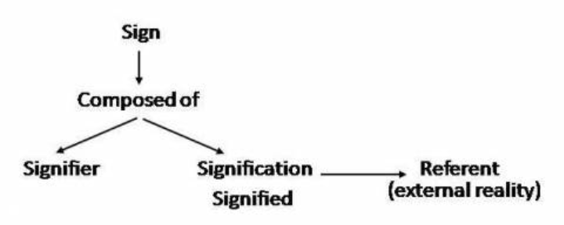
Brief Overlook of Semiotics
Signs – A combination of signifier and signified
Signifier – The physical existence of what carries meaning
Signified – The mental representation that is the meaning
Denotative meaning – Common sense, obvious meaning
Connotative – Interaction of denotative meaning and one’s subjective feelings

Slide 8
Foundations of Food and Culture
Pierre Bourdieu – Distinction: Social Critique of the Judgement of Taste *Published in 1979
What is the main message in Bourdieu’s article?
What evidence/examples does Bourdieu refer to support his claims?
What is the relationship between food, presentation and culture for teachers, professionals, and industrial and commercial employees?
How does food convey information about class and gender?
How is body type embodied in class and gender relations?
How does schema play a role in our understanding of certain foods?
What cultural significance is given to different types of food items?

Slide 9
Foundations of Food and Culture
Pierre Bourdieu – Distinction: Social Critique of the Judgement of Taste *Published in 1979
Compared the spending habits of teachers, professionals, and industrial and commercial employees in respect to food, presentation and culture.
Food is consumed differently between rich and poor, as well as between people of different professions.
Food communicates ideas about social class and gender relations – food tastes are also shaped by social class, gender relations.
‘Taste, a class culture turned into nature, that is embodied, helps to shape the class body.’
Body schema governs the selection of certain foods.
Tastes in food cannot be considered in complete independence of the other dimensions of the relationships to the world, to others and one’s own body, through which the practical philosophy of each class is enacted.
Each lifestyle can only really be constructed in relationship to the other, which is its objective and subjective negation, so that the meaning of behaviour is totally reversed depending on which point of view is adopted and on whether the common words which have to be used to name the conduct are invested with popular or bourgeois connotations, i.e. freedom & abundance.
Emphasis from substance and function to form and manner – there is opposition between form, (social form) and substance.

Slide 10
Foundations of Food and Culture
Claude Levi-Strauss – The Culinary Triangle * Published in 1966
What is the main message in Levi-Strauss’s article?
What evidence/examples does Levi-Strauss refer to support his claims?
What is the culinary triangle?
What is the relationship between culture and cooked, rotten and raw foods?
What is the relationship between smoked, roasted and boiled foods and raw, cooked and rotten foods?
How do cultures prepare foods across time and space?

Slide 11
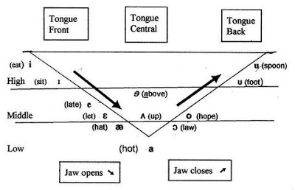
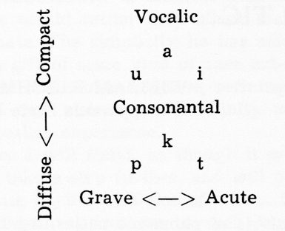
Foundations of Food and Culture
Claude Levi-Strauss – The Culinary Triangle * Published in 1966
Uses linguistic principles of the ‘vowel triangle’ and ‘consonant triangle’ to relate to cooking

Slide 12
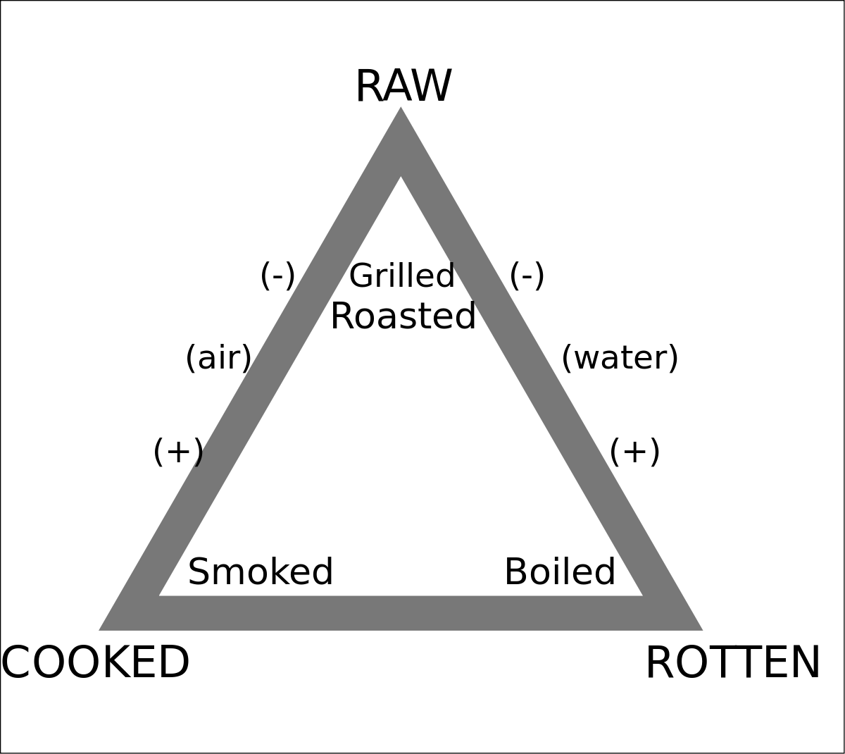
Foundations of Food and Culture
Claude Levi-Strauss – The Culinary Triangle * Published in 1966

Slide 13
What you Should Know
Know Claude Levi-Strauss’s theory of the culinary triangle
Know examples given by Claude Levi-Strauss of cultures and their use of cooking, rotting, and raw food methods. You should also be able to name cultures that have used smoking, boiling and grilling methods. Here are some examples:
Guayaki of Paraguay roast all their game, except when they prepare meat destined for the rites which determine the name of the child: meat must be boiled.
Caingang of Brazil prohibit boiled meat for the widow and widower, and also for anyone who has murdered an enemy.
Poconachi of Mexico interpret roasted as a compromise between the raw and the burned. After the universal fire, they relate – that which had not been burned became white, that which had burned was black, and that which had only been singed turned red. This explanation accounts for various colors of the corn and bean.
Know the categories that Claude Levi-Strauss adds at the end of the article and understand how they relate to the culinary triangle, i.e. fried, grilled, and steamed.
What about other processing techniques, i.e. fermentation?

Slide 14
Discussion
Write down 5 things that come to your mind about the following food items. What cultural signs are attributed with each food item?

Slide 15
Coffee

Slide 16
Salad

Slide 17
Bread

Slide 18
Eggs

Slide 19
Soup

Slide 20
Cake

Slide 21
Cheese

Slide 22
Steak

Slide 23
Fruit

Slide 24
Candy

Slide 25
Pizza

Slide 26
Discussion
What kind of food etiquette did your family follow at the diner table?
Did you eat together?
Did you have family conversations?
Did you eat in front of the TV?
What were the divisions of labour (i.e. cooking, cleaning dishes, preparation, etc.)?
What kind of rules were set at the table?
Language, preventing bodily functions, etc.…
What other kind of food rituals can you remember partaking in as a child (parties, barbecues, corn roasts, gatherings, etc.)?

Slide 27
Readings to Focus on for Next Class
Chapter 7:
Goody, J. (1982) Industrial Food: Towards the Development of a World Cuisine, pp. 72 – 90.
Chapter 8:
Mintz, S. W. (1979) Time, Sugar and Sweetness, pp. 91 – 103.

Slide 28
Have a great week!
Before next class, please check out!
The Hive

