Slide 1
Food and Culture
Erik Chevrier
September 30th, 2019

Slide 2
Reading for Next Week
I have modified the reading list for next week.
Focus on:
Shiva, V. (2015) Earth Democracy: Justice, Sustainability and Peace, North Atlantic Books.
Chapter 1 – Living Economies, pp. 11 – 64.
Please read if you have time:
Wittman, H., Desmarais, A. A., & Wiebe, N. (2011) Food Sovereignty in Canada: Creating Just and Sustainable Food Systems, Fernwood Publishing.
Chapter 2 – Qualman, D. (2011) Advancing Agriculture by Destroying Farms? The State of Agriculture in Canada, pp. 20 – 42.

Slide 3
Discussion
What did you choose for your first food blog?
What type of report are you doing?
Interview
Traditional paper
Conference
Interview
How are you gathering evidence?
How are you structuring your paper/project?
What are some issues you may encounter?
What are some topics you’ll address?
What is the cultural significance of your food item?
What was the main ‘findings’ for your report?
What was discussed at the conference?
Who are you interviewing?

Slide 4
Foundations of Food and Culture
Pierre Bourdieu – Distinction: Social Critique of the Judgement of Taste *Published in 1979
What is the main message in Bourdieu’s article?
What evidence/examples does Bourdieu refer to support his claims?
What is the relationship between food, presentation and culture for teachers, professionals, and industrial and commercial employees?
How does food convey information about class and gender?
How is body type embodied in class and gender relations?
How does schema play a role in our understanding of certain foods?
What cultural significance is given to different types of food items?

Slide 5
Foundations of Food and Culture
Pierre Bourdieu – Distinction: Social Critique of the Judgement of Taste *Published in 1979
Compared the spending habits of teachers, professionals, and industrial and commercial employees in respect to food, presentation and culture.
Food is consumed differently between rich and poor, as well as between people of different professions.
Food communicates ideas about social class and gender relations – food tastes are also shaped by social class, gender relations.
‘Taste, a class culture turned into nature, that is embodied, helps to shape the class body.’
Body schema governs the selection of certain foods.
Tastes in food cannot be considered in complete independence of the other dimensions of the relationships to the world, to others and one’s own body, through which the practical philosophy of each class is enacted.
Each lifestyle can only really be constructed in relationship to the other, which is its objective and subjective negation, so that the meaning of behaviour is totally reversed depending on which point of view is adopted and on whether the common words which have to be used to name the conduct are invested with popular or bourgeois connotations, i.e. freedom & abundance.
Emphasis from substance and function to form and manner – there is opposition between form, (social form) and substance.

Slide 6
Foundations of Food and Culture
Claude Levi-Strauss – The Culinary Triangle * Published in 1966
What is the main message in Levi-Strauss’s article?
What evidence/examples does Levi-Strauss refer to support his claims?
What is the culinary triangle?
What is the relationship between culture and cooked, rotten and raw foods?
What is the relationship between smoked, roasted and boiled foods and raw, cooked and rotten foods?
How do cultures prepare foods across time and space?

Slide 7
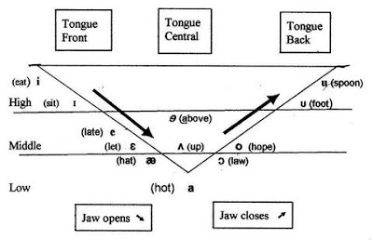
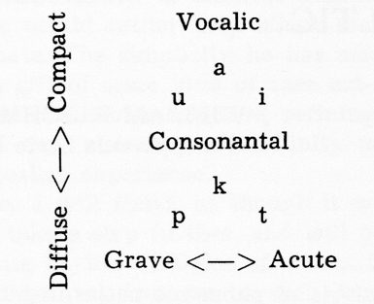
Foundations of Food and Culture
Claude Levi-Strauss – The Culinary Triangle * Published in 1966
Uses linguistic principles of the ‘vowel triangle’ and ‘consonant triangle’ to relate to cooking

Slide 8
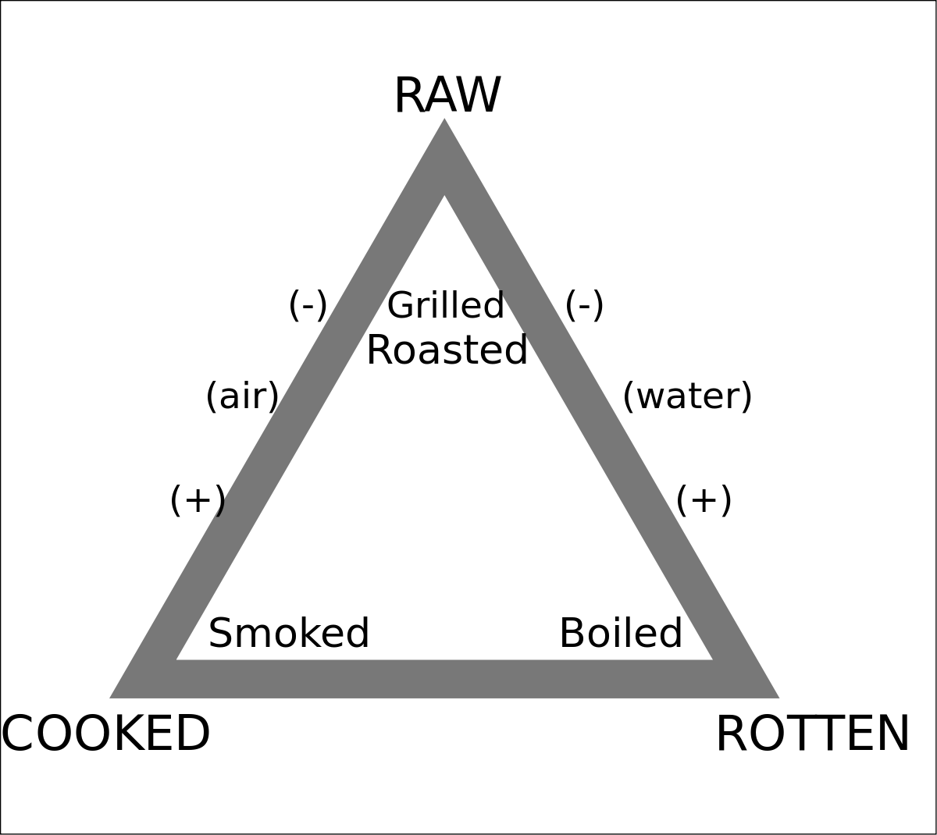
Foundations of Food and Culture
Claude Levi-Strauss – The Culinary Triangle * Published in 1966

Slide 9
What you Should Know
Know Claude Levi-Strauss’s theory of the culinary triangle
Know examples given by Claude Levi-Strauss of cultures and their use of cooking, rotting, and raw food methods. You should also be able to name cultures that have used smoking, boiling and grilling methods. Here are some examples:
Guayaki of Paraguay roast all their game, except when they prepare meat destined for the rites which determine the name of the child: meat must be boiled.
Caingang of Brazil prohibit boiled meat for the widow and widower, and also for anyone who has murdered an enemy.
Poconachi of Mexico interpret roasted as a compromise between the raw and the burned. After the universal fire, they relate – that which had not been burned became white, that which had burned was black, and that which had only been singed turned red. This explanation accounts for various colors of the corn and bean.
Know the categories that Claude Levi-Strauss adds at the end of the article and understand how they relate to the culinary triangle, i.e. fried, grilled, and steamed.
What about other processing techniques, i.e. fermentation?

Slide 10
Foundations of Food and Culture
Jack Goody – Towards the Development of a World Cuisine *Published in 1982
What is the main message in Goody’s article?
What are important factors in the development of a ‘World Cuisine’?
What is the history of:
1 – Preserving
2 – Mechanization
3 – Retailing
4 – Transport
Is adulteration of food a new concern? Why or why not?
How does global food trade function today?
What is the role of advertising in creating a global food cuisine?

Slide 11
Foundations of Food and Culture
Jack Goody – Towards the Development of a World Cuisine *Published in 1982
The development of mass cuisine developed because of advances in four main areas:
1 – Preserving
2 – Mechanization
3 – Retailing
4 – Transport

Slide 12
Foundations of Food and Culture
Towards the Development of a World Cuisine
Preserving methods
Salting meat and fish were salted as of the 15th century to be shipped by sea
Pickling was an early industrial activity
Sugar was used to preserve fruit and meat
Brief history of canning
In 1681 – Invention of the ‘digester’ Canning ‘or bottling’ by Denis Papin in 1681
End of 17th century – glass containers for medicine and wine at end of 17th century
1804 – Appert opened bottling factory at Massy, near Paris – developed new improved methods
1814 – Donkin, Hall, Gamble set up canning factories in Bermondsey – food rations purchased by Navy
1821 – William Underwood began trading internationally in Boston – jellies, jams, pickles, ketchup, sauces
1825 – Kensett & Doggett set up cannery in New York
1870 – Rapid expansion of industrial canned goods, especially in France and Brittan
1847 & 1855 – Grimwade took a patent for condensed milk and powdered milk

Slide 13
Foundations of Food and Culture
Towards the Development of a World Cuisine
Brief History of Artificial Freezing
Early 1800s – Ice houses in Scotland, Russians conserve chickens in snow, natural ice was packed into refrigerators
1806 – Frederic Tudor began worldwide ice shipping company from Boston
1851 – Refrigerated rail cars in USA
1850 – James Harrison developed first practical ice making machine
Development in branding and advertising – mass production & mass consumption
1823 – Mr. Lea & Mr. Perrins Worcestershire Sauce
1860 – Dr. Kellogg produced granola based foods
1890s – Charles Post produced Post Toasties – marketed as health food
Flaking, toasting, puffing, extrusion

Slide 14
Foundations of Food and Culture
Towards the Development of a World Cuisine
Mechanization and Transportation
Mechanization of food production, preparation and canning.
1849 – Mechanism for pressing out can tops
1876 – Howe machine increased canning production
Middle to late 1800s – Development of Railways
Retailing
1300s – Company of Grocers
Shift from open markets to closed shops 1600s
Late 1800s early 1900s – rapid expansion of retail outlets – advertising becomes significant
Significant factors:
- Separation of people from producing food, separation of people from arable land = people become dependent on food markets.
- Adulteration of food is not a new concern
- Time and space are major obstacles that were overcome to develop a world food system
- Industrialization of means of production

Slide 15
Foundations of Food and Culture
Sidney W. Mintz – Time, Sugar, Sweetness (published in 1979)
What is the main message in Mintz article?
What evidence does Mintz use to back up her claim?
What are key terms used by Mintz?
How did anthropologists study food?
What is the history of sugar?
What does Mintz say about sugar as a substance?
What does Mintz say about the function of sugar?
What meaning does sugar communicate?
What is the relation between gender, class, privilege and sugar (over time and space)?

Slide 16
Foundations of Food and Culture
Sidney W. Mintz – Time, Sugar, Sweetness (published in 1979)
Anthropologists have been interested in studying food substances and techniques.
Food and eating were studied by unusual circumstances and through classical literary accounts.
Studies focus on patterned relationships between substances and human groups as forms of communication
Relationships to be considered (consumption and production)
With ‘The Age of Discovery’ foods were transported beyond their areas of cultivation and production
Sugar is the main focus of this article
Cannot be studied in isolation
Sweetness is a taste that has infinite uses and functions
Taste for sweetness varies immensely
Sugar comes in many forms and is extracted from many sources

Slide 17
Foundations of Food and Culture
Sidney W. Mintz – Time, Sugar, Sweetness (published in 1979)
History of Sugar
Evidence of sugar cane in South Asia as early as 4th century B.C.
8th century A.D. in Mediterranean islands and Spain (more medicine than food)
13th century English monarchs used sugar (Henry the 3rd)
14th century sugar shipped from Venice to Brittan
15th century sugar was becoming popular for the rich – appearing in two cookbooks edited by Thomas Austin
17th & 18th century sugar consumption rose significantly
19th and 20th century sugar consumption dramatically increased (becoming more than just a rich persons ingredient) – in the 1800s it was a product for the rich but it became a daily necessity by the 1900s
Sugar was produced by slaves on plantations in ‘America’

Slide 18
Foundations of Food and Culture
Sidney W. Mintz – Time, Sugar, Sweetness (published in 1979)
Substance of Sugar
Hedonic tone
Empty calories
Overlaid with ‘natural foods’
Evidence of natural preference to sweet
Function of Sugar
Preservation
Display class (before it became commercialized)
Make medicine taste better
Sweeten items like tea and coffee
Increased caloric content
Flavour enhancer
Became part of junk food
Mediated relationship between ingestion, time and space
Becomes a method of communication (is embodied with meaning)

Slide 19
Foundations of Food and Culture
Mary Douglas – The Abominations of Leviticus * Published in 1966
Marvin Harris – The Abominable Pig *Published in 1985
Both texts look at biblical dietary rules
Get into groups and answer the following questions:
What animals are permitted and forbidden to be eaten according to the Old Testament?
What are the reasons given in the biblical texts as for why certain animals are forbidden to be eaten?
What explanations do the authors give as justifications for these rules?
What similarities and differences exist between Harris & Douglas’s explanations?
According to Harris, what are the reasons why the Old Testament and the Koran forbid people from eating pigs?
What do other religions beliefs about food?

Slide 20
What to Know from the Abominations of Leviticus
Know some examples of animals that are not permitted to be eaten according to the Old Testament.
Animals that are okay to eat:
Ox, sheep, goat, hart, gazelle, roebuck, wild goat, ibex, antelope, mountain sheep
All cud chewing animals that parts the hoof or has hoof cloven in two – with exceptions
Water animals that have fins and scales
Clean birds
All clean winged things
Insects: locusts, cricket, grasshopper
Animals considered abominable:
Cud chewing animals who have a hoof cloven that cannot be eaten include: camel, hare, rock badger, swine
Animals in the water that do not have fins and scales and swarm
Not these birds: eagle, vulture, osprey, buzzard, kite, raven, ostrich, night hawk, sea gull, hawk, little owl, great owl, water hen, pelican, falcon, carrion vulture, cormorant, stork, heron, hoopoe, bat, water hen
Winged insects that go upon all fours
Animals that walk on paws
Non cud chewing animals or cud chewing animals that part the hoof but are not cloven footed
Swarming animals: weasel, mouse, great lizard, gecko, land crocodile, chameleon

Slide 21
Interpretations of Biblical Texts
Mary Douglas (summary)
All interpretations fall under two groups:
1 – Rules are meaningless, arbitrary because their intent is disciplinary and not doctoral
2 – They are allegories of virtues and vices
Maimonides – dietary rules did not have sound physiological basis & sacrifice is the most important act of the Jewish religion
Stein – disciplinary measures & natural reasons – to chose the most delicious meats
Robert Smith & Frazer – rules are arbitrary because they are irrational
Pfeiffer – rules of Priestly Code are largely arbitrary
Zaehner – Jewish abomination of creeping things may have been taken over from Zoroastrianism
Things to take into consideration from Douglas:
Definitions of clean and unclean = holiness vs un-holiness
God’s work through blessing is essentially to create order

Slide 22
Interpretations of Biblical Texts
Marvin Harris (summary)
Why is the pig forbidden to be eaten according to the Koran and the Old Testament.
Maimonides – a pig’s habits and food are filthy and loathsome
This is a contradiction because compared with chickens and goats, pigs don’t eat dung or wallow in natural filth
Ruminants chew cud and are herbivories that thrive off plants high in cellulose – these animals do not share food with humans. Pigs do not thrive off high cellulose plants.
Pigs do not have great body heat regulation, therefore not fit well for hot environments. Without access to mud or water, pigs may wallow in feces
Pigs are not used as working animals and do not provide fiber and cloth from their hair
Ecological factors, i.e. deforestation and increase in human populations made pig husbandry difficult
The reason cannot be medical because although trichinosis can be caught from undercooked pork, tapeworms, other parasites and diseases can be caught from undercooked cattle
Food laws in Leviticus were mostly codifications of preexisting traditional food prejudices and avoidances
The Koran allows people to eat camels but not pigs – camels reproduce very slowly but may be useful to nomadic people

Slide 23
Negative Consequences of Marketing
The Nag Factor

Slide 24
Please watch!
The Century of Self – Part 1 – Happiness Machine

Slide 25
Discussion
Write down 5 things that come to your mind about the following food items. What cultural signs are attributed with each food item?

Slide 26
Coffee

Slide 27
Salad

Slide 28
Bread

Slide 29
Eggs

Slide 30
Soup

Slide 31
Cake

Slide 32
Cheese

Slide 33
Steak

Slide 34
Fruit

Slide 35
Candy

Slide 36
Pizza

Slide 37
Discussion
What kind of food etiquette did your family follow at the diner table?
Did you eat together?
Did you have family conversations?
Did you eat in front of the TV?
What were the divisions of labour (i.e. cooking, cleaning dishes, preparation, etc.)?
What kind of rules were set at the table?
Language, preventing bodily functions, etc.…
What other kind of food rituals can you remember partaking in as a child (parties, barbecues, corn roasts, gatherings, etc.)?

Slide 38
Thank you!
Questions or concerns?
Before next class, please visit the City Farm School Gardens and the Hive at Loyola!

