Slide 1
Fundamentals of Social Psychology
Conformity
October 15th, 2019
Erik Chevrier

Slide 2
Discussion
Are you highly susceptible to social influence?
  Why or why not?
Can you think of a time that you went along with a behaviour because others were performing the behaviour, especially behaviour that you didn’t want to participate in?
  Why did you go along with the behaviour?
  What would have happened if you didn’t go along with the behaviour?
Think of a situation (or situations) where someone got socially reprimanded for NOT following social norms.
  What social punishments did they experience?

Slide 3
The Psychology of Influence
Robert Cialdini
Six weapons of influence
1 – Reciprocation
2 – Commitment and consistency
3 – Social proof
4 – Liking
5 – Authority
6 – Scarcity

Slide 4
Conformity
A change in behaviour as a result of the real or imagined influence of other people
  Can override survival behaviours
  People are more influenceable than they believe
  Produces positive and negative consequences
Informational Social Influence – Conforming because we believe that others’ interpretation of an ambiguous situation is more correct than ours and will help us choose an appropriate course of action.
Normative Social Influence – The influence of other people that leads us to conform in order to be liked and accepted by them; this type of conformity results in public compliance with the group’s beliefs and behaviours but not necessarily in private acceptance.
  Public Compliance – Conforming to other people’s behaviour publicly, without necessarily believing in what they are doing or saying.
  Private Acceptance – Conforming to other people’s behaviour out of a genuine belief that what they are doing or saying is right.
  Are there any instances where you complied publicly but did NOT privately accept the information/belief/behaviour?

Slide 5
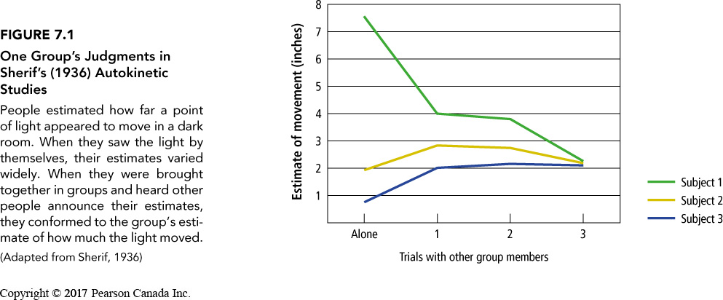
Informational Social Influence
Conforming because we believe that others’ interpretation of an ambiguous situation is more correct than ours and will help us choose an appropriate course of action.
  Muzafer Sherif
  Autokinetic Effect
Situations most likely to produce informational social influence
  When the situation is ambiguous
  When the situation is a crisis
    Contagion – The rapid transmission of emotions or behaviour through a crowd
  When other people are experts
  Mass psychological illness – The occurrence of similar physical symptoms for which there is no known physical or medical cause in a group of people
  What are examples of mass psychological illnesses and/or contagions?

Slide 6
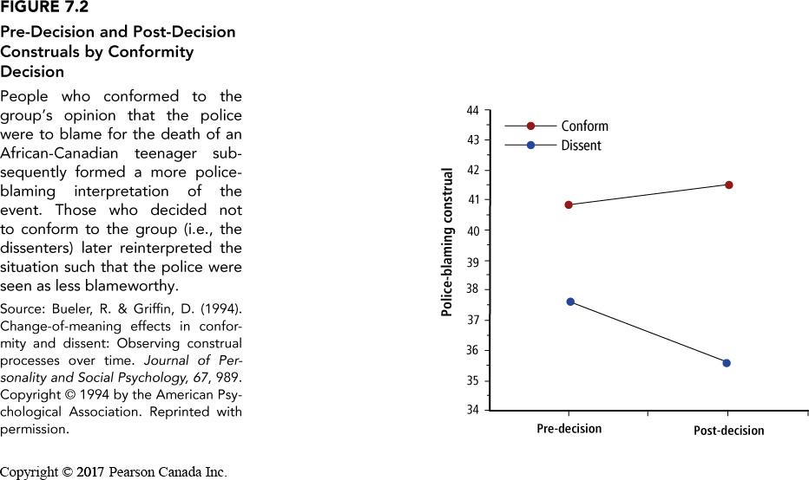
Concerns With Informational Social Influence
Information shapes our social reality – we can be led astray
Informational social influence can ‘backfire’
  War of the Worlds
  Orson Wells Press Conference
Informational social influence can cause mass hysteria
  It is possible to resist social influence
  Be aware
  Take action
  Idiosyncrasy credits

Slide 7
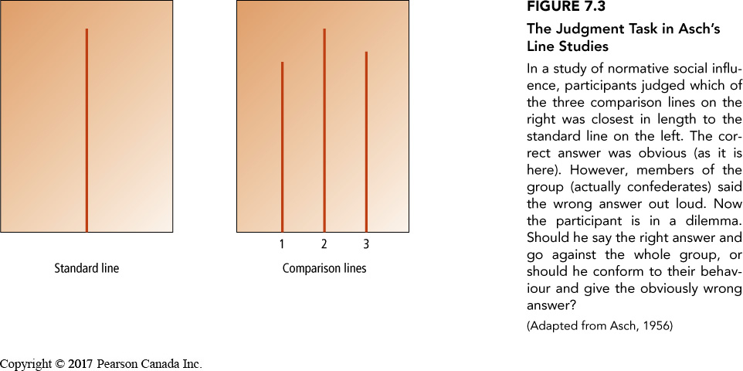
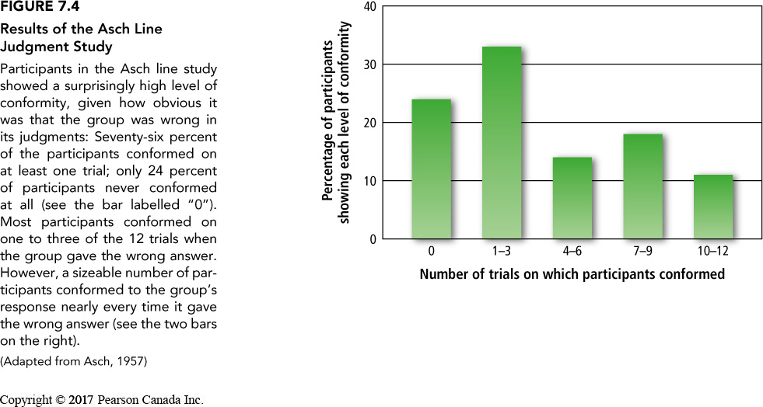
Normative Social Influence
The influence of other people that leads us to conform in order to be liked and accepted by them; this type of conformity results in public compliance with the group’s beliefs and behaviours but not necessarily in private acceptance.
Social Norms – The implicit or explicit rules a group has for the acceptable behaviours, values, and beliefs of its members.
Conformity and Social Approval
  Solomon Asch – Conformity experiment
  Conformity dropped when people were asked to write down response on piece of paper

Slide 8
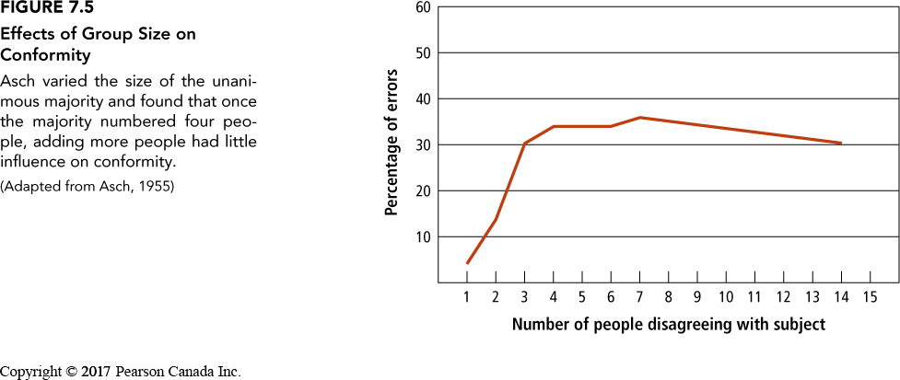
Social Impact Theory
The theory that conforming to social influence depends on the strength of the group, its immediacy, and the number of other people in the group.
The likelihood that you will respond to social influence from other people depends on three variables:
Strength – How important is the group to you?
Immediacy – How close is the group to you in space and time during the influence attempt?
Number – How many people are in the group?
Conformity will increase as strength and immediacy increases
Group size matters – conformity increases until about 5 – 7 people then gradually reduces
Unanimous decisions are more influential
Dissent from someone else helps people resist influence
Slight gender differences – can be attributed to social norms about gender
Uncertainty leads to more conformity
Fear of rejection can lead to more conformity
Culture affects how people value and succumb to social influence

Slide 9
Minority Influence
The case in which a minority of group members influences the behaviour or beliefs of the majority
  Key is consistency over time and between ‘minority’ group members
  Minorities influence people through informational social influence
  Public compliance and private acceptance
  How are you affected by the presence of others? How are you affected by the viewpoints of minorities?

Slide 10
Compliance
A change in behaviour in response to a direct request from another person
Door-in-the-face technique – A technique to get people to comply with a request whereby people are presented first with a large request, which they are expected to refuse, and then with a similar, more reasonable request, to which it is hoped they will accept
  Reciprocity norm – a social norm by which the receipt of something positive from another person requires you to reciprocate, ort behave similarly, in response
Foot-in-the door technique – A technique to get people to comply with a request, whereby people are presented first with a small request, to which they are expected to acquiesce, followed by a larger request, to which it is hoped they will also acquiesce.
  Change in self-perception – People are influenced by their behaviour and adopt values about ‘helping others’
Lowballing – An unscrupulous strategy whereby a salesperson induces a customer to agree to purchase a product at a very low cost, and then subsequently raises the price; frequently, the customer will still make the purchase at the inflated price.
  Illusion of irreversibility
  Anticipation of event
  Convenience of completing the transaction rather than starting over somewhere else
Strategic Self-anticonformity
  To elicit reaffirming messages
  To elicit attitudinal or behavioural compliance from another person

Slide 11
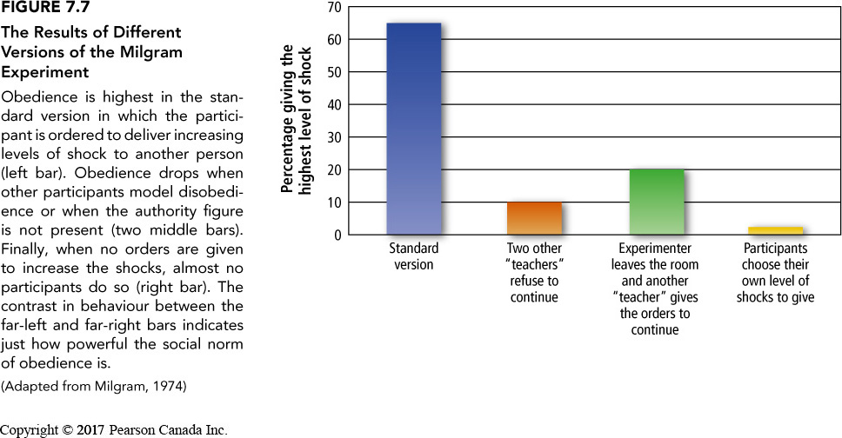
Obedience
Conformity in response to the commands of an authority figure
Stanley Milgram Shock Experiment
  Short Video
  Normative social influence
  Informational social influence
    Importance of expertise

Slide 12
Why We Obey
Automatic processing – not paying attention
Self-Justification
Not about aggression
People can resist influence

Slide 13
Learning Check
What is conformity, obedience, and compliance?
What is private acceptance and public compliance?
What is informational social influence? What factors contribute to informational social influence?
What is normative social influence? What factors contribute to normative social influence?
What does the Asch line experiment reveal?
What is a contagion and mass psychogenic illness? How do they manifest?
What are differences in social influence? i.e. gender? Culture? Other variables?
What are consequences of normative social influence?
What is minority social influence? How does it work?
What are different compliance techniques? How do they work?
What is strategic self-anticonformity? How is it used?
What does Milgram’s experiments reveal?
What are reasons people obey?

Slide 14
Questions or Concerns?
Have a great day!

