Slide 1
Fundamentals of Social Psychology
Exam Review
October 1st, 2019
Erik Chevrier

Slide 2
Exam Overview
Your exam will be based on:
Chapter 1, 3, 4, and 5 of Social Psychology, Sixth Canadian Edition
The PowerPoint slides
Video links included in the slide that we discussed in class
Composition of the exam will contain:
20 multiple choice questions.
1 of 2 essay questions – with follow-up questions.
Multiple choice questions:
Will be taken from the textbook and PowerPoint Slides.
Will be based on recall and application of concepts, terms, studies, etc.
Essay Questions:
Will be taken from Textbook, PowerPoint, and/or Video links.
Will be based on a critical understanding of the topic at hand.

Slide 3
Grading
Exam Format
20 = Multiple Choice (1 point each)
1 of 2 = Essay Questions (10 points each)
Essay Questions– Points (0 – 10)
0 = You wrote nothing.
1 – 2 = You wrote something but it is not right at all.
3 – 5.5 = You wrote something that is partially true but mainly wrong.
5.5 – 6.5 = You are correct but extremely vague.
6.5 – 7.5 = You are correct but slightly vague.
7.5 – 8.5 = You are correct and are clear. You provide examples to back up your claim(s).
8.5 – 10 = You are spot on. You provide a range of examples to back up your claim(s). Your answer is full. You don’t leave anything out. Each part of your answer is completely correct. This is given to exceptional answers only.

Slide 4
Study Tricks
Form study groups
Read the textbook more than once
Go over the PowerPoint slides and study them in detail
Make sure you can define key concepts
Make sure you understand the charts
If you don’t understand the material, get in touch with me
Try to explain the material to someone else
Study (again) the night before the exam
Refresh the material for at least an hour before the exam
Get plenty of rest the night before the exam
Eat fruits and/or vegetables (or at least something healthy) before the exam
When you get to the exam, just relax and take your time

Slide 5
Practice Questions
1) If someone were to report that more people die from grizzly bear attacks than from strokes because there is a greater number of grizzly bear attacks reported by media sources. What is the most likely explanation for that report.
a) the availability heuristic
b) the base rate fallacy
c) upward counterfactual thinking
d) the grizzly heuristic
e) downward counterfactual thinking.

Slide 6
Mental Strategies and Shortcuts - Heuristics
Availability Heuristics – A mental shortcut whereby people base a judgment on the ease which they can bring information to mind
Representativeness Heuristic – A mental shortcut whereby people classify something according to how similar it is to a typical case
Base Rate Information – Information about the frequency of members of different categories

Slide 7
Practice Questions
2) _______ are culture-specific norms that dictate what kinds of emotional expression are allowed.
a) Nonverbal rules
b) Display rules
c) Expressive norms
d) External rules
e) Encoding rules

Slide 8
Facial Expressions of Emotion
Why is decoding sometimes inaccurate?
Affect blends – A facial expression in which one part of the face registers one emotion while another part of the face registers a different emotion
Display Rules – Culturally determined rules about which emotional expressions are appropriate to show
Gender differences, collectivist vs individualist
What kind of display rules exist in North America & other locations?

Slide 9
Practice Questions
3) Which of the following is an example of a direct persuasion attempt?
a) Ramona works hard in school to make her mother proud.
b) Jason moves from Calgary to P.E.I and picks up a maritime accent.
c) Gavin watches a romantic comedy to make his girlfriend happy.
d) Marianne thinks of her ex-boyfriend and becomes sad.
e) A bully threatens Billy and makes him give the bully his lunch money.

Slide 10
Direct Persuasion
Direct attempts at persuasion also occur when our friends try to get us to do something we don’t really want to do or when a schoolyard bully uses force or threats to make smaller kids part with their lunch money or completed homework.
Page 2 – Social Psychology – Sixth Canadian Edition

Slide 11
Practice Question
According to the textbook, schemas can be accessible for three reasons. Please name and explain these reasons. How does culture influence schemas? Please give an example of how culture can affect schemas. How do schemas affect the way we understand personality? How does culture play a role in developing personality schemas?

Slide 12
Automatic Thinking – Low Effort Thinking
Automatic thinking – Is thought that is generally unconscious, unintentional, involuntary, and effortless.
Schemas – Mental structures people use to organize their knowledge about the social world themselves and that influence the information people notice, think about, and remember.
We tend to fill in the blanks with SCHEMA-CONSISTENT INFORMATION.
Kunda, Sinclair, Griffin (1997) – Actor (life of the party) vs Sales person (pushy) – Lawyer (argue) vs Construction Worker (physical fight)
Herold Kelly (1950) – lecturer – cold person vs warm person
How People are Affected By Profuse Amounts of Publicity? – Advertising and Priming
Activity – Automatic Thinking!

Slide 13
Accessibility and Priming
Accessibility – The extent to which schemas and concepts are at the forefront of people’s minds and are, therefore, likely to be used when making judgments about the social world.
Schemas can be accessible for three reasons:
Some schemas are chronically accessible because of past experience – these schemas are constantly active and ready to use to interpret ambiguous situations.
Schemas can be accessible because they are related to a current goal.
Schemas can become temporary accessible because of our recent experiences.
Priming – The process by which recent experiences increase the accessibility of a schema, trait, or concept.
Words have to be accessible and applicable to act as a prime.
Schemas may be quite resistant to change
Schemas are influenced by culture
Perception Without Awareness (PWA) – Daren Brown – How to Control a Nation – Toy Story
How to Control a Nation Full Video
The Art of Misdirection

Slide 14
Priming and Accessibility

Slide 15
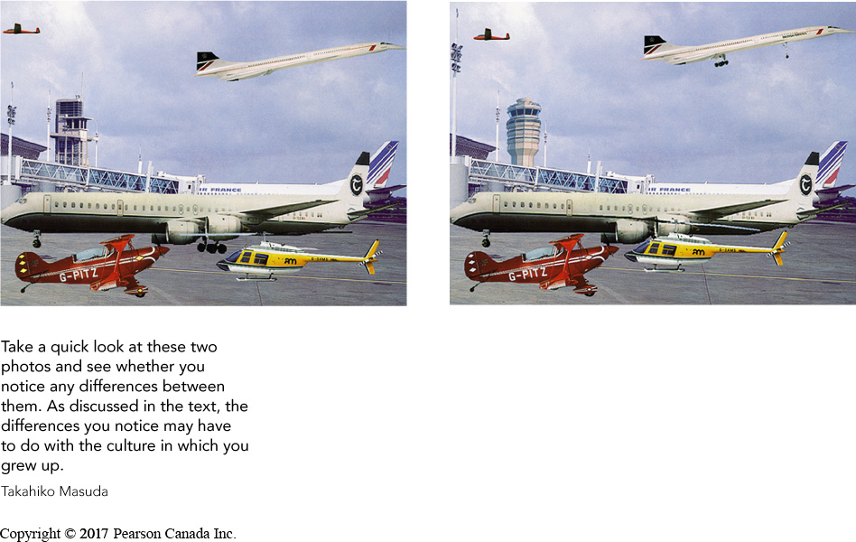
Cultural Differences in Automatic Thinking
Analytic Thinking Style – A type of thinking in which people focus on the properties of objects without considering their surrounding context; this type of thinking is common in Western cultures
Holistic Thinking Style – A type of thinking in which people focus on the overall context, particularly
East-Asians found targets on rich-information websites faster than Canadians
(Nisbett, Masuda, et al.)
fMRI & ERP evidence
Analytic and holistic reasoning can be primed!

Slide 16
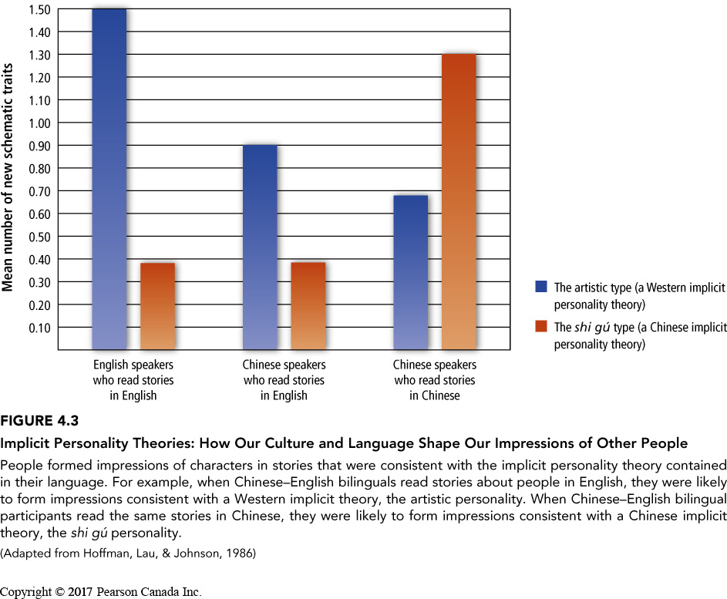
Implicit Personality Theories
Implicit Personality Theory:
A type of schema people use to group various kinds of personality traits together; for example, many people believe that if someone is kind, they will be generous as well.
Happens automatically
Can lead us to misjudge people
Are strongly ties to culture
‘artistic personality’ – creative, intense, temperamental, unconventional lifestyle
‘shi gu’ – Worldly, devoted to family, socially skillful, somewhat reserved

Slide 17
Questions or Concerns?
Study Hard

