Slide 1
Food and Culture
Political Economy of food and culture
Erik Chevrier
October 21th, 2019

Slide 2
Due Date for Action Research Proposals
October 28th, 2019 in class – Hard Copy Only!

Slide 3
Reading to Prioritize for Next Week
Alkon, A. H., & Agyeman, J. (2011) Cultivating Food Justice: Race, Class and Sustainability, MIT Press.
Chapter 14 – Holt-Giminez, E. (2011) Food Security, Food Sovereignty or Food Justice: Crises, Food Movements and Regime Change, pp. 309 – 330.

Slide 4
Action Research Project Discussion
How are your projects coming along?
Get into groups of 3 people
  1 person pitches their project – Other two listen
  2 people give feedback
  Switch people – 1 new person pitches project, other two listen

Slide 5
Let’s Identify a Problem With Our Current Food System
1 – Large agrochemical companies are extracting almost all of the profits from Canadian farmers. To compensate, the Canadian government subsidizes farming.
2 – Only a handful of large seed and agrochemical companies own most of the market.
3 – Most of these corporations have directly caused the death of millions of people.
Solution – We need to become food sovereign by taking control of our own food economy locally!

Slide 6
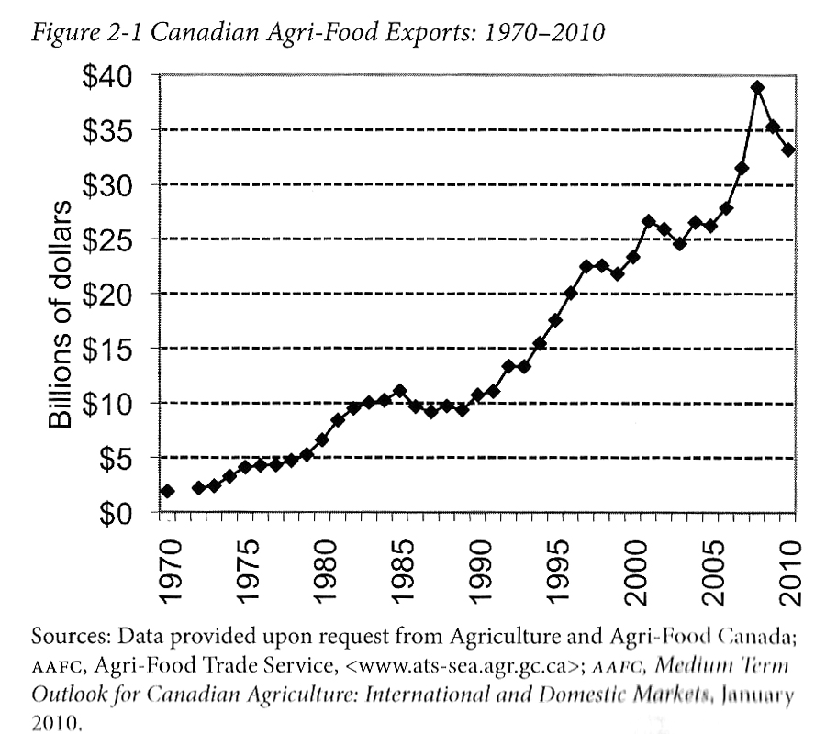
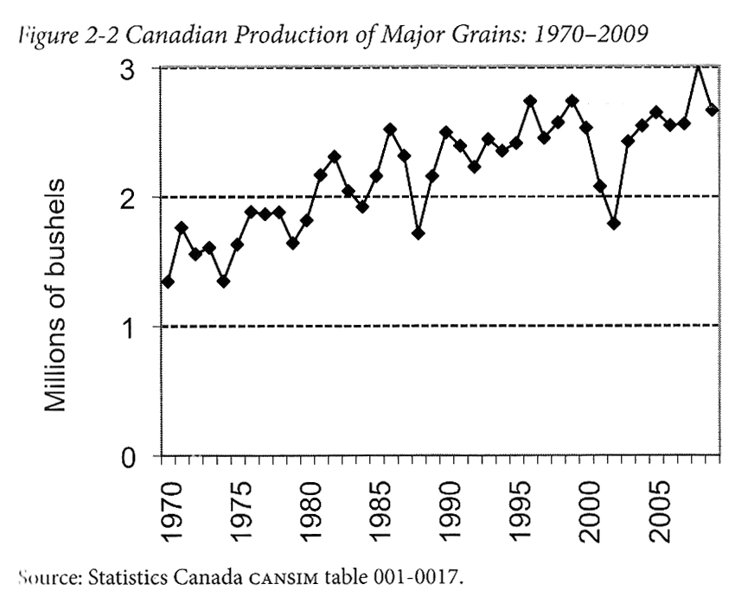
Advancing Agriculture by Destroying Farms? The State of Agriculture in Canada Qualman, D. (2011) Advancing Agriculture by Destroying Farms? The State of Agriculture in Canada, pp. 20 – 42. In, Wittman, H., Desmarais, A. A., & Wiebe, N. (2011) Food Sovereignty in Canada: Creating Just and Sustainable Food Systems, Fernwood Publishing

Slide 7
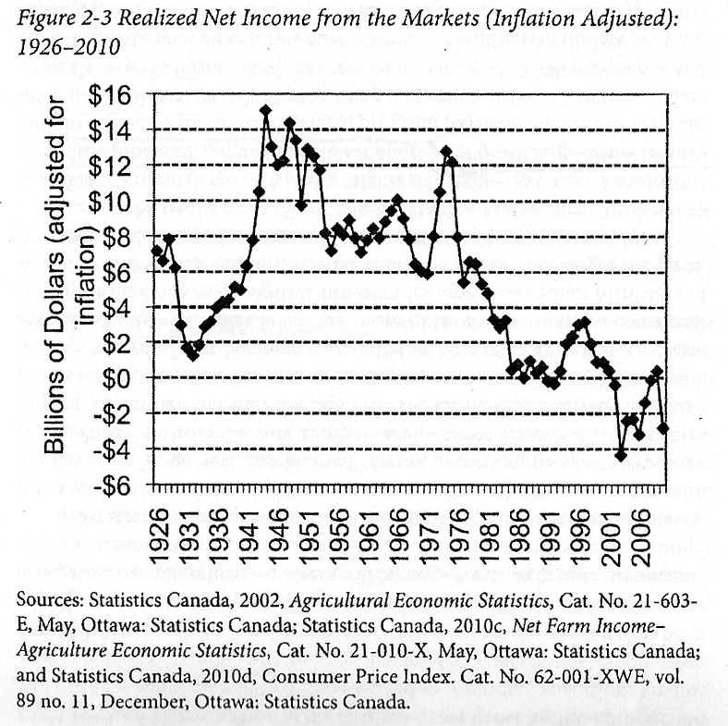
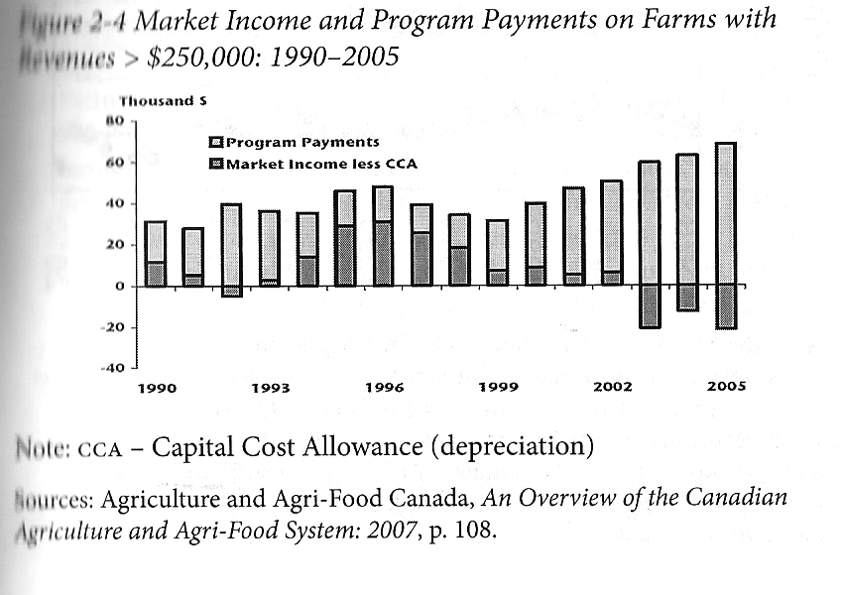
Advancing Agriculture by Destroying Farms? The State of Agriculture in Canada Qualman, D. (2011) Advancing Agriculture by Destroying Farms? The State of Agriculture in Canada, pp. 20 – 42. In, Wittman, H., Desmarais, A. A., & Wiebe, N. (2011) Food Sovereignty in Canada: Creating Just and Sustainable Food Systems, Fernwood Publishing

Slide 8
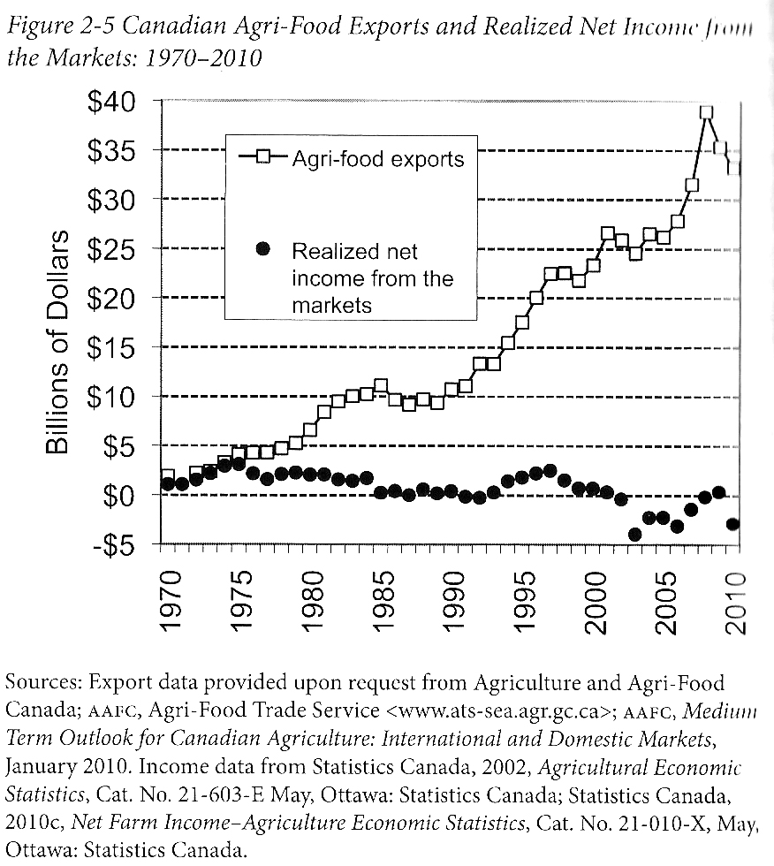
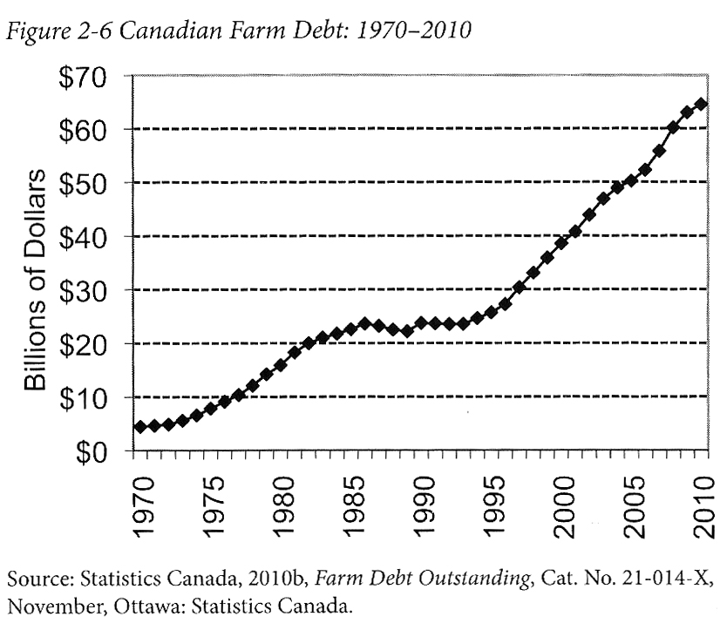
Advancing Agriculture by Destroying Farms? The State of Agriculture in Canada Qualman, D. (2011) Advancing Agriculture by Destroying Farms? The State of Agriculture in Canada, pp. 20 – 42. In, Wittman, H., Desmarais, A. A., & Wiebe, N. (2011) Food Sovereignty in Canada: Creating Just and Sustainable Food Systems, Fernwood Publishing

Slide 9
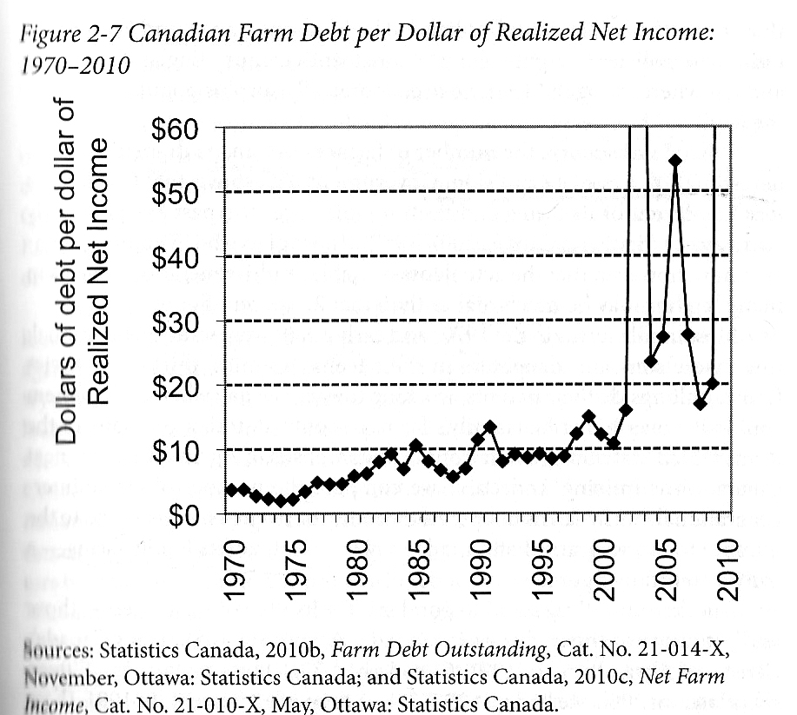
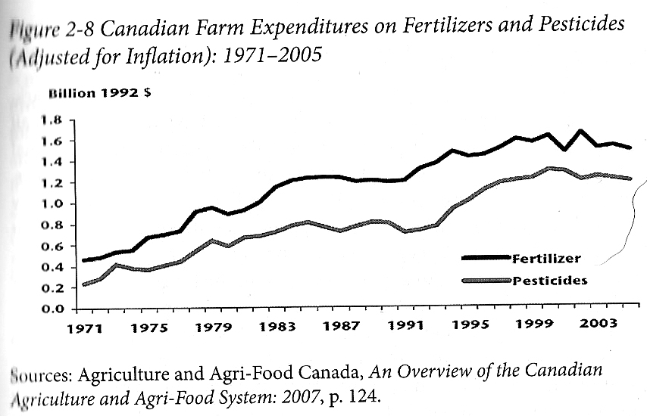
Advancing Agriculture by Destroying Farms? The State of Agriculture in Canada Qualman, D. (2011) Advancing Agriculture by Destroying Farms? The State of Agriculture in Canada, pp. 20 – 42. In, Wittman, H., Desmarais, A. A., & Wiebe, N. (2011) Food Sovereignty in Canada: Creating Just and Sustainable Food Systems, Fernwood Publishing

Slide 10
Advancing Agriculture by Destroying Farms? The State of Agriculture in Canada Qualman, D. (2011) Advancing Agriculture by Destroying Farms? The State of Agriculture in Canada, pp. 20 – 42. In, Wittman, H., Desmarais, A. A., & Wiebe, N. (2011) Food Sovereignty in Canada: Creating Just and Sustainable Food Systems, Fernwood Publishing
Drain on taxpayers:
  Canadian taxpayers have provided 3 – 4 billion dollars per year, $67 billion (about 8000$ per household) to agri-business transnationals
  Canadian tax payers continue to subsidize agriculture, large portions of these subsidies produce food that is exported.
  Example: Dairy farmers get $250 million
  Farm subsidies

Slide 11
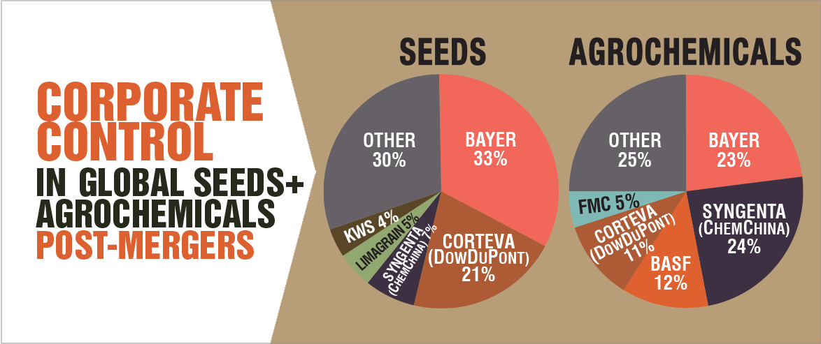
Only A Few Large Corporations Own Most of the Agrochemical Market https://cban.ca/gmos/issues/corporate-control/

Slide 12
Companies of War, Destruction and Death
These are a few examples:
Monsanto still uses chemicals that were used to kill people, but in our food
  Is Round-Up safe to drink?
  Farmer won lawsuit against Monsanto – Glyphosate causes cancer
  The World According to Monsanto
  Monsanto is now owned by Bayer who used to be part of I.G. Farben, manufacturing poisonous gas (Zyklon B) for concentration camps during the World War.
  BASF was also part of IG Farben.
Dow Chemical Invented Agent Orange
BASF was also part of IG Farben a company who worked with the Nazis and tested chemicals and drugs on people including Zyklon B
Dow Chemical now owns Union Carbide who was responsible for a large devastating explosion in Bhopal, India:
  The Bhopal disaster: Toxic legacy
  One Night in Bhopal
  The Bhopal Disaster

Slide 13
Who is Vandana Shiva?
Hero’s Sanctuary
Vandana Shiva on Food Sovereignty at Concordia

Slide 14
Discussion
What is the main findings of Vanada Shiva’s article Living Economies?
Compare and contrast the three types of economies mentioned by Shiva. What features do they have?
What are some myths about markets?
What does it mean to enclose the commons?
What is terra matter and terra nullius? Why are these terms important?
What are ways to close the commons?
What is the TRIPS agreement? Why is it important?
Why should be concerned about turning commons into commodities?

Slide 15
Living Economies – Vandana Shiva
Earth democracy refers to every being having equal access to the earth’s resources that make life possible; this access is assured by recognizing the importance of the other two economies: nature’s economy and the sustenance economy.
Economy and ecology derive from oikos – household
Economy derives from the Latin word oeconomia meaning household management
Three types of economies: markets – nature – sustenance
What are features of the three types of economies suggested by Vandana Shiva?

Slide 16
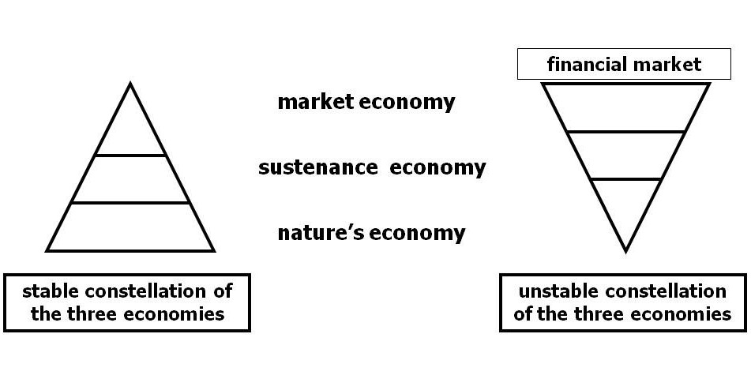
Living Economies – Vandana Shiva

Slide 17
Living Economies – Vandana Shiva
Market economy (globalized free market economy, capitalism, corporate globalization):
  Based on scarcity
  Private property – closing commons
  Capital exchange
  Measured by GDP/NDP – total productive output
  Externalizes social, economic burden, and destroys natural economy for profits and capital accumulation
  Places of exchange
  Social relations have become a relationship between things (reification)
  Two forms of markets – concrete and ‘the market’
  Two main reasons why ecological disasters and the number of displaced, destitute, and disposable people increase in direct proportion to economic growth
  1 – Reduction of visible economy to the market and activities controlled by capital
  2 – The legal rights of corporations have increased at the cost of the rights of real people

Slide 18
Living Economies – Vandana Shiva
Nature economy
  The first and most important economy – without it, no other economies can exist
  Not recognized by traditional econometrics
  It is being destroyed by practices of market economies
  The production and reproduction of nature by nature

Slide 19
Living Economies – Vandana Shiva
Sustenance economy
  People work to directly provide the conditions necessary to maintain their lives
  Human production and reproduction is possible
  Balance with natural economy
  Reproduce society through partnerships, mutuality and reciprocity
  More important than market economy – market economy cannot exist without the sustenance economy

Slide 20
Living Economies – Vandana Shiva
Closing of commons:
  1 – The exclusion of people from access to resources that had been their common property of held in common
  2 – The creation of ‘surplus’ or ‘disposable’ people by denying rights of access to the commons that sustained them
  3 – The creation of private property by the enclosure of common property
  4 – The replacement of diversity that provides for multiple needs and performs multiple functions with monocultures that provide raw material
  5 – The enclosure of minds and imagination, with the result that enclosures are defined and perceived as universal human progress, not as growth of privilege and exclusive rights for a few and dispossession and impoverished for the many
  Terra matter – Mother earth
  Terra nullius – Empty land (denied land to original inhabitants and obscured regenerative capacity of the earth)
Myths about markets:
  Market economies are more efficient – industrial agriculture uses more energy than it produces
  Free trade allows food to be delivered efficiently
  Globalization creates a knowledge society
  Important topics to understand about privatization
  In 1995 Trade-Related Intellectual Property Rights (TRIPs): Article 27.3(b) intellectual agreement of the WTO

Slide 21
Living Economies – Vandana Shiva
Market economies have produced a shift in how resources are perceived. Transformation of commons into commodities has two implications:
  It deprives politically weaker groups of their right to survive
  It robs nature of the ability to self-renew and sustain
The entire foundation of the ‘ownership society’ is based on new enclosures. The contrived law to justify contemporary enclosures according to Epstein (in Shiva) is based on three falsifications:
  The erasure of the history of colonization as a taking and the denial of the experience of occupied inhabitants and their prior rights and prior claims.
  The defining of the behaviour of states acting on public trust doctrines eminent domain.
  The reduction of the public to the individual.

Slide 22
Living Economies – Recap

Slide 23
Aristotle Aristotle. Aristotle in 23 Volumes, Vol. 21, translated by H. Rackham. Cambridge, MA, Harvard University Press; London, William Heinemann Ltd. 1944.
Chrematistics – art of acquisition – limitless accumulation unnatural and problematic
Oikonomia – management of the household – true form of an economy

Slide 24
Karl MarxMarx, K. Capital Volume 1, Penguin Classics.
C – C – Basic barter
C – M – C – The way classical economists viewed basic barter with money
M – C – M’ – What really happens when barter systems incorporate money – Limitless accumulation
M – M’ – Usury capital system – Limitless accumulation

Slide 25
Karl PolanyiPolanyi, K. (2001) The Great Transformation; The Political and Economic Origins of Our Time, Beacon Press
Types of economic practices:
  Markets (exchange)
  Household economy
  Redistribution
  Reciprocity

Slide 26
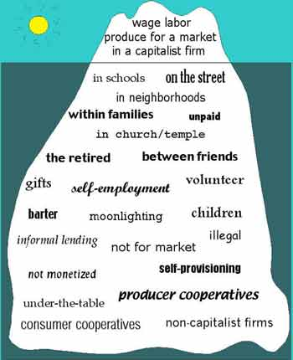
Gibson Graham – Take back the Economy Gibson-Graham, J.K., Cameron, J., Healy, S. (2013) Take Back the Economy: An Ethical Guide for Transforming Communities, University of Minnesota Press
Katherine Gibson Interview Playlist

Slide 27
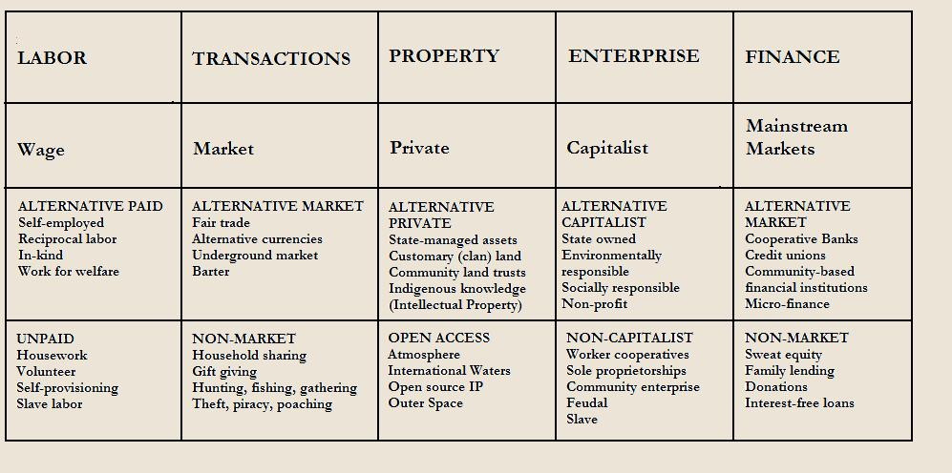
Gibson Graham – Take back the Economy Gibson-Graham, J.K., Cameron, J., Healy, S. (2013) Take Back the Economy: An Ethical Guide for Transforming Communities, University of Minnesota Press

Slide 28
Gibson-Graham – Take back the Economy Gibson-Graham, J.K., Cameron, J., Healy, S. (2013) Take Back the Economy: An Ethical Guide for Transforming Communities, University of Minnesota Press
Please use Gibson-Graham’s diagram from Take Back the Economy and identify types of food organizations and practices in regards to the five categories:
  Enterprise
  Labour
  Transactions
  Property
  Finance

Slide 29
Take Back the Economy – Commons Toolkit
Gibson-Graham, J.K., Cameron, J., Healy, S. (2013) Take Back the Economy: An Ethical Guide for Transforming Communities, University of Minnesota Press
Types of commons:
  Biophysical –Exist naturally – i.e. rocks, soil, air, etc.
  Cultural – Things shared by members of the same culture – i.e. language, musical heritage, symbols
  Social – Things shared between members of a social system – i.e. education, health, political systems
  Knowledge – Things people know – i.e. Indigenous ecological knowledge, scientific achievements
Ways to assess commons. To be a commons:
  Access – Must be shared widely
  Use – Must be negotiated by a community
  Benefit – Must be distributed to the community and possibly beyond
  Care – Must be performed by community members
  Responsibility - Must be assumed by the community
  Property – Must be collectively owned private property, state owned property and/or open access property

Slide 30
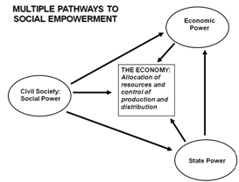
Envisioning Real Utopias – Erik Olin Wright
Olin Wright, E. (2010) Envisioning Real Utopias, Verso

Slide 31
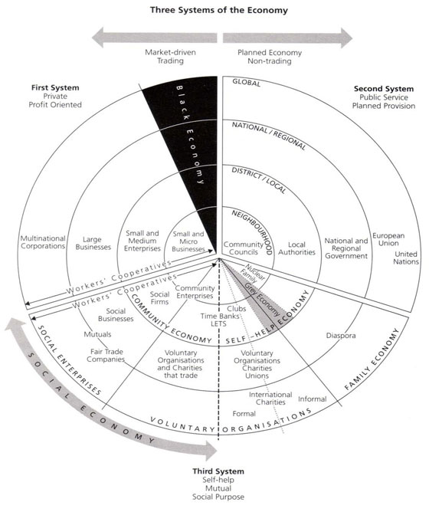
Three Systems of an Economy – John Pierce
Pearce, J. (2009) Social Economy: Engaging as a Third System, In Amin, A. The Social Economy; International Perspectives on Economic Solidarity, p. 26.

Slide 32
ACTIVITY: Three Systems of an Economy – John Pierce
Pearce, J. (2009) Social Economy: Engaging as a Third System, In Amin, A. The Social Economy; International Perspectives on Economic Solidarity, p. 26.
Please use John Pearce’s diagram to identify where the following organizations would be located
  Food bank
  The Hive Solidarity Cooperative
  Monsanto
  A local farm
  A local for profit café
  A government owned regional food delivery program
  A family producing their own food

Slide 33
Introduction to Food Sovereignty
Darrin Qualman Advancing Agriculture by Destroying Farms? The State of Agriculture in Canada
Food Sovereignty is NOT:
  A set of policies simplistically aimed at maximizing production and exports
  A disregard for the destruction of family farms and rural communities
  A push towards high-input, high-cost, high-energy-use model for food production that generates chronic negative returns for the farm families who work the soil
  A concentration of land ownership into the hands of fewer and fewer owners, many of them non-farmers
  A corporate takeover of a growing number of agricultural sectors (e.g. hog production and cattle finishing)
  A push towards massive production units that concentrate potential pollutants
  A transfer of key food processing facilities to foreign companies, even to foreign lands
  Economic policies that make foreign-based transnationals the primary beneficiaries of the wealth created by farm families working our land
  A system that makes citizens ever more dependent on food supplied further and further from their homes

Slide 34
Advancing Agriculture by Destroying Farms? The State of Agriculture in Canada Qualman, D. (2011) Advancing Agriculture by Destroying Farms? The State of Agriculture in Canada, pp. 20 – 42. In, Wittman, H., Desmarais, A. A., & Wiebe, N. (2011) Food Sovereignty in Canada: Creating Just and Sustainable Food Systems, Fernwood Publishing

Slide 35
Advancing Agriculture by Destroying Farms? The State of Agriculture in Canada Qualman, D. (2011) Advancing Agriculture by Destroying Farms? The State of Agriculture in Canada, pp. 20 – 42. In, Wittman, H., Desmarais, A. A., & Wiebe, N. (2011) Food Sovereignty in Canada: Creating Just and Sustainable Food Systems, Fernwood Publishing

Slide 36
Advancing Agriculture by Destroying Farms? The State of Agriculture in Canada Qualman, D. (2011) Advancing Agriculture by Destroying Farms? The State of Agriculture in Canada, pp. 20 – 42. In, Wittman, H., Desmarais, A. A., & Wiebe, N. (2011) Food Sovereignty in Canada: Creating Just and Sustainable Food Systems, Fernwood Publishing

Slide 37
Advancing Agriculture by Destroying Farms? The State of Agriculture in Canada Qualman, D. (2011) Advancing Agriculture by Destroying Farms? The State of Agriculture in Canada, pp. 20 – 42. In, Wittman, H., Desmarais, A. A., & Wiebe, N. (2011) Food Sovereignty in Canada: Creating Just and Sustainable Food Systems, Fernwood Publishing

Slide 38
Advancing Agriculture by Destroying Farms? The State of Agriculture in Canada Qualman, D. (2011) Advancing Agriculture by Destroying Farms? The State of Agriculture in Canada, pp. 20 – 42. In, Wittman, H., Desmarais, A. A., & Wiebe, N. (2011) Food Sovereignty in Canada: Creating Just and Sustainable Food Systems, Fernwood Publishing
Drain on taxpayers:
  Canadian taxpayers have provided 3 – 4 billion dollars per year, $67 billion (about 8000$ per household) to agri-business transnationals
  Government programs for agriculture sector:
    Crop insurance – Insurance for crops for potential damage i.e. insects, weather, plant disease
    Margin-based support programs – insurance for crops for potential damage i.e. insects, weather, plant disease
      Agriculture Income Disaster Assistance Program
      Canadian Farm Income Program
    Savings account programs – Savings programs that are matched by government to withdraw when net incomes fall
      Net income stabilization account
    Ad-hoc payments – Made to farmers to offset large losses
    Quebec’s ASRA –L’assurance stabilization des revenues agricoles –To stabilize Quebec farm incomes in relation to production costs

Slide 39
What is Capitalism?
Markets
Profit
Private ownership of the means of production
Money based system
Financial markets
Private property
Alienation
Exploitation
Wage Labour
Externalities
Expendable work force
Inequality
Advertising
Consumerism
Firms
Institutions
Imperialism
Colonialism
Exchange
Free (non-slave) labour
Cycles and crisis
Growth
Competition
Limited democracy (usually representational)

Slide 40
Thanks!
Questions or concerns?
Go Eat at the People’s Potato!

