Slide 1
Fundamentals of Social Psychology
Group Processes
October 22nd, 2019
Erik Chevrier

Slide 2
What is a Group?
A group is a collection of three or more people who interact with one another and are interdependent in the sense that their needs and goals cause them to rely on one another.
Assemble together for a common purpose
Which groups do you belong?
How do they behave together?
What do they have in common?
How are you interdependent with them?
Why did you join these groups?
How cohesive are these groups?
What are the social roles of members of the group?
What are the social norms of the group?

Slide 3
Why Do People Form Groups?
Forming a group fulfils basic needs
There is strong evidence that forming groups is innate and universal
Groups help define who we are
Groups form an important role in motivating people to be involved in social change

Slide 4
Composition and Function of Groups
Groups range in size from 3 to large numbers of people.
If the group is too large, you cannot interact with all members of the group
Members tend to be alike (i.e. age, sex, beliefs, opinions)
There are two reasons for homogeneity of groups
Many groups attract people who are similar before they can join
Groups can operate in ways that encourage similarity in the members

Slide 5
Composition and Function of Groups
Social norms are powerful determinants of behaviour (i.e. normative social influence, social impact theory)
Social roles are shared expectations by group members about how particular people in the group are supposed to behave.
Stanford Prison Experiment – Shorter Video
Stanford Prison Experiment – Documentary
Interesting Perspective about the Stanford Prison Experiment
Gender roles – People of different genders have associated expected roles.
Women and men are treated differently – women are still paid less and occupy more traditionally female dominated occupations. See page 217 – 218 for statistics on gender comparisons.
Trans issues are not present in the textbook but exist – targets of hate crimes and violence.
Group cohesiveness – Qualities of a group that bind people together and promoting liking among them. The more cohesive the group, the more likely people stay in the group, take part in group activities and try to recruit likeminded members.

Slide 6
Discussion
Do you perform better on tasks in the presence of other people?
Which tasks do you perform better?
Which tasks do you perform worse?
What factors influence your performance when other people are around?

Slide 7
Social Facilitation
Social facilitation is the tendency for people to do better on simple tasks, but worse on complex tasks, when they are in the presence of others and their individual performance can be evaluated.
Presence of others causes arousal. When arousal exists, it is easier to do something simple (dominant response) but more difficult to do something complex or learn something new.
Arousal plays three roles:
Other people cause us to become particularly alert
They make us apprehensive about how we’re being evaluated (evaluation apprehension)
They distract is from the task at hand

Slide 8
Social Loafing
Social Loafing is the tendency for people to do worse on simple tasks but better on complex tasks, when they are in the presence of others and their individual performance cannot be evaluated.
Gender and cultural differences – Those with an interdependent view of themselves (collectivist cultures) and relational interdependence (women) are less likely to social-loaf. Although everyone is prone to social loafing.

Slide 9
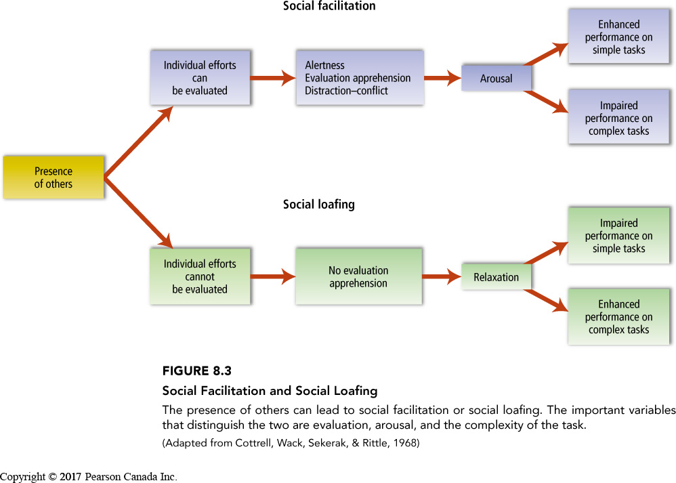
Social Facilitation
Social facilitation is the tendency for people to do better on simple tasks, but worse on complex tasks, when they are in the presence of others and their individual performance can be evaluated.
Social Loafing is the tendency for people to do worse on simple tasks but better on complex tasks, when they are in the presence of others and their individual performance cannot be evaluated.

Slide 10
Deindividuation
Deindividuation – The loosening of normal constraints on behaviour when people are in a group, leading to an increase in impulsive and deviant acts.
Three factors lead to impulsive and often violent behaviour:
The presence of others, or the wearing of uniforms and disguises, makes people feel less accountable for their actions because it reduces the likelihood that any individual will be singled out and blamed.
The presence of others lowers self-awareness, thereby shifting people’s attention away from their moral standards.
Deindividuation increases the extend to which people obey the group’s norms. Specific norms of the group determines whether deindividuation will lead to negative behaviours.

Slide 11
Group Decisions
In general, groups will do better than individuals if people are motivated to search for the answer that is best for the entire group and not for themselves.
Sometimes groups hinder good problem solving.
Process loss – Any aspect of group interaction that inhibits good problem solving.
Failure to share unique information – Groups tend to focus on the information they share and ignore unique information.
Groupthink – A kind of thinking which maintaining group cohesiveness and solidarity is more important than considering the facts in a realistic manner. Occurs most when:
A group is highly cohesive
The group is isolated from contrary opinions
Ruled by a leader who makes their wishes known
Groupthink causes several symptoms:
Group feels invulnerable, members self-censor, causes the group to make an inferior decision
Groupthink can occur even if some of the antecedent conditions are missing:
It may be enough for people to identify strongly with the group, have clear norms for behaviour, and low confidence the group can solve the problem

Slide 12
Groupthink

Slide 13
Avoiding Groupthink
A wise leader can take several steps to ensure that his or her group is immune to this style of decision making:
Remain impartial
Seek outside opinions
Create subgroups
Seek anonymous opinions

Slide 14
Group Polarization
Initially studies found that groups took riskier decision than individuals (risky shift).
New research shows that groups tend to make decisions that are more extreme in the same direction as the individuals’ initial predispositions.
Group polarization – The tendency for groups to make decisions that are more extreme than the initial inclination of the members – towards greater risk if the group members’ initial tendency is to be risky and toward greater caution if the group members’ initial tendency is to be cautious.
There are two reasons for this:
Persuasive arguments explanation – All individuals bring to the group a set of arguments that support their original recommendation. Others may have not considered these arguments and take them into consideration. They end up with a greater number of arguments than they originally started out with.
Social comparison theory – When people discuss an issue in a group, they first check to see how everyone feels. They then take a position similar to everyone else but a little more extreme.

Slide 15
Discussion
What Traits Does a Good Leader Possess?

Slide 16
Leadership in Groups
Great person theory – Certain key personality traits make a person a good leader, regardless of the situation the leader faces.
Only weak relationships have been found between leadership and personality traits
Slightly more intelligent, more extraverted, driven by desire for power, charismatic, socially skilled, open to new experiences, more confident in their leadership abilities
Dominance
Integrative complexity – the ability to recognize more than one perspective on an issue and to be able to integrate these various perspectives.
Tall, small family, published many books – US presidents
Smart, tall, not good-looking, messy, achievement-oriented
These studies are dependent on how we measure leadership effectiveness.
They also fall victim to the fundamental attribution error

Slide 17
Leadership Styles
Transactional Leaders – Leaders who set clear, short-term goals and reward people who meet them.
Transformational Leaders – Leaders who inspire followers to focus on common, long-term goals.
The most effective leader adopts both styles.
Great leaders increase integrative complexity during a crisis and return to a normal level afterwards
Integrative complexity – The ability to recognize more than one perspective on an issue and to be able to integrate these various perspectives
The social situation is important!

Slide 18
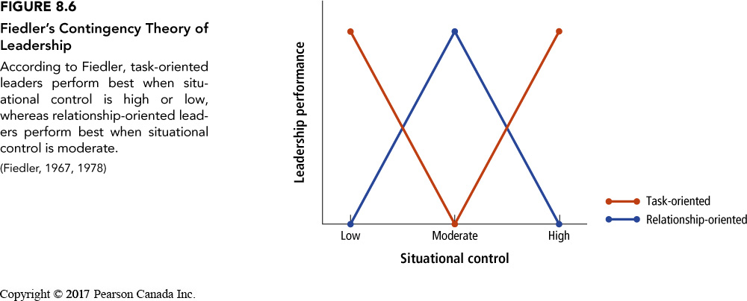
Contingent Theory of Leadership
Contingent theory of leadership – The theory that leadership effectiveness depends both on how task-oriented or relationship oriented the leader is, and on the amount of control and influence the leader has over the group.
Task-oriented leader – A leader who is concerned more with getting the job done than with the feelings of and relationships of the workers.
Relationship-oriented leader – A leader who is concerned premaritally with the feelings and relationships among the workers.

Slide 19
Gender and Leadership
Agentic – (associated with men) aggressive, controlling, dominant, independent, self-confident
Communal – (associated with women) concerned with the welfare of others, warm, helpful, kind, affectionate
Even when women use a transformational style, women are evaluated negatively by male subordinates.
See page 234 – 235 for more information about gender roles, politics, and leadership styles.

Slide 20
Social Dilemmas
Social dilemmas – Conflicts in which the most beneficial action for an individual, if it is chosen by most people, will have harmful effects on everyone.

Slide 21
Increasing Cooperation in the Prisoners Dilemma
If the situation is with a friend or future partner, people tend to act more cooperatively
Collectivist cultures tend to favour cooperation more than individualist cultures
Smaller numbers foster more cooperation
Tit-for-tat strategy – A means of encouraging cooperation by, at first, acting cooperatively but then always responding the way your opponent did.
Consistent contributors create a norm of cooperation

Slide 22
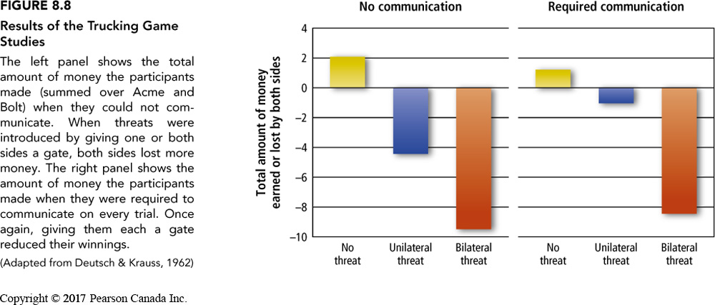
Using Threats To Resolve Conflict

Slide 23
Negotiation and Bargaining
Negotiation – A form of communication between opposing sides in a conflict, in which offers are made and a solution occurs only when both parties agree.
Integrative solution – A solution to a conflict whereby the parties make trade-offs on issues according to their different interests; each side conceded the most on issues that are unimportant to them but important to the other side.

Slide 24
More About Group Behaviour
Sherif – Robbers Cave – Realistic Conflict Theory

Slide 25
Learning Check
What is a group? Composition? Function?
Why do people form groups?
What are social norms?
What is group cohesiveness?
What are social roles?
What are gender roles?
What is the Stanford prison experiment?
What is social facilitation?
What is social loafing?
What is deindividuation? What factors lead to deindividuation?
What is process loss? What is group think?
How can we avoid groupthink?
What is group polarization and what factors lead to group polarization?
What is the great person theory? What are some factors that were found to corelate with the great person theory?
What is transactional leadership style? What is transformational leadership style? What is integrative complexity?
What is the contingent theory of leadership? What is a relationship focused leader? What is a task focused leader? Which form of leadership style works best?
What is agentic and communal leadership styles? How does this relate to gender?
What is a social dilemma? What is the prisoners dilemma? What can we say about cooperation in the prisoners dilemma? How can we increase cooperation in the prisoners dilemma?
What is a tit-for-tat strategy? How does it function?
What is the trucking game? What are the results of th3e trucking game?
What is negotiation? What is an integrative solution?
What is realistic conflict theory? What is the robbers cave experiment? What we3re the results?

Slide 26
Questions or Concerns?
Have a great day!

