Slide 1
Food and Culture
Political Economy of food and culture
Erik Chevrier
October 7th, 2019

Slide 2
Reading for Next Week
Holt-Gimenez, E. (2017) A Foodie’s Guide to Capitalism: Understanding the Political Economy of What We Eat, Monthly Review Press, New York.
Chapter 1 – How our Capitalist Food System Came to Be (pp. 23 – 56)
I will provide you an e-copy of the chapter.

Slide 3
Who is Vandana Shiva?
Hero’s Sanctuary
Vandana Shiva on Food Sovereignty at Concordia

Slide 4
Quiz
What is the main claim(s) made by Vanada Shiva in her chapter about Living Economies? What support/evidence did Vandana Shiva use to support her claim(s)?
In your answer, please address the following:
Compare and contrast the three types of economies mentioned by Shiva. What features do they have?
What is terra matter and terra nullius? Why are these terms important?
What are the myths about markets stated by Shiva?
What is the TRIPS agreement? Why is it important?

Slide 5
Discussion
What is the main findings of Vanada Shiva’s article Living Economies?
Compare and contrast the three types of economies mentioned by Shiva. What features do they have?
What are some myths about markets?
What does it mean to enclose the commons?
What is terra matter and terra nullius? Why are these terms important?
What are ways to close the commons?
What is the TRIPS agreement? Why is it important?
Why should be concerned about turning commons into commodities?

Slide 6
Living Economies – Vandana Shiva
Earth democracy refers to every being having equal access to the earth’s resources that make life possible; this access is assured by recognizing the importance of the other two economies: nature’s economy and the sustenance economy.
Economy and ecology derive from oikos – household Economy derives from the Latin word oeconomia meaning household management
Three types of economies: markets – nature – sustenance
What are features of the three types of economies suggested by Vandana Shiva?

Slide 7
Living Economies – Vandana Shiva

Slide 8
Living Economies – Vandana Shiva
Market economy (globalized free market economy, capitalism, corporate globalization):
Based on scarcity
Private property – closing commons
Capital exchange
Measured by GDP/NDP – total productive output
Externalizes social, economic burden, and destroys natural economy for profits and capital accumulation
Places of exchange
Social relations have become a relationship between things (reification)
Two forms of markets – concrete and ‘the market’
Two main reasons why ecological disasters and the number of displaced, destitute, and disposable people increase in direct proportion to economic growth
1 – Reduction of visible economy to the market and activities controlled by capital
2 – The legal rights of corporations have increased at the cost of the rights of real people

Slide 9
Living Economies – Vandana Shiva
Nature economy
The first and most important economy – without it, no other economies can exist
Not recognized by traditional econometrics
It is being destroyed by practices of market economies
The production and reproduction of nature by nature

Slide 10
Living Economies – Vandana Shiva
Sustenance economy
People work to directly provide the conditions necessary to maintain their lives
Human production and reproduction is possible
Balance with natural economy
Reproduce society through partnerships, mutuality and reciprocity
More important than market economy – market economy cannot exist without the sustenance economy

Slide 11
Living Economies – Vandana Shiva
Closing of commons:
1 – The exclusion of people from access to resources that had been their common property of held in common
2 – The creation of ‘surplus’ or ‘disposable’ people by denying rights of access to the commons that sustained them
3 – The creation of private property by the enclosure of common property
4 – The replacement of diversity that provides for multiple needs and performs multiple functions with monocultures that provide raw material 5 – The enclosure of minds and imagination, with the result that enclosures are defined and perceived as universal human progress, not as growth of privilege and exclusive rights for a few and dispossession and impoverished for the many
Terra matter – Mother earth
Terra nullius – Empty land (denied land to original inhabitants and obscured regenerative capacity of the earth)
Myths about markets:
Market economies are more efficient – industrial agriculture uses more energy than it produces
Free trade allows food to be delivered efficiently
Globalization creates a knowledge society
Important topics to understand about privatization
In 1995 Trade-Related Intellectual Property Rights (TRIPs): Article 27.3(b) intellectual agreement of the WTO

Slide 12
Living Economies – Vandana Shiva
Market economies have produced a shift in how resources are perceived. Transformation of commons into commodities has two implications:
It deprives politically weaker groups of their right to survive
It robs nature of the ability to self-renew and sustain
The entire foundation of the ‘ownership society’ is based on new enclosures. The contrived law to justify contemporary enclosures according to Epstein (in Shiva) is based on three falsifications:
The erasure of the history of colonization as a taking and the denial of the experience of occupied inhabitants and their prior rights and prior claims.
The defining of the behaviour of states acting on public trust doctrines eminent domain.
The reduction of the public to the individual.

Slide 13
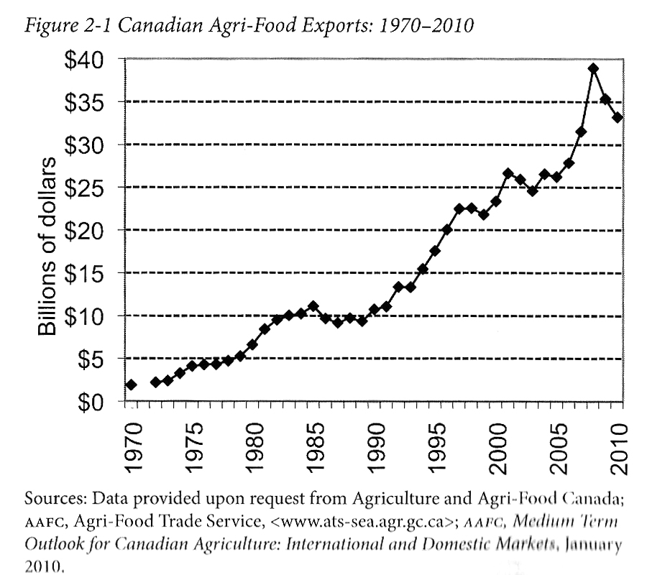
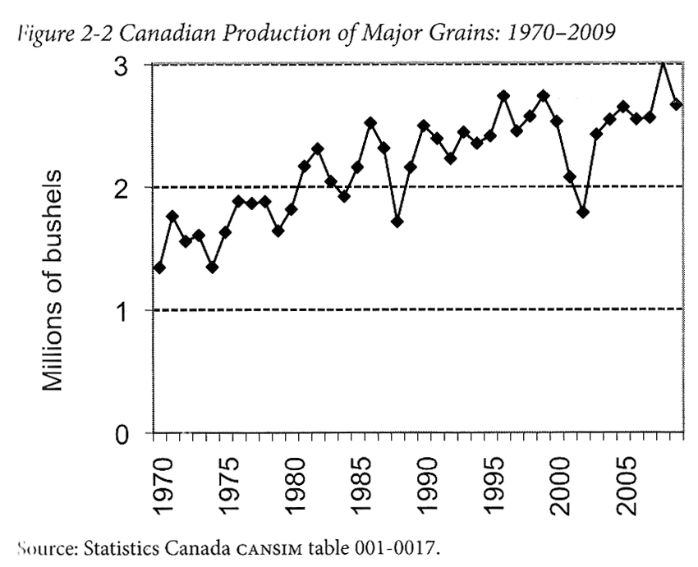
Advancing Agriculture by Destroying Farms? The State of Agriculture in Canada Qualman, D. (2011) Advancing Agriculture by Destroying Farms? The State of Agriculture in Canada, pp. 20 – 42. In, Wittman, H., Desmarais, A. A., & Wiebe, N. (2011) Food Sovereignty in Canada: Creating Just and Sustainable Food Systems, Fernwood Publishing

Slide 14
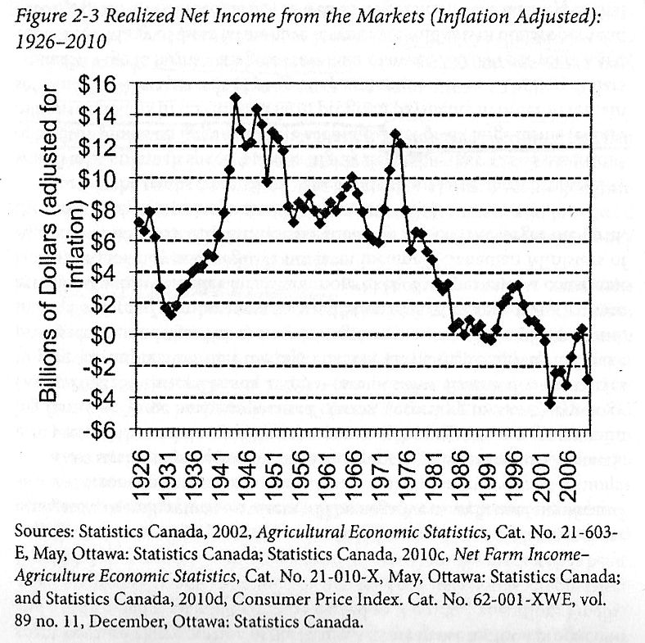
Advancing Agriculture by Destroying Farms? The State of Agriculture in Canada Qualman, D. (2011) Advancing Agriculture by Destroying Farms? The State of Agriculture in Canada, pp. 20 – 42. In, Wittman, H., Desmarais, A. A., & Wiebe, N. (2011) Food Sovereignty in Canada: Creating Just and Sustainable Food Systems, Fernwood Publishing

Slide 15
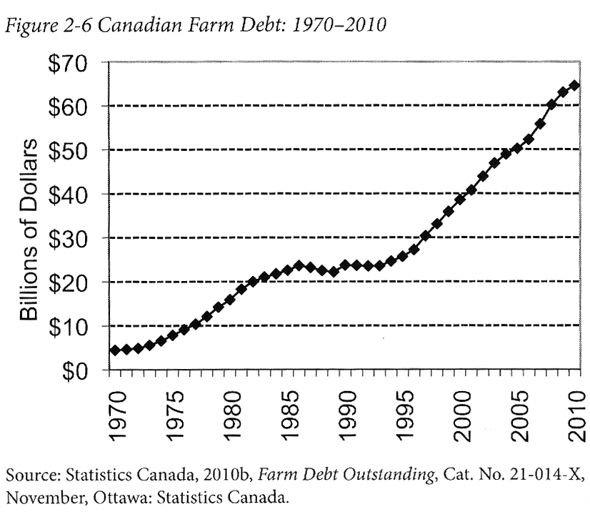
Advancing Agriculture by Destroying Farms? The State of Agriculture in Canada Qualman, D. (2011) Advancing Agriculture by Destroying Farms? The State of Agriculture in Canada, pp. 20 – 42. In, Wittman, H., Desmarais, A. A., & Wiebe, N. (2011) Food Sovereignty in Canada: Creating Just and Sustainable Food Systems, Fernwood Publishing

Slide 16
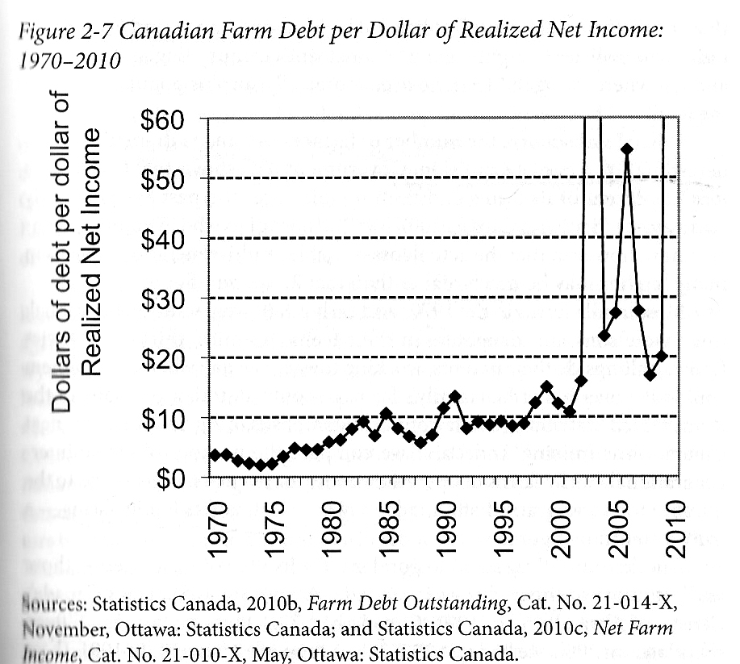
Advancing Agriculture by Destroying Farms? The State of Agriculture in Canada Qualman, D. (2011) Advancing Agriculture by Destroying Farms? The State of Agriculture in Canada, pp. 20 – 42. In, Wittman, H., Desmarais, A. A., & Wiebe, N. (2011) Food Sovereignty in Canada: Creating Just and Sustainable Food Systems, Fernwood Publishing

Slide 17
Advancing Agriculture by Destroying Farms? The State of Agriculture in Canada Qualman, D. (2011) Advancing Agriculture by Destroying Farms? The State of Agriculture in Canada, pp. 20 – 42. In, Wittman, H., Desmarais, A. A., & Wiebe, N. (2011) Food Sovereignty in Canada: Creating Just and Sustainable Food Systems, Fernwood Publishing
Drain on taxpayers:
Canadian taxpayers have provided 3 – 4 billion dollars per year, $67 billion (about 8000$ per household) to agri-business transnationals
Government programs for agriculture sector:
Crop insurance – Insurance for crops for potential damage i.e. insects, weather, plant disease
Margin-based support programs – insurance for crops for potential damage i.e. insects, weather, plant disease
Agriculture Income Disaster Assistance Program
Canadian Farm Income Program
Savings account programs – Savings programs that are matched by government to withdraw when net incomes fall
Net income stabilization account
Ad-hoc payments – Made to farmers to offset large losses
Quebec’s ASRA –L’assurance stabilization des revenues agricoles –To stabilize Quebec farm incomes in relation to production costs

Slide 18
Living Economies – Recap

Slide 19
Aristotle Aristotle. Aristotle in 23 Volumes, Vol. 21, translated by H. Rackham. Cambridge, MA, Harvard University Press; London, William Heinemann Ltd. 1944.
Chrematistics – art of acquisition – limitless accumulation unnatural and problematic
Oikonomia – management of the household – true form of an economy

Slide 20
Karl MarxMarx, K. Capital Volume 1, Penguin Classics.
C – C – Basic barter C – M – C – The way classical economists viewed basic barter with money M – C – M’ – What really happens when barter systems incorporate money – Limitless accumulation M – M’ – Usury capital system – Limitless accumulation

Slide 21
Karl PolanyiPolanyi, K. (2001) The Great Transformation; The Political and Economic Origins of Our Time, Beacon Press
Types of economic practices:
Markets (exchange)
Household economy
Redistribution
Reciprocity

Slide 22
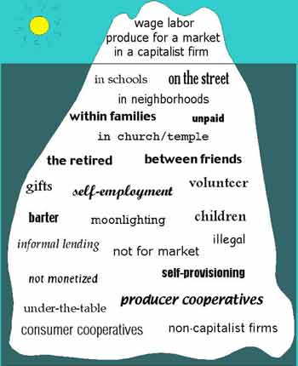
Gibson Graham – Take back the Economy Gibson-Graham, J.K., Cameron, J., Healy, S. (2013) Take Back the Economy: An Ethical Guide for Transforming Communities, University of Minnesota Press
Katherine Gibson Interview Playlist

Slide 23
Gibson Graham – Take back the Economy Gibson-Graham, J.K., Cameron, J., Healy, S. (2013) Take Back the Economy: An Ethical Guide for Transforming Communities, University of Minnesota Press

Slide 24
Gibson-Graham – Take back the Economy Gibson-Graham, J.K., Cameron, J., Healy, S. (2013) Take Back the Economy: An Ethical Guide for Transforming Communities, University of Minnesota Press
Please use Gibson-Graham’s diagram from Take Back the Economy and identify types of food organizations and practices in regards to the five categories:
Enterprise
Labour
Transactions
Property
Finance

Slide 25
Take Back the Economy – Commons Toolkit Gibson-Graham, J.K., Cameron, J., Healy, S. (2013) Take Back the Economy: An Ethical Guide for Transforming Communities, University of Minnesota Press
Types of commons:
Biophysical –Exist naturally – i.e. rocks, soil, air, etc.
Cultural – Things shared by members of the same culture – i.e. language, musical heritage, symbols
Social – Things shared between members of a social system – i.e. education, health, political systems
Knowledge – Things people know – i.e. Indigenous ecological knowledge, scientific achievements
Ways to assess commons. To be a commons:
Access – Must be shared widely
Use – Must be negotiated by a community
Benefit – Must be distributed to the community and possibly beyond
Care – Must be performed by community members
Responsibility - Must be assumed by the community
Property – Must be collectively owned private property, state owned property and/or open access property

Slide 26
Envisioning Real Utopias – Erik Olin Wright Olin Wright, E. (2010) Envisioning Real Utopias, Verso

Slide 27
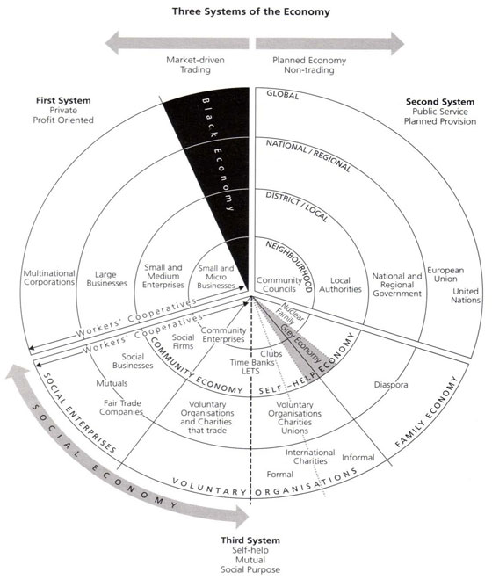
Three Systems of an Economy – John Pierce Pearce, J. (2009) Social Economy: Engaging as a Third System, In Amin, A. The Social Economy; International Perspectives on Economic Solidarity, p. 26.

Slide 28
Introduction to Food Sovereignty
Darrin Qualman Advancing Agriculture by Destroying Farms? The State of Agriculture in Canada
Food Sovereignty is NOT:
A set of policies simplistically aimed at maximizing production and exports
A disregard for the destruction of family farms and rural communities
A push towards high-input, high-cost, high-energy-use model for food production that generates chronic negative returns for the farm families who work the soil
A concentration of land ownership into the hands of fewer and fewer owners, many of them non-farmers
A corporate takeover of a growing number of agricultural sectors (e.g. hog production and cattle finishing)
A push towards massive production units that concentrate potential pollutants
A transfer of key food processing facilities to foreign companies, even to foreign lands
Economic policies that make foreign-based transnationals the primary beneficiaries of the wealth created by farm families working our land
A system that makes citizens ever more dependent on food supplied further and further from their homes

Slide 29
ACTIVITY: Three Systems of an Economy – John Pierce Pearce, J. (2009) Social Economy: Engaging as a Third System, In Amin, A. The Social Economy; International Perspectives on Economic Solidarity, p. 26.
Please use John Pearce’s diagram to identify where the following organizations would be located
Food bank
The Hive Solidarity Cooperative
Monsanto
A local farm
A local for profit café
A government owned regional food delivery program
A family producing their own food

Slide 30
Thanks!
Questions or concerns?
Go Eat at the People’s Potato!

