Slide 1
Fundamentals of Social Psychology
Attitudes and attitude change
October 8th, 2019
Erik Chevrier

Slide 2
Check In
How is everything going?
  What is going well?
  What could be improved on?
Is this class meeting your expectations?
  Why?
  Why not?
Are you enjoying the material?
  Are the readings difficult, easy, or what was expected?
What could help you improve your experience in this class?
  Class format/structure?
  Learning activities?

Slide 3
Discussion – The Century of Self
Get into groups of 4 or 5
Answer the following questions.
What is the first part of The Century of Self About?
Who is Edward Bernays? What did he do?
What is PR? What is significant about the PR industry?
What is the relationship between psychology and advertising?
What is the relationship between psychology and politics?
What are the different techniques used to ‘control the masses’?

Slide 4
For Thursday – Watch the Push
The Push – Darren Brown
Trailer
  Identify persuasion tactics used by Darren Brown

Slide 5
Activity
Please describe your stance on the following issues:
  Climate change
  Social equality
  Income tax and government spending
  Welfare
  Carbon tax
  What are some of your attitudes towards the election?
    Do you have a favourite party/candidate?
    Is there a particular issue that interests you most?
    Do you believe that it is a fundamental duty for citizens to vote?

Slide 6
Attitude
Attitudes are evaluations of people, objects or ideas.
Affectively Based Attitudes – An attitude based primarily on people’s emotions and feelings about the attitude object.
  Stem from people’s values, sensory reaction, and/or aesthetic reaction
  Have 3 things in common
    1 – They do not result from rational examination of the issue
    2 – They are not governed by logic
    3 – They are often linked to people’s values, so that trying to change them challenges those values
Cognitively Based Attitude – An attitude based primarily on a person’s beliefs about the properties of an object.
Behaviorally Based Attitude – An attitude based primarily on observations of how one behaves toward an attitude object.
  Self-perception theory – when our attitudes and feelings are uncertain or ambiguous, we infer these states by observing our behaviour and the situation in which it occurs.

Slide 7
Explicit vs Implicit Attitudes
Explicit attitudes are ones that we can consciously endorse and easily report
Implicit attitudes are ones that are involuntary, uncontrollable, and at times ‘unconscious’
  Implicit association test - https://implicit.harvard.edu/implicit/
Studies cited
  Implicit and explicit attitudes are positively correlated when people reflect on their feelings about an attitude object but not when they are asked about their cognitions of the object (Gawronski and LeBel, 2008)
  Implicit attitudes are rooted more in people’s childhood experiences, explicit attitudes are more rooted in their recent experiences (Rudman, Phelan, Heppen, 2007)

Slide 8
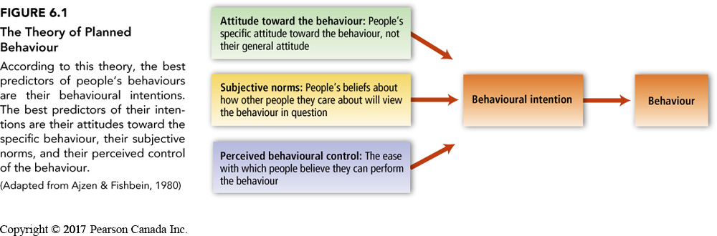
Theory of Planned Behaviour

Slide 9
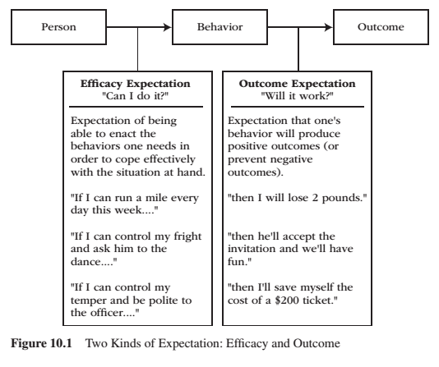
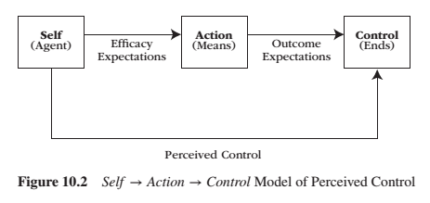
Perceived Behavioural Control
Reeve, J. (2015) Understanding Motivation and Emotion, 6th ed. John Wiley and Sons

Slide 10
Example of Theory of Planned Behaviour
Implications for Safer Sex – p. 144 – 146.
Summary:
  Even the most positive of attitudes towards condom use do not guarantee that people will practice safer sex. The theory of planned behaviour suggests that other factors must be taken into account as well, including subjective norms, perceived behavioural control and behavioural intentions.
    mood, self-esteem, intoxication

Slide 11
Activity
How would you use the theory of planned behaviour to assess whether people would agree to reduce their plastic consumption?

Slide 12
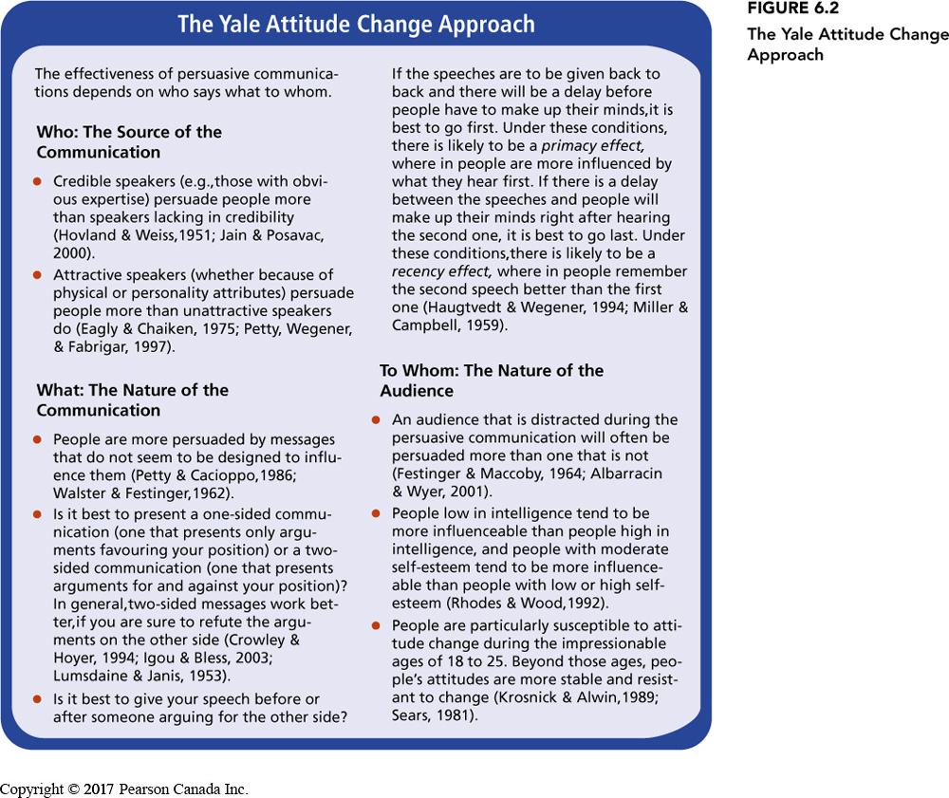
How do Attitudes Change?
Persuasive Communication advocates a particular side of an issue
  Persuade - to move by argument, entreaty, or expostulation to a belief, position, or course of action
  Yale Attitude Change Approach

Slide 13
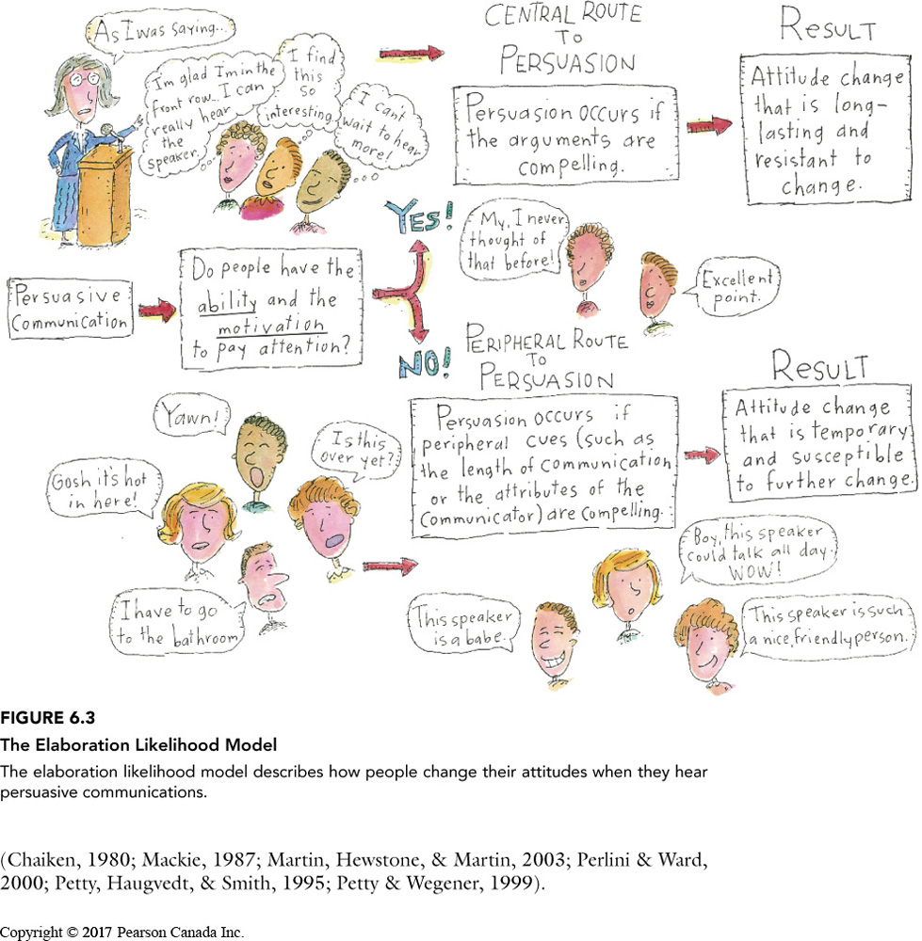
Central and Peripheral Routes to Persuasion

Slide 14
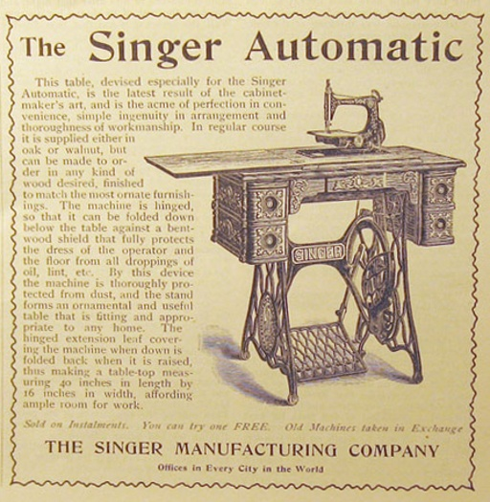

Central and Peripheral Routes to Persuasion
McDonalds Commercial

Slide 15
Fear and Attitude Change
Fear-Arousing Communication – A persuasive message that attempts to change people’s attitudes by arousing their fears
  Fear get’s attention → listening to messages about how to reduce fear motivates people to analyze the message carefully and change their attitudes via central route
  If fear is too overwhelming or there is no way to affectively remove the threat, the message will not work
  Humour can work well in defusing fearful situations
  Fear based ads – Texting and Driving
  If you see something, say something

Slide 16
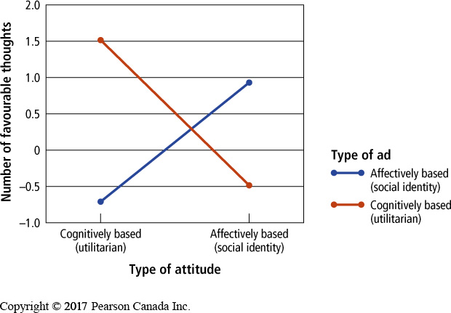
Implementation of Attitude Change – Advertising
Change cognitively based attitudes with rational arguments
  Utilitarian products
Change affectively based attitudes using emotion
  Intangible products – social identity products
People reacted more favourable to ads that matched their attitudes
People react more favourably to attitudes that match their cultural preference for individualism (independent) vs collectivism (interdependent)
Product placement
Advertising today
  Data mining, specific targeting, attitudes and preferences are known by data companies, fMRI usage in devising ads, etc.

Slide 17
Resisting Persuasive Messages
Attitude Inoculation – The process of making people immune to attempts to change their attitudes by exposing them to small doses of arguments against their position
  Peer pressure
  Smoking prevention
  Attacks on attitude – making them more robust

Slide 18
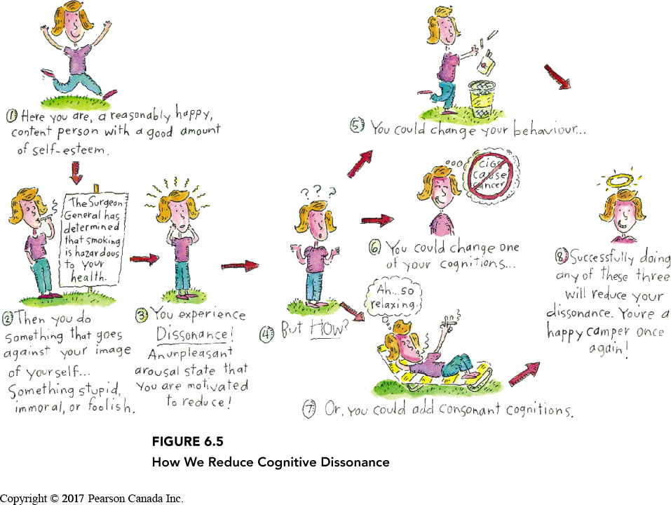
Cognitive Dissonance
A feeling of discomfort caused by the realization that one’s behaviour is inconsistent with one’s attitudes or that one holds two conflicting attitudes
  Cognitive dissonance is a state of psychological tension occurring when thoughts, beliefs, attitudes, and/or behaviours are in conflict with each other.
Alleviating Dissonance
1 – Justify behaviour by changing one of the dissonant cognitions
2 – Changing behaviour to bring it in line with the dissonant cognition
3 – Justify behaviour by adding new cognitions

Slide 19
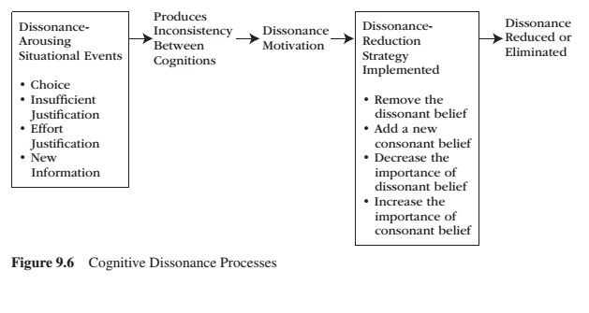
Motivational Processes Underlying Dissonance
Reeve, J. (2015) Understanding Motivation and Emotion, 6th ed. John Wiley and Sons

Slide 20
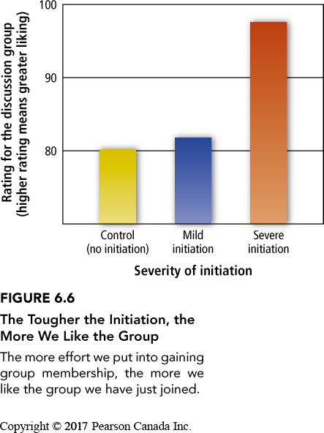
Post-Decision Dissonance
Post-Decision Dissonance that is inevitably aroused after a person makes a decision; such dissonance is typically reduced by enhancing the attractiveness of the chosen alternative and devaluing the rejected alternative
  Effects can be implicit
Permanence – the more permeant and less revocable the decision, the greater the need to reduce dissonance.
Dissonance reduction following a difficult moral decision can cause people to behave either more or less ethically in the future.
Effort Justification – The tendency for individuals to increase their liking for something they have worked hard to attain
  What are examples of choices you made recently? What are your justifications for that choice?

Slide 21
External vs Internal Justification
External Justification – A person’s reason or explanation for the dissonant behaviour resides outside the individual
Internal Justification – A person’s reason or explanation for the dissonant behaviour resides inside the individual
Counter-Attitudinal Advocacy – A process that occurs when a person states an opinion or attitude that runs counter to his or her private belief or attitude
  Create dissonance by introducing hypocrisy (especially effective with people with high self-esteem)
  When we do this with little external justification, we start to believe our own lies
  Used to deal with social problems like racism, safe sex practices
Insufficient Punishment – Dissonance aroused when individuals lack sufficient external justification for having resisted a desired activity or object, usually resulting in an individuals devaluing the forbidden activity or object
  Uses internal justification to reduce dissonance – longer lasting.
Removing or reducing autonomy also removes or reduces intrinsic motivation

Slide 22
Avoid the Rationalization Trap
Rationalization Trap – The potential for dissonance reduction to produce a succession of self-justifications that ultimately result in a chain of stupid immoral acts
Self-Affirmation Theory suggests that people will reduce the impact of a dissonance arousing threat to their self-concept by focusing on and affirming their competence on some dimension unrelated to the threat

Slide 23
The Psychology of Influence
Robert Cialdini
Six weapons of influence
1 – Reciprocation
2 – Commitment and consistency
3 – Social proof
4 – Liking
5 – Authority
6 – Scarcity

Slide 24
Activity
Why do people still support politicians who go against what they promised?
A Few Examples!
  Recently, Trump was caught colluding with the president of Ukraine in order to obtain information about a political rival. Despite this, Trump still has a strong base that continue to support him. Why is that?
  Trudeau has taken a strong stance to be more environmentally and fiscally responsible; however recently he purchased Kinder Morgan’s Trans Mountain Pipeline for $4.5 billion dollars. Despite some criticism, Trudeau still has a strong support base. Why is that?
  When George Bush senior was campaigning, he uttered the words, Read My Lips, No New Taxes. Then two years after winning, he increased taxes in order to reduce the deficit. Why did people continue to support him after he raised taxes?

Slide 25
Learning Check
- What is an attitude? What are components of an attitude?
- What is an implicit vs explicit attitude?
- When do attitudes predict behaviour?
- What is the theory of planned behaviour? How does it apply to an example, like encouraging safe sex?
- How do attitudes change?
- What is the Yale Attitude Change Approach?
- What are central and peripheral routes to persuasion? Which works best?
- What is fear-arousing communication? How does it work?
- What is the difference between utilitarian and social identity products and how does that relate to advertising? What is the best route to persuasion to take in advertising?
- What is attitude inoculation? How does it work?
- What is cognitive dissonance theory?
- What is post decision dissonance? How is affected by permanence? How does it affect our moral values?
- What is justification of effort?
- What is internal and external justification? How do they help maintain or change behaviour and/or attitudes?
- What is counter-attitudinal advocacy? How can it be used to tackle social problems?
- What is insufficient punishment? How does it work?
- How do we avoid the rationalization trap?
- What is the self-affirmation theory?

Slide 26
Questions or Concerns?
Have a great day!

