Slide 1
Building Food Sovereign Campuses
Erik Chevrier
November 15th, 2019

Slide 2
Let’s Build Food Sovereign Campuses!
Why?
1 – Our current food system is NOT sustainable!
2 – Universities are ideal locations to develop more sustainable (just, secure, sovereign) food systems!
Universities have researchers, funding, professors, students, land, farm…
3 – Campus food systems should be organized internally through a partnership with faculty, students, administration, and/or other stakeholders.
It is a wasted opportunity to contract large multinational corporations instead of relying on internal experts (professors and researchers) and students eating the food.
4 – Universities in Quebec are publicly funded, they have a moral obligation to positively affect the communities they are part of and the world at large.

Slide 3
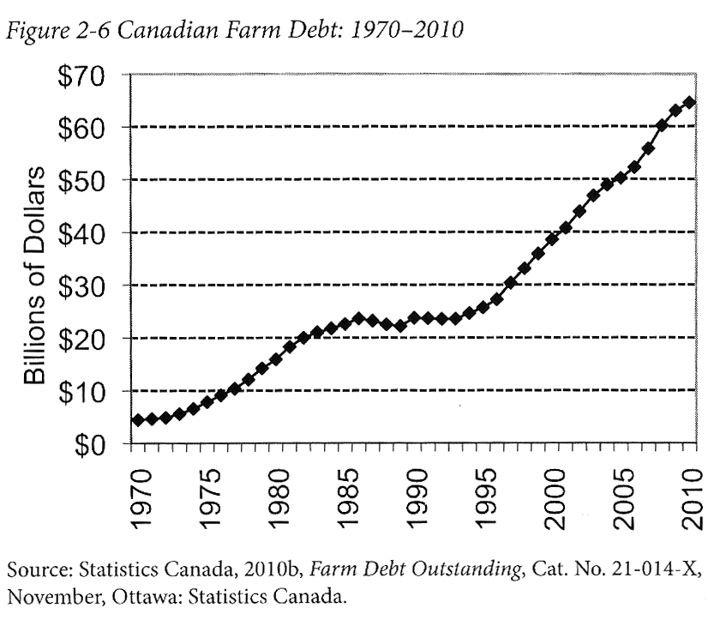
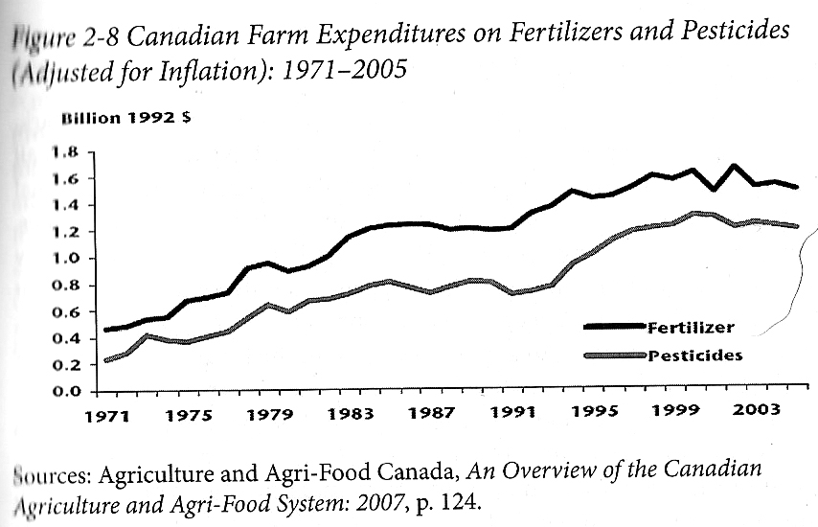
Our Current Food System is NOT Economically Sustainable Qualman, D. (2011) Advancing Agriculture by Destroying Farms? The State of Agriculture in Canada, pp. 20 – 42. In, Wittman, H., Desmarais, A. A., & Wiebe, N. (2011) Food Sovereignty in Canada: Creating Just and Sustainable Food Systems, Fernwood Publishing

Slide 4
Only A Few Large Corporations Own Most of the Agrochemical Market https://cban.ca/gmos/issues/corporate-control/

Slide 5
Companies of War, Destruction and Death
These are a few examples:
Monsanto still uses chemicals that were used to kill people, but in our food
Is Round-Up safe to drink?
Farmer won lawsuit against Monsanto – Glyphosate causes cancer
The World According to Monsanto
Monsanto is now owned by Bayer who used to be part of I.G. Farben, manufacturing poisonous gas (Zyklon B) for concentration camps during the World War.
Dow Chemical Invented Agent Orange
BASF was also part of IG Farben a company who worked with the Nazis and tested chemicals and drugs on people including Zyklon B
Dow Chemical now owns Union Carbide who was responsible for a large devastating explosion in Bhopal, India:
The Bhopal disaster: Toxic legacy
One Night in Bhopal
The Bhopal Disaster

Slide 6
Issues With Our Current Food System
Issues with food security – there are over 800 million people starving in the world today! Issues with food sovereignty – peasants and farmers are being affected by trade agreements and food dumping! Issues with genetic modification process – epigenetics matter! Issues with use of herbicides – glyphosates are being identified as cancer causing! Issues with privatization – restricted access! Issues with cost on farmers – family farms are not sustainable! Issues with reduction of biodiversity – we are destroying nature! Issues with unwanted genetics spreading onto non GMO farms – lawsuits! Issues with loss of Indigenous farming methods – they are being lost! Issues with soil arability – we are killing our soil! Issues with killing pollinators – fruits need bees! Issues with water ‘dead zones’ – we are polluting our water! Issues with corporate concentration of agribusinesses – former war companies are now food chemical companies! Issues with health – our food contains toxins! Rising cost of seed and chemicals – we don’t need to buy seeds! Research funding being directed to GMOs instead of traditional breeding methods – ‘science’ is not only about GMOs! Pest and weed resistance to Bt crops and glyphosate! There are so many more critiques!

Slide 7
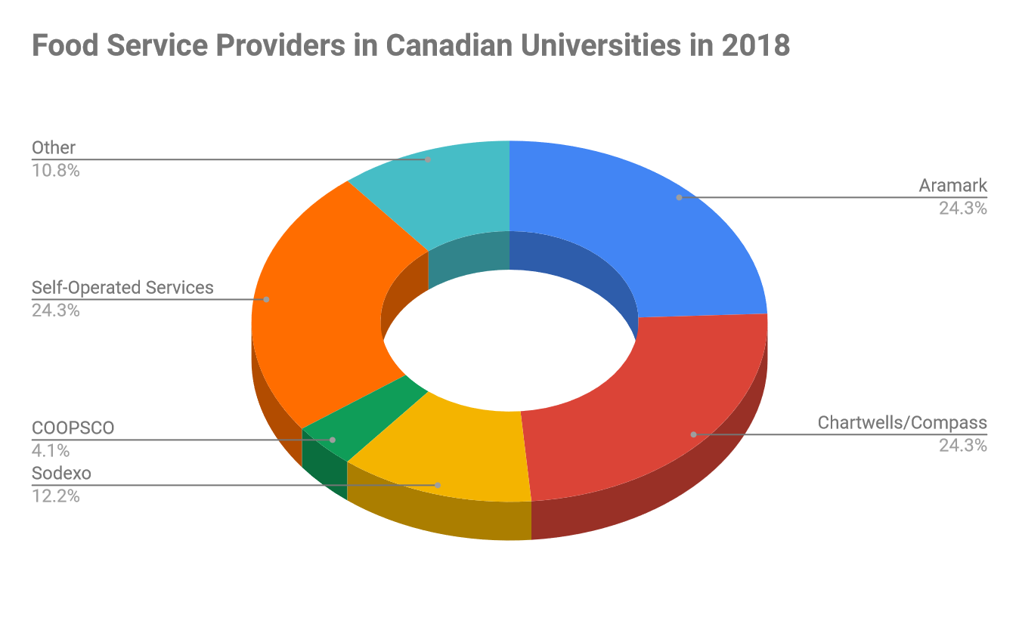
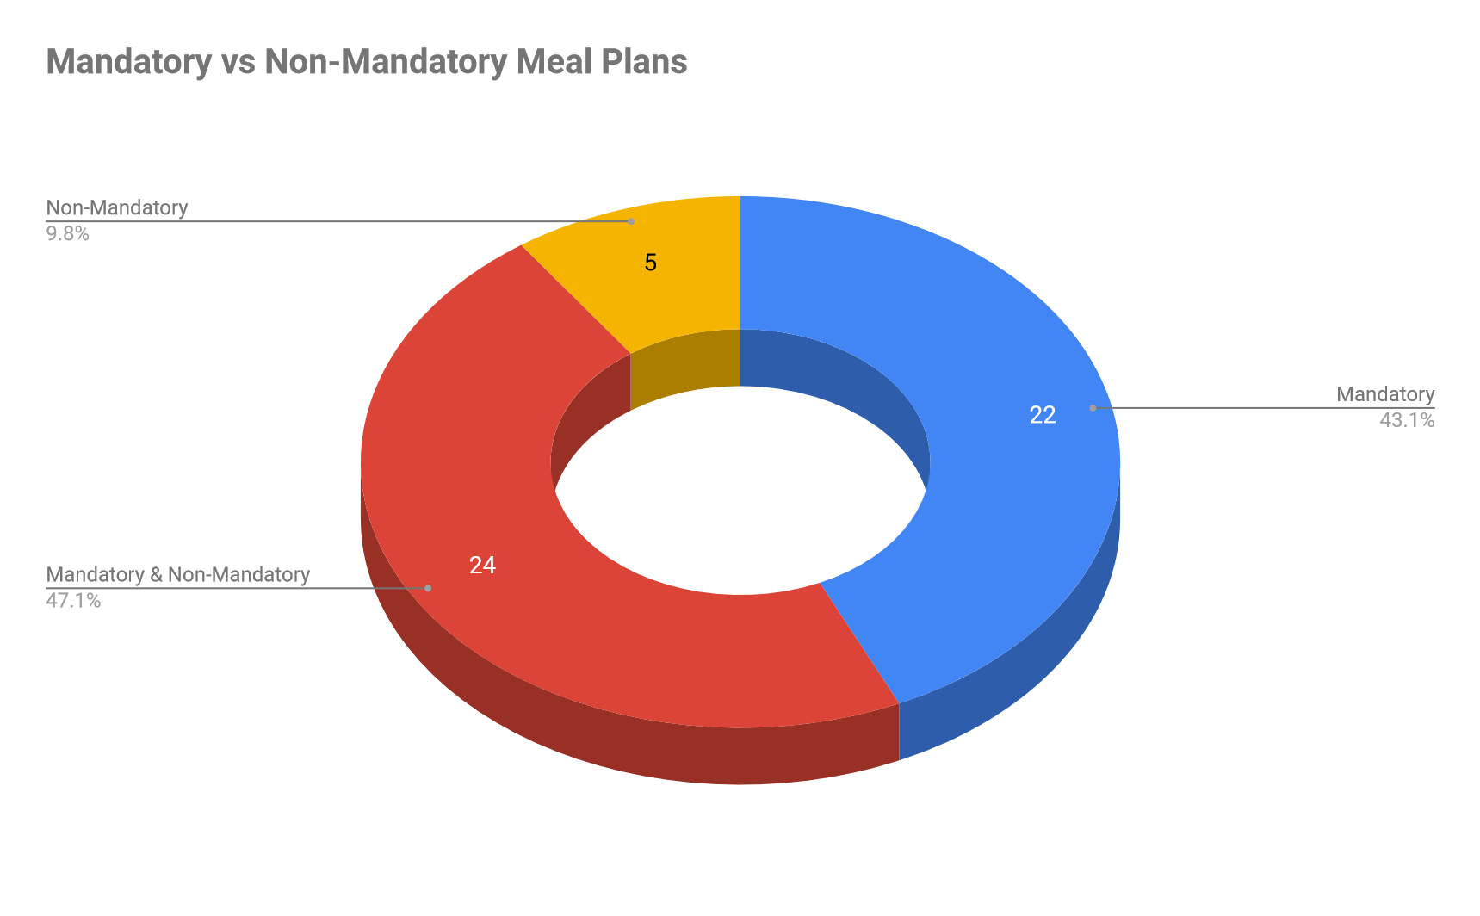
Campus Food Problems
Problems with multinational food corporations on campus
Mandatory resident meal plan
Exclusivity agreements
Monopoly over food services
Unhealthy food
Waste
Serving times not ideal
Costly
NOT GOING TO TRANSFORM OUR FOOD SYSTEM!

Slide 8
How to Transform Campus Food Systems
Working within the administrative structures!
Have frequent communication with key administrators
Get on food related committees and/or any committee that can influence food services
Get to know the Request for Proposal (RFP) process and get on to RFP committees - C-65.1 - Act respecting contracting by public bodies
Get on senate and the board of governors
Use the language of sustainability and refer to the McGill’s strategic goals
Oppose problematic practices!
Get involved with student unions
Hold ‘successful’ referendum votes
Organize demonstrations/actions/strikes
Let administrators know your position
Talk with the press
Organize a better food system!
Create organizations that:
Grow, process, distribute and manage food waste on campus through semi-autonomous food organizations
Form a food coalition or food group federation
Use economic models that prioritize people and the planet over profits
Involve the community at large
Engage with professors and encourage them to allow students to perform participatory-action-research projects as assignments!

Slide 9
Concordia Food Groups

Slide 10
Thank You!
Please visit my website: www.erikchevrier.ca
You can get this presentation and my contact information there
Please visit the Concordia Food Groups website: www.concordiafoodgroups.ca

