Slide 1
Fundamentals of Social Psychology
Prejudice
November 26th, 2019
Erik Chevrier

Slide 2
Jane Elliott
Blue eyes brown eyes experiment
Shorter video

Slide 3
Prejudice
A hostile or negative attitude toward people in a distinguishable group based solely on their membership in that group.
  Affective component
    Involves positive or negative affect
  Cognitive Component
  Behavioural Component
  Attitude – evaluations of people, objects or ideas.

Slide 4
Cognitive Component
Stereotype – A generalization about a group of people in which identical characteristics are assigned to virtually all members of the group, regardless of actual variation among the members
  Resistant to change
  Stereotyping does not necessarily lead to negative or harmful behaviours
  Traits or characteristics of a group that people are most likely to talk about are traits that become part of the stereotype of the group – ‘gossip value’

Slide 5
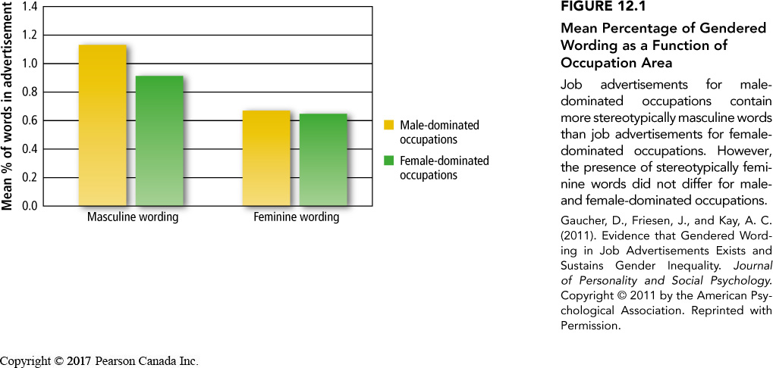
Stereotypes of Gender
Two forms of sexism:
  Hostile sexism – hold negative stereotypes of women
  Benevolent sexism – hold positive stereotypes of women
  Have you experienced any of these forms of sexism?
  Gender based stereotypes are established at an early age

Slide 6
Discrimination: Behavioural Component
Discrimination – Unjustified negative or harmful action towards a member of a group simply because of his or her membership in that group
  Examples: Housing, schools, court rooms, body type, sexual orientation, etc.

Slide 7
Implicit Racism
Modern racism – Outwardly acting unprejudiced while inwardly maintaining prejudice attitudes
  Racist attitudes may surface if someone feels ‘safe’, are intoxicated or stressed
Modern racism scale – measures subtle racism
  i.e. minorities are getting too demanding in their push for special rights
  Modern homonegativity scale
  Modern Prejudiced Attitudes Towards Aboriginals Scale
Implicit Prejudices can be measured using the Implicit Association Test (IAT)
Critiques of IAT
  Does not measure emotions but salience of the word associated with it
  IAT does not measure prejudice but picks up familiarity effect
  IAT may make people more aware of prejudices causing them to be more uncomfortable and less friendly when engaging with people from ‘different group’

Slide 8
What Causes Prejudice
First step – Creation of groups – form social identity
  We make sense of our social world by creating groups, taxonomies and categories
In-Group Bias – The tendency to evaluate in-group members more positively than out-group members
  People give more favourable ratings to people in their group
  Out-group members are seen more negatively
  Minimal group – The tendency to favour the in-group while denigrating the out-group is so pervasive that people show this bias even under the most minimal conditions.
    Stronger when people choose their groups, however trivial criteria can still create in-groups with strangers
Second step – Having a social identity contributes to feelings of self-esteem

Slide 9
Social Identity
People who strongly identify with a group are more likely to:
  favour the group
    When the group’s identity is threatened, people attempt to restore it
  discriminate an out-group
    When people’s group identities are threatened, they are more likely to discriminate against someone from an out-group

Slide 10
Self-Esteem Benefits
Social identity gives people a self-esteem boost
Those who discriminate against out-groups get boosts in self-esteem
When self-esteem is threatened, people are more likely to ‘put down’ the out-group as a means of restoring feelings of self-worth.
Having high self-esteem can prevent people from ‘putting down’ the out-group

Slide 11
Implications of Social Categorization for Reducing Prejudice
Reinforce a common identity – we are all people
Emphasize superordinate groups that members of in and out groups belong
Eliminate the ‘us’ vs ‘them’ mentality
Self-affirmation theory – A theory suggesting that people will reduce the impact of a dissonance-arousing threat to their self-concept by focusing on and affirming their competence on some dimension unrelated to the threat.
  people who have affirmed themselves in some way, are less likely to need to boost their self-esteem by ‘putting down’ members of an out-group
What are the implications of giving people boosts in self-esteem in order to prevent discrimination against ‘out-groups’?

Slide 12
Activation of Stereotypes
When stereotypes are activated, they can cause people to behave in ways that are harmful to members of an out-group
  i.e. shootings of black males by police officers
  How are stereotypes produced/reinforced?

Slide 13
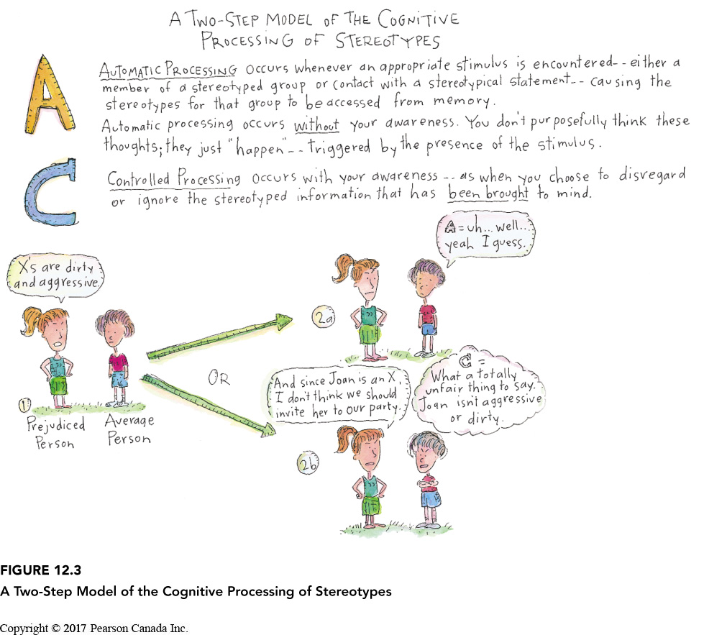
Automatic vs Controlled Processing of Stereotypes
Two-step model of cognitive processing →
Those who are more willing to control
prejudice are less likely to show prejudice
We can selectively activate and inhibit stereotypes in service of self-enhancement

Slide 14
Meta-Stereotypes
A person’s belief regarding the stereotype that out-group members hold about their own group
When people are expected that members of the out-group will perceive them negatively, they are more likely to be prejudice towards that group
  In prejudice reduction, it may not be effective to let people to put themselves in the perspective of the out-group if this leads them to believe that the out-group holds negative feelings about their group
  Prejudice may be reduced if people are asked to take an ‘other-focused’ perspective rather than a ‘self-perspective’
    Learn as much as possible about the other person, rather than focus on how they are being evaluated by the other person.
  We project our own prejudice onto other groups and therefore assume that they also dislike us

Slide 15
Reducing Prejudice by Revising Stereotypes
Stereotypes are very resistant to change
People hang on to stereotypes in the face of contradictory evidence
When faced with contradictory evidence, people sometimes create a new subtype for this deviant member.
Stereotypes can eventually change when people come in contact with many examples that are inconsistent with the stereotype

Slide 16
Affect and Mood
Emotions elicited by a particular group are the most important determinate of our level of prejudice.
Prejudice is also a product of our symbolic beliefs – the perception that a particular group promotes or hinders the values we cherish and a product of behavioural experiences with members of that group.
  Predicts attitudes towards gay and lesbians
Emotion is a strong predictor of prejudice that minority groups hold against majority groups
The more negative emotion people feel while interacting with a particular group, the more prejudice they have towards that group.
Mood can also affect prejudice.
  People in a bad mood are more likely to display prejudice
  Prejudice reduction should focus on changing people’s feelings towards an out-group

Slide 17
Attributional Biases
Fundamental attribution error – Attributing personality factors to someone’s behaviour instead of situational explanations.
Ultimate attribution error – Our tendency to make dispositional attributions about an entire group of people.
When people conform to our stereotype, we tend to blind ourselves to clues about why they might have behaved the way they did. We attribute their behaviour to their personality rather than the situation.

Slide 18
Realistic Conflict Theory
The theory that limited resources leads to conflict among groups and result in increased prejudice and discrimination.
  When resources are scarce, we are more threatened by out-groups
  Economic recession and prejudice towards immigrants are positively correlated.
  Experimental evidence too….p. 368 and 369.

Slide 19
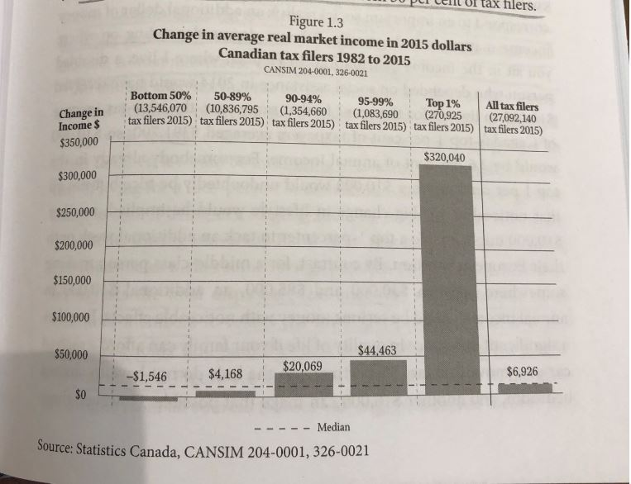
Real vs Market Income
Osberg, L. (2018) The Age of Increasing Inequality – The Astonishing Rise of Canada’s 1%, James Lorimer and Company.

Slide 20
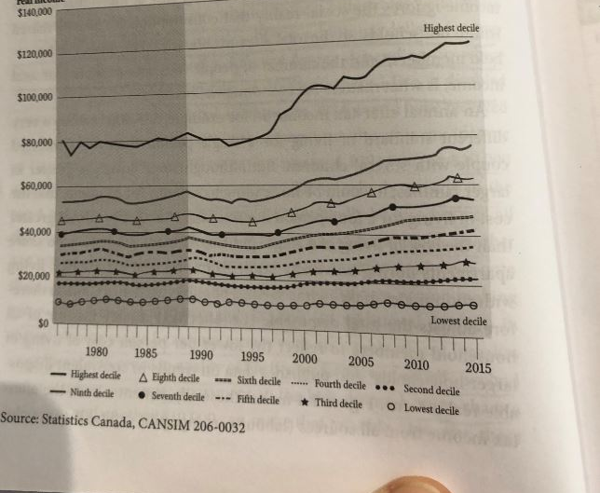
Average Disposable Income
Osberg, L. (2018) The Age of Increasing Inequality – The Astonishing Rise of Canada’s 1%, James Lorimer and Company.

Slide 21
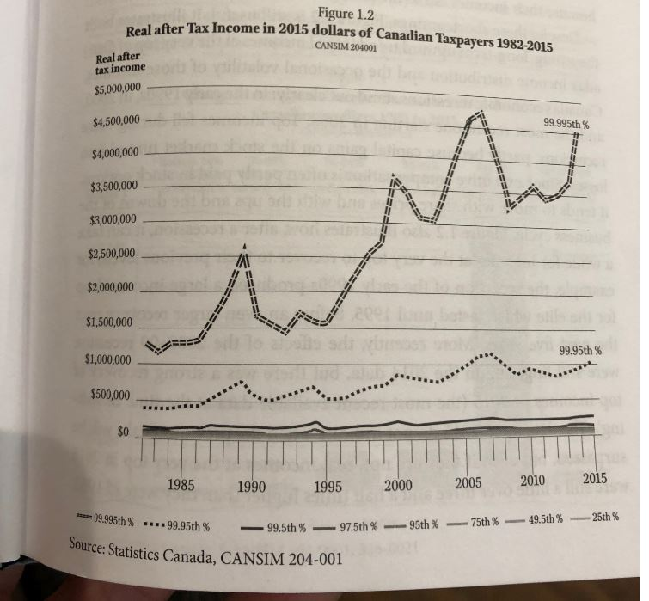
Real Income
Osberg, L. (2018) The Age of Increasing Inequality – The Astonishing Rise of Canada’s 1%, James Lorimer and Company.

Slide 22
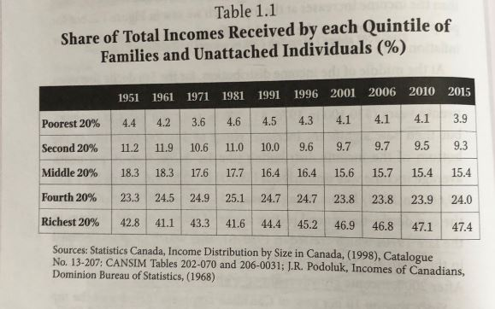
Family Income
Osberg, L. (2018) The Age of Increasing Inequality – The Astonishing Rise of Canada’s 1%, James Lorimer and Company.

Slide 23
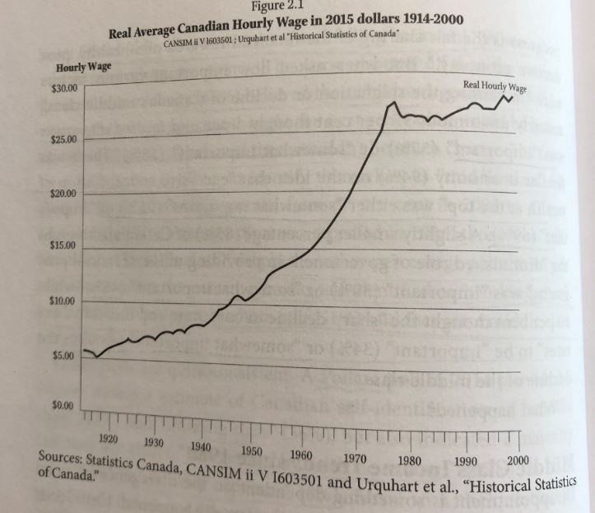
Average Wage
Osberg, L. (2018) The Age of Increasing Inequality – The Astonishing Rise of Canada’s 1%, James Lorimer and Company.

Slide 24
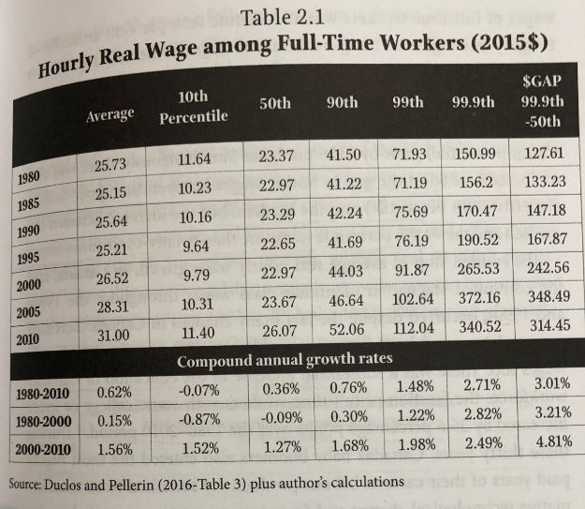
Real Hourly Wages
Osberg, L. (2018) The Age of Increasing Inequality – The Astonishing Rise of Canada’s 1%, James Lorimer and Company.

Slide 25
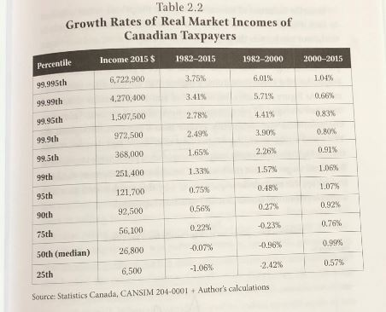
Growth Rates of Real Market Incomes
Osberg, L. (2018) The Age of Increasing Inequality – The Astonishing Rise of Canada’s 1%, James Lorimer and Company.

Slide 26
Links
Bank’s Big Secret
Debt and Wealth in Canada
House Market in Canada

Slide 27
Reducing Prejudice by Fostering Common Goals
Muzafer Sherif (1961) Boy Scout Camp
Sherif – Robbers Cave – Realistic Conflict Theory
Reducing prejudice
Eliminate competitive games
Promote non-competitive social contact
Create mutual interdependence – a situation in which two or more groups need each other to accomplish superordinate goals.

Slide 28
Pressure to Conform: Normative Rules
Many people uphold discriminatory behaviour in order to conform to, or fit in, with a majority view.
Injunctification – A motivated tendency to see things the same status quo (the way things are) as the most desirable state of affairs.
Motivated to justify the current system.
React negatively to people who don’t conform to prevailing social norms.

Slide 29
Individual Differences in Prejudice
Right-Wing Authoritarianism – Three clusters of attitudes.
  Authoritarian submission – high degree of submission to authority figures in society
  Authoritarian aggression – aggression towards groups that are seen as legitimate targets by authority figures
  Conventionalism – high degree of conformity to the rules and conventions that are established by authority figures
  How to combat right-wing authoritarianism…
  Create awareness that attitudes have changed towards particular out-group.
  Social pressure
  Encourage interaction with out-group

Slide 30
Individual Differences in Prejudice
Religious Fundamentalism – Belief in the absolute literal truth of one’s religious beliefs.
People with a ‘religious quest’ tend to be less prejudice

Slide 31
Individual Differences
Social Dominance Orientation – People who believe that people are inherently unequal and it is acceptable for some groups in society to be treated better than others.
  Prejudice reduction can backfire if explained that people should be treated equally
  Some success with ‘shared identity’

Slide 32
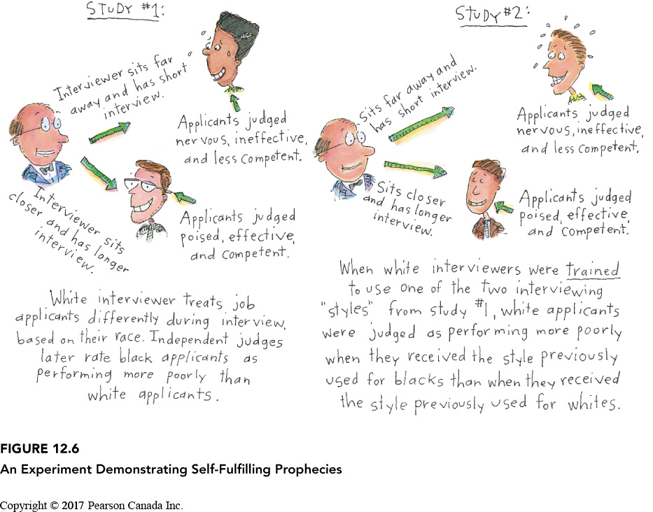
Self-Fulfilling Prophecies

Slide 33
Stereotype Threat
Apprehension experienced by members of a minority group that they behave in a manner that confirms an existing cultural stereotype.
  Tests and performance p. 376 and 377.
  Overcoming stereotype threat
  Change people’s mindsets
    Fixed vs improvable skills
    Remind people that it is normal to feel anxiety during tests
    Remind students that they are all good

Slide 34
Reducing Prejudice
Contact hypothesis
  Contact can reduce prejudice
  Six conditions
    Mutual interdependence
    Common goal
    Equal status
    Friendly informal setting
    Learning about multiple members of the outgroup
    Create social norms that promote equality among the group
    How can you create a program to reduce prejudice in a school setting?
    What are the implications of these methods to reduce prejudice?

Slide 35
Cooperation and Jigsaw Classroom
A classroom setting designed to reduce prejudice between children by placing them in small, desegregated groups and making each child dependent on the other children in the group to learn the course material and to do well in the class

Slide 36
Extended Contact Hypothesis
The mere knowledge that a member of one’s group has a close relationship with a member of another group can reduce one’s prejudice towards that group.

Slide 37
Learning Check!
Who is Jane Elliott? How did she address prejudice in her classroom?
What is prejudice? What components make up prejudice?
What is a stereotype? How does a stereotype work?
What are different kinds of sexism? How do they manifest?
What is discrimination? Provide examples of discrimination?
What is implicit racism? How does it manifest? How is it measured? What are critiques of these measurements?
What causes prejudice?
What is social identity? How does it relate to prejudice?
How does self-esteem relate to prejudice?
How does the text book suggest that we can reduce prejudice?
What are consequences of activating stereotypes?
What are automatic vs controlled processes involved in prejudice and stereotyping? What is the two step model of cognitive processing?
What is a meta stereotype? What does meta-stereotypes infer about prejudice reduction strategies?
What are ways to reduce prejudice by revising stereotypes?
How does affect and mood affect prejudice?
What is the ultimate attribution error?
What is realistic conflict theory?
Please recount Muzafer Sherif ‘s experiment and discuss the implications of his experiment.
How do normative rules affect prejudice?
What are individual differences in prejudice?
How can prejudice become a self fulfilling prophecy?
What is stereotype threat and what effects does it produce? How can we overcome it?
How do we reduce prejudice through contact? What other factors need to be present?
What is the jigsaw classroom?
What is the extended contact hypothesis?

Slide 38
Questions or Concerns?
Have a great day!

