Slide 1
Food and Culture
GMOs, Biodiversity, Privatization of Genetics
Erik Chevrier
November 4th, 2019

Slide 2
Readings to Focus on for Next Week
Smythe, E. (2014) Globalization and Food Sovereignty: Global and Local Change in the New Politics of Food, University of Toronto Press.
Chapter 10 – Food Sovereignty, Trade Rules, and the Struggle to Know the Origins of Food, pp. 289 – 318.

Slide 3
Discussion
What is the commons? What is a commodity?
How can food be recognized as a commodity or common?
What is property? What is a possession?
What is the difference between private and public?
What is a GMO?
What does Mae-Wan Ho suggest about GMOs?

Slide 4
The Dominant Epistemological View of Food?
The world has or will soon have the agricultural technology available to feed the 8.3 billion people anticipated in the next quarter of a century. The more pertinent question today is whether farmers and ranchers will be permitted to use that technology. Extremists in the environmental movement, largely from rich nations and/or the privileged strata of society in poor nations, seem to be doing everything they can to stop scientific progress in its tracks. It is sad that some scientists, many of whom should or do know better, have also jumped on the extremist environmental bandwagon in search of research funds. When scientists align themselves with antiscience political movements or lend their name to unscientific propositions, what are we to think? Is it any wonder that science is losing its constituency? We must be on guard against politically opportunistic, pseudo-scientists…
Borlaug, N., E. (2000) Ending World Hunger. The Promise of Biotechnology and the Threat of Antiscience Zealotry, Plant Physiology, 124(2) pp. 488.

Slide 5
Critique of Dominant Epistemological View of Food
When poisons are introduced into agriculture to control pests, or when GMOs are introduced under the argument of “feeding the world,” the justification given is always “science”. But “science” does not have a singular entity, and it did not come into existence within a vacuum. Today, what we generally refer to as “science” is in fact Western, mechanistic, reductionist modern science, which became the dominant practice of understanding the world during the Industrial Revolution and has continued as the dominant paradigm….To shape the industrial system in the form of new, violent technologies, and to shape the capitalist system in the form of new, profit-driven economics, a certain type of science was promoted and privileged as the only scientific knowledge system. Two scientific theories came to dominate this new, industrial paradigm, and they continue to shape practices of food, agriculture, health, and nutrition even today. The first is a Newtonian-Cartesian idea of separation: a fragmented world made of fixed, immutable atoms…The second significant theory that has framed the knowledge paradigm for industrial agriculture is Darwin’s theory of competition as the basis for evolution…The Newtonian-Cartesian theory of fragmentation and separation and the Darwinian paradigm of competition, have led to a nonrenewable use of Earth’s resources, a nonsustainable model for food and agriculture, and an unhealthy model of health and nutrition. An emphasis on the legitimacy of these arguments as the sole “scientific” approach has created a knowledge apartheid by discounting the knowledge of Mother Earth.
Shiva, V. (Shiva, V. (2016) Who Really Feeds the World, North Atlantic Books, pp. 4 – 7.

Slide 6
Importance of Action Based Research
Why are action based projects important?
It is important to challenge the problematic dominant epistemological understandings of food.
Instead we should produce ontological formations of the world we want by co-creating and co-recreating social relations that produce positive outcomes on people and the planet.
Action based learning theories incorporate students and facilitators as co-learners and co-collaborators. Together, they learn by doing. They also connect with the community.
Epistemology – A term meaning “theory of knowledge,” which gets at the how we know about the social world that lies behind all theoretical approaches. (Frampton, Kinsman, Thompson, Tileczek, (2006))
Ontology – Assumptions relating to how the social comes into being that inform all theories and ways of writing the social. (Frampton, Kinsman, Thompson, Tileczek, (2006))

Slide 7
Commodification of Food
Commodity:
Cambridge English Dictionary
A substance or product that can be traded, bought, or sold.
A valuable quality
Oxford Dictionary
A raw material or primary agricultural product that can be bought and sold, such as copper or coffee.
A useful or valuable thing.
Myriam-Webster Dictionary
An economic good: such as
A product of agriculture
An article of commerce especially when delivered for shipment
A mass-produced unspecialized product commodity chemicals
Something useful or valued
Convenience, advantage
A good or service whose wide availability typically leads to smaller profit margins and diminishes the importance of factors (such as brand name) other than price
One that is subject to ready exchange or exploitation within a market

Slide 8
Commodification of Food
Marx circulation of commodities and money
C – C
C – M – C
M – C – M’
M – M’
Polanyi – Fictitious Commodity
Land
Labour
Money
Food?

Slide 9
De-commodifying = Creating Commons (Recap of Vandana Shiva)
Closing of commons = commodifying food:
1 – The exclusion of people from access to resources that had been their common property of held in common
2 – The creation of ‘surplus’ or ‘disposable’ people by denying rights of access to the commons that sustained them
3 – The creation of private property by the enclosure of common property
4 – The replacement of diversity that provides for multiple needs and performs multiple functions with monocultures that provide raw material 5 – The enclosure of minds and imagination, with the result that enclosures are defined and perceived as universal human progress, not as growth of privilege and exclusive rights for a few and dispossession and impoverished for the many
Terra matter – Mother earth
Terra nullius – Empty land
Bio nullius – Life as empty intelligence

Slide 10
Land Grab Vandana Shiva (2015) Who Really Feeds the World? The Failures of Agribusiness and the Promise of Agroecology
European Union
1% control 20% of EU Farmland
3% control 50% of EU Farmland
80% of farms (small-scale) control 14.5% of EU Farmland
Between 2007 and 2010, small-scale farmers lost 17% of EU Farmland
Farmer suicide is linked to debt-induced landgrabs

Slide 11
Violence Against Farmers Vandana Shiva (2015) Who Really Feeds the World? The Failures of Agribusiness and the Promise of Agroecology
Farmers are being criminalized for seed breeding, seed saving and seed sharing
Contribution to seed breeding is being erased – farmers have coevolved with nature
Patents lead to royalty collection
Contamination leads to lawsuits

Slide 12
Corporation
Definition of Corporation in Quebec
A business corporation (also called "corporation" or "legal person") is a separate legal entity and, accordingly, has its own specific rights and obligations.
The purpose of a business corporation is to operate an enterprise in order to generate profits that will be distributed, if applicable, among its shareholders.
A business corporation:
has an existence separate from that of its shareholders;
owns property in its own name;
acquires rights and assumes obligations and liabilities;
signs contracts through its directors;
may sue or be sued in the same way as a natural person
The Corporation – What is a Corporation?
The Corporation – Full Movie - 2h 11min 33sec

Slide 13
Only A Few Large Corporations Own Most of the Agrochemical Market https://cban.ca/gmos/issues/corporate-control/

Slide 14
Companies of War, Destruction and Death
These are a few examples:
Monsanto still uses chemicals that were used to kill people, but in our food
Is Round-Up safe to drink?
Farmer won lawsuit against Monsanto – Glyphosate causes cancer
The World According to Monsanto
Monsanto is now owned by Bayer who used to be part of I.G. Farben, manufacturing poisonous gas (Zyklon B) for concentration camps during the World War.
BASF was also part of IG Farben.
Dow Chemical Invented Agent Orange
BASF was also part of IG Farben a company who worked with the Nazis and tested chemicals and drugs on people including Zyklon B
Dow Chemical now owns Union Carbide who was responsible for a large devastating explosion in Bhopal, India:
The Bhopal disaster: Toxic legacy
One Night in Bhopal
The Bhopal Disaster

Slide 15
What is a GMO?
Genetic Engineering
Mae-Wan Ho
GMO is an organism with synthetic genetic material inserted into its gnome. It is made in a laboratory.
Epigenetics
Epigenetics – More Technical Mechanics

Slide 16
Food Commodities – Issues with GMOs
Issues with genetic modification process – epigenetics matter! Issues with use of herbicides – glyphosates are being identified as cancer causing! Issues with privatization – restricted access! Issues with cost on farmers – family farms are not sustainable! Issues with reduction of biodiversity – we are destroying nature! Issues with unwanted genetics spreading onto non GMO farms – lawsuits! Issues with seed saving – food can reproduce itself! Issues with loss of Indigenous farming methods – they are being lost! Issues with soil arability – we are killing our soil! Issues with killing pollinators – fruits need bees! Issues with water ‘dead zones’ – we are polluting our water! Issues with corporate concentration of agribusinesses – former war companies are now food chemical companies! Health concerns with GMOs – growing evidence! Rising cost of seed and chemicals – we don’t need to buy seeds! Research funding being directed to GMOs instead of traditional breeding methods – ‘science’ is not only about GMOs Pest and weed resistance to Bt crops and glyphosate We still cannot feed the world – the problem is not about production, it is about access! The problem is rooted in the capitalist food system!

Slide 17
Health Hazards of GMOs
Mae-Wan Ho
Uncontrollable, unpredictable impact on safety due to the genetic modification process
Scrambling of host gene, widespread mutations, inactive genes, activating genes, creating new transcripts, creating new proteins, etc.
Toxicity of transgene protein(s) introduced
Transgene protein toxic, transgene protein allergenic or immunogenic, protein created by sequence insert may be toxic, etc.
Effects due to the GM insert and its stability
Genetic rearrangement with further unpredictable effects, horizontal gene transfer and recombination, spreading antibiotic drug resistance, creating new viruses and bacteria that cause disease, etc.
Toxicity of herbicides used with herbicide-tolerant GM crops

Slide 18
GMO Myths According to Vandana Shiva
Myth 1 – GMOs are an ‘invention of corporations’ and therefore can be patented and owned
Myth 2 – Genetic engineering is more accurate and precise than conventional breeding
Myth 3 – GMOs are just like naturally occurring organisms, and therefore they are safe
Myth 4 – GMOs are based on cutting edge science; GMO critics are ‘anti-science’
Myth 5 – GMOs increase yields and are the answer to world hunger
Myth 6 – GMOs reduce chemical use and are therefore environmentally beneficial
Myth 7 – GMOs promote free choice

Slide 19
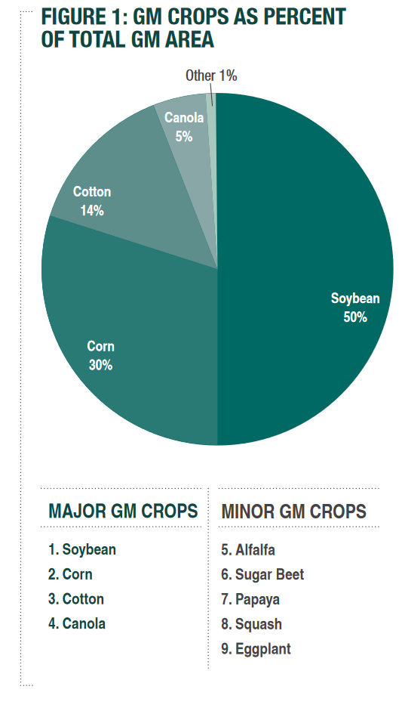
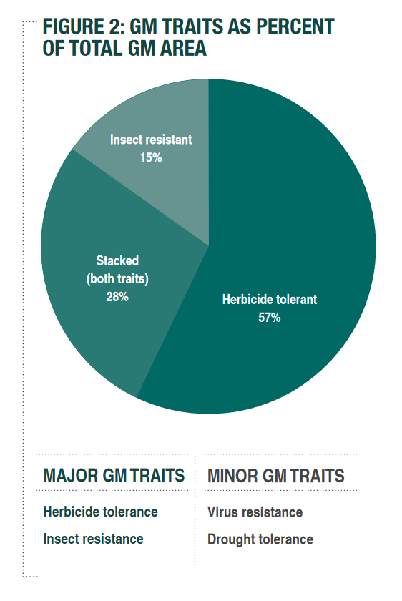
Source

Slide 20
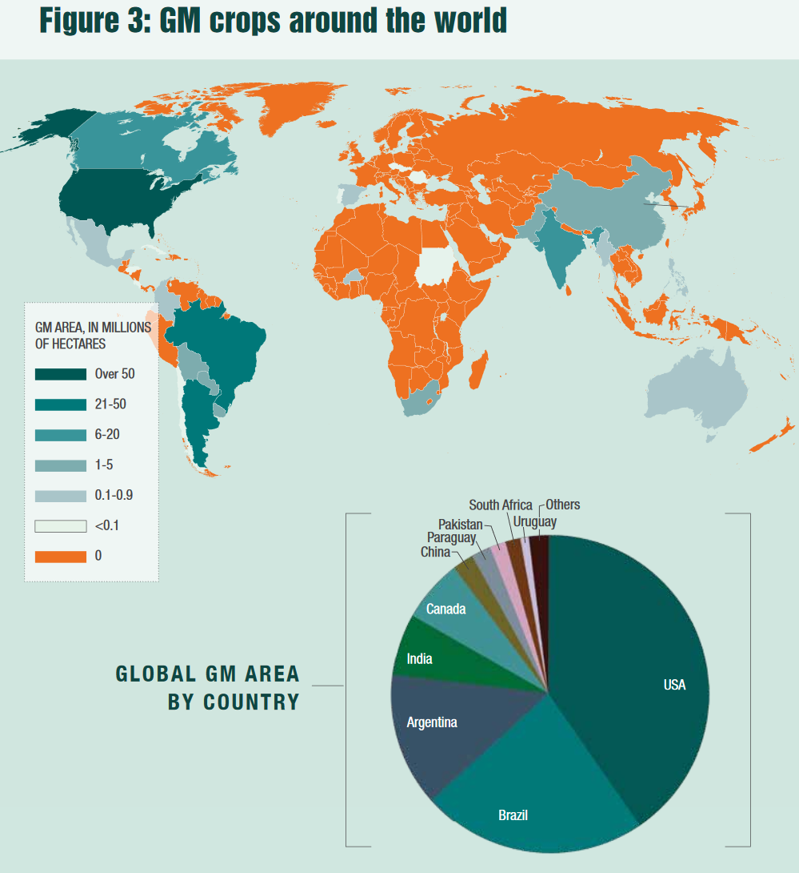
Source

Slide 21
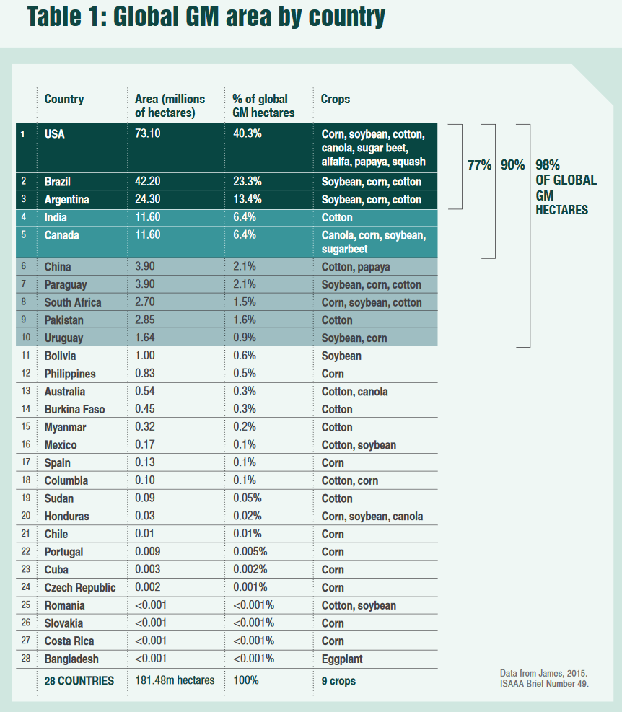
Source

Slide 22
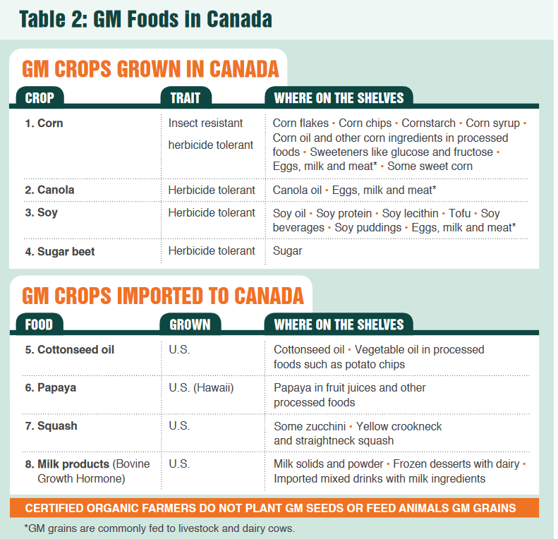
Source

Slide 23
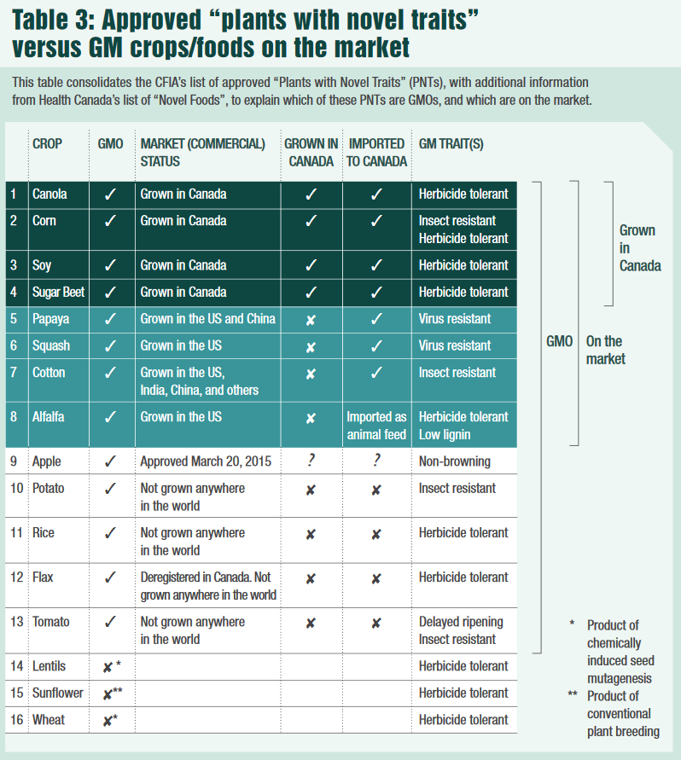
Source

Slide 24
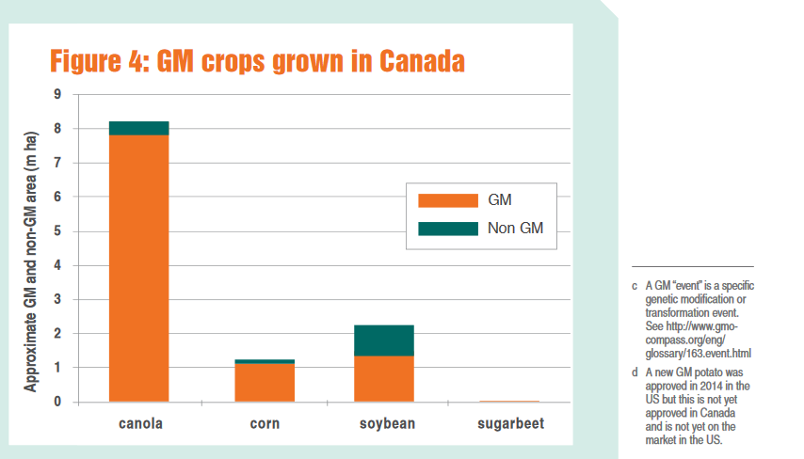
Source

Slide 25
GMOs in Canada Presently
GMO products that are presently on the market in Canada Alfalfa Canola Corn Cotton Papaya Salmon Soy Squash Sugar beet
GMO products that are not presently on the market in Canada Apple Flax Potato Rice Wheat
Source

Slide 26
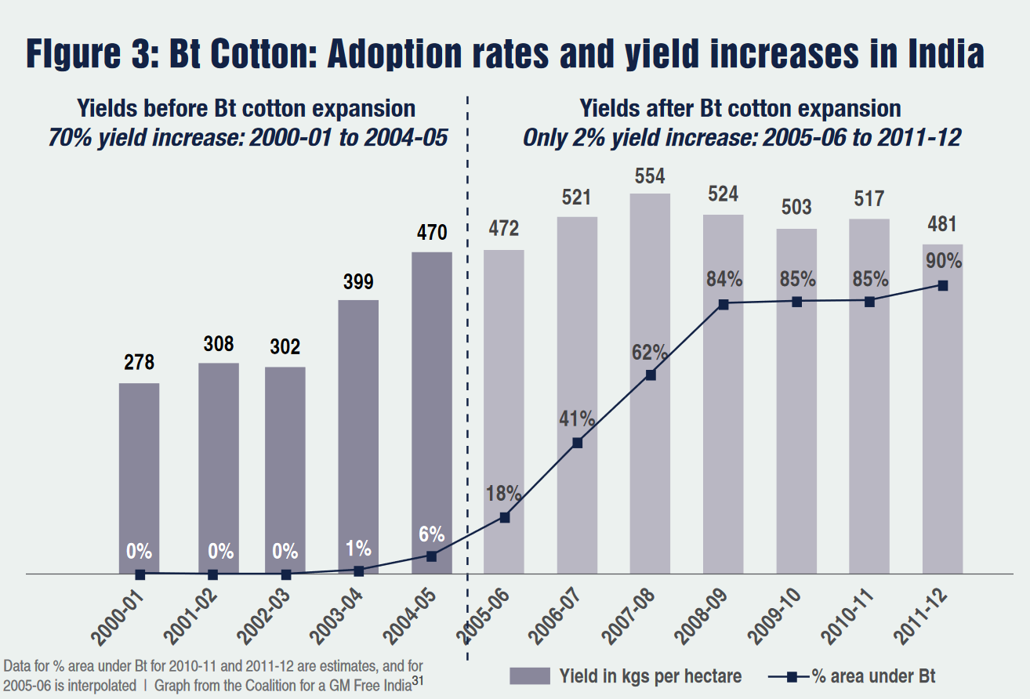
Source

Slide 27
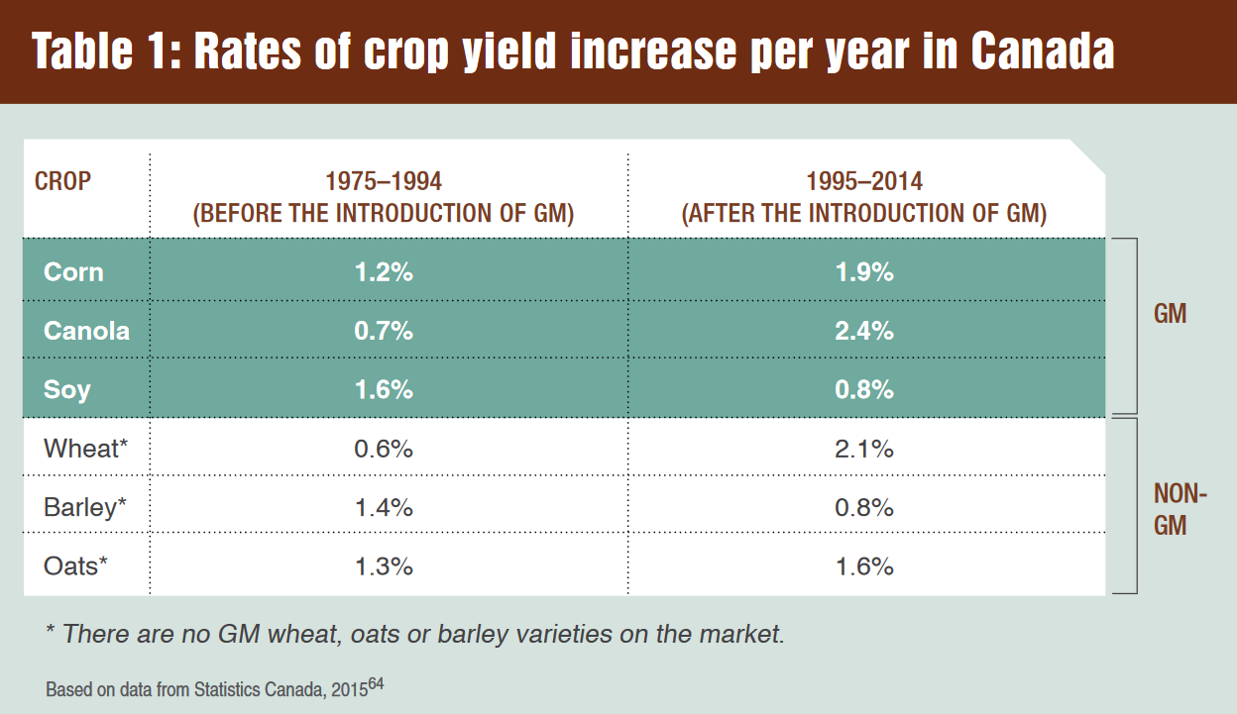
Source

Slide 28
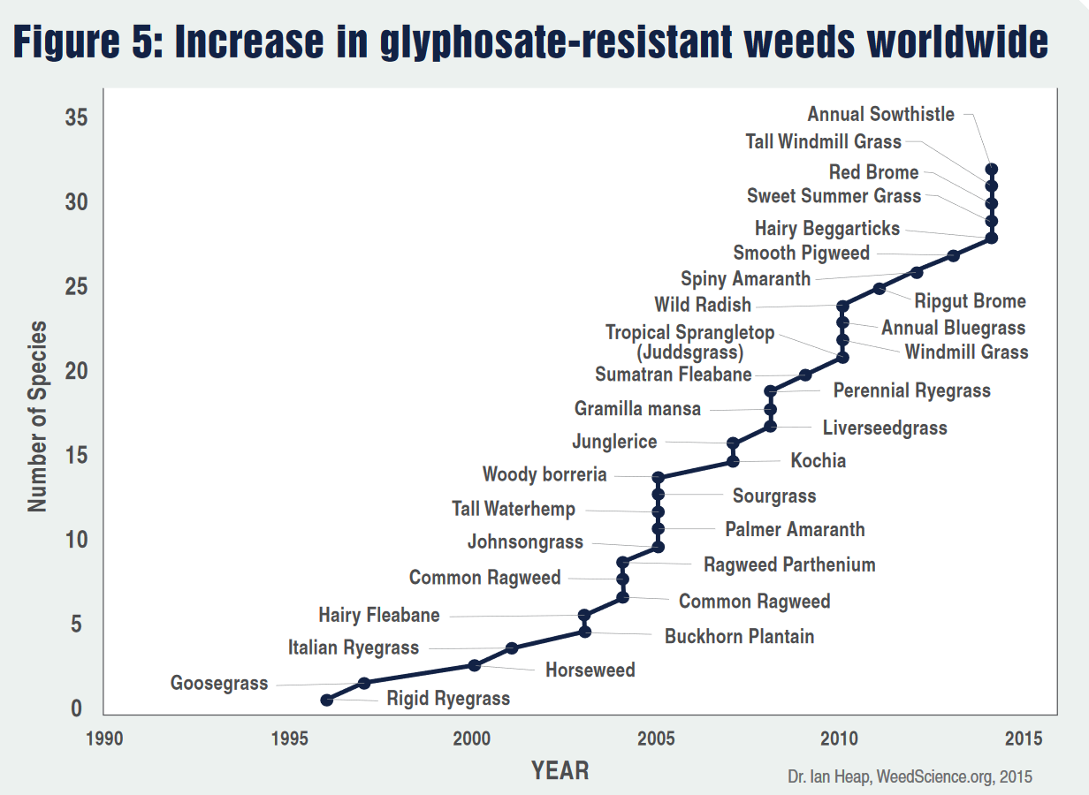
Source

Slide 29
Biodiversity Vandana Shiva (2015) Who Really Feeds the World? The Failures of Agribusiness and the Promise of Agroecology
Seed Saving Movement Navdanya
System to monitor ecological changes (Navdanya):
Provides documentation of the biodiversity status of a farm, including crop, tree and animal biodiversity
Indicates the contribution of biodiversity to provisioning of internal inputs and to the building and maintenance of nature’s economy through the conservation of the soil, water, and biodiversity
Indicates the contribution of biodiversity to the self-provisioning of food needs by agricultural families and communities, and to the building and maintenance of people’s economy
Reflects the market economy of the farm in terms of incomes from the sale of agricultural produce, as well as the additional costs for external inputs and retail food when biodiversity is lost
Baranaja: Twelve Seeds of Sustainability

Slide 30
Commons Toolkit - Recap Gibson-Graham, J.K., Cameron, J., Healy, S. (2013) Take Back the Economy: An Ethical Guide for Transforming Communities, University of Minnesota Press
Types of commons:
Biophysical
Cultural
Social
Knowledge
Ways to assess commons:
Access
Use
Benefit
Care
Responsibility
Property

Slide 31
Documentary to Watch
Seed: The Untold Story (Trailer)

Slide 32
Living Soil Not Chemical Fertilizers
FAO Video About Soil
The Soil Story

Slide 33
Discussion About Group Projects
I will give you back your proposals.
Please read over the comments carefully.
Let me know if you have questions or concerns.

Slide 34
Thanks!
Questions or concerns?
Try to go vegetarian for the weekend.

