Slide 1
Advertising and the Consumer Culture
Advertising Blog

Slide 2
Advertising Blog
Students will write a blog posts of about 600 – 1000 words and will be encouraged to publish them on social media. The blogs must provide a critical analysis of one of the two topics below. Even though this is a blog, the topics must be properly researched and analyzed with credible (reliable/valid) references, not based on conjecture.
Blog posts must critically analyze the topic in a clear, concise, informative, and interesting manner and should link the topic to the class readings. The blog must address an appropriate audience and make sure the information is conveyed to this audience based on their level of knowledge of the subject matter. Students with video production skills can produce a video instead of a blog, however this must also be approved by me (Erik Chevrier).
A hard copy of the blog must be handed to me on February 13th

Slide 3
Blog Topics
(1) deconstructing an advertisement, media campaign, YouTube Video, or other relevant media product. Students must use the models and cultural frames discussed in class: including but not limited to Johnson (1986), Nesbit-Larking (2007), Leiss, Kline, Jhally, Botterill, Asquith (2018), O’Barr (2005) and/or Holm (2017).
(2) produce a brief research report (with at least five sources) about a topic related to advertising and consumer culture. Topics can include but are not restricted to: advertising and desire; advertising and body image; feminist perspectives in advertising; Indigenous perspectives in advertising; race and advertising; new media and advertising; political advertising; data mining; future of advertising; technology and advertising; product placement; and mise-en-scène advertising. Students can propose other topics, but these must be approved by me.

Slide 4
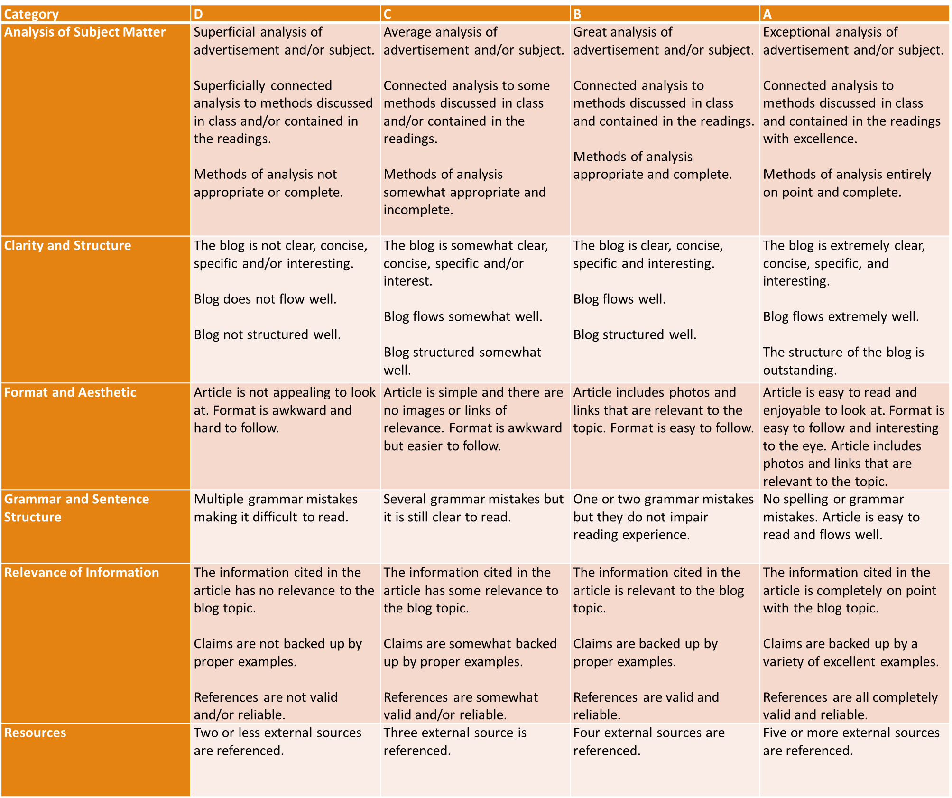

Slide 5
Discussion Questions
Do you want to analyze an ad or write about an advertising topic?
Which topic/ad interests you?
What methods of analysis are appropriate to use?
What references are useful?
What do you expect to write about?
Framing? Structure? Examples?

