Slide 1
Community and Local Activism
Erik Chevrier
January 16th, 2020
Theoretical Perspectives and Models of Community Work

Slide 2
Discussion
What social, political, economic, environmental issues are you interested in?
How do these issues intersect?
What are root causes, maintaining factors, and symptoms of these issues?
What are people doing to address these issues already?

Slide 3
Wet'suwet'en Nation
CBC News January 10, 2019
Invasion Mini Documentary
Call to Action
Gidimt’en Yintah Access

Slide 4
Discussion
Please summarize the readings you completed.
What was the main argument/point?
What support/examples do they give to support their main argument/point?
How does this reading relate to other readings from other courses?
How does this reading relate to your life as an organizer or in other ways?
What do the authors say about power?
What do the authors say about community building/social change?
What do the authors say about capitalism?

Slide 5
Aristotle Aristotle. Aristotle in 23 Volumes, Vol. 21, translated by H. Rackham. Cambridge, MA, Harvard University Press; London, William Heinemann Ltd. 1944.
Chrematistics – art of acquisition – limitless accumulation unnatural and problematic
Oikonomia – management of the household – true form of an economy

Slide 6
Karl Marx Marx, K. Capital Volume 1, Penguin Classics.
C – C – Basic barter C – M – C – The way classical economists viewed basic barter with money M – C – M’ – What really happens when barter systems incorporate money – Limitless accumulation M – M’ – Usury capital system – Limitless accumulation

Slide 7
Karl Polanyi Polanyi, K. (2001) The Great Transformation; The Political and Economic Origins of Our Time, Beacon Press
Types of economic practices:
Markets (exchange)
Household economy
Redistribution
Reciprocity

Slide 8
Living Economies – Vandana Shiva

Slide 9
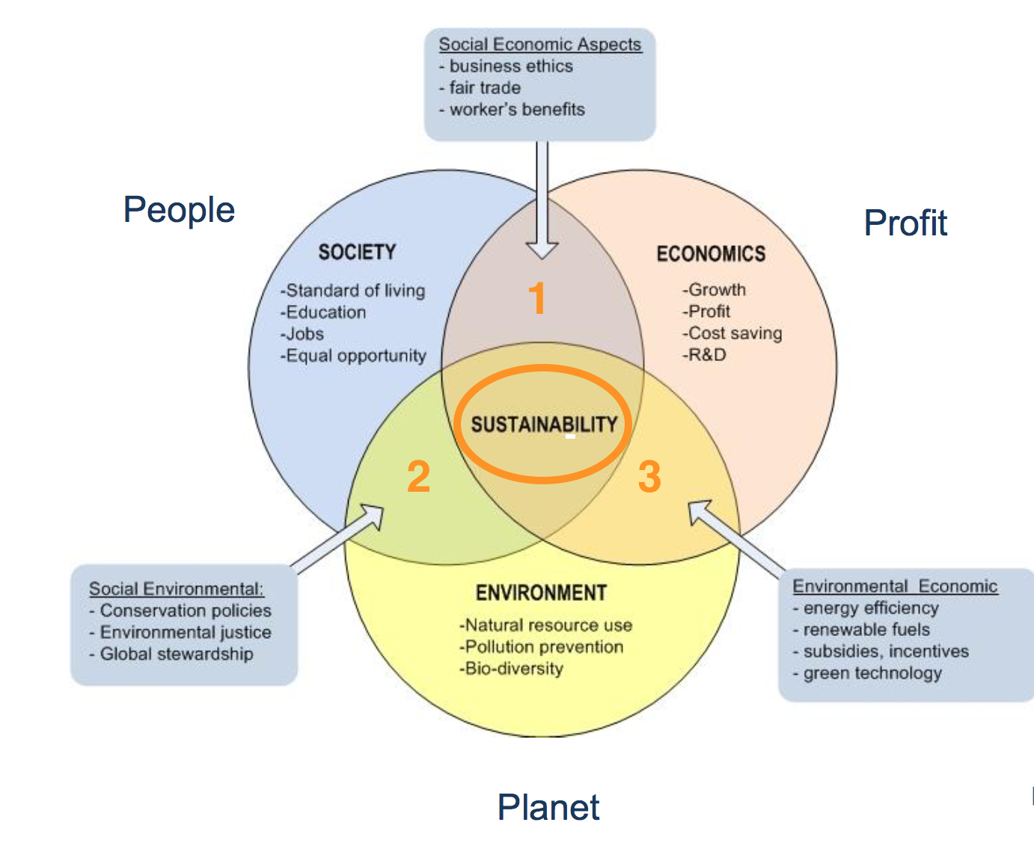
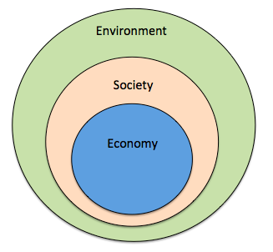
Prioritize the Biosphere and Social Relations Over the Market
Triple Bottom line
Nested model

Slide 10
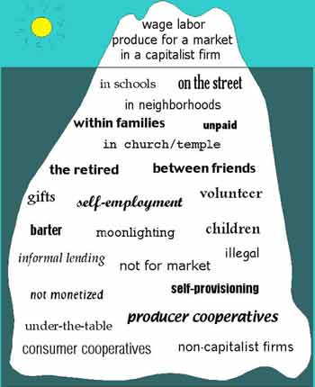
Take back the Economy Gibson Graham Gibson-Graham, J.K., Cameron, J., Healy, S. (2013) Take Back the Economy: An Ethical Guide for Transforming Communities, University of Minnesota Press
Katherine Gibson Interview Playlist

Slide 11
Take back the Economy Gibson Graham Gibson-Graham, J.K., Cameron, J., Healy, S. (2013) Take Back the Economy: An Ethical Guide for Transforming Communities, University of Minnesota Press

Slide 12
Envisioning Real Utopias Erik Olin Wright Olin Wright, E. (2010) Envisioning Real Utopias, Verso

Slide 13
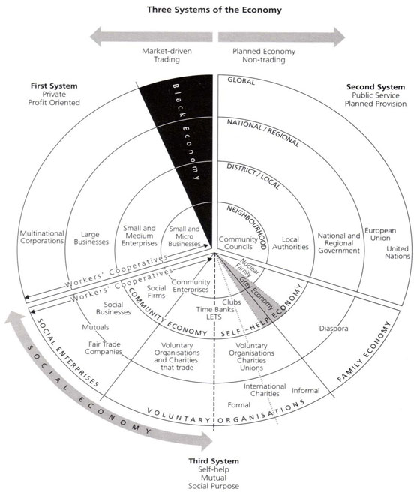
Three Systems of an Economy – John Pierce Pearce, J. (2009) Social Economy: Engaging as a Third System, In Amin, A. The Social Economy; International Perspectives on Economic Solidarity, p. 26.

Slide 14
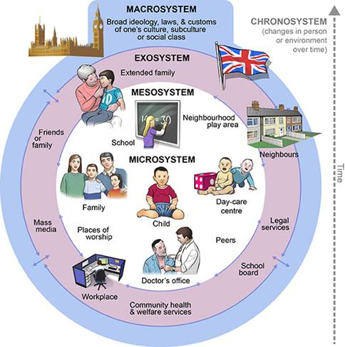
Ecological Systems Theory of Development

Slide 15
What is Capitalism?
What features of a economic, social and political system does capitalism have?

Slide 16
What is Capitalism?
Markets Profit Private ownership of the means of production Money based system Financial markets Private property Alienation Exploitation Wage Labour Externalities Expendable work force Inequality Advertising Consumerism Firms Institutions Imperialism Colonialism Exchange Free (non-slave) labour Cycles and crisis Growth Competition

Slide 17
Post-Capitalist Possibilities
What does post-capitalism/anti-capitalism mean?
Building Visions
What is our relationship to the natural world? How do we ensure that the environment is protected?
How do people get food? What do they eat? How is it distributed? How is it produced?
How do we handle waste?
How are people sheltered? What types of living arrangements do people have?
How are people educated? What should they learn?
How do we care for people (i.e. children, elderly, sick, etc.)
How are decisions made?
How do people travel?
How do people get and share information?

Slide 18
Food for Thought
Calls to “fix a broken food system” assume that the capitalist food system used to work well. This assumption ignores the food systems long, racialized history of mistreatment of people of colour. The food system is unjust and unsustainable, but it is not broken. It functions precisely as the capitalist food system has always worked, concentrating power in the hands of the privileged minority and passing off the social and environmental “externalities” disproportionately to racially stigmatized groups. (Holt-Gimenez, 2017, p. 160)
We have created a society which appears to be totally beyond our control, but which in reality depends on our act of constant re-creation. The problem is not to destroy that society, but to stop creating it. Capitalism exists today not because we created it two hundred years ago or a hundred years ago, but because we created it today. If we do not create it tomorrow, it will not exist. (Holloway, 2010, p. 230)
We make capitalism by creating and recreating the social relations of capitalism: we must stop doing so, we must do something else, live different social relations. Revolution is simply that: to stop making capitalism and do something else instead. The struggle is not a struggle for survival (that is the genuine struggle of abstract labour) but a struggle to live. (Holloway, 2010, p. 236)

Slide 19
Getting Started Minieri, J., Klein, K., Getsos, P. (2007) Tools for Radical Democracy: How to Organize for Power in Your Community, Jossey-Bass.
Finding partners and getting to work
1 – Go out and talk to people.
2 – Identify initial organizing committee.
3 – Make a proposal for power.
4 – Develop principles.
5 – Kick it off – engage the broader community.
6 – Train an organizing team.
7 – Establish a leadership team.
8 – Ramp up the work.

Slide 20
Questions or Concerns?
Do we want to bring food?
Readings for the next two weeks. What do you want to read for next week?
Shragge, E. (2013) Activism and Social Change: Lessons for Community Organizing, 2nd edition, University of Toronto Press. Chapter 1 – Theoretical Perspectives and Models of Community Work (pp. 1 – 29)
Choudry, A., Hanley, J., Shragge, E. (2012) Organize! Building from the Local for Global Justice, PM Press. Chapter 1 – Introduction: Organize! Looking Back, Thinking Ahead (pp. 1 – 22)
Kuyek, J. (2011) Community Organizing: A Holistic Approach Chapter 2 – Understanding Power Over (pp. 17 – 27) Chapter 3 – A Neighbourhood Rebuilds Itself (pp. 30 – 40) Chapter 4 – Transforming Our Culture (pp. 41 – 56)
Whitmore, E., Wilson, M. G., Calhoun, A. (2011) Activism that Works, Fernwood Publishing Chapter 2 – Building Success in Social Activism (pp. 11 – 28)
See you all next week.

