Slide 1
Advertising and the Consumer Culture
Analyzing Advertisements
Erik Chevrier
January 21st, 2020

Slide 2
Encoding vs Decoding
To decode, we must make inferences about the encoding process:
  Most of the time, we do not know:
    The intensions of the encoders
    The reason behind using certain ‘codes’ over others
    The market/demographic research used to make the ‘codes’
    The thought process of those who produced the ‘codes’
  To understand the encoding/decoding process, we should take into account:
    Intended and unintended effects
    Positive and negative effects

Slide 3
Advertising Codes, Contexts and Conventions
Factors that are important for ad construction, operation and analysis:
  Context
    National, cultural, surrounding media
    Diverse and in constant state of change
  Medium
    Communication channel
    Different codes and conventions
    Institutional limitations and possibilities
    Modern advertising usually consists of integrated, multimedia campaigns
    Identify different contexts and media channels and discuss how this may effect encoding and decoding, codes and conventions of advertisements.

Slide 4
Analyzing Advertisements
Static Advertisements
  Print & digital
  Are easier to analyze than motion pictures
  Digital static ads rely on web-browser technology
  Toyota ‘Elevate’ ad
Video Advertisements
  2014 Toyota Corolla Commercial: 'Style Never Goes Out of Style’
  Television, internet, film, product placement
  More costly
  More complex
    24 frames per second (24 static images)
    Sound
    Story
  Breaks television ‘flow’ to stand out
  2014 Toyota Corolla Commercial: 'Style Never Goes Out of Style’
Digital Advertising
  Interactive
  Static ads and videos are part of integrative campaigns
  Video game ads
    Branded reward tokens

Slide 5
Semiotics
Semiotics:
  Is an analytic method that complements context and medium specificity, by focusing on broad cultural processes by which meaning is produced and communicated across a range of cultural forms.
  Is the study of how meaning is produced and reproduced within a society
  Provides us with powerful tools for analyzing advertisements as well as helping us gain some distance from everyday practices of communication of meaning, so that we can look at them, with new eyes and understand them in new ways.
  Involves ‘unnatural tasks’ (Bignell, 1997) such as abstracting the ad from its environment, and then breaking it down into constituent parts (signs), working out what they mean and how they’re organized, then trying to determine potential ambiguities or alternative readings.

Slide 6
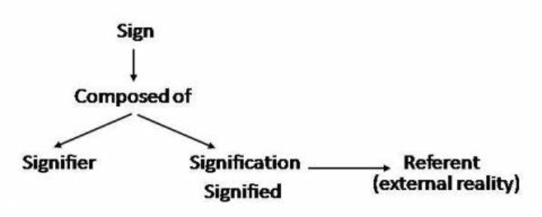
Semiotics
Sign – Most basic discrete unit of meaning
  Word, colour, sound, set of lines, shapes,
  Like atoms, we can dissect individual units
Assemblages – Collections of signs (that carry meaning)
  Texts
Ferdinand de Saussure – Understand power and flexibility of language as a social construction through which meaning is organized.
  Language is a structure that allows for flexibility and consistency.
  Meaning between signifier and signified is arbitrary
    (flexible and consistent)
  Meaning is produced through cultural conventions
  Langue – Giant system of grammar and vocabulary
  Parole – Grammar and vocabulary can be manipulated

Slide 7

Analyzing the Meaning of Ads
Bignell (1997)
Break down ads into constituent signs and coherent signs
  Parts vs sum of parts vs complete whole
Denotative meaning of a sign
  Obvious, literal meaning of the sign
Connotative meaning of a sign
  Symbolic, seemingly secondary, more metaphorical meanings
  More socially conditioned
Anchorage
  Barthes – Use of captions or slogans in order to lock down (anchor) one possible meaning out of the many offered by the images
    Words, logos, etc.
  Volkswagen ad – Portaloo Hearse
  Meanings of signs and symbols are not natural – they are constructed, not universal, not eternal and arbitrary.

Slide 8
Mythology and Ideology
Mythology is concerned with the idea that signs are never natural or neutral, but rather always attain their connotations in relation to particular histories and culture.
  Anchorage is part of mythology
  Barthes – Interested in the ways in which meanings reflect the social and cultural arrangements of power, and communicate unspoken understandings about how the social world works.
    How is meaning embodied in a sign?
Ideology
  Is a set of beliefs, values, ideas and feelings that shape how we understand, approach, and engage with the world around us.
  It is always at work, it informs every action and idea in a society
  Advertising implies a particular vision of the world.
  Unpacking problems or obstacles
  Reinforcing representations of social relations (gender, class, etc.)
  Understanding priming, schemas, and controlled vs automatic processing is important

Slide 9
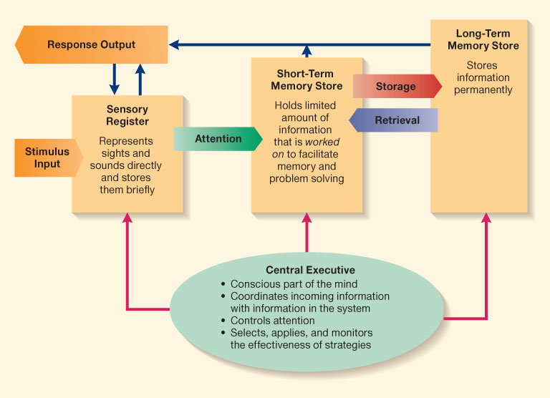
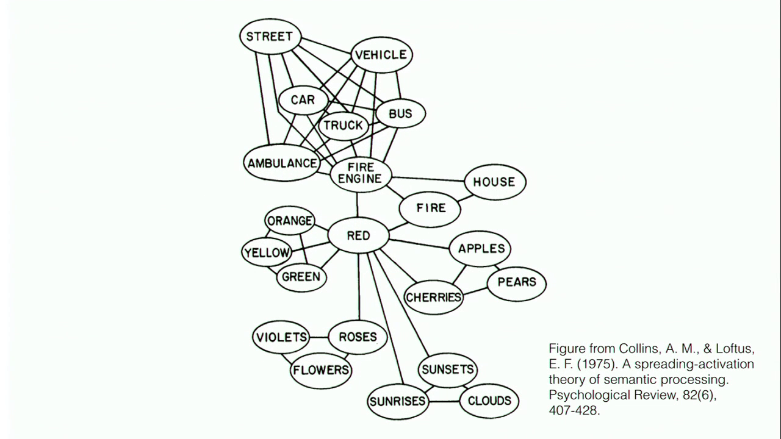
Cognitive Model & Schemas
Cognitive Model
Semantic Processing – Spreading Activation

Slide 10
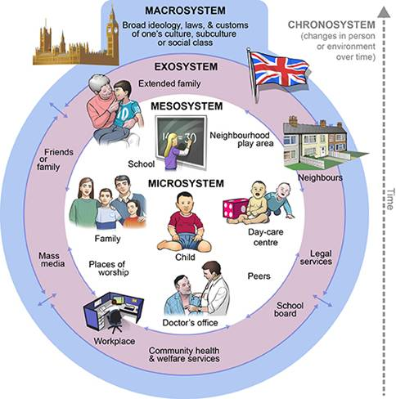
Ecological Systems Theory of Development

Slide 11
Unpacking Freedom, Gender and Ideology
Kia Sportage

Slide 12
Deciphering Advertisements (Jib Fowles, (1996) Deciphering Advertisements)
Context for the ad
  Product category?
  Which medium does it appear?
  Who is the intended audience?
Implications for the ad
  What is the ad implying about relationships between people?
  What is this ad saying about identity and gender relations?
  What does the ad convey about social status?
  What kind of cultural beliefs are displayed in the ad?
  How does the ad attempt to commodify human experience?
Looking at the ad
  What are the aesthetic properties of the ad?
  Photograph or drawing (retouching?)
  What is in the foreground?
  What is the commodity?
    Subtract the commodity and look at the ad’s symbolic appeal
  List various elements pictured in the symbolic appeal
  What are the meanings of these symbols in relation to the intended audience?
  What are the inferred states of mind of humans in the ads?
  Where is the space in which the ad is situated?
  What is the timeframe in which the ad is situated?
  Consider the ad as a narrative, can we tell the story?
  What is missing?
  Does the symbolic appeal idealize anything?
  Imagine someone looking at the ad, what state of mind would they be in? What does the ad supplement to their state?
  Is there intertextual referents from something earlier?
  What is in frame, what is framed out?

Slide 13

Levi's – Go Forth - Video

Slide 14
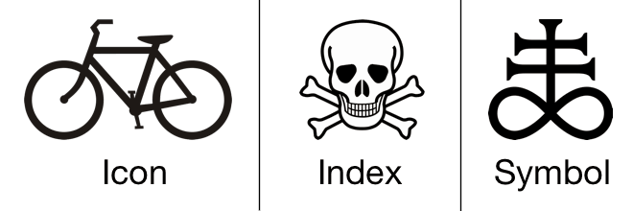
Other Important Points
  Signs come in 3 forms
    Icons – Resemble objects to which they refer
    Indexes – Signs that are immediately implied in their referent
    Symbols – Bear no obvious resemblance to their referents but come to be associated to them

Slide 15
Media Fantasy Becomes Reality
Jean Baudrillard
  The media – especially when the content is fictional and fantastic – are more real than the world they proport to represent.
  The symbolic structure of the media is so powerful that the meaning is dissolved as mere content is relegated to the demands of form.
  Verisimilitude - They appear to be real.
Mark Poster
  Mediation is becoming so intense and worked over that ‘reality’ is consistently in question
Nesbitt-Larking
  Forms that blend reality:
    Infotainment
    Docudrama
    ‘Faction’ – blending fact from fiction
    Reality television
    News/entertainment spoof

Slide 16
The Power of Words
The power of words in regards to memory

Slide 17
The Power of Suggestion
An Inquiry Into How People Are Affected by Profuse Amounts of Publicity: A Multidisciplinary Approach
Advertising as a suggestion – Page 26
Suggestions can bypass critical thought because there is no direct request to refuse

Slide 18
The Psychology of Influence
Robert Cialdini
Six weapons of influence
1 – Reciprocation
2 – Commitment and consistency
3 – Social proof
4 – Liking
5 – Authority
6 – Scarcity

Slide 19
Changing Values and Attitudes
Values:
Desirable, trans-situational goals, varying in importance, that serve as a guiding principles in people’s lives
Attitudes:
An internal state that, given the occurrence of certain stimulus events, will ultimately result in some sort of response or behaviour.
Cognitive dissonance:
Cognitive dissonance is a state of psychological tension occurring when thoughts, beliefs, attitudes, and/or behaviours are in conflict with each other.
Key Factors:
Ratio of dissonance
Importance of factors in dissonance
Avoiding dissonance
1 – Modify
2 – Change importance
3 – Rationalize
4 – Add new consonant beliefs to bolster

Slide 20
Conformity
A change in behaviour as a result of the real or imagined influence of other people
  Can override survival behaviours
  People are more influenceable than they believe
  Produces positive and negative consequences
Informational Social Influence – Conforming because we believe that others’ interpretation of an ambiguous situation is more correct than ours and will help us choose an appropriate course of action.
Normative Social Influence – The influence of other people that leads us to conform in order to be liked and accepted by them; this type of conformity results in public compliance with the group’s beliefs and behaviours but not necessarily in private acceptance. Conformity experiment
  Public Compliance – Conforming to other people’s behaviour publicly, without necessarily believing in what they are doing or saying.
  Private Acceptance – Conforming to other people’s behaviour out of a genuine belief that what they are doing or saying is right.

Slide 21
Compliance
A change in behaviour in response to a direct request from another person
Door-in-the-face technique – A technique to get people to comply with a request whereby people are presented first with a large request, which they are expected to refuse, and then with a similar, more reasonable request, to which it is hoped they will accept
  Reciprocity norm – a social norm by which the receipt of something positive from another person requires you to reciprocate, ort behave similarly, in response
Foot-in-the door technique – A technique to get people to comply with a request, whereby people are presented first with a small request, to which they are expected to acquiesce, followed by a larger request, to which it is hoped they will also acquiesce.
  Change in self-perception – People are influenced by their behaviour and adopt values about ‘helping others’
Lowballing – An unscrupulous strategy whereby a salesperson induces a customer to agree to purchase a product at a very low cost, and then subsequently raises the price; frequently, the customer will still make the purchase at the inflated price.
  Illusion of irreversibility
  Anticipation of event
  Convenience of completing the transaction rather than starting over somewhere else
Improving the deal:
When a product is offered at a high price, then after a brief pause, another product is offered to the deal or the price is reduced
Strategic Self-anticonformity (Reverse Psychology)
  To elicit reaffirming messages
  To elicit attitudinal or behavioural compliance from another person

Slide 22
Other Persuasion Techniques
Priming
Persuasion
  Central Routes
  Peripheral Routes
Cognitive Dissonance
Internal and External Justification (justification spiral)
Conditioning

Slide 23
Automatic Thinking – Low Effort Thinking
Automatic thinking – Is thought that is generally unconscious, unintentional, involuntary, and effortless.
Schemas – Mental structures people use to organize their knowledge about the social world themselves and that influence the information people notice, think about, and remember.
  We tend to fill in the blanks with SCHEMA-CONSISTENT INFORMATION.
How People are Affected By Profuse Amounts of Publicity? – Advertising and Priming
Activity – Automatic Thinking!

Slide 24
SAY THIS WORD OUTLOUD 10 TIMES
ROAST

Slide 25
SAY THIS WORD OUTLOUD 10 TIMES

Slide 26

Answer the following question?
What do you put in a toaster?

Slide 27
Information Processing Model

Slide 28
Accessibility and Priming
Accessibility – The extent to which schemas and concepts are at the forefront of people’s minds and are, therefore, likely to be used when making judgments about the social world.
  Schemas can be accessible for three reasons:
    1 – Some schemas are chronically accessible because of past experience – these schemas are constantly active and ready to use to interpret ambiguous situations.
    2 – Schemas can be accessible because they are related to a current goal.
    3 – Schemas can become temporary accessible because of our recent experiences.
    Priming – The process by which recent experiences increase the accessibility of a schema, trait, or concept.
      Words have to be accessible and applicable to act as a prime.
      Schemas may be quite resistant to change
      Schemas are influenced by culture
    Perception Without Awareness (PWA) – Daren Brown – How to Control a Nation – Toy Story
    How to Control a Nation Full Video
    The Art of Misdirection
    Advertising makes consumption schemas continuously accessible. Advertising primes our consumer drives.

Slide 29
Learning Check
What is encoding and decoding of advertising? Why is this important?
What are factors that are important for ad construction, operation and analysis? What is the importance of the medium, contexts, codes and conventions?
What is an integrated ad campaign? What is an example of an integrated ad campaign?
What are static ads? What is an example of a static ad? How can we analyze static ads?
What is a video advertisement? What is particular about analyzing video advertisements? What is an example of a video ad?
What is television flow? What is the goal of an ad in relation to flow?
What is a digital advertisement? What is particular about analyzing digital ads? What is an example of a digital ad? What is meant by advertising interactivity and a feedback loop?
What is a semiotic analysis?
What is a sign? What are assemblages?
Who is Ferdinand de Saussure and what was he known for? What did de Saussure say about language and parole? What did de Saussure say about the relationship between the signifier and signified? What are critiques of semiology?
What are denotative and connotative meanings of signs?
What is anchorage? What does Barthes say about anchorage?
What does mythology and ideology have to do with advertising?
What is a mythological analysis? What is an ideological analysis?
What are three categories that are used by Fowels to decipher advertising? What are five examples of questions Fowels recommends asking?
What are icons, indexes, and symbols?
What are Cialdini six weapons of social influence and how can they be used in advertising?
What is cognitive dissonance? How can it be used in advertising? How can cognitive dissonance lead people away from your message?
What is conformity? Why is this important for advertising?
What are compliance techniques? How can they be used in advertising?
What is priming? Why is priming important in advertising?

Slide 30
Have a Great Night
Questions or concerns?
Readings for next week:
Chapter 2 – The History of Advertising: Contexts, Transformations and Continuity, Holm, N. (2017) Advertising and Consumer Society: A Critical Introduction, Palgrave Macmillan, pp. 14 – 32.
Chapter 4 – Advertising, Capitalism, and Ideology. Holm, N. (2017) Advertising and Consumer Society: A Critical Introduction, Palgrave Macmillan, pp. 63 – 92.

