Slide 1
Community and Local Activism
Erik Chevrier
January 23th, 2020
Theoretical Perspectives and Models of Community Work

Slide 2
What is Capitalism?
What features of a economic, social and political system does capitalism have?

Slide 3
What is Capitalism?
Markets Profit Private ownership of the means of production Money based system Financial markets Private property Alienation Exploitation Wage Labour Externalities Expendable work force Inequality Advertising Consumerism Firms Institutions Imperialism Colonialism Exchange Free (non-slave) labour Cycles and crisis Growth Competition
What does post-capitalism/anti-capitalism mean?

Slide 4
Links
Bank’s Big Secret
Debt and Wealth in Canada
Household Debt
House Market in Canada
Trans Mountain Pipeline

Slide 5
Real vs Market Income Osberg, L. (2018) The Age of Increasing Inequality – The Astonishing Rise of Canada’s 1%, James Lorimer and Company.

Slide 6
Average Disposable Income Osberg, L. (2018) The Age of Increasing Inequality – The Astonishing Rise of Canada’s 1%, James Lorimer and Company.

Slide 7
Real Income Osberg, L. (2018) The Age of Increasing Inequality – The Astonishing Rise of Canada’s 1%, James Lorimer and Company.

Slide 8
Family Income Osberg, L. (2018) The Age of Increasing Inequality – The Astonishing Rise of Canada’s 1%, James Lorimer and Company.

Slide 9
Average Wage Osberg, L. (2018) The Age of Increasing Inequality – The Astonishing Rise of Canada’s 1%, James Lorimer and Company.

Slide 10
Real Hourly Wages Osberg, L. (2018) The Age of Increasing Inequality – The Astonishing Rise of Canada’s 1%, James Lorimer and Company.

Slide 11
Growth Rates of Real Market Incomes Osberg, L. (2018) The Age of Increasing Inequality – The Astonishing Rise of Canada’s 1%, James Lorimer and Company.

Slide 12
Defining Community Organizing Shragge, E. (2013) Activism and Social Change: Lessons for Community Organizing, 2nd edition, University of Toronto Press.
Rubin and Rubin (1992)
Community organizing is a search for social power and an effort to combat perceived helplessness through learning that appears personal is often political.
Community organizing creates capacity for democracy and for sustained social change. It can make society more adaptable and governments more accountable….Community organizing means bringing people together to combat shared problems and to increase their say about decisions that affect their lives.
Traditions
Community action
Personal development
Capacity for democracy (different forms of democracy)
i.e., associational, representational, direct.
Sustained social change
Five Goals:
Improvement in quality of life through resolution of shared problems
Reduction of the level of social inequalities caused by poverty, racism, sexism
The exercise and preservation of democratic values as part of the process of organizing
Enabling people to achieve their potential as individuals and the creation of a sense of community

Slide 13
Politics of Organizing Shragge, E. (2013) Activism and Social Change: Lessons for Community Organizing, 2nd edition, University of Toronto Press.
Traditional theories vs common sense
Two (interrelated) perspectives
Shaped by examining our underlying values and constructing a basic social standpoint
How change takes place, including a discussion of human agency and related social processes
To build a vision of the long-term direction of organizing, acknowledging the underlying values is important.
Reactionary perspective – values to stop social change and decrease power of the lower class and minority groups
Conservative perspective – values to maintain the status quo
Liberal – describe those who promote more limited social changes that do not actively challenge the existing social and economic system
Radical – Describe those who see the capitalist system as the cause of social problems and see organizing as a way to make more basic changes as well as win concrete gains
Marxist movements
Anti-racist movements
Feminist movements
Critique of leadership role taken by men in the field of organizing in the 60s
Women represent a key constituency of community workers
Contradictions?

Slide 14
Strategies and Models Shragge, E. (2013) Activism and Social Change: Lessons for Community Organizing, 2nd edition, University of Toronto Press.
Social action – exerting pressure on specific targets in order for the targets to make a change in policy or behaviour
Creation of a service (developmental process) – create new community initiatives to address the problem
Three distinct models (Rothman):
Locality development – problems can be solved by bringing local interests together through creative problem-solving
Social planning – a technocratic model that emphasizes top-down approaches to problem-solving. Involves experts & professionals.
Social action – promotes changes in power relations and direct action from a segment of the community. Involves conflict.
Development = consensus model vs conflict = social action (Minkler & Wallerstein)
Functionalism = balance & opportunity vs conflict = take power (Stoecker)

Slide 15
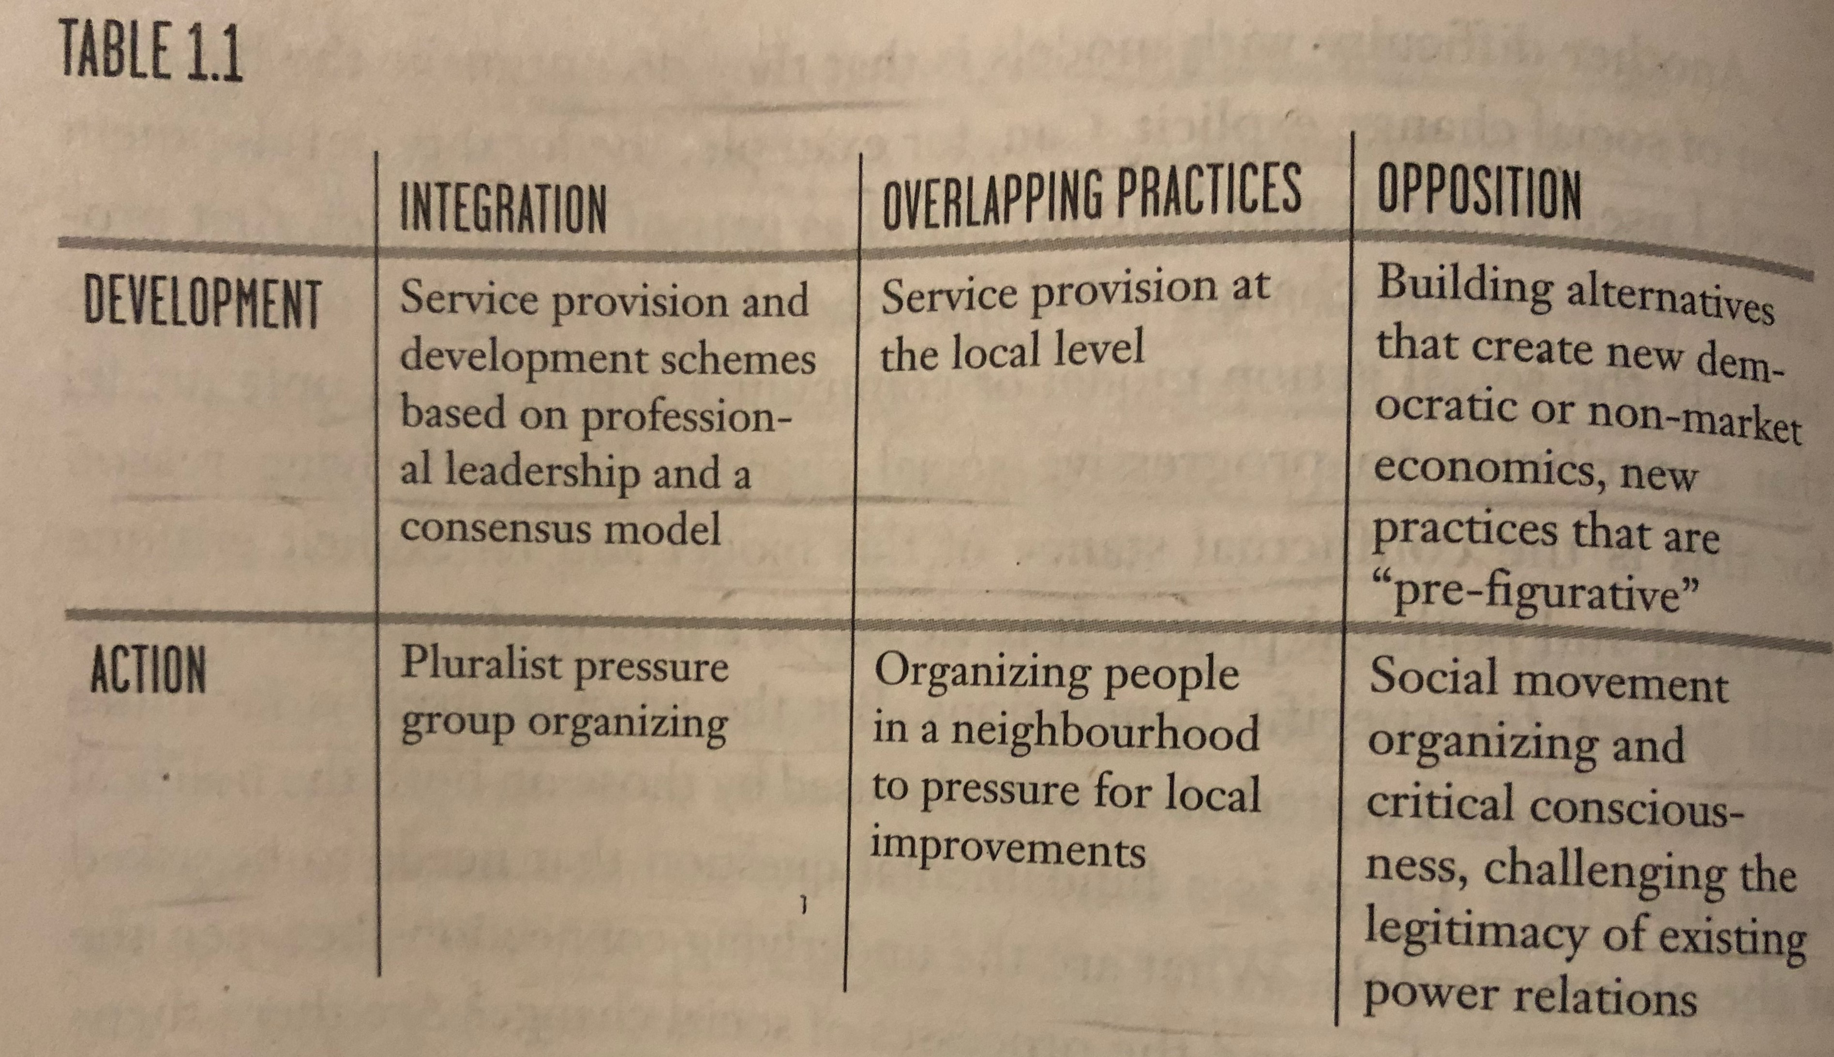
Limitations of Model-Building Shragge, E. (2013) Activism and Social Change: Lessons for Community Organizing, 2nd edition, University of Toronto Press.
Complexities and overlaps are not easily represented in models
Movement from action to service provision is common
Models do not represent shifts in transitions

Slide 16
Power Kuyek, J. (2011) Community Organizing: A Holistic Approach
Power over – requires the domination or oppression of others. Unlike the other two forms, it has to have a clear material base, as it is grounded in the ability to punish by imposing physical or economic sanctions.
Power with – sees the world as made up of changing relationships and our collective energy and ability to act together. It includes influence and leadership as legitimate forms of power.
Power-from-within – the personal power each of us has, our energy, self-knowledge, self-discipline, character.

Slide 17
Food for Thought
Calls to “fix a broken food system” assume that the capitalist food system used to work well. This assumption ignores the food systems long, racialized history of mistreatment of people of colour. The food system is unjust and unsustainable, but it is not broken. It functions precisely as the capitalist food system has always worked, concentrating power in the hands of the privileged minority and passing off the social and environmental “externalities” disproportionately to racially stigmatized groups. (Holt-Gimenez, 2017, p. 160)
We have created a society which appears to be totally beyond our control, but which in reality depends on our act of constant re-creation. The problem is not to destroy that society, but to stop creating it. Capitalism exists today not because we created it two hundred years ago or a hundred years ago, but because we created it today. If we do not create it tomorrow, it will not exist. (Holloway, 2010, p. 230)
We make capitalism by creating and recreating the social relations of capitalism: we must stop doing so, we must do something else, live different social relations. Revolution is simply that: to stop making capitalism and do something else instead. The struggle is not a struggle for survival (that is the genuine struggle of abstract labour) but a struggle to live. (Holloway, 2010, p. 236)

Slide 18
Asking Serious Questions Kuyek, J. (2011) Community Organizing: A Holistic Approach
Social and cultural – what do we mean by inclusivity and tolerance? What is the role of cultural identity?
Environmental – How do we learn to live carefully on the earth? And to change our environmental behaviour?
Economic – How do we transform an economy that traches the earth, impoverishes and creates inequality?
Political – How do we create power to resist change that harms and creates the good changes we want to see for our children?

Slide 19
Transforming Our Culture to a Culture of Hope
Creating a safe learning environment.
Changing education paradigms
Building Visions
Activist Theatre
Brandon You at Le Plateau Council
Braodon You Ville Marie
Coppertone Culture Jam
Global Invisible Theatre
Chartwells New Scheduled Meal Plan
Speaking Truth
Our Own Media
DVDs and Videos (or new media technology)

Slide 20
Building Visions
What is our relationship to the natural world? How do we ensure that the environment is protected?
How do people get food? What do they eat? How is it distributed? How is it produced?
How do we handle waste?
How are people sheltered? What types of living arrangements do people have?
How are people educated? What should they learn?
How do we care for people (i.e. children, elderly, sick, etc.)
How are decisions made?
How do people travel?
How do people get and share information?

Slide 21
Getting Started Minieri, J., Klein, K., Getsos, P. (2007) Tools for Radical Democracy: How to Organize for Power in Your Community, Jossey-Bass.
Finding partners and getting to work
1 – Go out and talk to people.
2 – Identify initial organizing committee.
3 – Make a proposal for power.
4 – Develop principles.
5 – Kick it off – engage the broader community.
6 – Train an organizing team.
7 – Establish a leadership team.
8 – Ramp up the work.

Slide 22
Questions or Concerns?
Do we want to bring food?
Readings for the next week.
Shragge, E. (2013) Activism and Social Change: Lessons for Community Organizing, 2nd edition, University of Toronto Press.
Chapter 2 – Getting from There to Here: Historical Development of Community Work (pp. 29 – 50)
Chapter 3 – Legacy and Traditions of Social Action (pp. 51 – 81)
Chapter 4 – Social Action Continues: Fighting Back in a Neo-Liberal Age (81 – 98)
See you all next week.

