Slide 1
Advertising and the Consumer Culture
Erik Chevrier
January 7th, 2020
Introduction to course – advertising and consumer society

Slide 2
About Me
Erik Chevrier Website
Projects:
Coop Collective Vision
Concordia Food Groups Research Project
Research for the CSU on Concordia’s Investment Practices
Masters Thesis:
How Individuals are Affected by Profuse Amounts of Publicity: A multidimensional approach
Office hours: By request – Before or after the course (by request) Office location: H-1125.12 – We can meet at Loyola E-Mail: professor@erikchevrier.ca Facebook Group for the Class: https://www.facebook.com/groups/advertisingandtheconsumerculture/

Slide 3
Who are you?
What is your name?
What is your program major and minor?
What is your level of knowledge about advertising and consumer culture?
Why did you take this course?
What do you want to get out of this course?
What kind of media platforms do you use? How much time do you spend with different media platforms?
How do you participate in consumer culture? What do you do for work? What are your consumer/shopping habits? What is your ecological footprint? Do you do social justice or volunteer work?

Slide 4
What is Advertising?
You are a commodity to be sold to advertisers!
We Deliver Young People
YUL-LAB
Advertising and the End of the World

Slide 5
What is Advertising?
Advertising is a product whose purpose is to sell other products/and or ideas.
Advertising provides a source of revenue to media companies and is a form of media itself.
Advertising is a creation of artistic expression, but one controlled by commercial/political interests.
Advertising reflects and creates culture simultaneously – it is designed to reflect social interactions but, in the process, it influences social behaviour.
Advertising is loved and hated by people.
Advertisers are always trying to find new ways to capture the attention of their audience and at the same time, people also watch ads for pleasure.
Many people don’t believe that they are personally affected by advertising, yet, they insist that it affects everyone else.
Advertising is pervasive in industrialized nations and consists of a plethora of commercial signs and symbols that communicate ideas and meaning – mainly to sell products and services and/or political ideas.
Attention is what advertisers seek but oversaturating the adverting environment causes people to pay less attention to advertising.
Anyone with a social media account and a following!
What is advertising to you?

Slide 6
Advertising and the Consumer Culture Write-Up
The goal of this course is to provide students with a critical examination of advertising and consumer culture in contemporary society. To accomplish this, we take a multidimensional approach by looking at advertising agencies, producers, and technologies; codes, texts, and forms; audiences and readings; and political socio-economic environments.
Students learn about advertising and consumer culture by looking at the changing structure of advertisements over the course of history. For example, we explore six advertising strategies and their historical context: utility-based ads in the 1800 - 1920s, product symbol-based ads from the 1920s - 1950s, personification ads from the 1950s - 1970s, lifestyle ads from the 1970s - 1990s, demassifying ads from the 1990s - 2000s, and the mise-en-scène ads in the 2000s until now.
Furthermore, we juxtapose these strategies, within their historical contexts, with political and economic trends that helped pave the way for modern-day consumerism. For example, we look at the history of capitalism, industrialization, Fordism, liberalism, neoliberalism, financialization, and globalization, among other topics. We also explore what an economy is by looking at how commodities are produced, processed, distributed, and how current economic practices are affecting the biosphere.
In the course, students critically analyze their own economic practices to encourage them to become engaged, socially and environmentally responsible, ethical citizens of the world. Students write blog posts deconstructing advertisements, campaigns, slogans, messages from influencers and other relevant topics related to advertising and consumer culture. Students also get involved with a community project by forming groups (like advertising agencies) and devising a media campaign to promote a social cause, social economy organization, non-profit and/or another community group. Students are encouraged to work with students from Erik Chevrier’s course Community and Local Activism, where students are expected to create social cooperatives and/or social justice campaigns.
Topics covered in this course include but are not limited to: semiology, ideology, mythology, culture, consumerism, political economy, commodity fetishism, advertising agencies, structure of advertisements, culture jamming, materialism, resistance movements, modernism, post-modernism, digital advertising, social media, privacy, priming, feminism, racism, Marxism, among others.

Slide 7
Learning Objectives
To develop a critical understanding of advertising and consumer culture:
By exploring the interrelation between cultural codes, forms, and texts; reception and readings of audiences; political and socio-economic environments; and productive organizations and technologies.
By examining the history of advertising, advertising agencies, commodities, and new industrialized production methods.
By investigating new media forms and their impact on consumerism, privacy, political systems and social systems.
To develop a critical understanding of political economy:
By exploring power dynamics of those who produce, transform, distribute, and consume products – especially advertising agencies and audiences.
By analyzing different types of political and economic arrangements focusing on the interaction between three main actors: states, corporations, and civil society.
By understanding the history of capitalism, market economies, industrialization, mass production, consumerism and advertising.
By evaluating other types of ‘post-capitalist’ political arrangements.
By reviewing Marx’s theory of commodity fetishism (the perception of social relations being about a relationship between commodities instead of a relationship between people) and Lukács's theory of reification (the act of transforming human properties, relations and actions into properties, relations and actions of human‑produced things which have become independent from their creators).
To learn how to ‘read’ advertisements:
By analyzing the influence of media forms, contexts, and meanings.
By introducing semiotics, mythology and ideology.
By examining social media forms, like Facebook, Youtube, and Twitter, etc.

Slide 8
Learning Objectives
To learn how advertisers encode meaning:
By exploring the various technologies used to create advertisements.
By evaluating advertising as a product of art and research.
By understanding social influence and conformity tactics.
To identify power relations in advertising and consumer culture:
By exploring perspectives from feminists, Marxists, the LGTBQ community, Indigenous peoples, and from people of colour.
By evaluating criticisms of advertising from a multidisciplinary approach, i.e. psychologists against advertising to children, women’s rights groups advocating against unrealistic representations in advertising, etc.
By understanding the extent of data collection and surveillance technologies in modern society.
To learn about cultural resistance movements:
By exploring art forms of cultural resistance, like culture jamming, and ‘detournement’ from the French situationists.
By encouraging communications students to be critical of their own consumption habits and participate in creating a more just society.
To learn about cultural resistance movements:
By exploring art forms of cultural resistance, like culture jamming, and ‘detournement’ from the French situationists.
By encouraging communications students to be critical of their own consumption habits and participate in creating a more just society.
Participate in community service-learning:
Help promote local community groups.
Get involved in media campaigns relating to social justice causes.

Slide 9
Course Evaluation
Assignment | Date Due | Grade %
Exam 1 | 18-Feb | 20
Exam 2 | TBD | 20
Blog | 4-Feb | 15
Community Service-Learning Proposal Project | 10-Mar | 5
Community Service-Learning Project | 7-Apr | 30
Class Participation | Ongoing | 10
Total |  | 100

Slide 10
Blog
Students will write a blog posts of about 600 words and will be encouraged to publish them on social media. The blogs must provide a critical analysis of one of the two topics below. Even though this is a blog, the topics must be properly researched and analyzed with credible (reliable/valid) references, not based on conjecture.
Blog posts must critically analyze the topic in a clear, concise, informative, and interesting manner and should link the topic to the class readings. The blog must address an appropriate audience and make sure the information is conveyed to this audience based on their level of knowledge of the subject matter. Students with video production skills can produce a video instead of a blog, however this must also be approved by me (Erik Chevrier).
Blog Topics:
(1) deconstructing an advertisement, media campaign, YouTube Video, or other relevant media product. Students must use the models and cultural frames discussed in class: including but not limited to Johnson (1986), Leiss, Kline, Jhally, Botterill, Asquith (2018), O’Barr (2005) and/or Holm (2017).
(2) produce a brief research report (with at least five sources) about a topic related to advertising and consumer culture. Topics can include but are not restricted to: advertising and desire; advertising and body image; feminist perspectives in advertising; Indigenous perspectives in advertising; race and advertising; new media and advertising; political advertising; data mining; future of advertising; technology and advertising; product placement; and mise-en-scène advertising. Students can propose other topics, but these must be approved by me.

Slide 11
Participation
The participation grade is based on attendance, involvement in in discussions, participation in classroom activities, and supplemental tasks from time to time. Students are encouraged to make suggestions for the class to view, analyze, and discuss media pieces that relate to the weekly readings.
With regards to the participation grade, you will receive 5 out of 10 points for attending all the classes. The remainder of the grade is based on your involvement in discussion and participation in classroom activities.

Slide 12
Community Service-Learning Project
The objective of this assignment is to give students hands on experience with creating promotional campaigns that enhance the Concordia community and community at large. Students will devise a media campaign to promote a social cause, social economy organization, non-profit and/or another community group. Students are encouraged to work with students from Erik Chevrier’s course Community and Local Activism, where students are expected to create social cooperatives and/or social justice campaigns.
Students will be encouraged to perform their project together as a group, however, they may choose to work on something in a group that already exists and/or create something with likeminded people outside the classroom. Students will form clusters and contribute to the project based on their area of expertise. Students will be evaluated based on the depth of their involvement with the project, their deliverables (which will be agreed upon in their proposal), clearly reporting their contribution to the project, an oral presentation summarizing their role in the project, and linking the project to the course material.

Slide 13
Exams
There will be two exams. The first is on February 11th, and the other is determined by the Exam’s Office – it will be posted on your Concordia Portal. Students will discuss and determine the format of the exams at least two weeks before each exam is given.

Slide 14
Course Format
This course consists of a variety of pedagogical styles including lectures, discussions, guest speakers, and/or community service learning (if requested as part of a project). Students are expected to read the required text and/or watch the assigned movie before coming to class. In class, students participate in interactive activities, discussions and have occasional visits from people who work: in advertising, culture jamming, with alternative economic practices and/or other related domains. At times, the class participates in fieldtrips on and off campus. Students are notified in advance by e-mail and in class prior to these events.

Slide 15
Safe Space Classrooms
Concordia classrooms are considered ‘safe space classrooms’. In order to create a climate for open and honest dialogue and to encourage the broadest range of viewpoints, it is important for class participants to treat each other with respect. Name-calling, accusations, verbal attacks, sarcasm, and other negative exchanges are counter-productive to successful teaching and learning. The purpose of class discussions is to generate greater understanding about different topics. The expression of the broadest range of ideas, including dissenting views, helps to accomplish this goal. However, in expressing viewpoints, students should try to raise questions and comments in ways that will promote learning, rather than defensiveness and feelings of conflict in other students. Thus, questions and comments should be asked or stated in such a way that will promote greater insight into the awareness of topics as opposed to anger and conflict. The purpose of dialogue and discussion is not to reach a consensus, nor to convince each other of different viewpoints. Rather, the purpose of dialogue in the classroom is to reach higher levels of learning by examining different viewpoints and opinions with respect and civility.

Slide 16
Professor’s Policies
Late assignment policy:
Unless you are given permission in advance, late assignments will not be accepted without adequate documentation of medical or personal emergencies.
Handing in Assignments:
All assignments MUST be submitted in hard copy at the beginning of class on the due date. Any assignment submitted electronically will be subject to a reduction of 10% of the value of the assignment. If the assignment is not a written report, please work out an arrangement to submit the assignment before the due date.

Slide 17
Readings
Students are expected to complete ALL the designated readings and watch ALL of the assigned videos BEFORE EACH CLASS. Students are also expected to attend ALL classes, and participate in class discussions.
Required Books:
Holm, N. (2017) Advertising and Consumer Society: A Critical Introduction, Palgrave Macmillan.
Leiss, W., Kline, S., Jhally, S., Botterill, J., Asquith, K. (2018) Social Communication in Advertising 4th Edition, Routledge.
The recommended readings are not provided, students are encouraged to seek them out on their own.
The power-point lecture notes will be posted on the course site on a weekly basis before each class.
Recommended readings: URLs and other electronic sources may be posted on the course website and/or Facebook group from time to time. Please visit the course website and Facebook group to get this material. These are only for interest and are not required.
These books are available at Concordia Community Solidarity Co-op Bookstore

Slide 18
Tentative Schedule and Readings
The following slide is a TENTATIVE schedule and is subject to change. Be sure to consult the course website regularly to be aware of any changes.
January 7 – Introduction to the Course
January 14 – Introduction to Advertising and Consumer Culture Required Readings: Chapter 1 – Introduction: Why study advertising? Holm, N. (2017) Advertising and Consumer Society: A Critical Introduction, Palgrave Macmillan, pp. 1 – 12. Chapter 1 – Introduction, Leiss, W., Kline, S., Jhally, S., Botterill, J., Asquith, K. (2018) Social Communication in Advertising, 4th Edition, Routledge, pp. 1 – 25.
Documentary to Watch: The Century of Self: Part 1 https://www.youtube.com/watch?v=eJ3RzGoQC4s
January 21 – Analyzing Advertisements Required Reading: Chapter 3 – Analyzing Advertisements: Form, Semiotics, and Ideology, Holm, N. (2017) Advertising and Consumer Society: A Critical Introduction, Palgrave Macmillan, pp. 35 – 61.
Documentary to Watch: The Century of Self: Part 2 https://www.youtube.com/watch?v=eJ3RzGoQC4s

Slide 19
Tentative Schedule and Readings
January 28 – History of Advertising and Consumer Society Required Readings: Chapter 2 – The History of Advertising: Contexts, Transformations and Continuity, Holm, N. (2017) Advertising and Consumer Society: A Critical Introduction, Palgrave Macmillan, pp. 14 – 32. Chapter 4 – Advertising, Capitalism, and Ideology. Holm, N. (2017) Advertising and Consumer Society: A Critical Introduction, Palgrave Macmillan, pp. 63 – 92.
February 4th – Advertising and the Economy Blog 1 Due Required Reading: Chapter 9 – Late-Modern Consumer Society, Leiss, W., Kline, S., Jhally, S., Botterill, J., Asquith, K. (2018) Social Communication in Advertising, 4th Edition, Routledge, pp. 214 – 237.
Documentary to Watch: The Corporation https://www.youtube.com/watch?v=Y888wVY5hzw
February 11 – Advertising and Commodities Required Readings: Chapter 5 – Advertising, Commodities and Commodity Fetishism, Holm, N. (2017) Advertising and Consumer Society: A Critical Introduction, Palgrave Macmillan, pp. 93 – 114. Chapter 6 – Audiences for Sale: Quantification, Segmentation, and Personalization, Holm, N. (2017) Advertising and Consumer Society: A Critical Introduction, Palgrave Macmillan, pp. 117 – 137.

Slide 20
Tentative Schedule and Readings
February 18 – Exam 1
March 3 – Advertising Agencies Required Reading: Chapter 7 – Advertising Agencies: Organization, Agency and Internal Conflict, Holm, N. (2017) Advertising and Consumer Society: A Critical Introduction, Palgrave Macmillan, pp. 142 – 160.
Documentary to Watch: The Persuaders by Douglas Rushkoff https://www.pbs.org/wgbh/frontline/film/showspersuaders/
March 10 – Advertising, the Internet, Social and Mobile Mediated Marketplaces Community Service-Learning Proposal Due Required Reading: Chapter 12 – The Internet, Social and Mobile Mediated Marketplace, Leiss, W., Kline, S., Jhally, S., Botterill, J., Asquith, K. (2018) Social Communication in Advertising, 4th Edition, Routledge, pp. 313 – 344.

Slide 21
Tentative Schedule and Readings
March 17 – Twenty-First-Century Promotional and Consumer Culture Required Reading: Chapter 13 – Twenty-First-Century Promotional and Consumer Culture, Leiss, W., Kline, S., Jhally, S., Botterill, J., Asquith, K. (2018) Social Communication in Advertising, 4th Edition, Routledge, pp. 345 – 372.
March 24 – Advertising as Art Required Reading: Chapter 8 – Advertising as Art: From Creativity to Critique. Holm, N. (2017) Advertising and Consumer Society: A Critical Introduction, Palgrave Macmillan, pp. 162 – 180.
Documentary to Watch: Art & Copy: Inside Advertising's Creative Revolution by Doug Pray
March 31 – Culture Jamming and Resistance Culture Required Readings: Chapter 9 – Empowering Consumers: Engagement, Interpretation, Interpretation and Resistance. Holm, N. (2017) Advertising and Consumer Society: A Critical Introduction, Palgrave Macmillan, pp. 181 – 199. Chapter 10 – The Politics of Advertising: Capitalism, Resistance, and Liberalism. Holm, N. (2017) Advertising and Consumer Society: A Critical Introduction, Palgrave Macmillan, pp. 201 – 209.
April 7 – Presentations Community Service-Learning Project Due
Final Exam During Exam Period

Slide 22
Key Points to Consider
Objectivity vs subjectivity
Parts vs whole
Representation vs reality
Process vs structure
Epistemology vs ontology

Slide 23
Perception is Subjective

Slide 24
Perception is Deceptive

Slide 25
Perception is Deceptive

Slide 26
Sometimes we cannot even notice what’s right in front of us!

Slide 27
Recap – Key Points to Consider
Objectivity vs subjectivity
Parts vs whole
Representation vs reality
Process vs structure
Epistemology vs ontology

Slide 28
How Does this Apply to Advertising?
Advertising is NOT good or bad. It has intended and unintended, positive and negative consequences, that we are aware and unaware of, that are created with helpful and/or harmful intentions.
To understand advertising and consumer culture, a critical, multidimensional approach is best.

Slide 29
Critical Multidimensional Model
Richard Johnson What is Cultural Studies Anyways, Social Text, (1986-87)

Slide 30
Critical Multidimensional Model
Paul Nesbitt-Larking. Politics, Society and the Media (2nd Edition). Broadview Press. 2009.

Slide 31
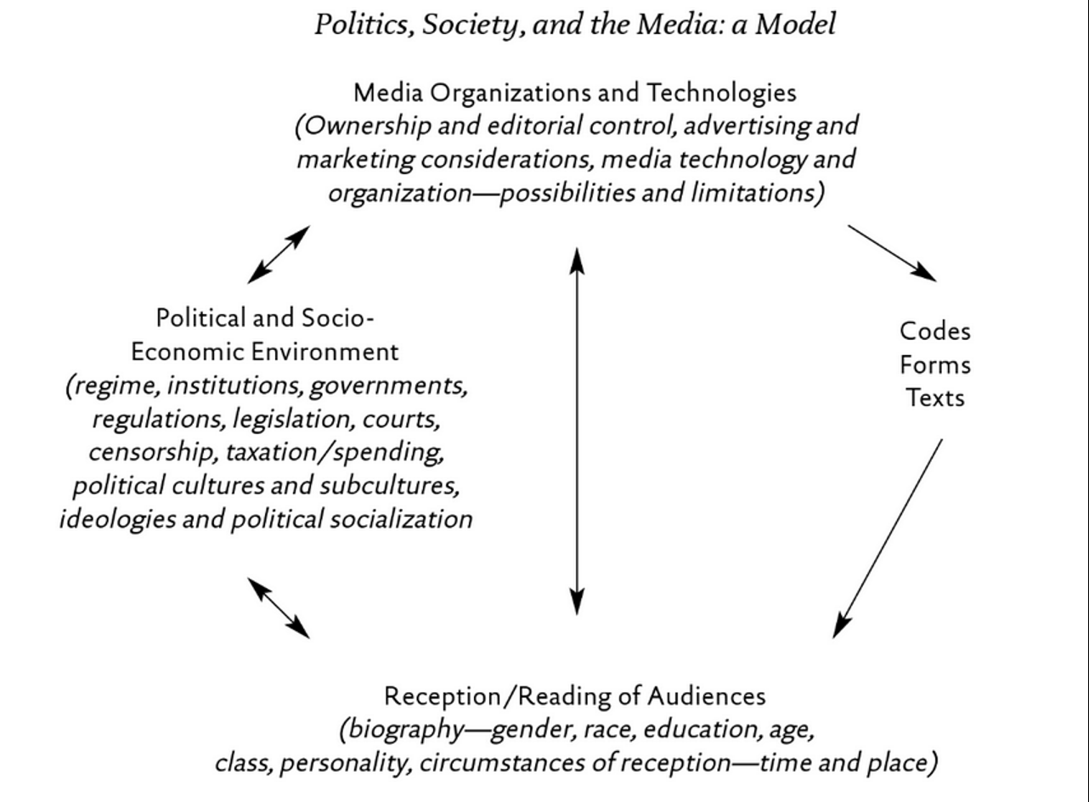
Critical Multidimensional Models

Slide 32
Let’s Analyze the New Nike Ad
Colin Kaepernick Nike Commercial

Slide 33
Compare and contrast ad campaigns!
Dove
Dove Evolution Video
Dove Onslaught Video
Axe
Axe Music Video
Axe Television Ad Diner Party
Axe Television Ad Dentist

Slide 34
Managing Expectations
What are your expectations about the course?
Grades, investment, learning, outcomes, etc.
What excites you about the assignments/readings?
What issues do you foresee with the assignments/readings?
What is your level of experience with topics related to ‘economic restructuring’?
What is your interest level in topics related to ‘economic restructuring’?
What specific topics are you interested you most? What topics interest you least?
What is your motivation for taking this course? Intrinsic & extrinsic factors?

Slide 35
Questions or Concerns?
See you all next week.
Prioritize the following reading.
Chapter 1 – Introduction, Leiss, W., Kline, S., Jhally, S., Botterill, J., Asquith, K. (2018) Social Communication in Advertising, 4th Edition, Routledge, pp. 1 – 25.
Reflect on your consumption habits over the next week in order to prepare for the discussion next week.

