Slide 1
Advertising and the Consumer Culture
Advertising and Commodities
Erik Chevrier
February 11, 2020

Slide 2
Discussion
Think of an item of clothing that you wear regularly.
  What is the value of the item?
  What is the meaning of the clothing item…to you? In general?
  What do you feel when you wear it?
  What did you feel when you bought it?
  Does it help define your fashion trend?
    What style of fashion would you ascribe to yourself?

Slide 3
Discussion Questions
Where was the clothing item made?
Who produced the clothing item?
What labour conditions went into making the clothing item?
What materials make up the clothing item?
Does the meaning you reported in the last discussion represent the labour conditions, materials used or use value of the item?
What do you use the item for? How does that relate to its value?

Slide 4
What about Apple?
What does Apple represent to you?
How are they generally seen by others?

Slide 5
What about Apple?
What does Apple represent to you? How are they generally seen by others?
The Crazy Ones
Although Apple is the company who sells popular brands like iPhones and iPads, their products are made by Foxconn. Apple is not the only company to subcontract other companies to manufacture products overseas.

Slide 6
What is a Commodity?
Definition of a commodity through Marx’s dialectic (as shown on the whiteboard)
  Use value vs exchange value = socially necessary labour = concrete vs abstract = value = equivalent vs relative = money = material relations between persons (reification) vs social relations of things (commodity fetishism) = market exchanges = buyers vs sellers = money = measure of value vs means of circulation = universal form
Neoclassical definition – A commodity refers to an item whose value does not depend on its origins or conditions of production and which is not usually considered in terms of brands.

Slide 7
Commodity Fetishism
Inanimate objects acquire human qualities or supernatural powers – that they do not possess.
These qualities and/or powers are not dependent on their use value and nor with the materials that make them up.
Social relations appear to arise from an object rather than from people.
Exchange value is where commodity meaning is created over and above use value.
Commodities seem to possess agency.
Objects do not possess the ability to enter into relations with each other, they can only do so through the interaction of people.
Modern advertising produces commodity meaning.

Slide 8
Commodity Fetishism and Advertising
Advertising hides the actual conditions of production because the commodity disguises its own origin and the secret of its birth, namely the production of specific human interrelations.
The price of the commodity stems from the obscured and misrecognized relations of production and thus objects appear as if they sprung out of nowhere.
Advertising fills the void in meaning with its own symbols.
Two meanings of commodities:
  Meaning that arise out of the actual material conditions of production
  Meanings that arise out of the promotion and circulation of a product in a market – advertising!
  Goods that lack a clear, distinct use value or where use value is difficult to differentiate between different versions of the same product are particularly prone to fetishism.

Slide 9
Please Define What is Represented by the Following Products and What Use they Serve
MacDonald's
Tim Hortons Coffee
Axe Body Spray
Dove Body Wash
Tropicana Orange Juice
Apple
Microsoft
Nike
Levi's
Budweiser
Du Maurier Cigarettes
Coke
Google

Slide 10
What Meaning is Given to the iPhone 5
Apple – You’re more powerful than you think
  Dreams
  Parenthood
  Strength
  Powerful
What fetish is Apple promoting?
What is the difference between the use value and exchange value?
What is the difference between the productive qualities and commodity meaning of the iPhone 5?
What other commodities can you think of that has ‘popular’ fetishized meaning…i.e. ‘Redbull Gives You Wings’.

Slide 11
Key Concepts
Alienation – Commodities are alienated from their conditions of production. Workers are alienated from their products of labour.
Alienation and fetishism abstracts human attributes and sells them back to the consumer via the purchase of the commodity. Commodities sell you yourself and your attributes back to you. Since commodities don’t actually fulfill actual needs, people are continuously searching for another product to satisfy their needs.
Commodity-sign – Commodities no longer refer to their material composition, productive qualities, or use value – they refer to commodity meanings or commodity-signs. Advertising is the main driver of producing commodity signs.

Slide 12
Audiences for Sale
Videos provided in the first class:
  We Deliver Young People
  YUL-LAB
People are bought and sold to advertisers. People are considered consumers in a market economy. The audience is a commodity.
Older ads targeted people with disposable income – white upper-class males and females for cleaning products. Now, people are segmented into niche consumer markets and target on a more personal level.
People influence the way niches and tastes are defined, they also define themselves according to the definitions of these niches and tastes.
  “Taste classifies and it classifies the classifier” Bourdieu
Eyeballs and clicks(click-bait) – advertisers pay for your attention
Advertisers deliver audiences to companies via media
Advertising is actually the reason why most media and infrastructure exist – i.e. the Metro newspaper
  Television programs and other media exist to produce audiences to sell to advertisers.

Slide 13
Fragmentation, Segmentation, Distinction
Old advertising looked for mass audiences and had to be more conservative not to offend people.
Today, people are segmented into niches that can be targeted on a more personal level based on your values, interests, demographic characteristics, and purchase intentions, etc.
Niche = A group of potential consumers defined by a particular set of interests, needs and consumer demands.
Nichification – Rationalizes mass audiences into discrete groups in order to extract profits by ensuring that targeted messages reach appropriate audiences thereby eliminating unproductive costly waste.
What niche demographic are you part of?

Slide 14
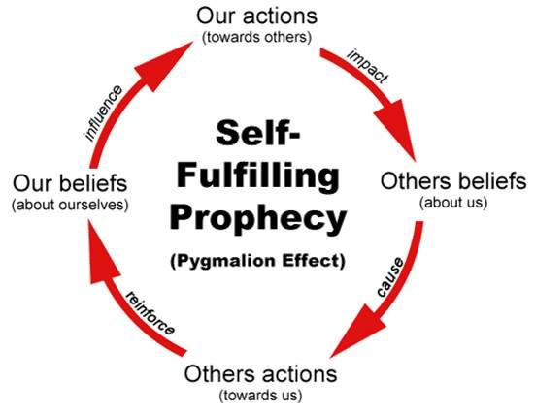
Fragmentation and Self-Fulfilling Prophecy

Slide 15
Conspicuous Consumption and Taste
Taste refers to what you like, dislike, enjoy, despise, seek out, on a sensual and intellectual level.
Conspicuous consumption is a term coined by Thorstein Veblen to describe purchase and display of goods in order to communicate one’s social status.
Taste is categorized and assigned different objects to those categories.
People define themselves through their taste preferences.
What are your tastes?

Slide 16
Personalization
Online data gathering – Vault 7
  Cookies
  Search engines
  Social media
  Points cards
Google and Facebook store data, sell data and provide companies with the ability to personally target you.
Purchase intention is one of the strongest predictors of future purchases. Companies try to find out what you regularly purchase to sell you these items and what you intend to purchase to sell you related items.

Slide 17
Needs and Wants
Make a list of products that you need and want?
How do you know if a product can satisfy a real need?
What products satisfy these real needs?

Slide 18
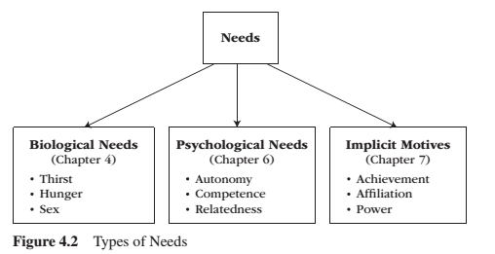
Needs
Need – A condition within the person that is essential and necessary for growth, well-being and life.
Deficiency needs – Are responses to a state of deprivation and generate tension-packed, urgency-laden emotions, such as pain, relief, anxiety, frustration, stress, etc.…
Growth needs – Gently guide behaviour toward a developmental trajectory of growth and well-being. They typically generate positive emotions, such as interest, enjoyment, hope and vitality.

Slide 19
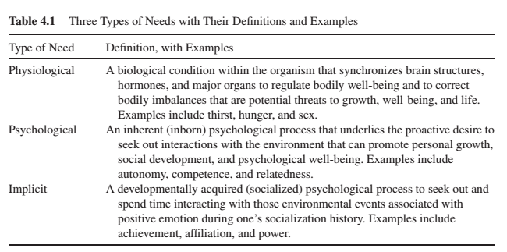
Needs

Slide 20
Learning Check
Advertising, Commodities, and Commodity Fetishism – Class Notes and Chapter 5 (Holm)
Exploring Marx(ism):
What is the value of a commodity?
Name and explain each part of the dialectic chain from Capital Volume 1 (as explained in class) beginning with the commodity, ending with money.
What is commodity fetishism? Why is commodity fetishism an important factor to consider when studying advertising?
What is reification?
What is the neo-classical definition of a commodity?
What is a commodity according to Holm?
What does Holm say about use value and exchange value?
What does Holm say about equivalence of commodities?
What does Holm say about the history of commodity fetishism?
Who is Foxconn? What does Holm suggest about commodity fetishism through the example of Foxconn?
According to Holm, what is a fair trade and organic commodity?
According to Holm, that are the two sites at which the meaning of commodities is produced?
Explain ‘The Crazy Ones’ advertising campaign? How does Holm use the example of ‘The Crazy Ones’ campaign to explain commodity fetishism?
Explain ‘You’re More Powerful Than You Think’ advertising campaign? How does Holm use the example of ‘You’re More Powerful Than You Think’ to explain commodity fetishism?
What does Holm suggest about alienation in relation to advertising commodity fetishism?
What does Holm suggest about needs and wants in relation to advertising and commodity fetishism?
According to Holm, what is a commodity-sign? What does Baudrillard suggest about ‘the fetishes of advertising becoming the main event?
What does Holm suggest about fetishism and consumerism?
Audiences for Sale: Quantification, Segmentation and Personalization – Class Notes and Chapter 6 (Holm)
What does Holm mean by audiences for sale? What does Holm mean by audiences are commodities?
What does Holm mean by advertising turns into terror? What does Adorno and Horkheimer suggest about advertising and culture in the 1940’s?
What does Holm mean by advertisers are units to be bought and sold? According to Holm, how are these ‘units of attention’ or ‘commercial units’ expressed in industry lingo – how is audience attention measured?
According to Holm, what is click-bait?
According to Holm, what is a niche? Give an example of a niche.
How are audiences fragmented, segmented and defined as distinct by advertisers?
According to Holm, what is a demographic?
According to Holm, what is nichification?
According to Holm, what is advertising ‘waste’?
What does Holm mean by, the search for markets becomes some self-fulfilling prophecy?
According to Holm, what is conspicuous consumption? How does distinction and taste communicate one’s social status? What are examples of ‘taste’ in advertising?
What does Bourdieu mean by ‘taste classifies the classifier’?
What does Holm mean by, we went from nichification to personalization?
According to Holm, what are ways in which advertisers gather personal information, online, about people and use them for advertising purposes? What does Horkheimer and Adorno suggest about ‘pseudo-individualization’?
According to Holm, how can user-generated content become part of an advertising campaign?
From the class notes, what are the three categories of needs that people have? Give examples of needs from these categories. What is the difference between a growth need and deficiency need? How does this relate to the idea that advertising creates ‘needs’? Can advertising create all needs? Why or why not?

Slide 21
Have a Great Night
Questions or concerns?
Study Hard!

