Slide 1
Food and Sustainability
Food Agriculture, Gender, Class and Race Erik Chevrier August 10th, 2020 www.erikchevrier.ca

Slide 2
Capitalism Food and Agriculture
Capitalist agriculture = contradiction
Not a lucrative investment for many capitalists
Inputs, machinery, seeds, etc.
Subsidies and insurance
Loans
Persistence of peasantry
Contradiction between overproduction and prices
Contradiction in agriculture labour time
Production and reproduction
Labour, production and (growing/cultivating) time
Appropriationism – (upstream) replace agroecological methods with machinery (implode)
Substitutionism – (downstream) replace producer-consumer buying with complex array of processors and distributors (explode)
Investments
Production and reproduction
Labour, production and (growing/cultivating) time

Slide 3
Agriculture Labour
Contract farming
Vertical integration
Market-specification contract
Resource-providing contract
Two things about contract farming:
Risk is on farmer
Farmer has larger stake then firms who provide seasonal contracts
Rational Agriculture
Contradiction with capitalist labour (absolute vs relative)
Requires more production time
Agroecology
Moral economy
Farming Styles
Capitalist, entrepreneurial, peasant farms

Slide 4
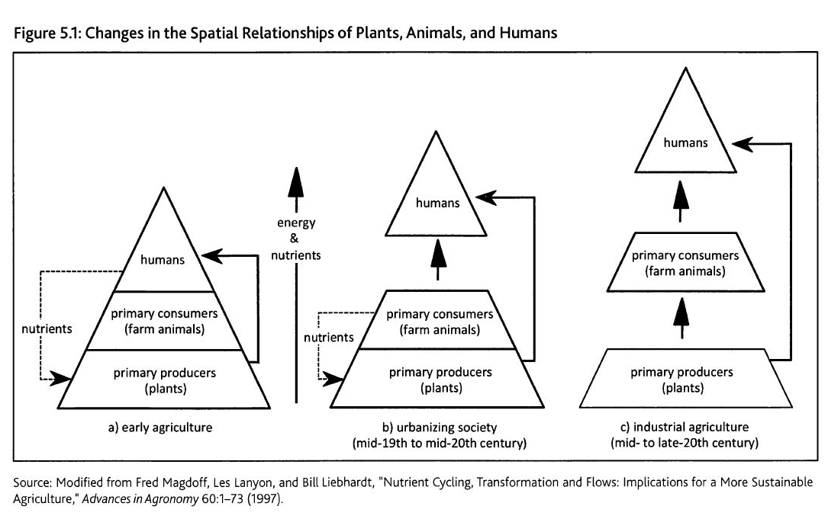
Metabolic Rift

Slide 5
Food and Structural Injustices
Food systems are structurally unjust
Modern agriculture developed along with capitalism, colonialism and slavery
Food plays a major role in social reproduction
The price of food determines the minimum amount you need to reproduce a labourer
Unequal divisions of labour
Shift from absolute to relative surplus
Structural Racism
Slaves worked on farms and plantations, offsetting the true cost of food (and labour)
Migrant labour
Modern slavery
Patriarchy
Political power and influence assumed by men
Women are the main labourers
Women are the main home labourers
Superexploitation of non-wage workers
Class
Caste system
Justification of slavery (property)

Slide 6
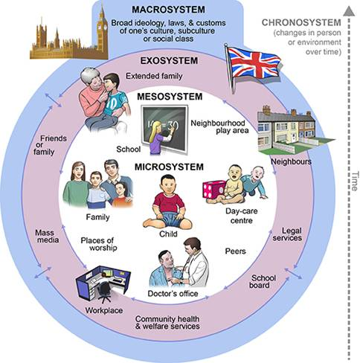
Ecological Systems Theory of Development

Slide 7
Capitalism and Food
We can’t change the food system without transforming capitalism. Yet we can’t transform capitalism without changing the food system. And we can’t do either of these things without ending patriarchy, racism, and classism. So, if we want a better food system, we have to change everything. Admittedly, this is a tall order for any social movement. The question for the food movement, however, is not “how do we change everything” but “how is the food system strategically positioned to influence systemic change?

Slide 8
Video
What is Agroecology?
Living Soil

