Slide 1
Food and Sustainability
Transforming the Food System Erik Chevrier August 12th, 2020 www.erikchevrier.ca

Slide 2
Solutions?
Reproduce your livelihood and your community as much as you can
Reconnect with food!
Support local farmers who use agroecological, permaculture, and organic methods
Look for CSA, labour exchange, farmers markets
Fight for social justice
You can’t have food justice without social justice!
Fight for food sovereignty
You can’t change it if you can’t control it!
Build a network of allies
The movement is multifaceted!
Transform Capitalism
De-commodify food
Build commons and collectives
Redistribute wealth
Let the workers own the means of production
Prioritize the biosphere and social welfare over markets and profit (nested model)
Reassess growth (don’t overproduce)

Slide 3
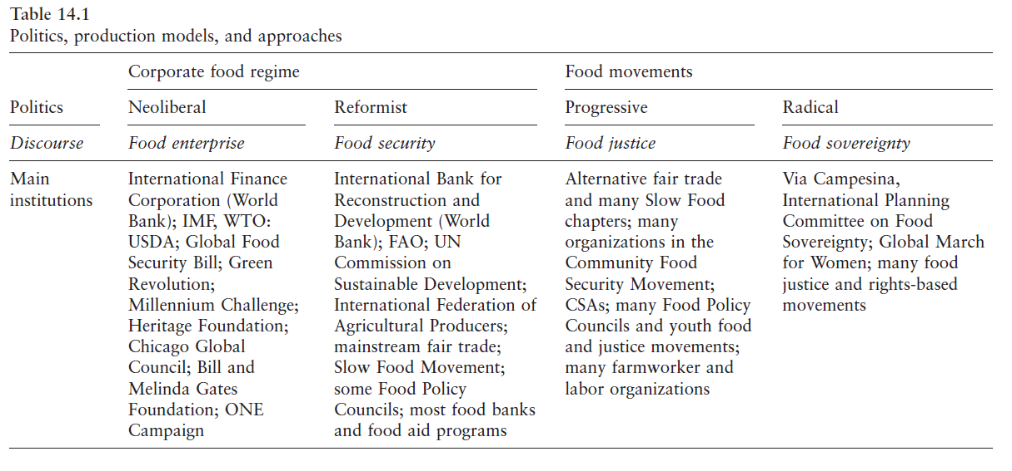

Slide 5
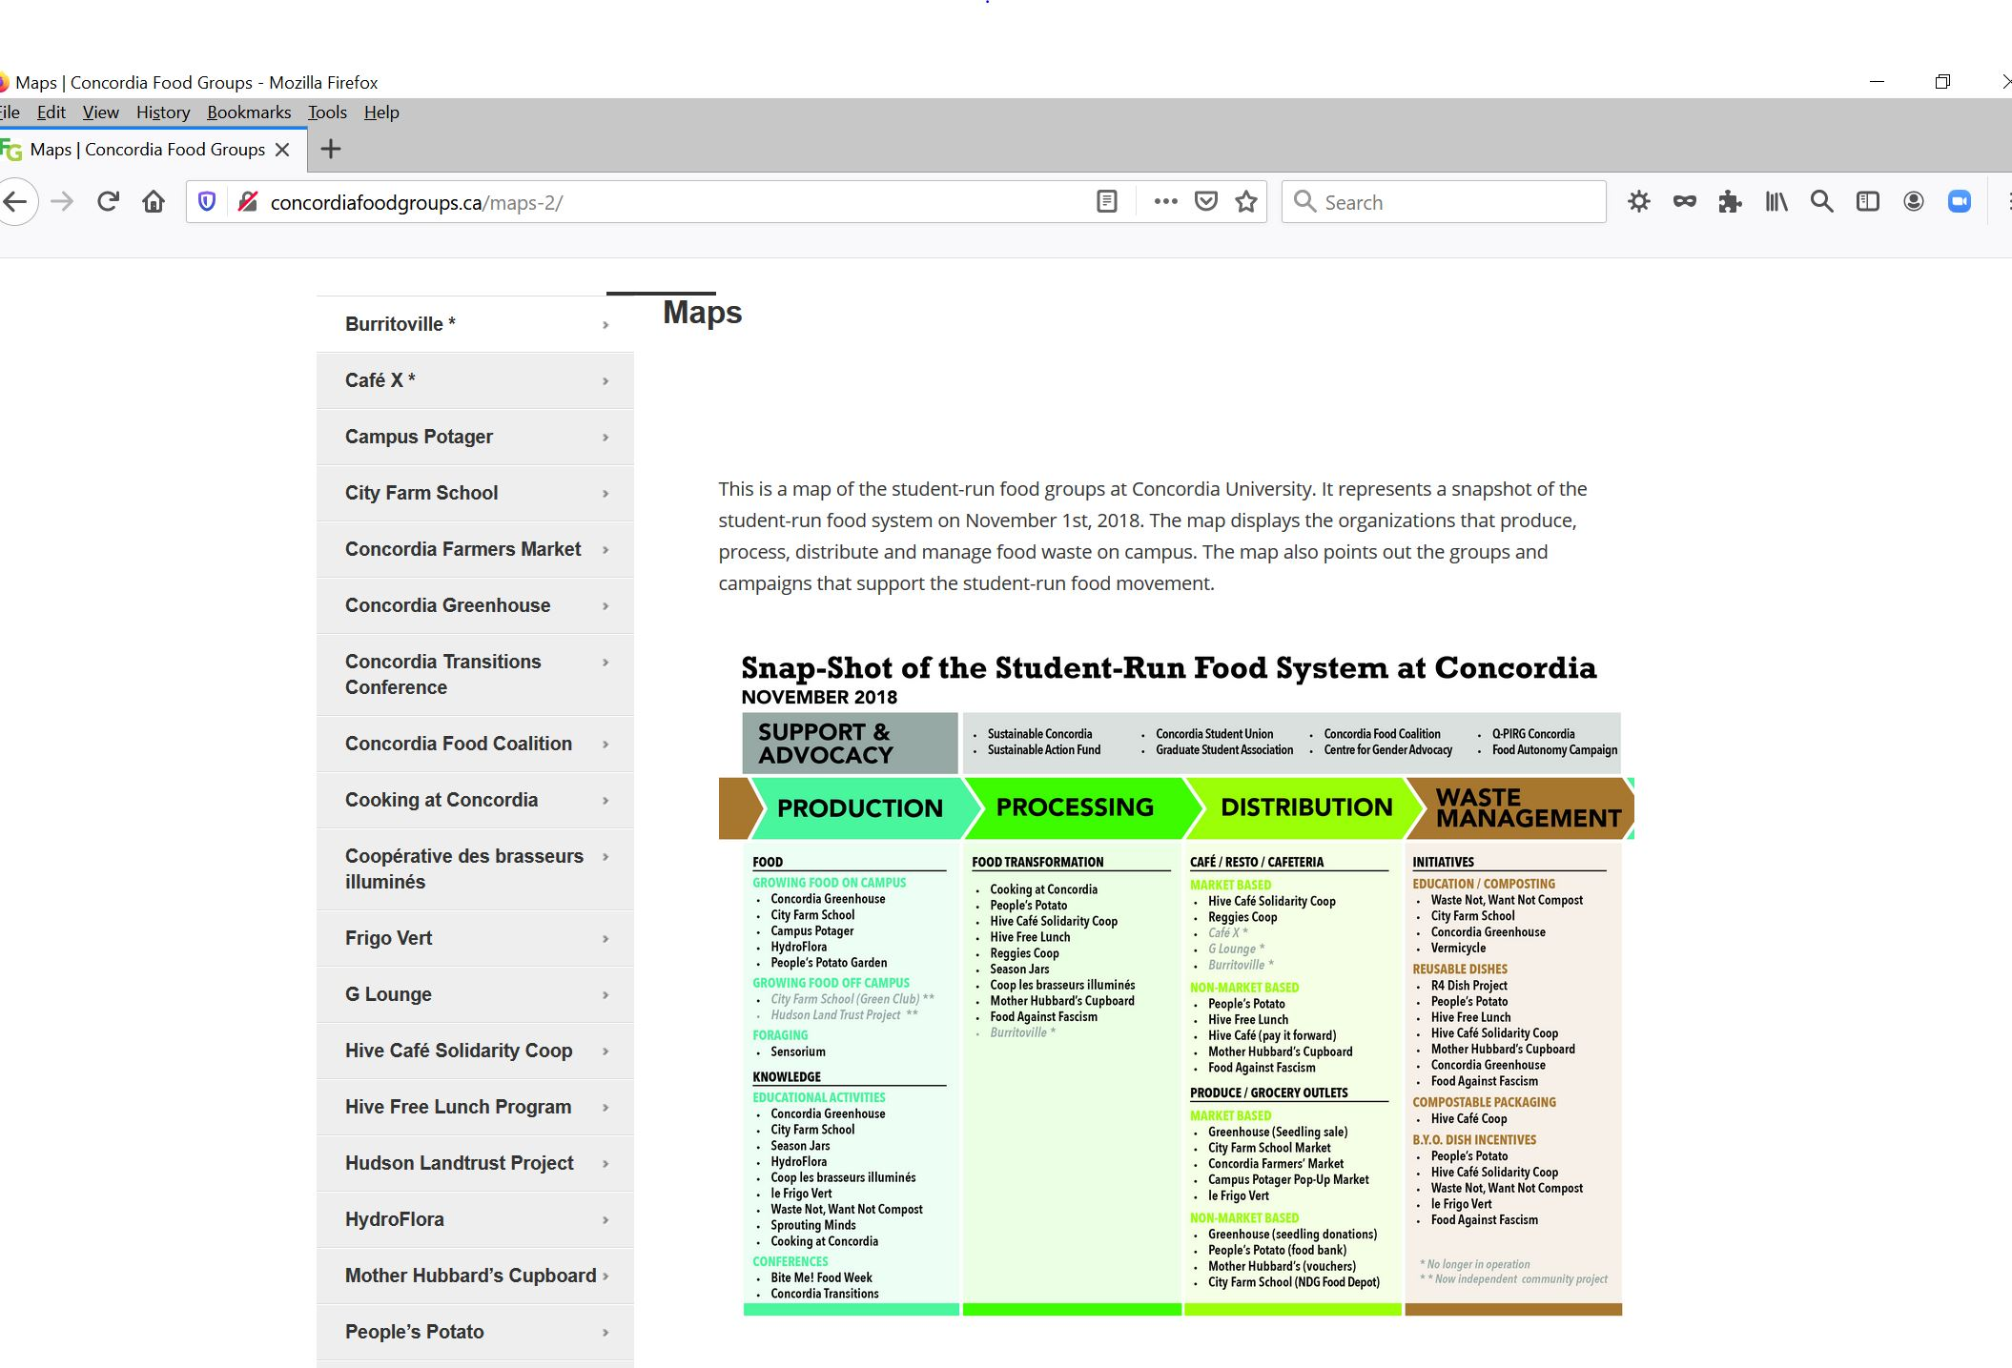

Slide 6
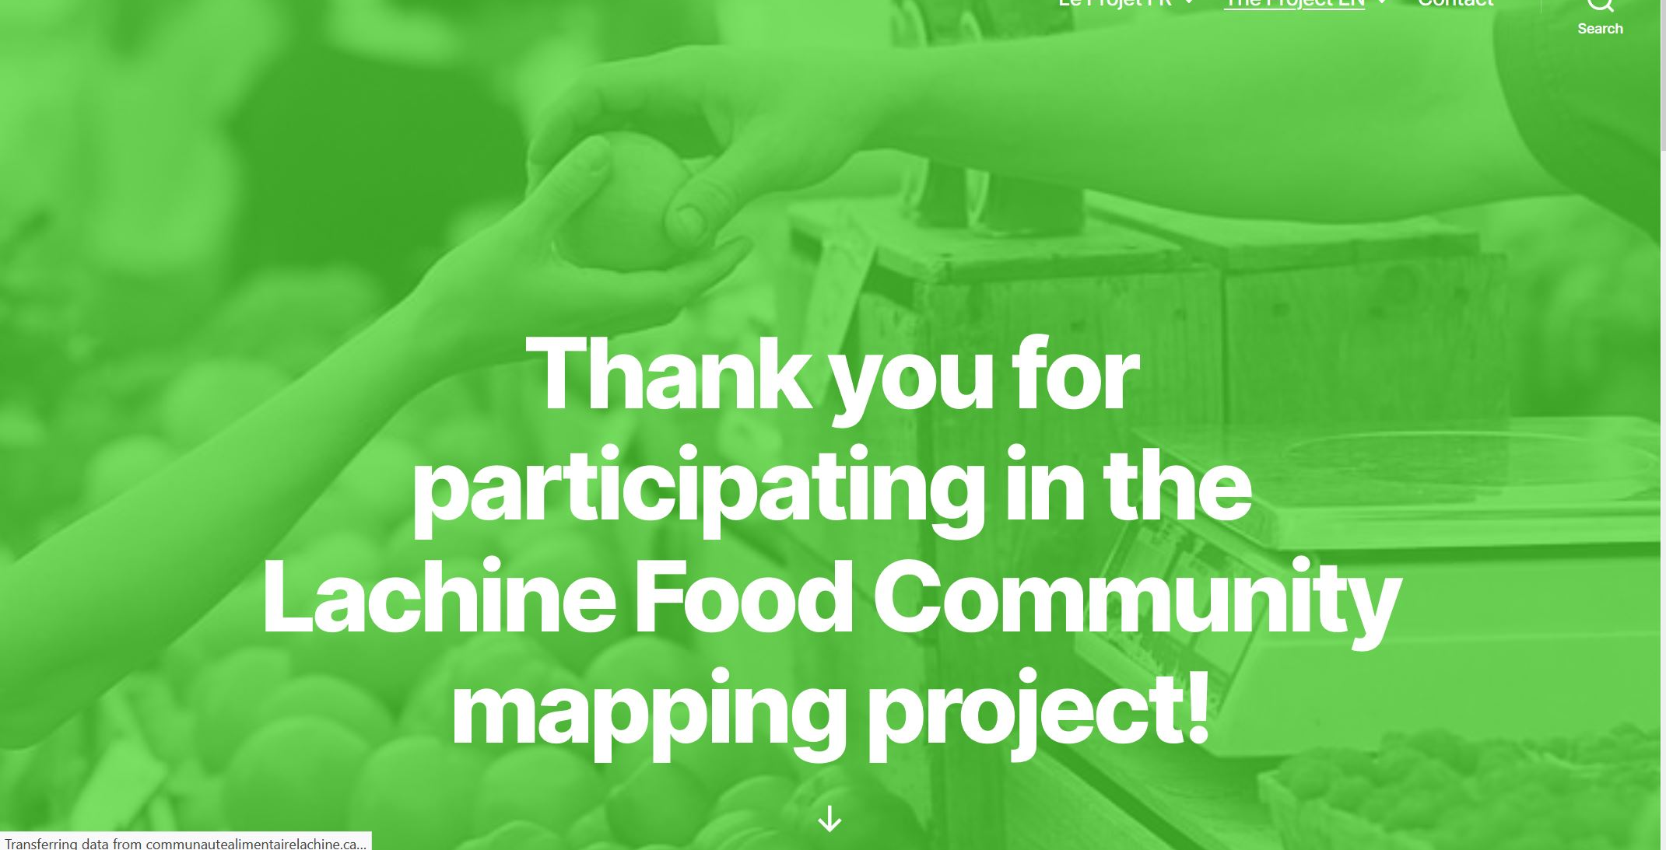

Slide 7
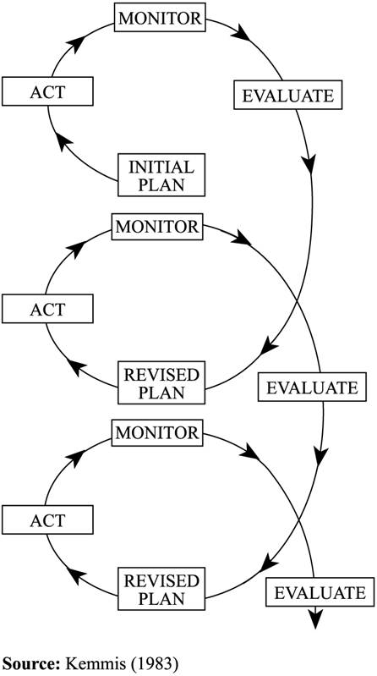
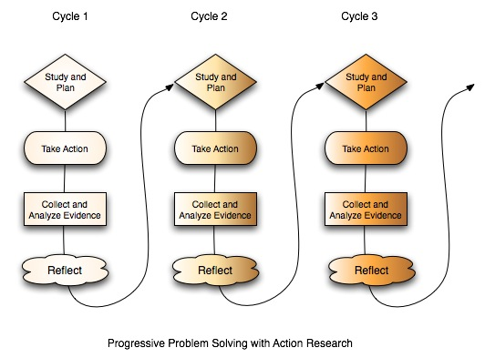

Slide 8
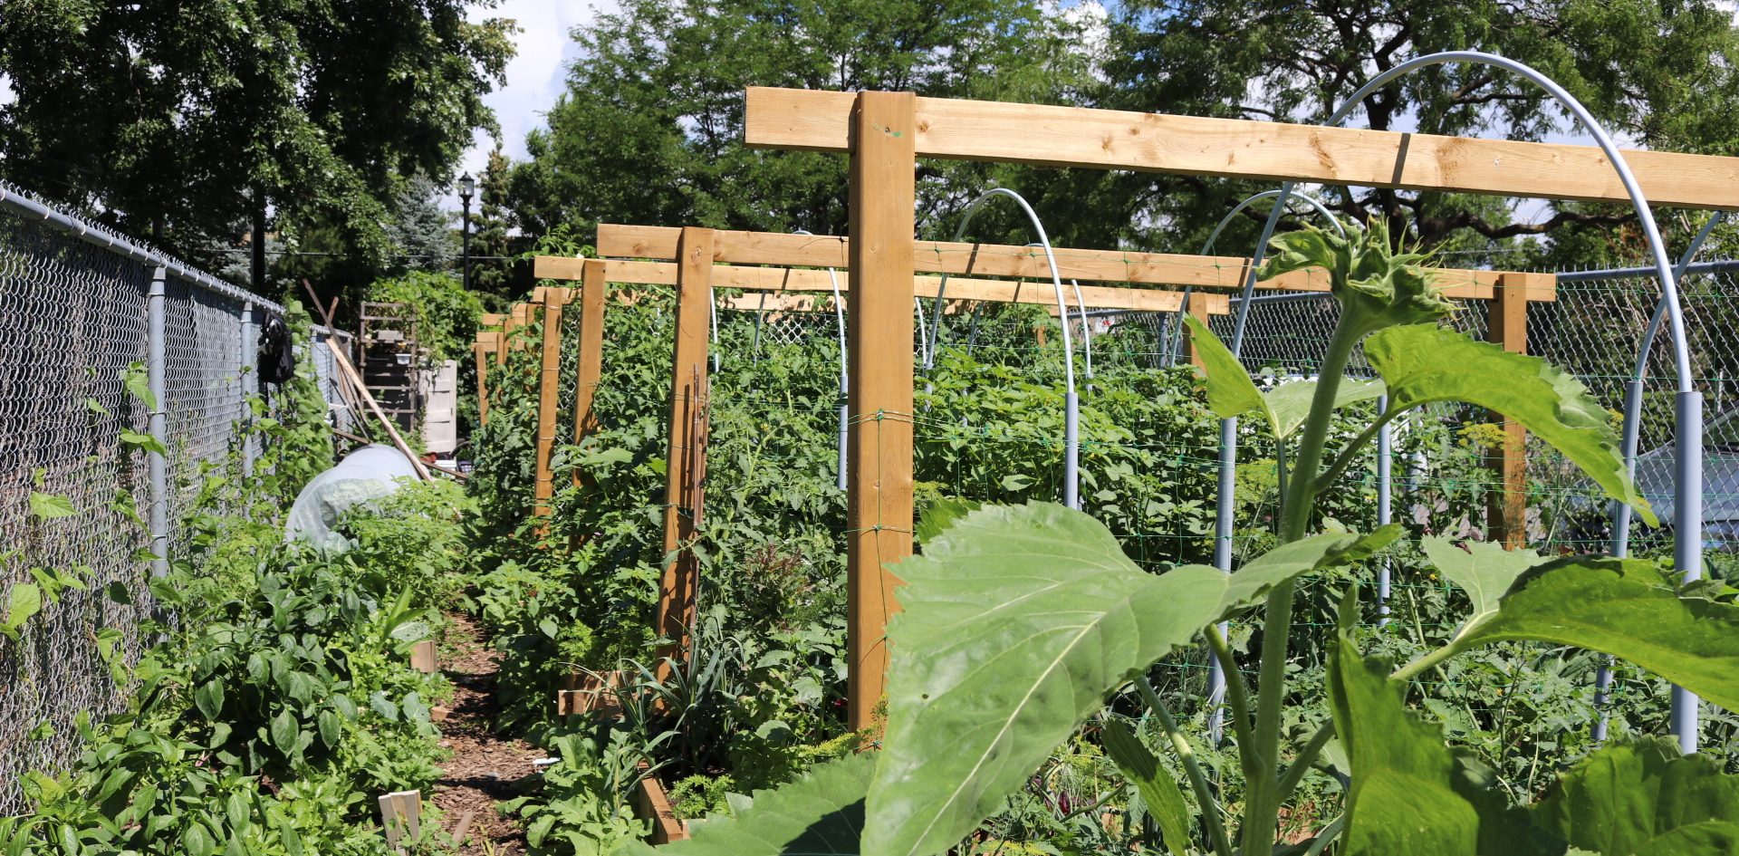

Slide 9
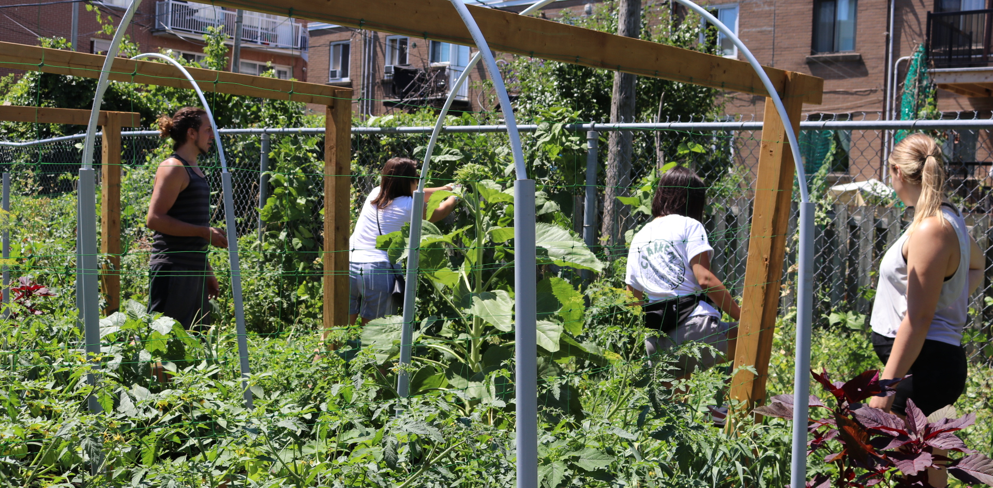

Slide 10
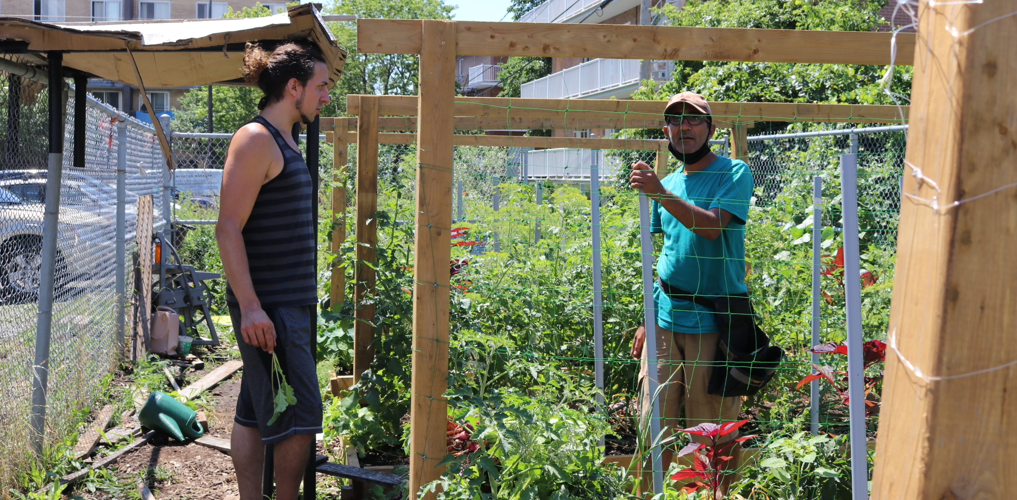

Slide 11
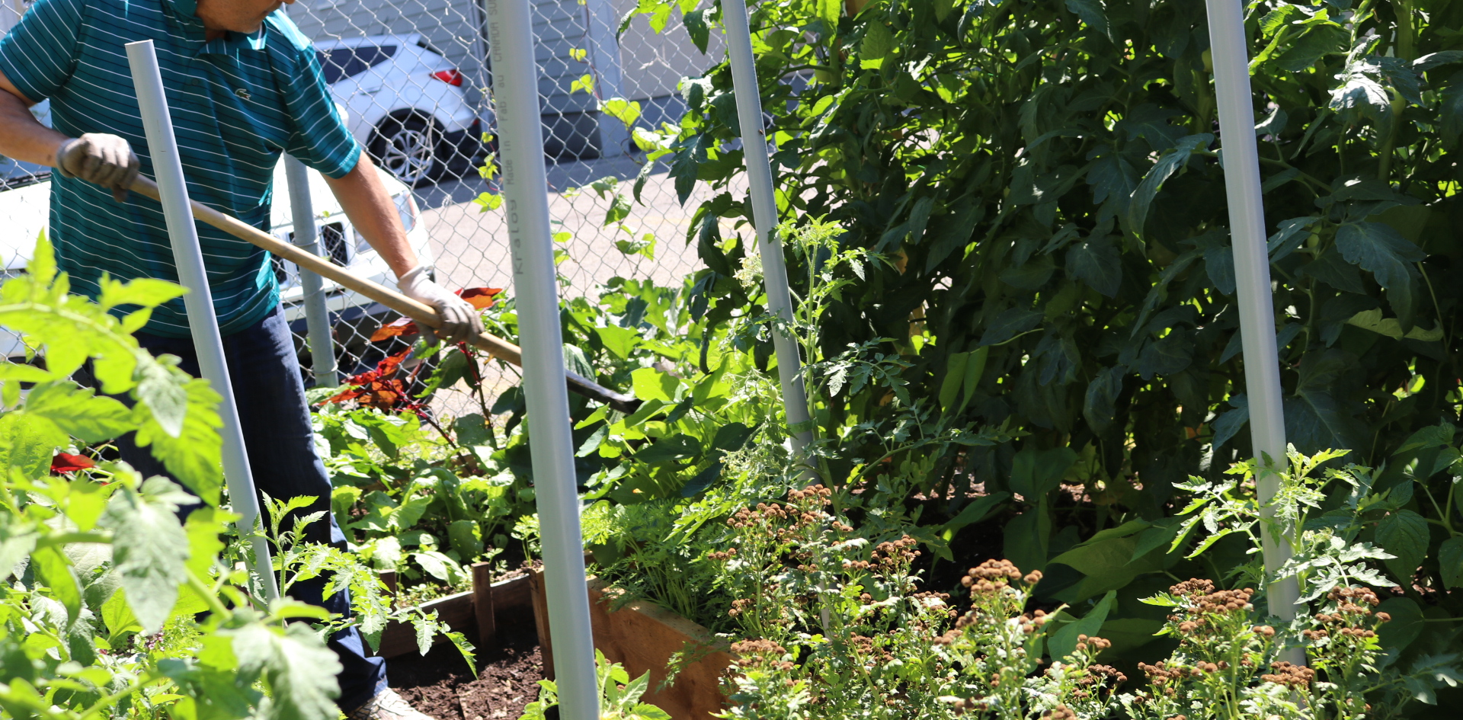

Slide 13
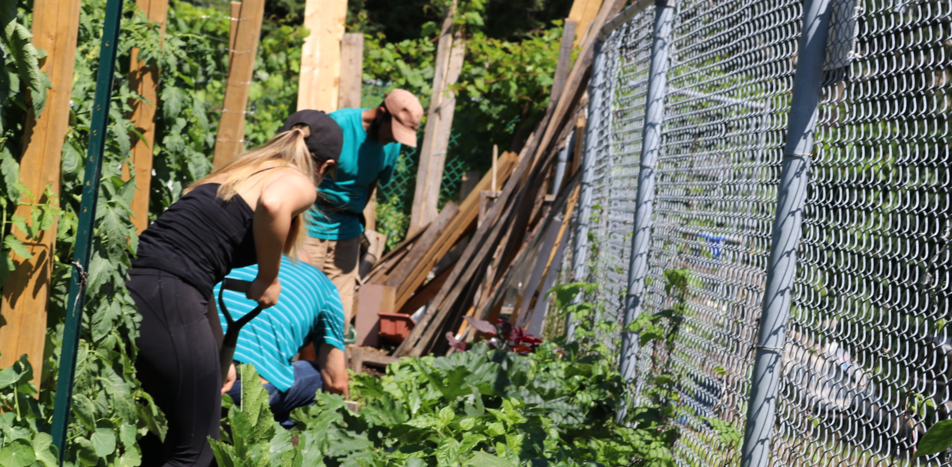

Slide 15
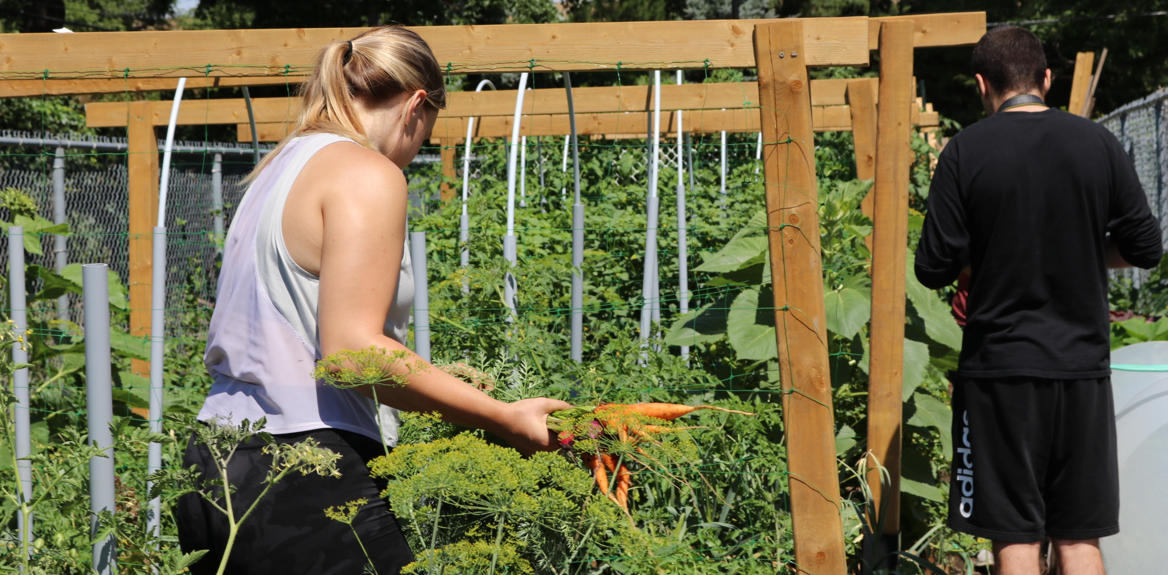

Slide 17
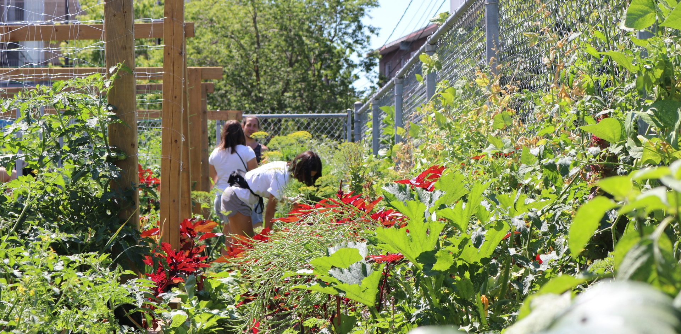

Slide 18
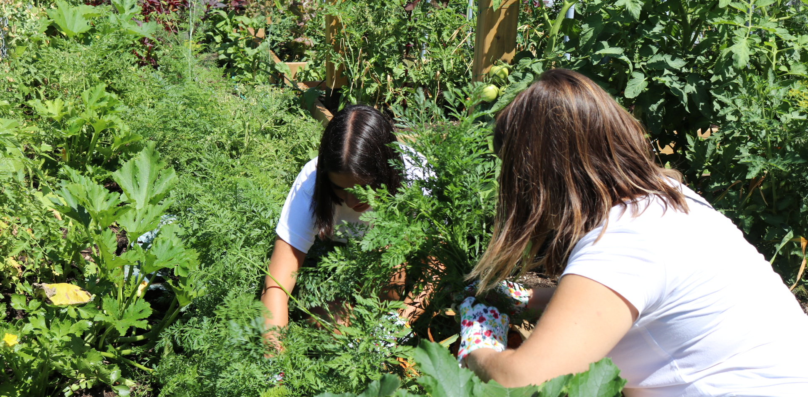

Slide 20
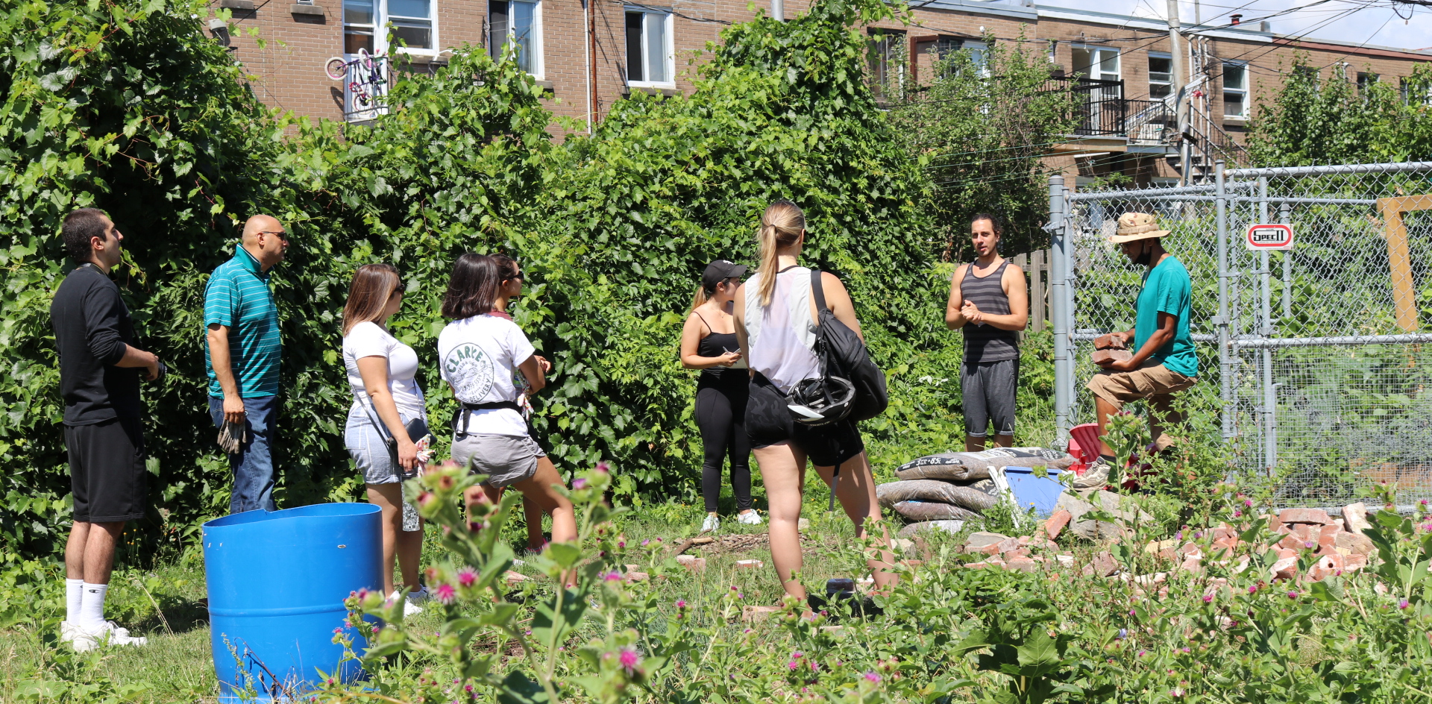

Slide 21
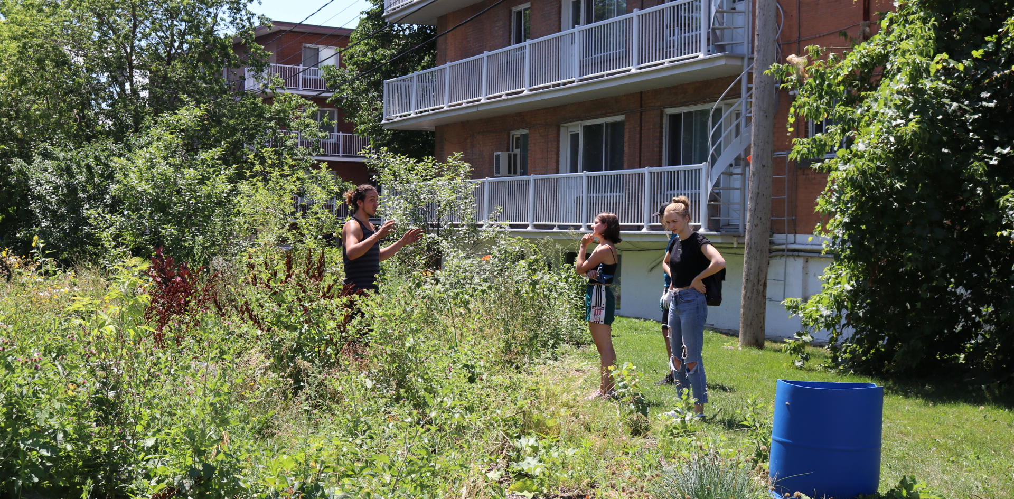

Slide 22
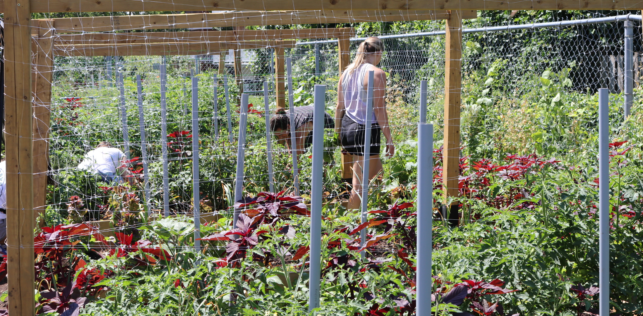

Slide 25
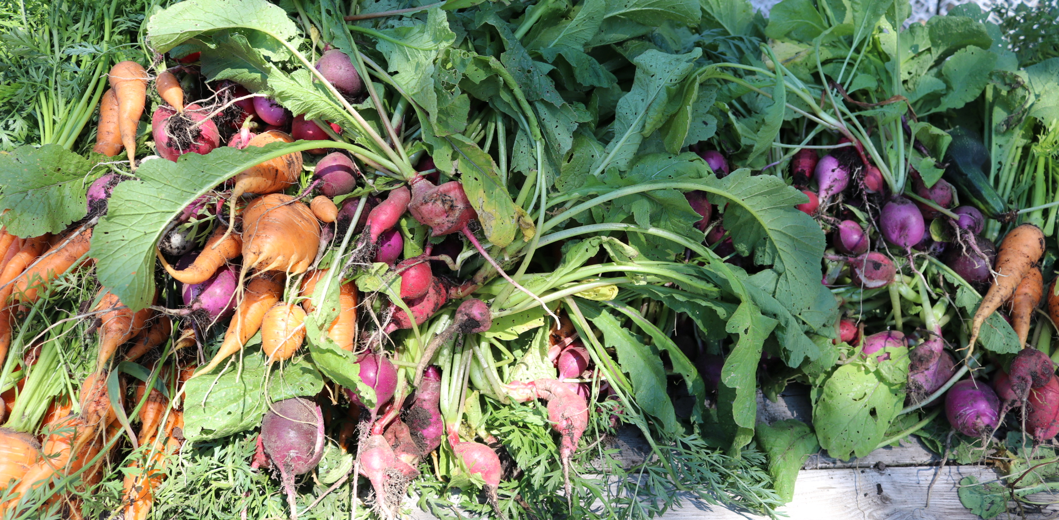

Slide 26
Final Question
How will you contribute to a sustainable food system?

