Slide 1
Food and Sustainability
Erik Chevrier
Food For Sustainable Growth
July 15, 2020

Slide 2
What Does Sustainable Growth Mean?
What is growth?
GDP & NDP
Gibson-Graham Diverse Economy (Previous Lecture)
Is perpetual sustained economic growth even possible on a planet with finite resources?
Sustainable growth has many meanings
Micro economic – Can the growth of a company be sustained without creating other significant economic problems that jeopardize the viability of a company/organization.
Sustainable Investing – Environmental, Social, Governance (ESG)
Sustainable Intensification
The real question is what do we want to grow? What types of value do you want to bring into the world, and how much of this value should we create?
Regenerative Enterprise (Roland & Lanuda, 2013)
Social capital - Material capital
Financial capital - Living capital
Intellectual capital - Experiential capital
Spiritual capital - Cultural capital

Slide 3
Double Food Pyramid
Mediterranean Diet deriving from the Greek word “diaita”- lifestyle, way of life - it is a social practice based on all the “savoir-faire”, knowledge, traditions ranging from the landscape to the table and covering the Mediterranean Basin, cultures, harvesting, fishing, conservation, processing, preparation, cooking and in particular the way we consume, i.e., conviviality
(Altomare R, Cacciabaudo F, Damiano G, et al. The mediterranean diet: a history of health. Iran J Public Health. 2013;42(5):449-457)
Canada Food Guide
Critique:
Colonial (infringes indigenous sovereignty)
Access (poverty, geographical location, political/social context)
Food restrictions

Slide 5
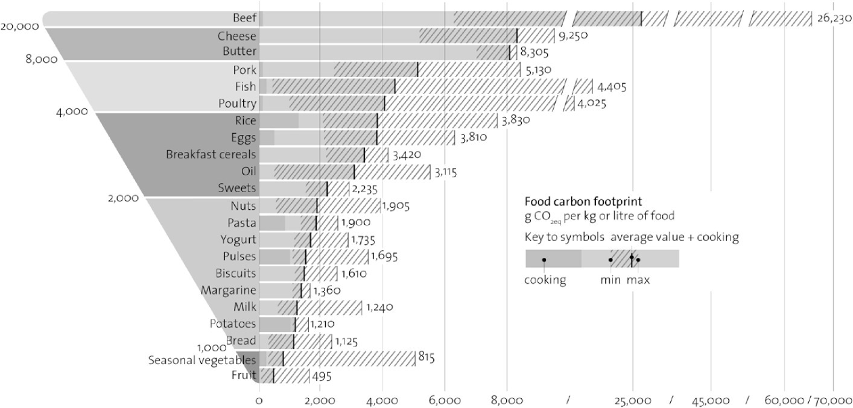

Slide 6
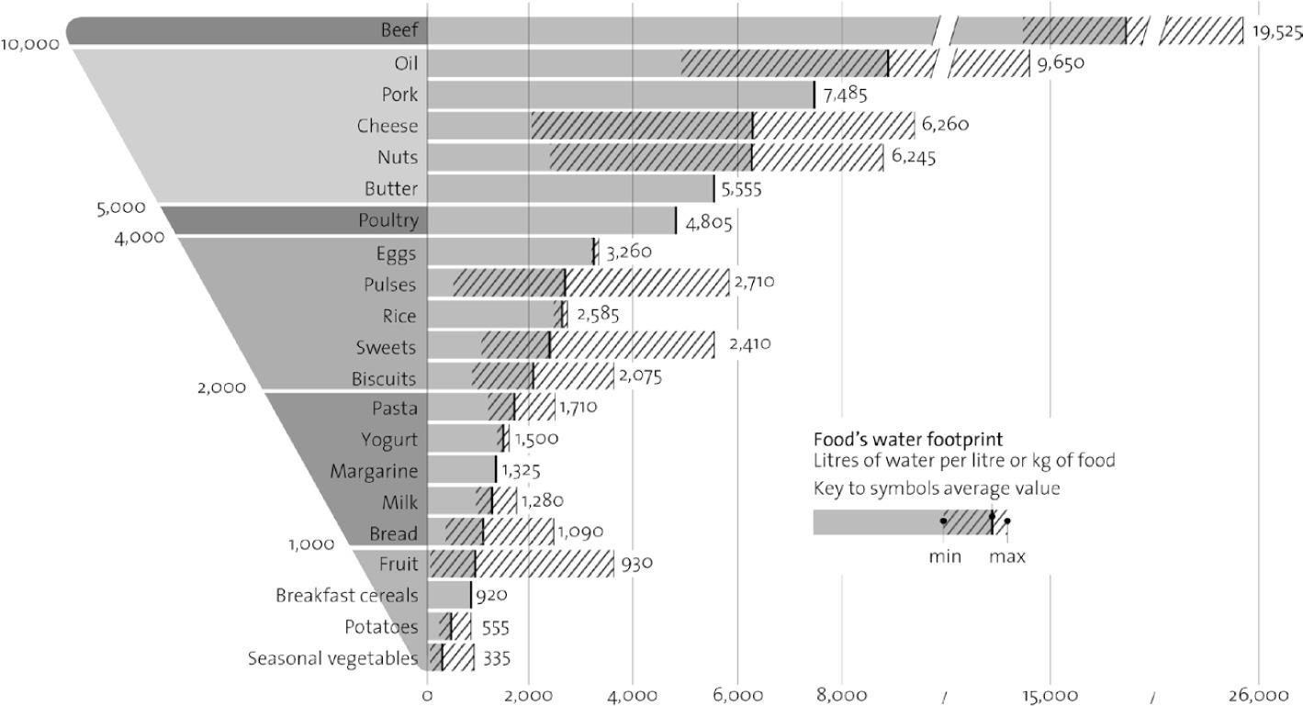

Slide 7
Resume of Nourished Planet
“Sustainable agricultural system are able to effectively and comprehensively meet the food, fuel, and fiber needs of today without compromising the ability of future generations to meet the needs tomorrow”
- Food security (availability, means to access, safe consumption, consistent access)
Health
Barriers to access (affordability & price fluctuations)
- Soil degradation (see chapter 1 & 2 for stats)
- Greenhouse gas (GHG) emissions
- Water conservation
- Food waste
- Future of farming
Critique
Too much focus on individual choices. Not enough focus on changing institutions and collective actions.
Double pyramid has to account for the needs of communities
Negative externalities reflect industrial farming methods
Heavy focus on living capital over financial capital but leaves out other forms of capital (slide 2)

Slide 8
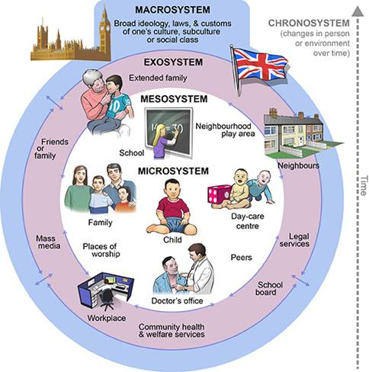
Ecological Systems Theory of Development

