Slide 1
Food and Sustainability
Food Commodities and Capitalism Erik Chevrier July 29^{th, 2020} www.erikchevrier.ca

Slide 2
What is This?

Slide 3
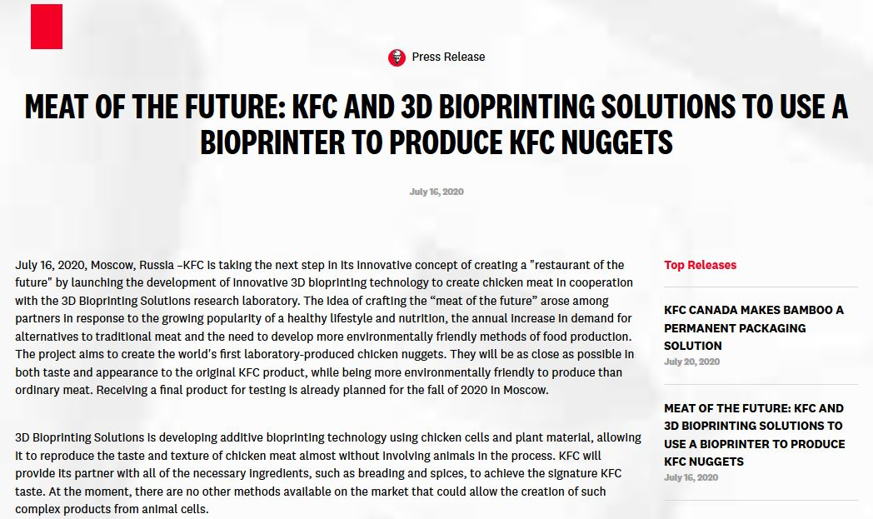
Source

Slide 4
Commodification of Food
Commodity:
Cambridge English Dictionary
A substance or product that can be traded, bought, or sold.
A valuable quality
Oxford Dictionary
A raw material or primary agricultural product that can be bought and sold, such as copper or coffee.
A useful or valuable thing.
Myriam-Webster Dictionary
An economic good: such as
A product of agriculture
An article of commerce especially when delivered for shipment
A mass-produced unspecialized product commodity chemicals
Something useful or valued
Convenience, advantage
A good or service whose wide availability typically leads to smaller profit margins and diminishes the importance of factors (such as brand name) other than price
One that is subject to ready exchange or exploitation within a market

Slide 5
What is the Value of This? What determines the Value of a Food Commodity?

Slide 6
Commodification of Food
Marx circulation of commodities and money
C – C
C – M – C
M – C – M’
See Diagram on Board Regarding Marx’s Value Theory
Polanyi – ‘Fictitious Commodities’
Land
Labour
Money
…FOOD!

Slide 7
Value of a Food Commodity

Slide 8
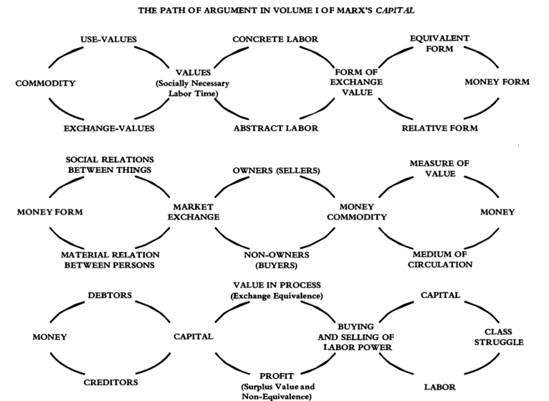
Value of a Food Commodity Visit David Harvey’s Website and/or Read Capital Volume 1

Slide 9
Value of a Food Commodity

Slide 10
Importance of Labour
Reproduction of the worker
Relative vs Absolute Surplus Value
Low prices = Low wages
Subsistence farming

Slide 11
Privatization of Food
GATT – General Agreement on Tariffs and Trade – 1947 – 1994
TRIPS Agreement
World Trade Organization – 1995
Vernon Hugh Bowman
Percy Schmeiser
Percy Schmeiser on Democracy Now
Monsanto vs Farmers
The World According to Monsanto

Slide 12
History of the Capitalist Food System
Rooted in Political Economy
Feudalism
Industrial Revolution
Creating enclosures
Separation from livelihood
Corn Laws 1815 (UK)
Mercantilism
Primitive Accumulation
Colonialism
Slavery

Slide 13
Food Regimes
First Regime – Colonialism
Regulation – uphold private property
Dispossession – of land and resources
Exploitation – of labourers
Technological development
Market expansion
Second Regime – Post-War
Over production
New Deal (in USA)
Parity (for farmers)
Migrant labourers
Green Revolution
Corporate Food Regime – Late 70’s Onwards
Profit
Neo-liberalism
Monopolies
Corporations
Globalizagtion

Slide 14
What is Capitalism?
Markets Profit Private ownership of the means of production Money based system Financial markets Private property Alienation Exploitation Wage Labour Externalities Expendable work force Inequality Advertising Consumerism Firms Institutions Imperialism Colonialism Exchange Free (non-slave) labour Cycles and crisis Growth Competition Limited democracy (usually representational)

Slide 15
Take Back the Economy – Commons Toolkit Gibson-Graham, J.K., Cameron, J., Healy, S. (2013) Take Back the Economy: An Ethical Guide for Transforming Communities, University of Minnesota Press
Types of commons:
Biophysical – Exist naturally – i.e. rocks, soil, air, etc.
Cultural – Things shared by members of the same culture – i.e. language, musical heritage, symbols
Social – Things shared between members of a social system – i.e. education, health, political systems
Knowledge – Things people know – i.e. Indigenous ecological knowledge, scientific achievements
Ways to assess commons. To be a commons:
Access – Must be shared widely
Use – Must be negotiated by a community
Benefit – Must be distributed to the community and possibly beyond
Care – Must be performed by community members
Responsibility – Must be assumed by the community
Property – Must be collectively owned private property, state owned property and/or open access property

Slide 16
Video
Vandana Shiva – Ted Talk
Hero’s Sanctuary
Vandana Shiva on Food Sovereignty at Concordia

