Slide 1
Food and Sustainability
Building Food Sovereignty
Erik Chevrier
July 8th, 2020

Slide 2
Food Security
We need to think beyond sustainability and food security to address root causes of food problems – we need to build food sovereign localities.
Food Security (Patel, 2010) – Food and Agriculture Organization of the UN (FAO):
The availability at all times of adequate world food supplies of basic foodstuffs to sustain a steady expansion of food consumption and to offset the fluctuations in production and prices (1975)
Food security, at the individual level, household, national, regional and global level [is achieved] when all people, at all times, have physical and economic access to sufficient, safe and nutritious foods to meet their dietary needs and food preferences for an active and healthy life (1996)
Food security [is] a situation that exists when all people, at all times, have physical, social and economic access to sufficient, safe and nutritious food that meets their dietary needs and food preferences for an active and healthy life (2001)

Slide 3
La Via Campesina Position at the World Food Summit (Desmarais, 2017)
Right to produce and access to land
Food is a basic human right
Agrarian reform
Protecting natural resources
Reorganizing food trade
Social peace
Democratic control

Slide 4
What is Food Sovereignty?
Food sovereignty is difficult to define because it has come to mean many different overlapping ideas.
Food sovereignty is, if anything, over defined. There are so many versions of the concept, it is hard to know exactly what it means. The proliferation of overlapping definitions is, however, a symptom of food sovereignty itself, woven into the fabric of food sovereignty by necessity. (Patel 2009 , p. 664).
The term has become a challenging subject for social science research, and has been interpreted and reinterpreted in various ways by different groups and individuals. Indeed, as it is a concept that is so broadly defined, it spans issues such as food politics, agroecology, land reform, pastoralism, fisheries, biofuels, genetically modified organisms (GMOs), urban gardening, the patenting of life forms, labour migration, the feeding of volatile cities, community initiatives and state policies, public health, climate change, ecological sustainability, and subsistence rights. (Alonso-Fradejas, Borras Jr, Holmes, Holt-Gimanez, and Robbins, 2015, p. 443)
Food sovereignty…is many things depending on place, time, culture, needs and so on. As with many forward-looking ideas, it is difficult to predict exactly what food sovereignty will look like in practice – to provide an exact blueprint of food sovereignty is not only difficult but also counter-productive. So it might be easier to define what it isn’t. (Qualman, 2011, p.20)

Slide 5
Introduction to Food Sovereignty
Darrin Qualman Advancing Agriculture by Destroying Farms? The State of Agriculture in Canada
Food Sovereignty is NOT:
A set of policies simplistically aimed at maximizing production and exports
A disregard for the destruction of family farms and rural communities
A push towards high-input, high-cost, high-energy-use model for food production that generates chronic negative returns for the farm families who work the soil
A concentration of land ownership into the hands of fewer and fewer owners, many of them non-farmers
A corporate takeover of a growing number of agricultural sectors (e.g. hog production and cattle finishing)
A push towards massive production units that concentrate potential pollutants
A transfer of key food processing facilities to foreign companies, even to foreign lands
Economic policies that make foreign-based transnationals the primary beneficiaries of the wealth created by farm families working our land
A system that makes citizens ever more dependent on food supplied further and further from their homes

Slide 6
What is Food Sovereignty?
Food sovereignty is a multidimensional concept that refers to a process and an outcome.
Process – it describes a movement, a struggle, a democratic process perpetually in negotiation and always in motion.
Outcomes – agreed upon declarations of rights, codes of ethics and guiding principles. These declarations are debated at conferences, meetings, and public forums and carried out by the parties (who agree with the declarations) in local communities. Right to have rights!
Food sovereignty refers to the rights of nations and people to control their own food economy – to decide how food is produced, consumed, processed, and distributed.
Food sovereignty is referred to as a paradigm, trend, framework, discourse, regime and model. It is the most radical food movement discourse and rivals the corporate neoliberal food system.
“Food sovereignty is inherently a multidisciplinary concept. The only way to be food sovereign is to develop networks of aggregation, processing, commercialization and distribution that are themselves linked to other sectors of the economy…Food sovereignty will not offer a sustainable vision for the future if these activities and options are not part of the larger picture.” (Edelman, Weis, Baviskar, Borras Jr, Holt-Gimenez, Kandiyoti, and Wolford 2014, p. 924)

Slide 7
What is Food Sovereignty?
Arrow for Change Definition of Food Sovereignty
The concept was defined and brought to the public debate by a grassroots movement La Via Campesina at the World Food Summit in 1996. It represents an alternative to neoliberal policies and is defined as “the right of people to healthy and culturally appropriate food produced through ecologically sound and sustainable methods, and their right to define their own food and agriculture systems.” It is based on the principles that recognizes: food as basic human right; value for food producers, their knowledge and skills and the need for them to be part of all food-related decision making; the imperative for agrarian reforms that reinstates control over all resources of production; protection of natural resources; food as a source of nutrition for consumption and not as a commodity for trade or as a weapon to control people; and the need to oppose multinational corporations and agencies that have taken control over global agriculture and food production. It also acknowledges the central role of women in food production and the creation of new social relations free of oppression and inequality. Food Sovereignty along with the Rights of Peasants is seen as new human rights, those that go beyond individual food and nutrition security. It is a collective right claimed by communities, states, people or regions. Food sovereignty is an essential pre-requisite for food security. (Arrow for Change, p. 31)

Slide 8
Food Sovereignty (Patel)
Via Campesina (1996)
Long-term food security depends on those who produce food and care for the natural environment. As stewards of food producing resources we hold the following principles as the necessary condition for achieving food security…Food is a basic human right. This can only be realized in a system where food sovereignty is guaranteed. Food sovereignty is the right of each nation to maintain and develop its own capacity to produce its basic foods respecting cultural and productive diversity. We have the right to produce our own food in our own territory. Food sovereignty is a precondition to genuine food security.
People’s Food Sovereignty Network (2002)
Food sovereignty is the right of peoples to define their own food and agriculture; to protect and regulate domestic agricultural production and trade in order to achieve sustainable development objectives; to determine the extent to which they want to be self-reliant; to restrict the dumping of products in their markets; and to provide local fisheries-based communities the priority in managing the use of and the rights to aquatic resources. Food sovereignty does not negate trade, but rather, it promotes the safe formulation of trade policies and practices that serve the rights of peoples to safe, healthy and ecologically sustainable production.

Slide 9
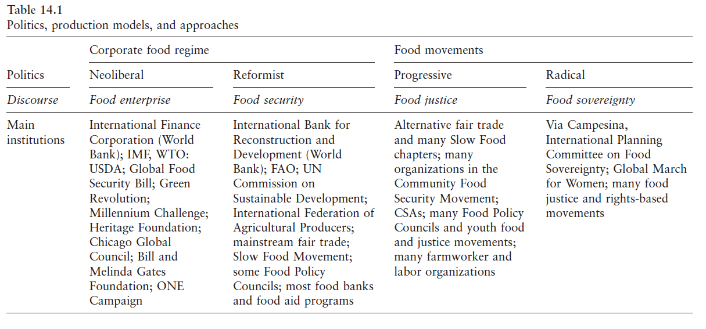

Slide 11
Food Sovereignty – A New Rights Framework (Wittman)
Food sovereignty is:
Rights of local peoples to control their own food systems, including markets, ecological resources, food cultures, and production models.
Examines food regimes, rights-based and citizenship approaches to food, alternative paradigm, agrarian reform, shift to agroecological production, gender equality, protection of intellectual and Indigenous rights.
Against trade liberalization – in favour of alternative trade regimes.
Rethinking land and nature – food production, agrarian reform and Indigenous knowledge
Unity in Diversity: Gender, Class and Ideology
Community-driven research and emerging research directions

Slide 12
Food Regimes (Wittman)

Slide 13
2007 Nyéléni Principles of Food Sovereignty
Focuses on food for people
Values food providers
Localizes food systems
Puts control locally
Builds knowledge and skills
Works with nature

Slide 14
Alternative Food Initiatives
Alternative food initiatives
Community food security
Food sovereignty
Collaborative food networks
In Canada
People’s Food Commission (1977-1980)
Provincial Network Organizations (1998)
Canadian Association for Food Studies (2005)
Food Secure Canada (2006)
Community Food Centres (2012)
The Depot
Challenges
Not adequately addressing social justice
Over focus on consumer-based solutions

Slide 15
Food Sovereignty (Patel)
Read the 2007 Nyéléni Declaration on Food Sovereignty from Patel (2009) What Does Food Sovereignty Look Like?
What does the declaration state?
Who formulated the declaration?
What are they fighting for?
What are they fighting against?
What can and will they do about it?

Slide 16
Find Out More About Food Sovereignty
La Via Campesina
Nyéléni Newsletter
People’s Coalition for Food Sovereignty
International Planning Committee for Food Sovereignty

Slide 17
Thanks!
Questions or concerns?

