Slide 1
Food and Sustainability
Erik Chevrier
June 29th, 2020

Slide 2
Introduction – Let’s Talk About Food
What is your name? Tell the group about yourself in a minute!
What type of food consumer are you?
What’s your favourite/least favourite food? Why?
Do you have any specific dietary needs (vegan, vegetarian, allergies, etc.)?
Are you a conscientious food consumer? Why? Why not?
What experience do you have producing food (gardening, farming, etc.)?
What experience do you have transforming/processing food (cooking)?
What experience do you have preserving food (canning, fermenting, etc.)?
What experience do you have with waste management (composting, repurposing, etc.)?

Slide 3
Importance of Action Based Research
Why are action based projects important?
It is important to challenge the problematic dominant epistemological understandings of food.
Instead we should produce ontological formations of the world we want by co-creating and co-recreating social relations that produce positive outcomes on people and the planet.
Action based learning theories incorporate students and facilitators as co-learners and co-collaborators. Together, they learn by doing. They also connect with the community.
Epistemology – A term meaning “theory of knowledge,” which gets at the how we know about the social world that lies behind all theoretical approaches. (Frampton, Kinsman, Thompson, Tileczek, (2006))
Ontology – Assumptions relating to how the social comes into being that inform all theories and ways of writing the social. (Frampton, Kinsman, Thompson, Tileczek, (2006))

Slide 4
The Dominant Epistemological View of Food?
The world has or will soon have the agricultural technology available to feed the 8.3 billion people anticipated in the next quarter of a century. The more pertinent question today is whether farmers and ranchers will be permitted to use that technology. Extremists in the environmental movement, largely from rich nations and/or the privileged strata of society in poor nations, seem to be doing everything they can to stop scientific progress in its tracks. It is sad that some scientists, many of whom should or do know better, have also jumped on the extremist environmental bandwagon in search of research funds. When scientists align themselves with antiscience political movements or lend their name to unscientific propositions, what are we to think? Is it any wonder that science is losing its constituency? We must be on guard against politically opportunistic, pseudo-scientists…
Borlaug, N., E. (2000) Ending World Hunger. The Promise of Biotechnology and the Threat of Antiscience Zealotry, Plant Physiology, 124(2) pp. 488.

Slide 5
Critique of Dominant Epistemological View of Food
When poisons are introduced into agriculture to control pests, or when GMOs are introduced under the argument of “feeding the world,” the justification given is always “science”. But “science” does not have a singular entity, and it did not come into existence within a vacuum. Today, what we generally refer to as “science” is in fact Western, mechanistic, reductionist modern science, which became the dominant practice of understanding the world during the Industrial Revolution and has continued as the dominant paradigm….To shape the industrial system in the form of new, violent technologies, and to shape the capitalist system in the form of new, profit-driven economics, a certain type of science was promoted and privileged as the only scientific knowledge system. Two scientific theories came to dominate this new, industrial paradigm, and they continue to shape practices of food, agriculture, health, and nutrition even today. The first is a Newtonian-Cartesian idea of separation: a fragmented world made of fixed, immutable atoms…The second significant theory that has framed the knowledge paradigm for industrial agriculture is Darwin’s theory of competition as the basis for evolution…The Newtonian-Cartesian theory of fragmentation and separation and the Darwinian paradigm of competition, have led to a nonrenewable use of Earth’s resources, a nonsustainable model for food and agriculture, and an unhealthy model of health and nutrition. An emphasis on the legitimacy of these arguments as the sole “scientific” approach has created a knowledge apartheid by discounting the knowledge of Mother Earth.
Shiva, V. (Shiva, V. (2016) Who Really Feeds the World, North Atlantic Books, pp. 4 – 7.

Slide 6
Food for Thought
Calls to “fix a broken food system” assume that the capitalist food system used to work well. This assumption ignores the food systems long, racialized history of mistreatment of people of colour. The food system is unjust and unsustainable, but it is not broken. It functions precisely as the capitalist food system has always worked, concentrating power in the hands of the privileged minority and passing off the social and environmental “externalities” disproportionately to racially stigmatized groups. (Holt-Gimenez, 2017, p. 160)
We have created a society which appears to be totally beyond our control, but which in reality depends on our act of constant re-creation. The problem is not to destroy that society, but to stop creating it. Capitalism exists today not because we created it two hundred years ago or a hundred years ago, but because we created it today. If we do not create it tomorrow, it will not exist. (Holloway, 2010, p. 230)
We make capitalism by creating and recreating the social relations of capitalism: we must stop doing so, we must do something else, live different social relations. Revolution is simply that: to stop making capitalism and do something else instead. The struggle is not a struggle for survival (that is the genuine struggle of abstract labour) but a struggle to live. (Holloway, 2010, p. 236)

Slide 7
What does it Mean to Have a Sustainable Diet?
Is your diet sustainable?

Slide 8
What does it Mean to Have a Sustainable Diet?
The term sustainability has lost meaning because it has been used for corporate/political greenwashing.
We need to refocus the conversation on what we are sustaining.
Sustainability refers to the perpetuation of something…the something is the important factor!
Instead we should ask:
What social, environmental and political conditions does our food practices sustain?
Effects can be positive and/or negative
Intended and/or unintended
We can be aware and/or unaware of these effects
Effects can take place on a macro and/or micro level

Slide 9
Is Your Diet Sustainable?
Digging deeper, we can ask:
Political economic conditions:
What were the labour conditions of the farmers that produced your food?
What social inequalities are expressed via your food consumption?
Individual and Social Health
How does your diet contribute to your individual health?
How does your diet impact the health of the community and the world at large?
Environmental Health
How does your diet affect biodiversity?
What is the environmental impact of your diet?

Slide 10
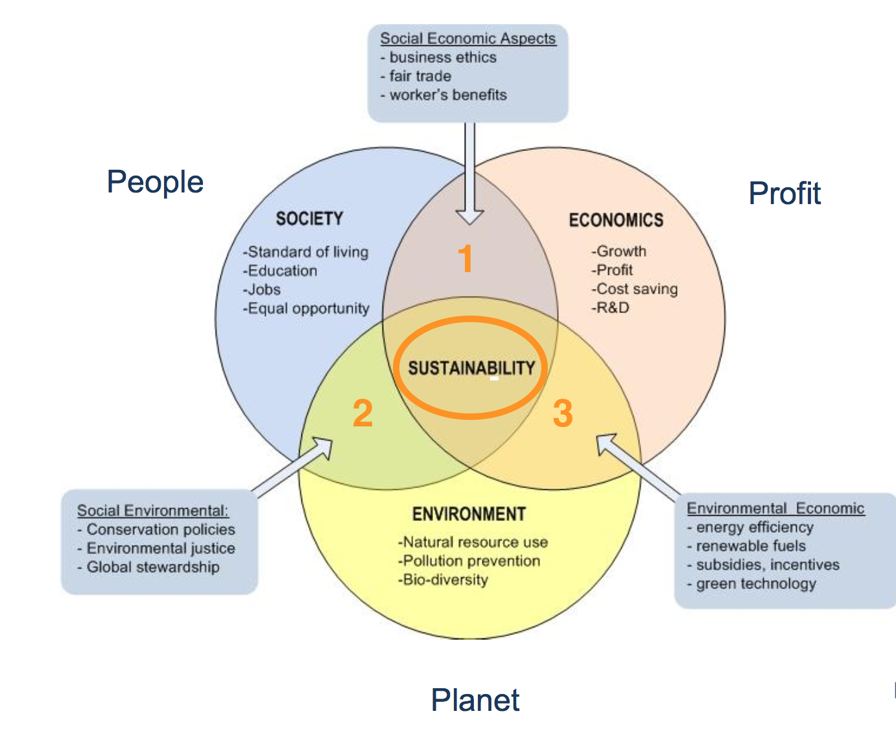
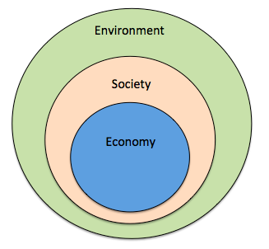
Prioritize the Biosphere and Social Relations Over the Market
Triple Bottom line
Nested model

Slide 11
Measuring and Meeting Expectations
Why did you take this course?
What do you want to get out of this course?
What aspects of food and sustainability interest you?
What excites you about the course?
What issues do you foresee with the course?
How do you expect to do in the course?

Slide 12
Activity Planting a Seed
Like a seed grows into a plant, we will all grow intellectually together as a class.
Take care of your plant and we’ll take care of each other’s intellectual and social needs during this course.
Your plant will need water, room to grow, light and nutrients (if it grows big).
How can you grow a plant group discussion…

Slide 13
Questions or Concerns?
Thanks!
Have a great day!
Before Next Class – Plant a Seed

