Slide 1
Food and Sustainability
Erik Chevrier
July 6th, 2020

Slide 2
What does it Mean to Have a Sustainable Diet?
Is your diet sustainable?

Slide 3
What does it Mean to Have a Sustainable Diet?
The term sustainability has lost meaning because it has been used for corporate/political greenwashing.
We need to refocus the conversation on what we are sustaining.
Sustainability refers to the perpetuation of something…the something is the important factor!
Sustainability is an adjective/modifier (Sumner refers to Shearman 1990)
Sustainability as a modifier points out contradictions (suggests that the status quo is not sustainable)
Instead we should ask:
What social, environmental and political conditions does our food practices sustain?
Effects can be positive and/or negative
Intended and/or unintended
We can be aware and/or unaware of these effects
Effects can take place on a macro and/or micro level

Slide 4
What does it Mean to Have a Sustainable Diet?
Digging deeper, we can ask:
Political economic conditions:
What were the labour conditions of the farmers that produced your food?
What social inequalities are expressed via your food consumption?
Individual and Social Health
How does your diet contribute to your individual health?
How does your diet impact the health of the community and the world at large?
Environmental Health
How does your diet affect biodiversity?
What is the environmental impact of your diet?

Slide 5
The Basics
What is food?
Substance with essential nutrients that sustain life
What is a food system?
An interdependent web of activities that include production, processing, distribution, consumption, and disposal of food. (Sumner, 2017)
What do we mean by sustainability?
We will explore this for the remainder of the course!

Slide 6
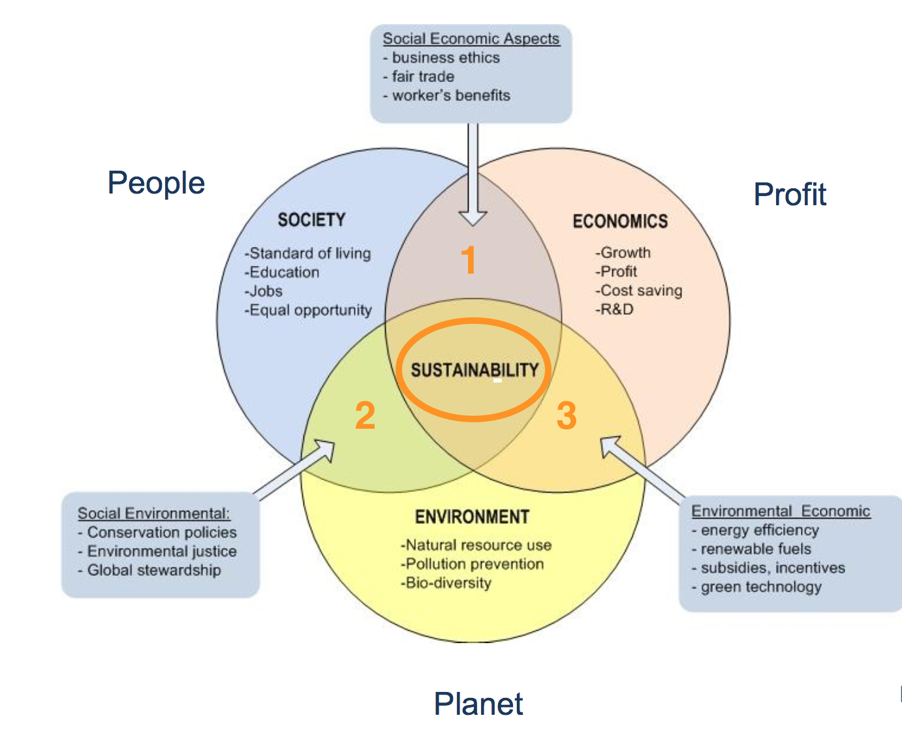
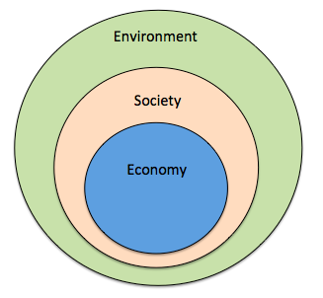
Prioritize the Biosphere and Social Relations Over the Market
Triple Bottom line
Nested model

Slide 7
Problems – Symptoms – Root Causes

Slide 8
Conceptualizing Sustainable Food Systems (Sumner, 2017)
Conceptualizing Sustainable Food Systems
Global corporate food system is the cause of unsustainability
An interdependent web of corporate-controlled activities at a global scale that include the production, processing, distribution, consumption and disposal of food.
Controlled by large corporations
Disembedded markets (Karl Polanyi – The Great Transformation)
Brundtland (1987) Our Common Future
Sustainability can be achieved by creating civil commons
Society’s organized and community-funded capacity of universally accessible resources to provide for the life preservation and growth of society’s members and their environmental life-host. The civil commons is…what people ensure together as a society to protect and further life, as distinct from money aggregates. (McMurray 1998)
Multiple scales
Decommodifying (re-commoning)
Sustainability as the outcome of structures and processes that build civil commons – formal and informal.
Feenstra’s characteristics of a sustainable food system and civil commons vision = democratic participation, two-way communication, livable wages, food sovereignty and improved access by all community members to an adequate nutritious diet.
Sustainability must be anchored in public systems
Food system – processing, distribution, consumption, disposal
Top-down and bottom-up approaches

Slide 10
Food for Thought
Calls to “fix a broken food system” assume that the capitalist food system used to work well. This assumption ignores the food systems long, racialized history of mistreatment of people of colour. The food system is unjust and unsustainable, but it is not broken. It functions precisely as the capitalist food system has always worked, concentrating power in the hands of the privileged minority and passing off the social and environmental “externalities” disproportionately to racially stigmatized groups. (Holt-Gimenez, 2017, p. 160)
We have created a society which appears to be totally beyond our control, but which in reality depends on our act of constant re-creation. The problem is not to destroy that society, but to stop creating it. Capitalism exists today not because we created it two hundred years ago or a hundred years ago, but because we created it today. If we do not create it tomorrow, it will not exist. (Holloway, 2010, p. 230)
We make capitalism by creating and recreating the social relations of capitalism: we must stop doing so, we must do something else, live different social relations. Revolution is simply that: to stop making capitalism and do something else instead. The struggle is not a struggle for survival (that is the genuine struggle of abstract labour) but a struggle to live. (Holloway, 2010, p. 236)

Slide 11
Questions or Concerns?
Thanks!
Have a great day!

